Slide 1
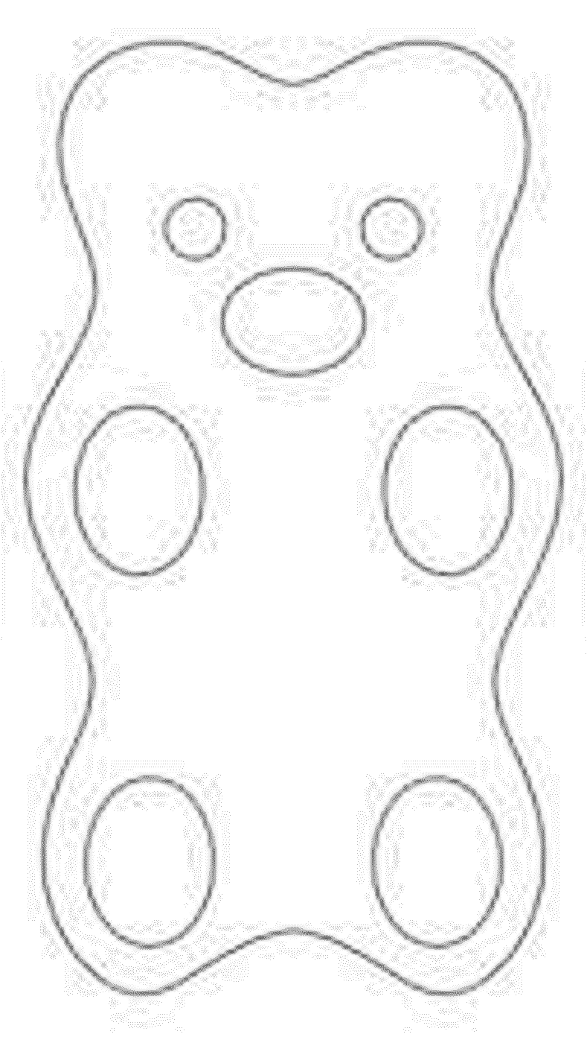
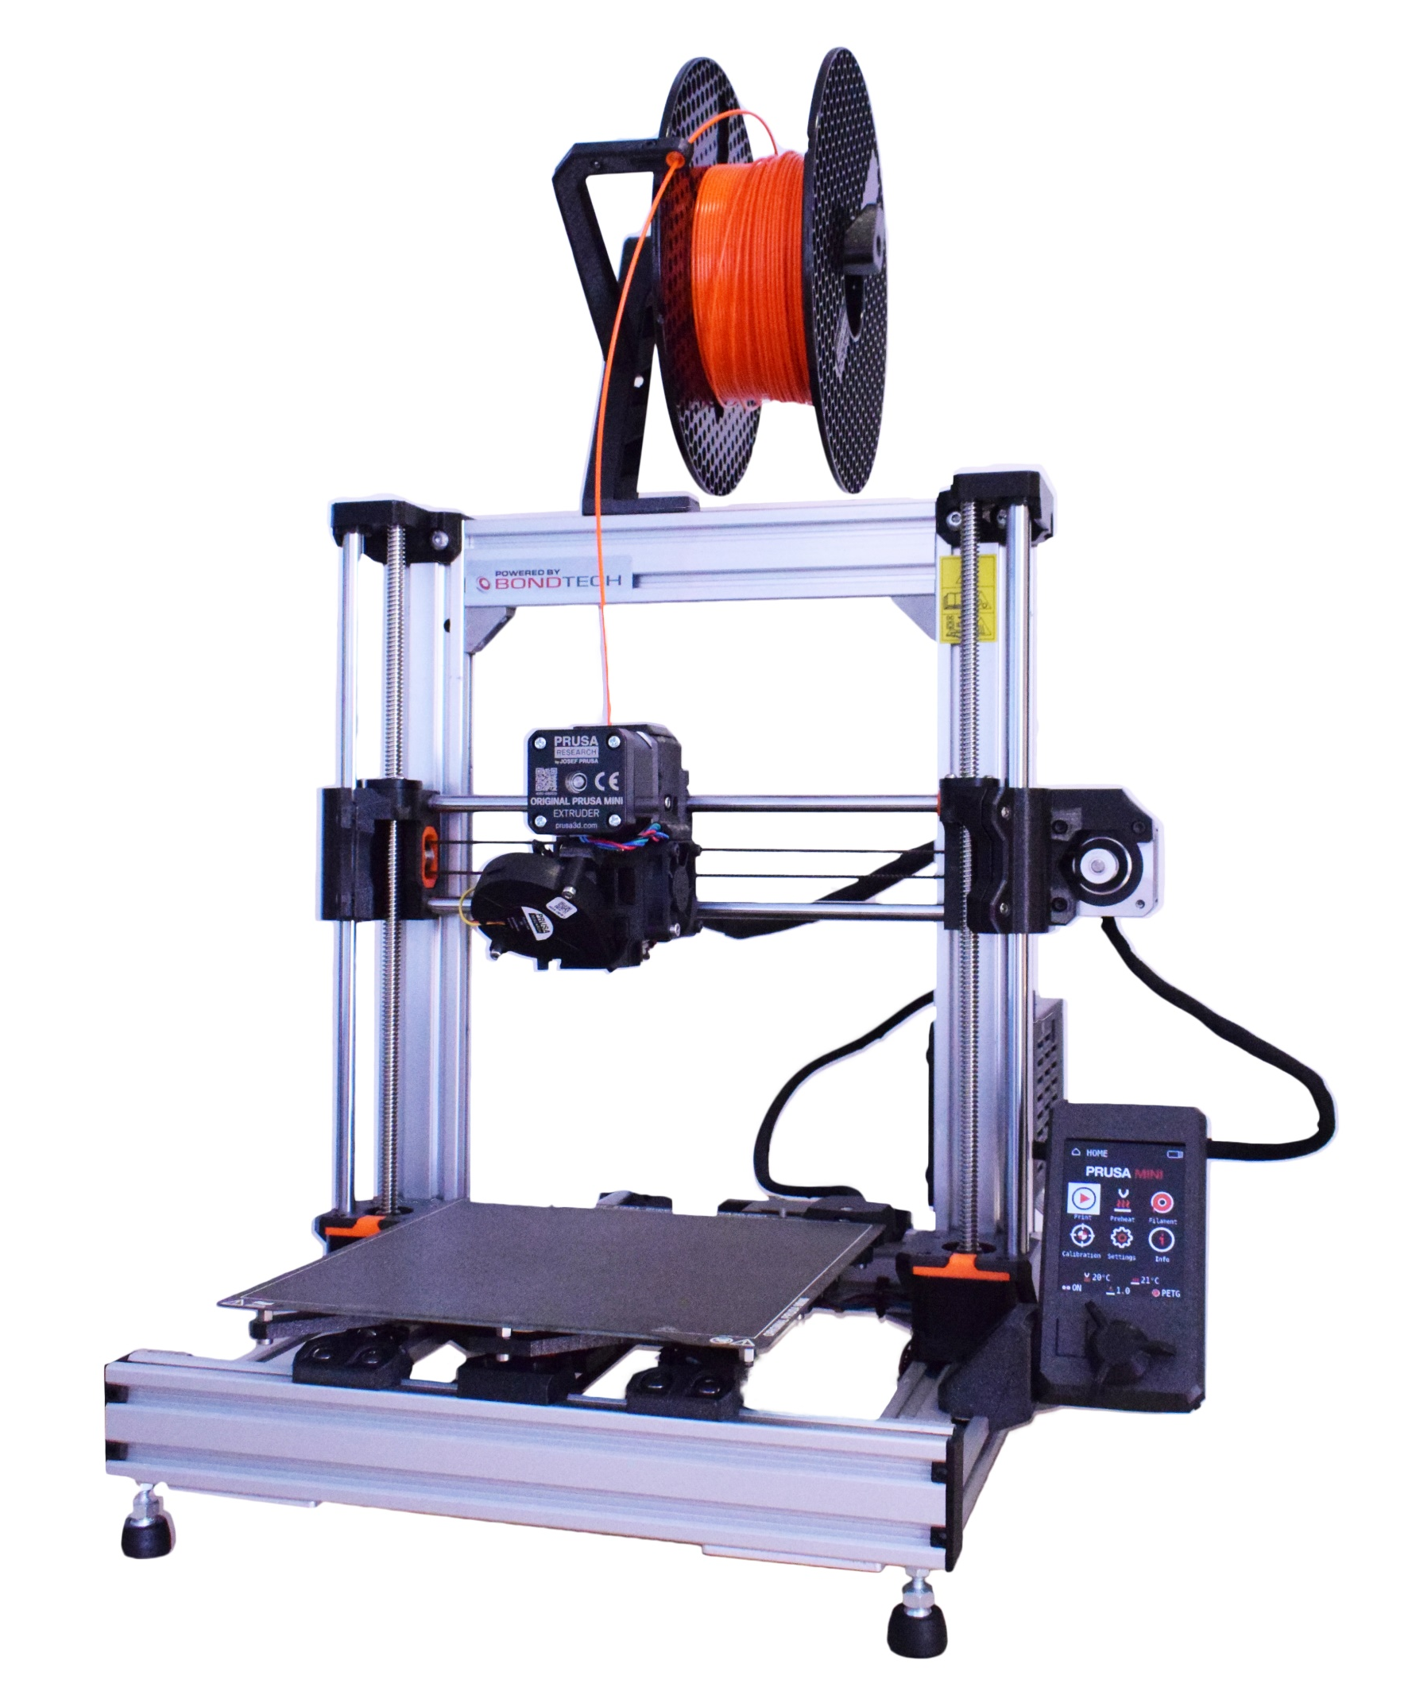
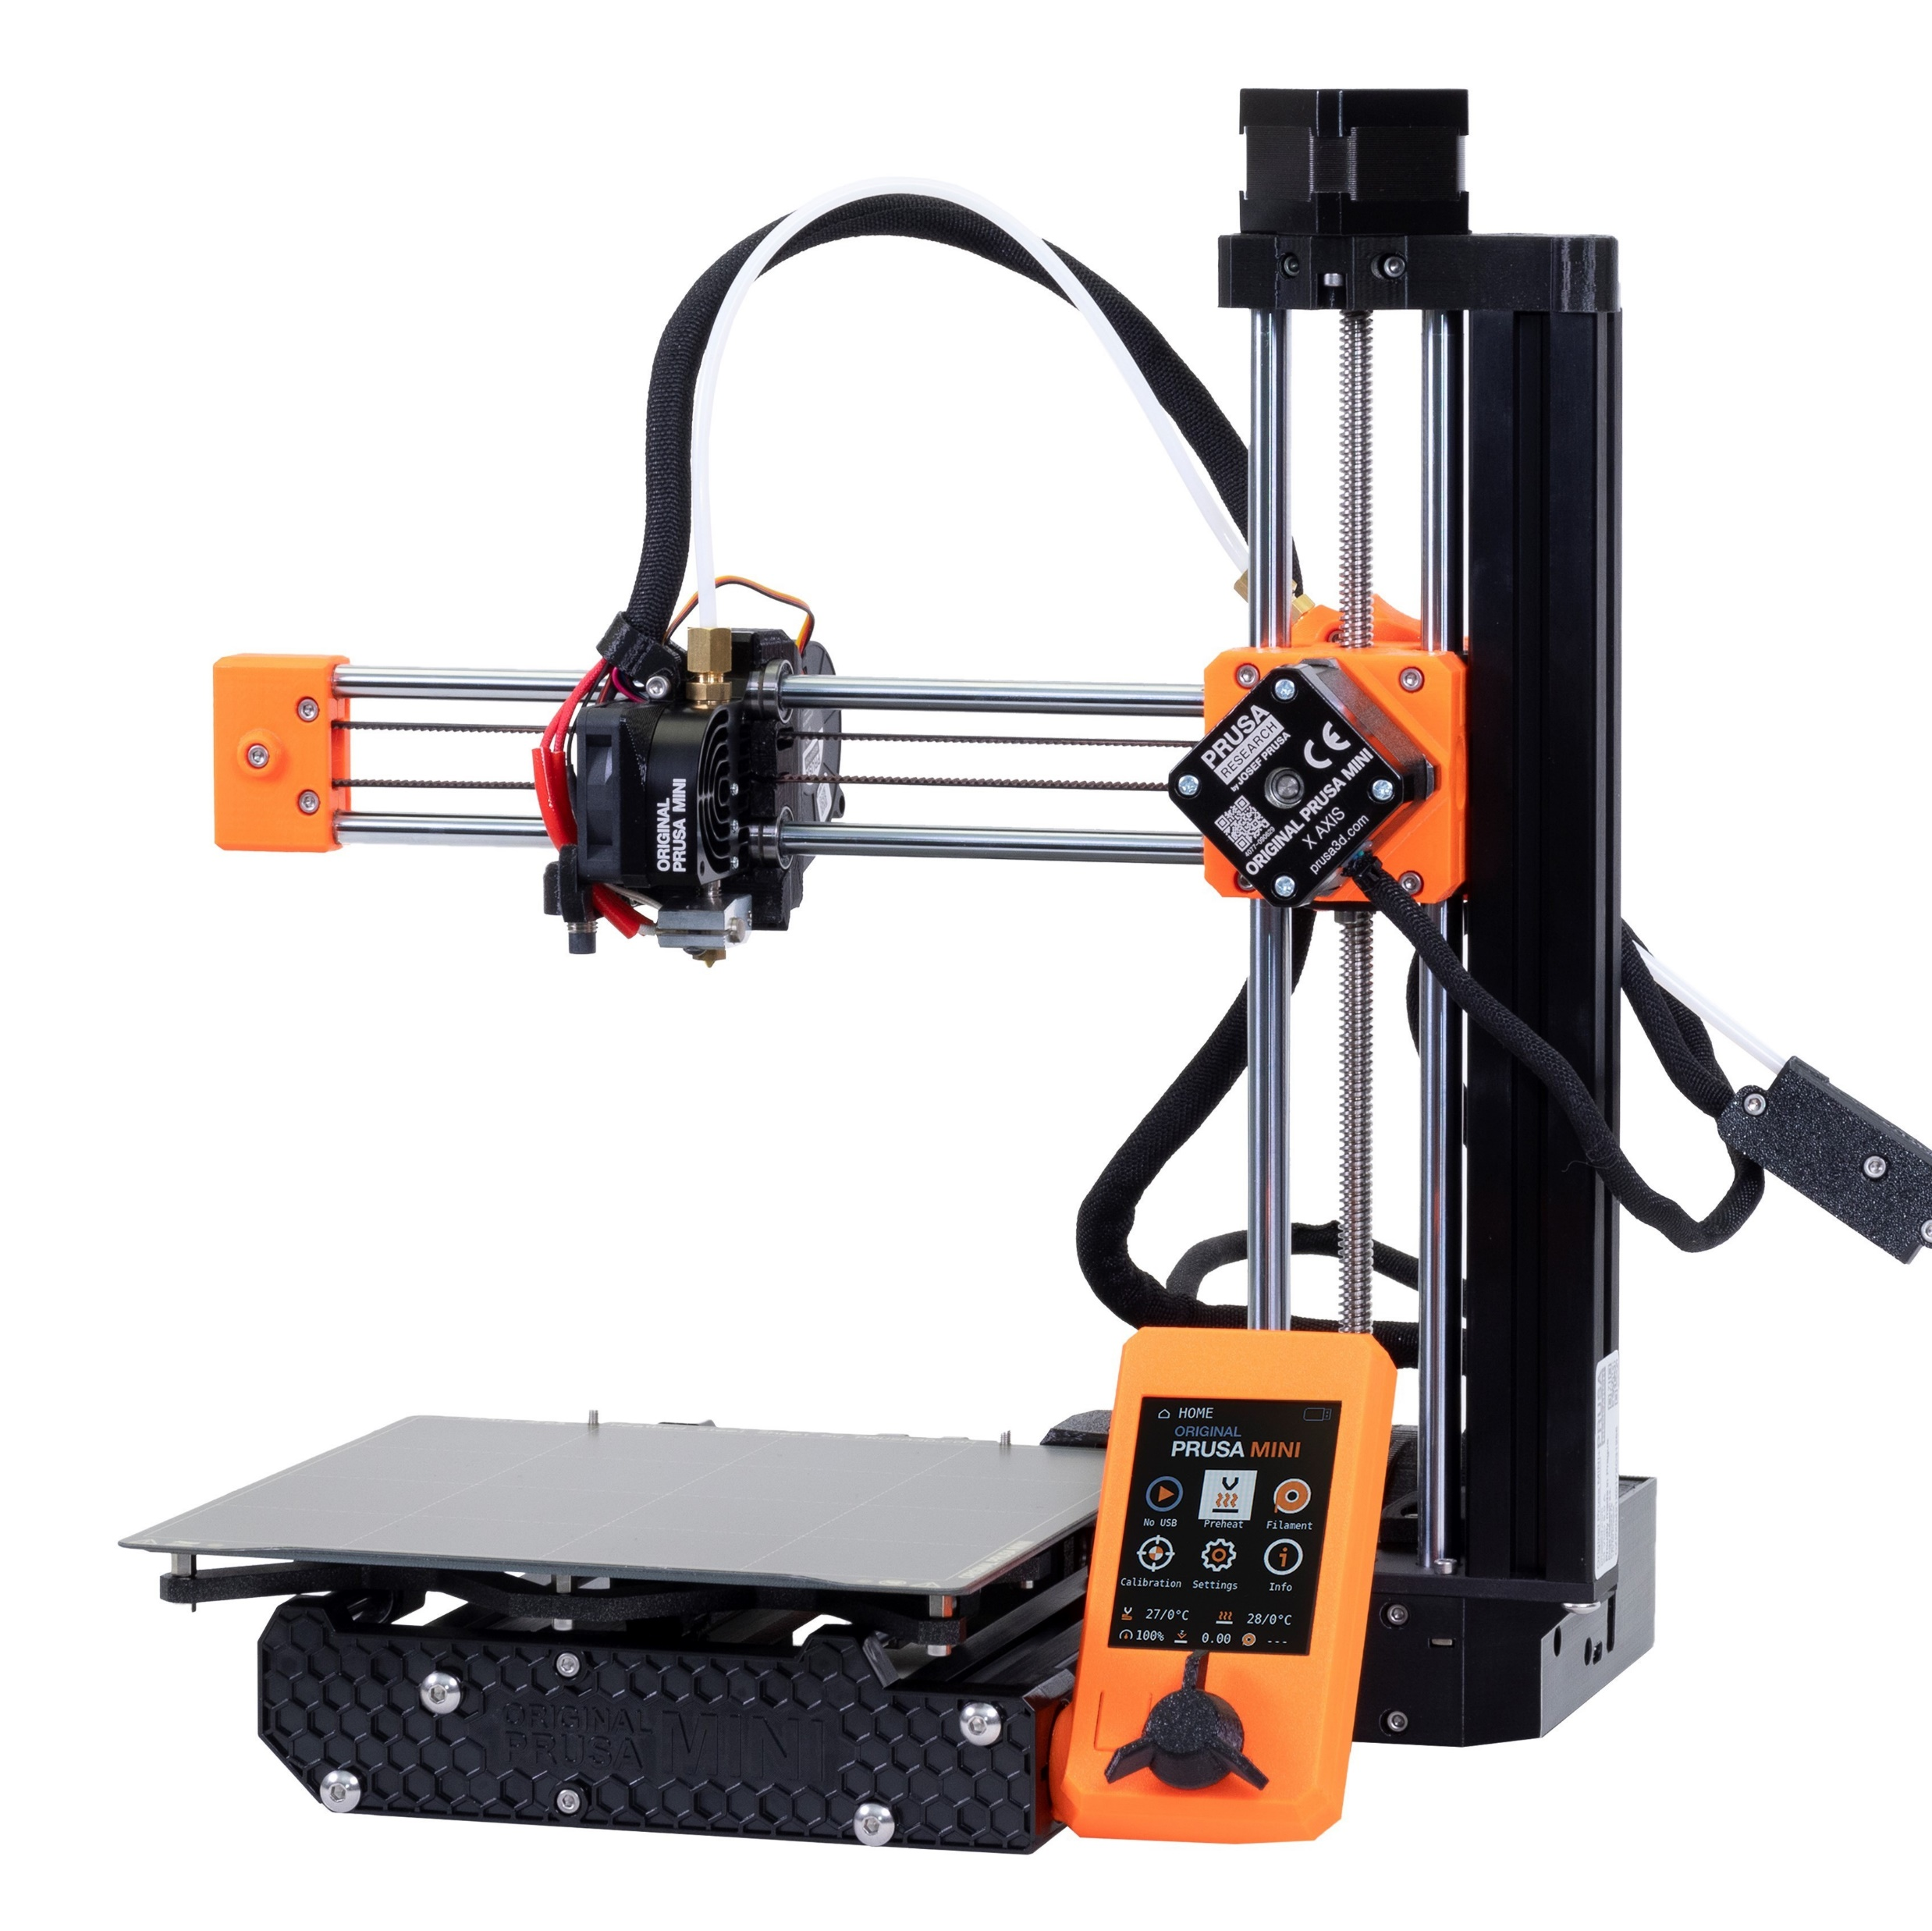
BEAR MINI FRAME – Z10
Based on Original PRUSA MINI(+) &
Community Contributions
(see credits)
ROBUST FRAME
RE-USE MOST STOCK HARDWARE
DUAL 10mm Z DIRECT-DRIVE
MK3S

