Slide 1
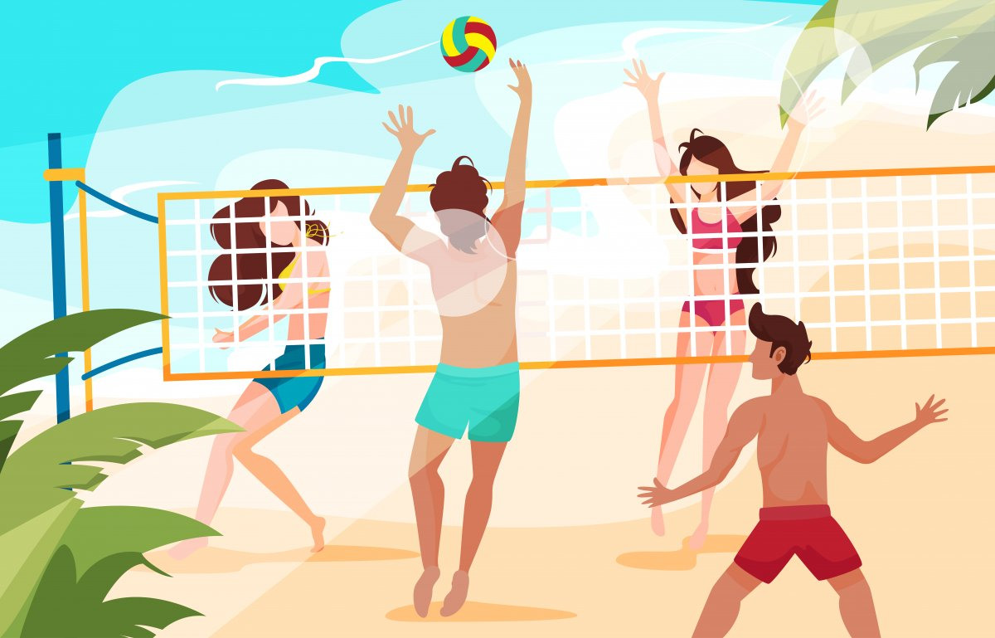
Volleyball the sport I play
Kostylev Vladislav gr. B01-208
MIPT 2023

Slide 2
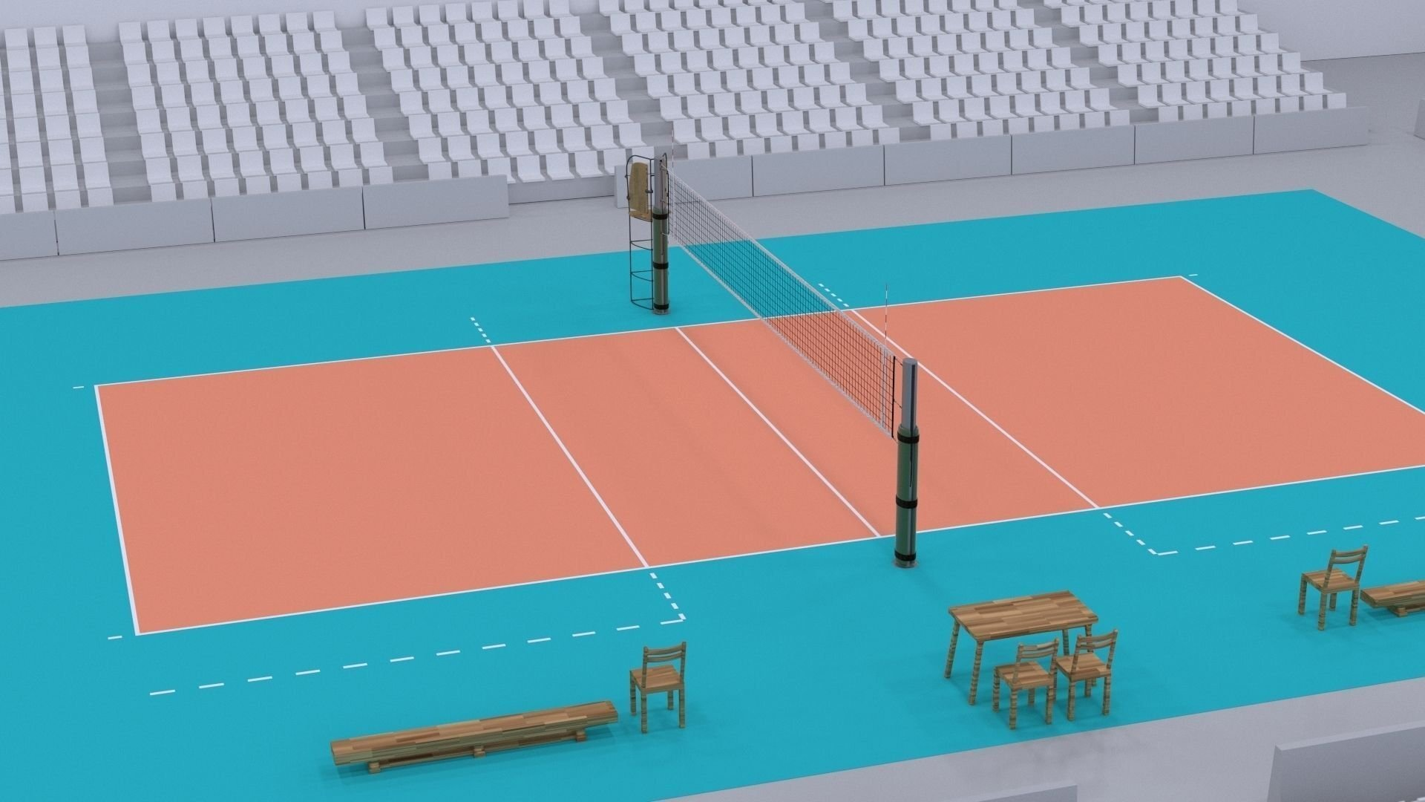
Why is it important?
Keep physical fit
Stay healthy
Reduce stress
ENJOY THE GAME

Slide 3
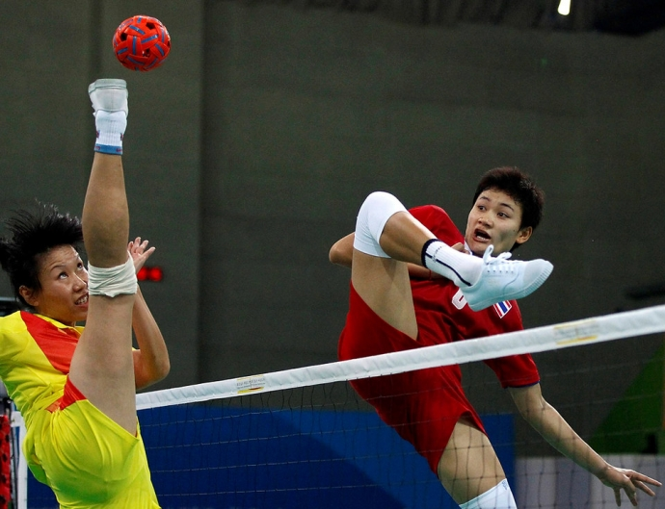
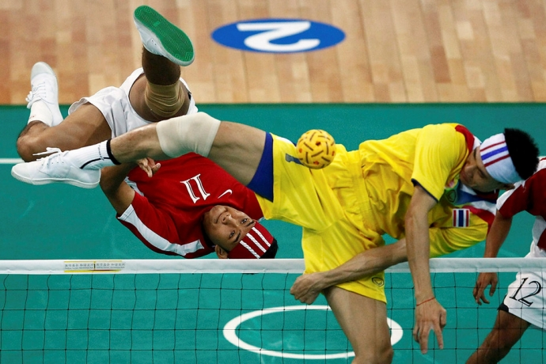
Sepak Takraw
https://s-cdn.sportbox.ru/images/styles/690_auto/fp_fotos/41/d4/9feb0a283f9cf12b_2010-11-24t080650z_01_zul42_rtridsp_3_games-asian_0.jpg
https://s-cdn.sportbox.ru/images/styles/690_auto/fp_fotos/e4/9e/5df3271c82b48936_2010-11-20t043855z_01_cb09_rtridsp_3_games-asian_0.jpg

Slide 4
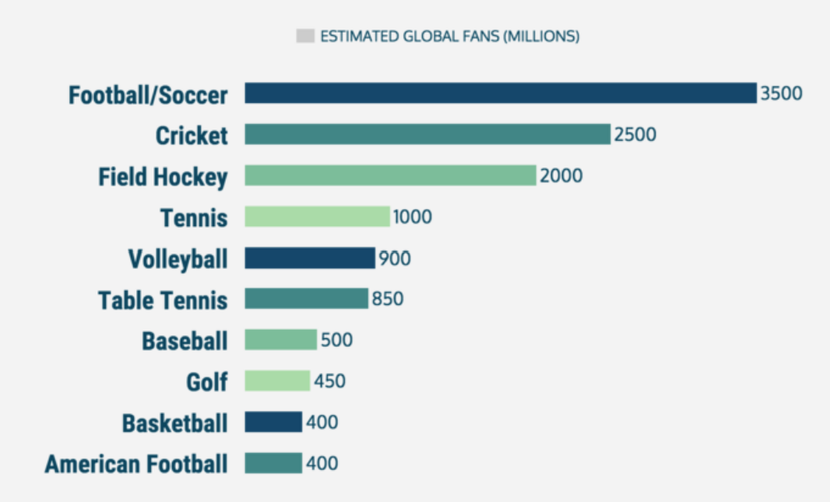
VOLLEYBALL popularity around the world
https://sports862.files.wordpress.com/2017/11/download.png

Slide 5
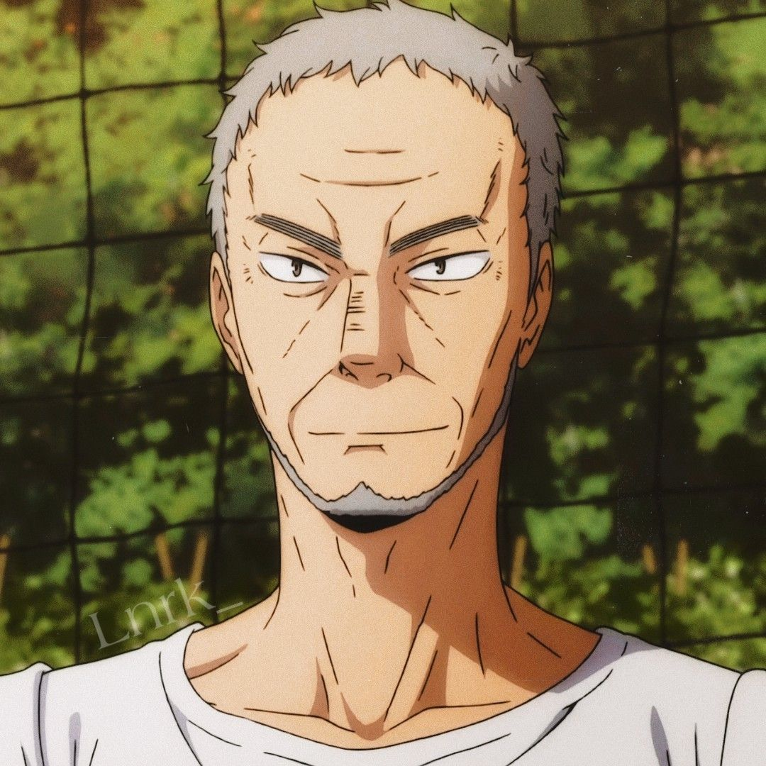
There is no better pass than one that is easier to hit
Ikkei Ukai
https://i.pinimg.com/originals/4c/2b/92/4c2b92aa01d3f512b9a17bf378413f08.jpg

