Slide 1
The TRIp I WILL NEVER FORGET
Kostylev Vladislav gr. B01-208
MIPT 2023

Slide 2
Why CYPRUS?
First foreign country
FIRST FLIGHT
all inclusive
New friends
Beautiful weather

Slide 3
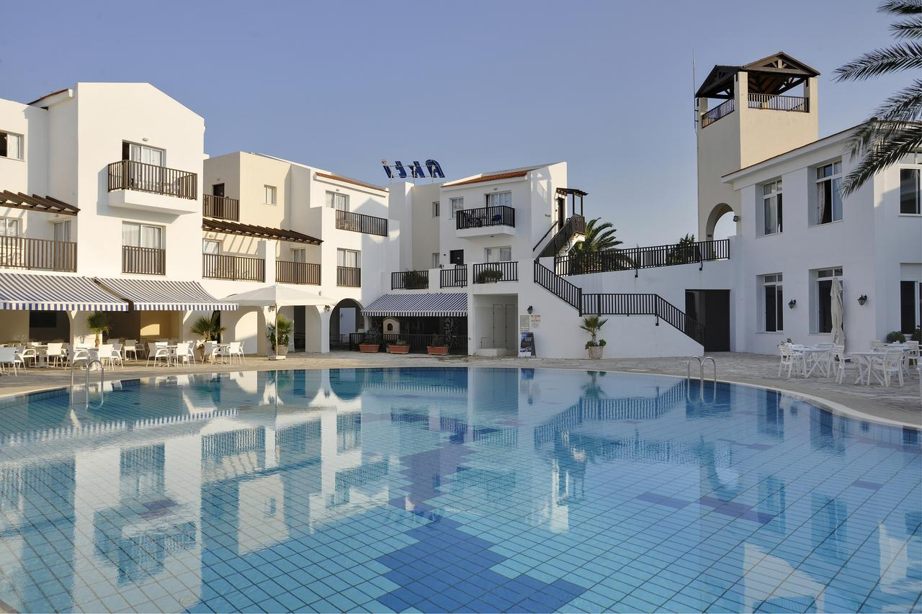
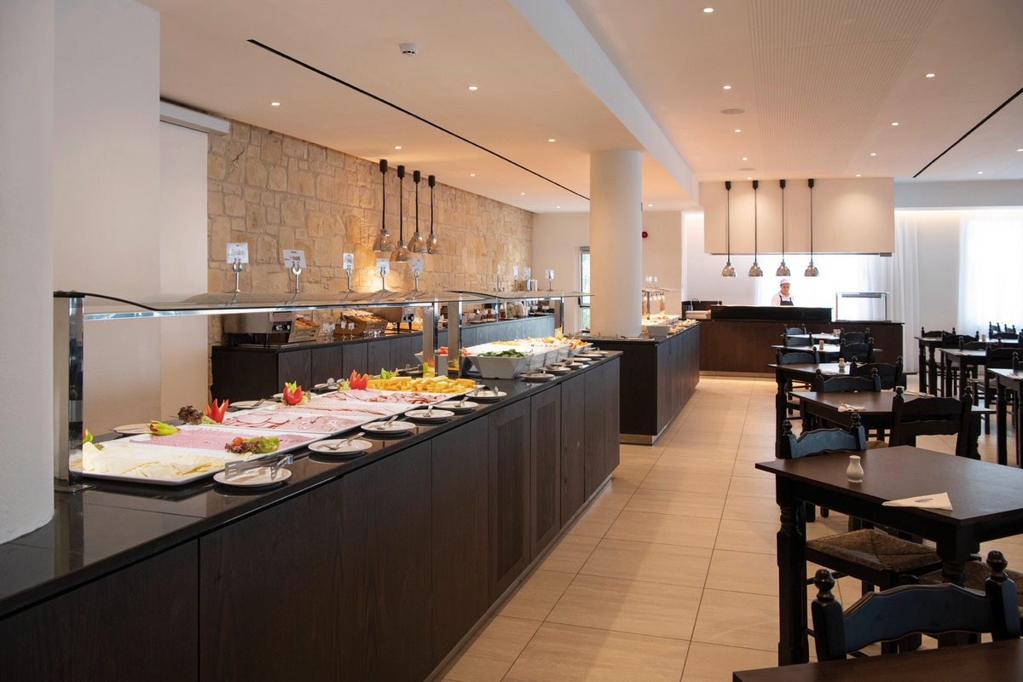
Akti Beach HOTEl
https://edge.travelatacdn.ru/upload/2017_24/content_hotel_594583cebcba60.94771373.jpg
https://https://www.its.de/pibe-media/derl_atc/hotel/PFO40027N_S23_18.jpg

Slide 4
Some facts
small population
330 days of sunshine
C-O-o-o-L-l-D
https://sports862.files.wordpress.com/2017/11/download.png

Slide 5
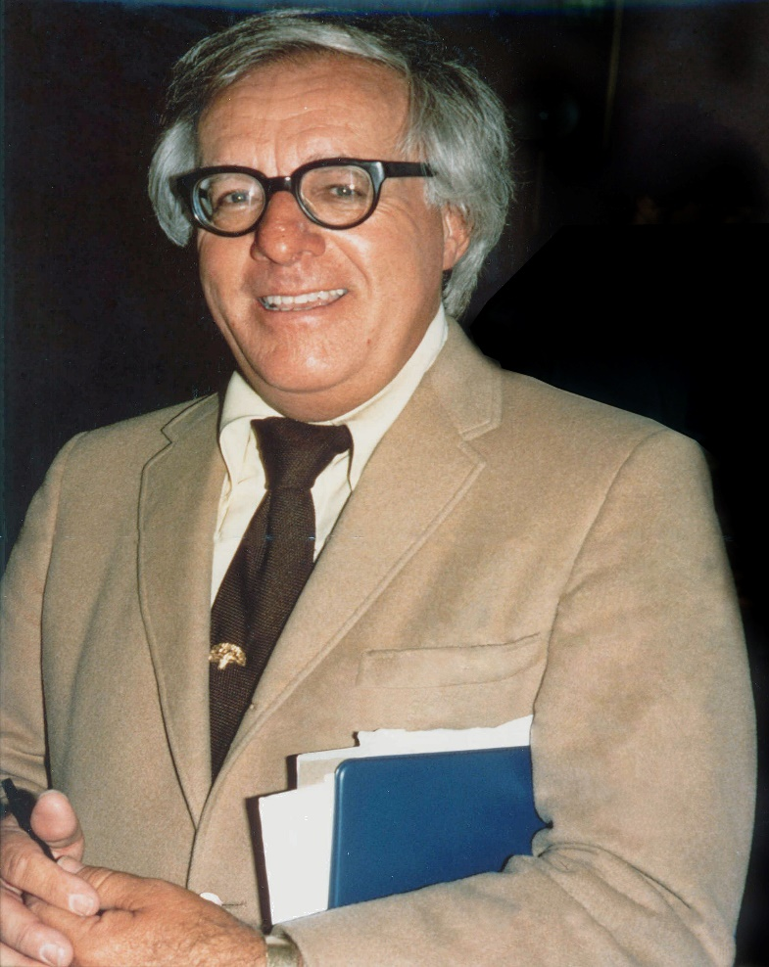
Look at the world. He is much more amazing than dreams.
Ray Bradbury
https://upload.wikimedia.org/wikipedia/commons/a/aa/Ray_Bradbury_%281975%29.jpg

