Slide 1
Identify New York Public High Schools with the Highest SAT Test Scores

Slide 2
Reason for data study/ data sets used
The purpose of this project is to identify which public high school's within the five boroughs that make up the New York City area have the highest overall SAT scores, while isolating the public high school's that received the highest score for each section (math, reading, and writing). Then locate the closest vendors to the top ten performing SAT test score public high school for insight on the surrounding area. Enabling a quick list of the closest vendor’s surrounding each top ten performing SAT test score for relevant places for transportation or afterschool gathering locations.
This report is targeted to people who are looking to relocate or trying to apply to New York City area public high schools with the highest performing SAT scores.

Slide 3
Data acquisition and cleaning
While there are many different types of data, almost all the data for this study was procured through excel spreadsheets and website scrapping. Considering these data types, pre-processing can be articulated as a set of incremental stages. Beginning with the ingestion of the large data sets into Jupiter Notebooks utilizing the python programming language. The next stage includes cleaning and transforming the data. This is completed by removing invalid records, columns, and translating all the columns to use a normalized set of values. Once the base set of data had been identified for this problem, data acquisition from a website was added. With the new website data extracted, a combination of two different datasets into a single table was achieved.

Slide 4
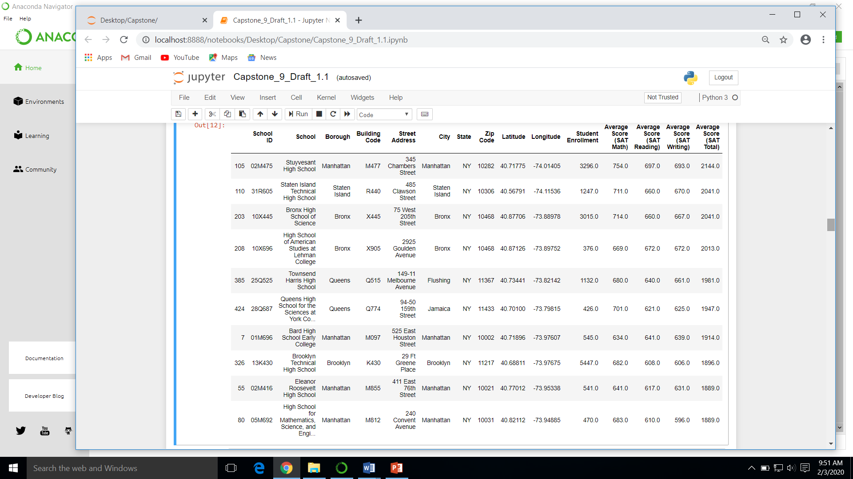
Top 10 Average SAT Total Score Table

Slide 5
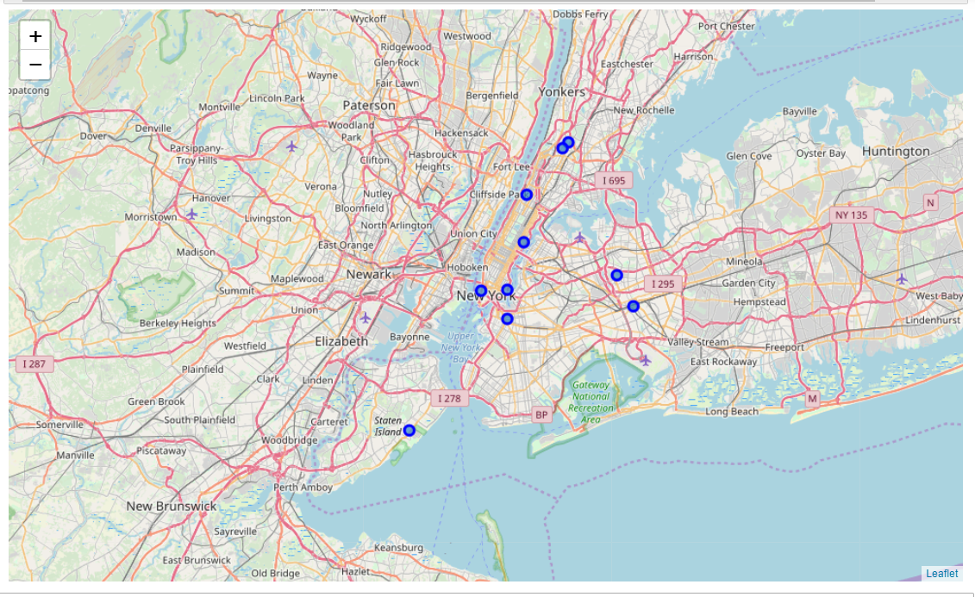
Location of the Top 10 Average SAT Total Score Public High Schools

Slide 6
Conclusion and future discussion
The aim of this project is to assist families and students identify public high schools within the New York City, five boroughs area with the highest average SAT test scores.
SAT test scores are used help colleges interpret students' overall academic performance in relation to the national applicant pool. Through this data families and students are provided with the necessary information to make logical and concise choices when choosing a public high school located within the New York City, five boroughs area.
For families and students that are planning for college admission after high school, the public high schools with the total highest test scores are of interest. Additionally, if a student is weak in one section of the test, a public high school that has high average test scores within this academic discipline is of interest as well.
Lastly, identifying the closest local vendors to the highest total average test score public high school assist family with planning for after school activities, transportation, and an overall general idea of what is within walking distance of the school.
Recognizing that this project was singularly focused on SAT test scores, future projects could use this data as a platform for more in depth analysis of public high schools located within the New York City, five boroughs area.

