Slide 1
Tiny Sorter
April 14

Slide 2
00
SURVEY
LINK IN CHAT

Slide 3
Agenda
01
03
Assemble Tiny Sorter
Teachable Machine
02
04
Arduino Code
STEM Box Project
You need the cardstock printout, scissors, and plastic box of stuff.
Use teachable machine to differentiate between candies.
Code your sorter.
Cardboard boat or Starburst slime

Slide 4
01
ASSEMBLY
The directions are on the cardstock sheet.
Full instructions at https://experiments.withgoogle.com/tiny-sorter/view

Slide 5
02
ARDUINO CODE
https://4hjccc.github.io/
Under April 2021

Slide 6
OVERVIEW
02
01
03
OPEN
DOWNLOAD
TEST
Double click the downloaded file open.
Download the code from the website
Download the code to your Arduino and open the serial monitor.

Slide 7
If there is a popup message about needing to create a folder, click OK.

Slide 8
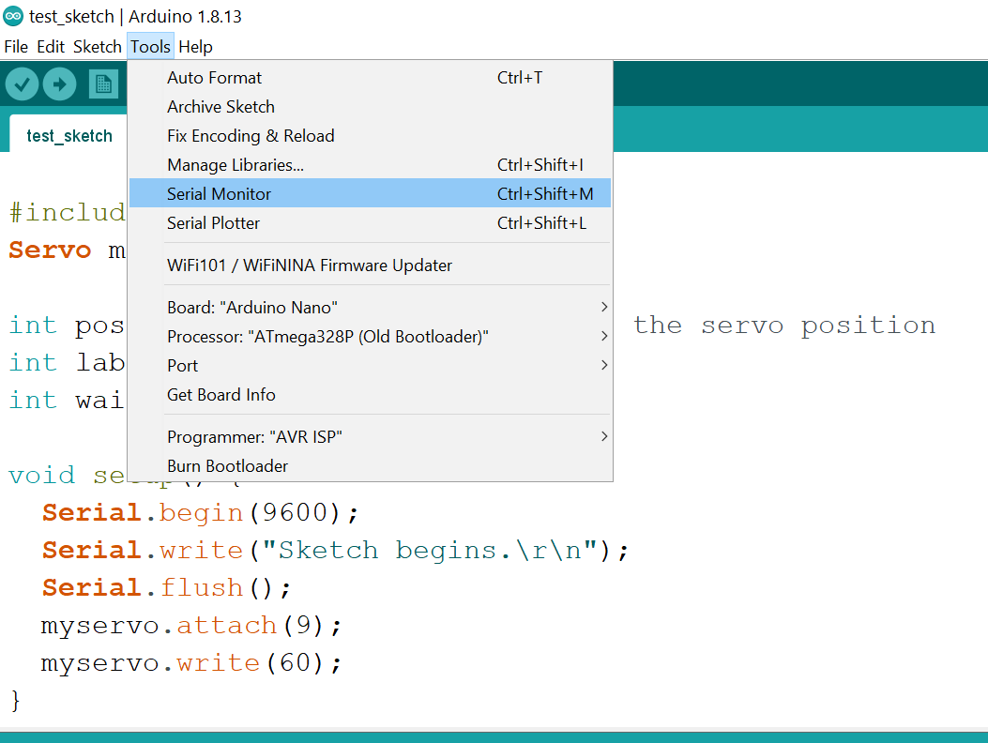
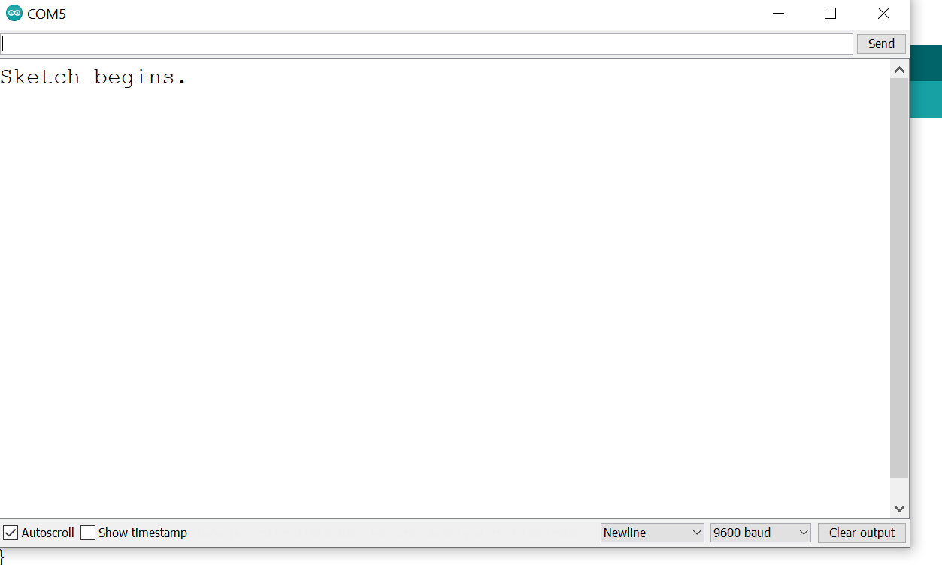
HOW TO USE THE CODE
Open the Serial Monitor after you download the code to the arduino.
If you want the motor to go right, hit 1 and then enter
If you want it to go left, hit 2 and then enter

Slide 9
03
TEACHABLE MACHINE
https://teachablemachine.withgoogle.com/train

Slide 10
Teachable Machine
Make training set
Train
Start sorting!
Take pictures of the m&ms and gummy bears in Teachable Machine.
Hit the training button and wait
Assign 1 and 2 to the different categories.
Use Teachable Machine to make the decisions, and you type in the number.

Slide 11
04
STEM BOX

