Slide 1
Tutorial for Arduino LED Blink (January meeting activity)
Michelle Wang
4H Virtual STEM Club

Slide 2
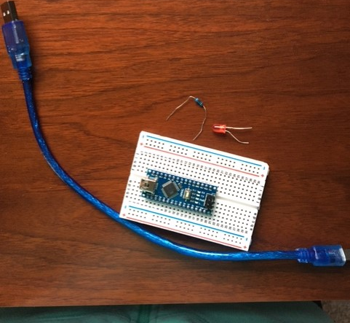
Parts you will need from the box
USB cable
LED
Resistor
Arduino board
(foil wrapped thing)
Breadboard
(white thing with holes)

Slide 3
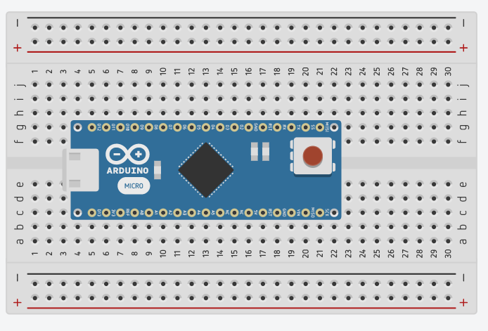
Put the Arduino board on the breadboard
Note on the diagram: There are two extra pins on the board in the diagram. The actual board you have does not have the two rightmost pins. I have marked them out in all the diagrams. Please pretend they don’t exist.

Slide 4
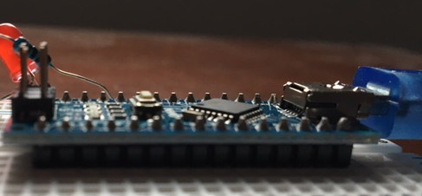
Put Arduino on breadboard. The front pins should go on c5 and g5 on the breadboard. Push it down until only the black plastic things show on the side view. Note: wiggle it around if it doesn’t go in smoothly.
Only black plastic things showing

Slide 5
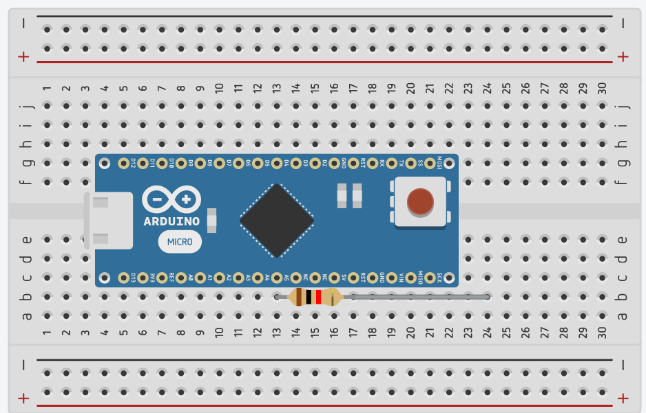
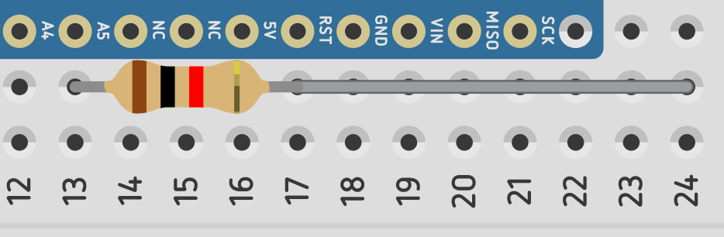
Take the resistor and put it in b13 on the breadboard (also pin A5 on the Arduino). Put the other side of the resistor in b24 on the breadboard.

Slide 6
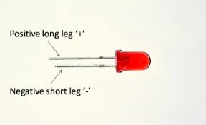
Long vs. Short ends of LED
An LED has a long end (positive ) and a short end (negative).
Make sure you do not get them mixed up!

Slide 7
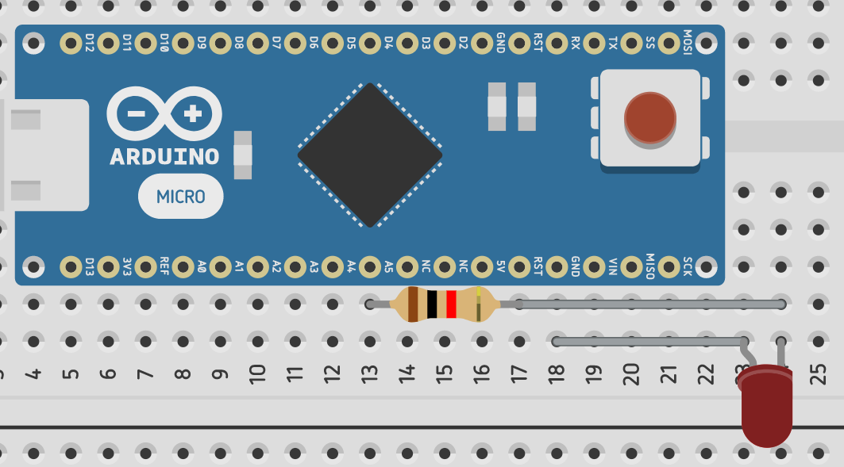
Put the long end of the LED in a24 on the breadboard and the short end in the breadboard’s a18 (also GND on Arduino).

Slide 8
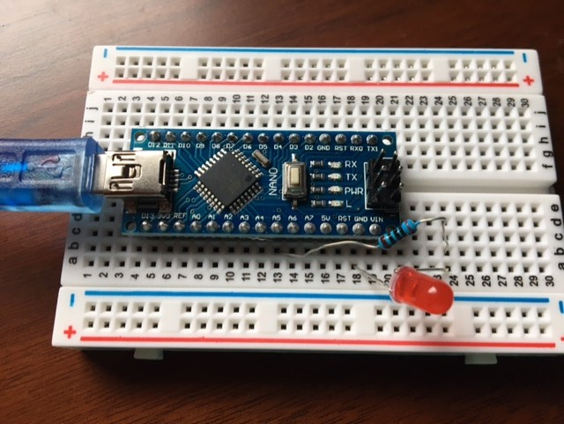
Picture of finished product

Slide 9
Software Stuff Walkthrough -Video Link:

Slide 10
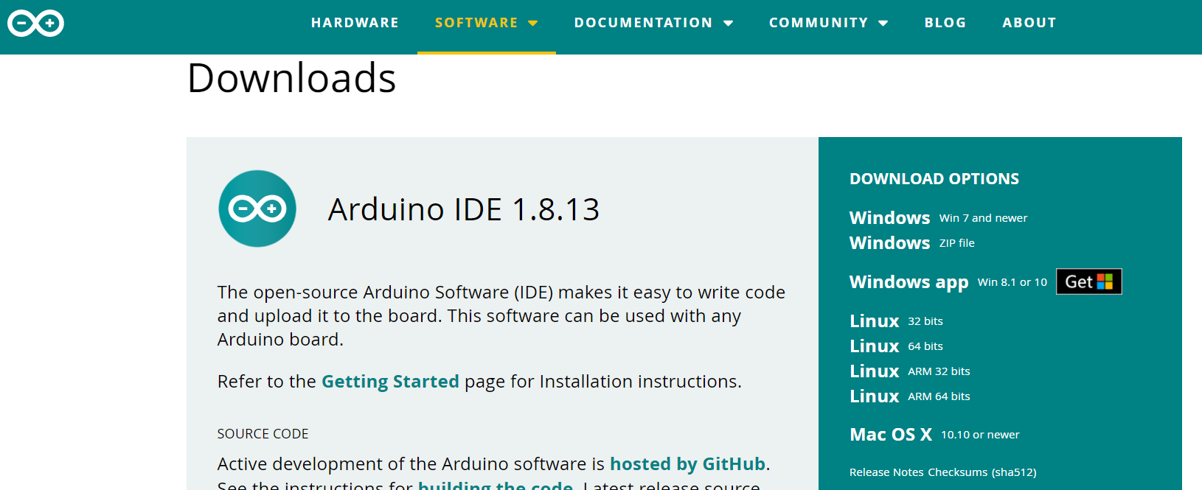
Download Arduino from the website
For computers only: https://www.arduino.cc/en/software

Slide 11
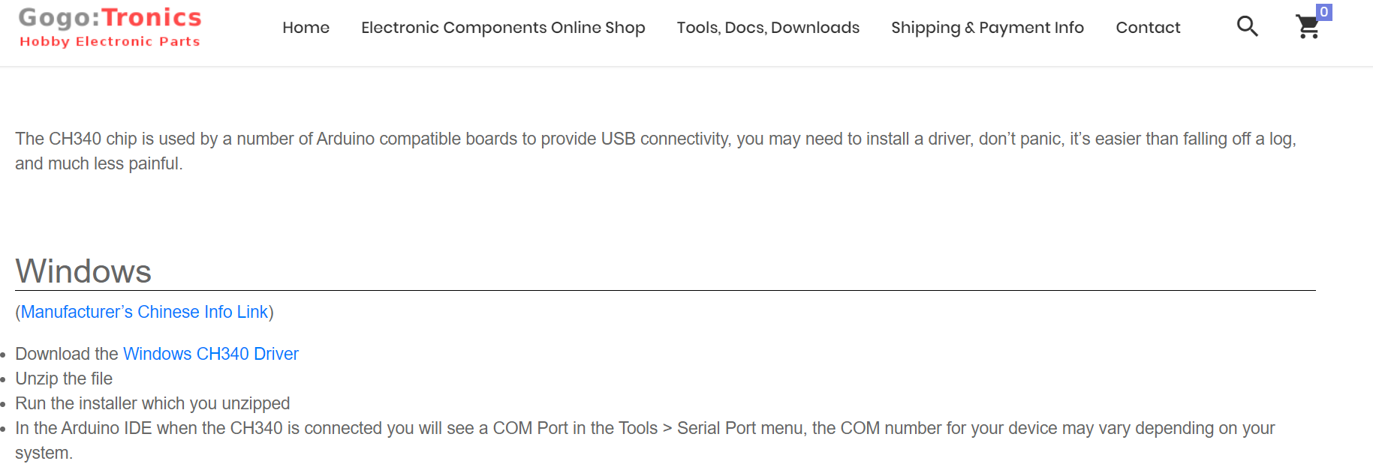
Download CH340 Driver
For computers: https://sparks.gogo.co.nz/ch340.html
Click this

Slide 12
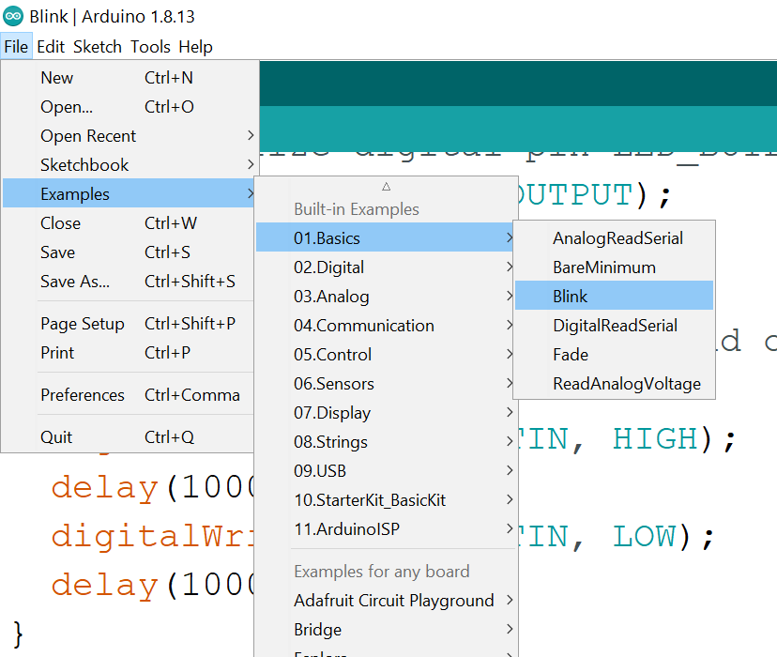
Open Arduino application and load program

Slide 13
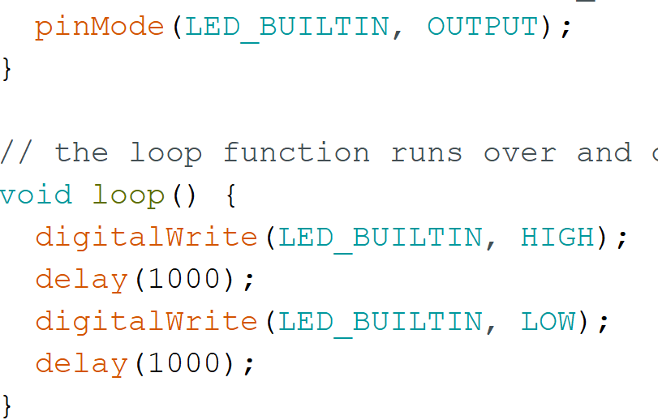
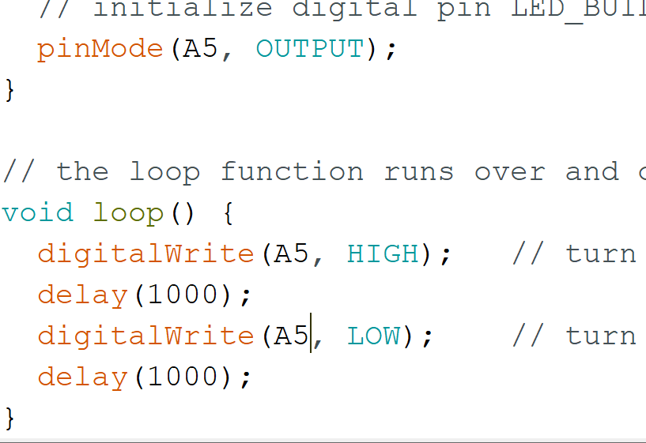

Change code slightly
Change all the “LED_BUILT_IN” to “A5” in the code
Connect your board to computer and hit upload (the arrow) at the top of the screen.

