Slide 1
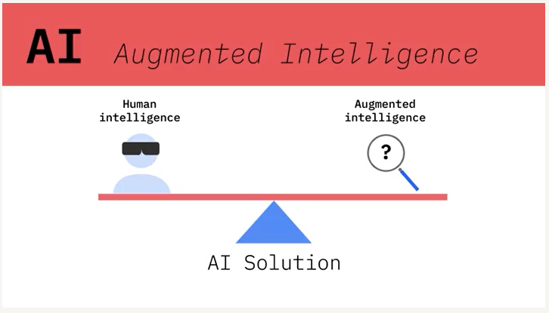
IBM: AI Professional Certification

Slide 2
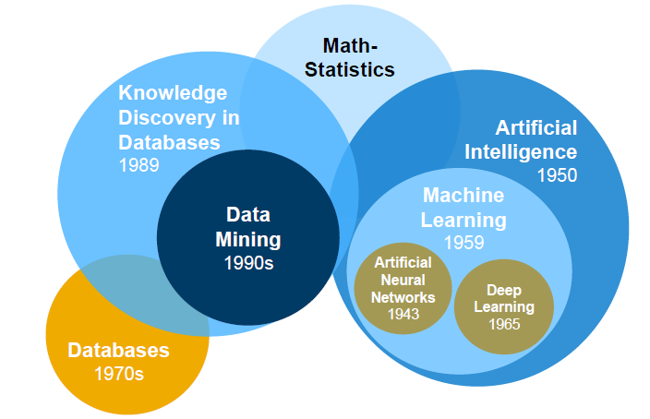
openSAP: Enterprise Machine Learning in a Nutshell

Slide 3
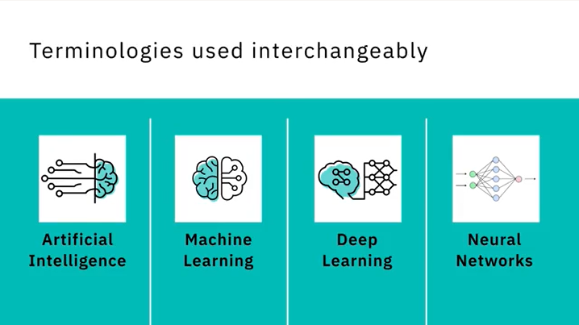

Generative AI
Generative AI
IBM: AI Professional Certification

Slide 4
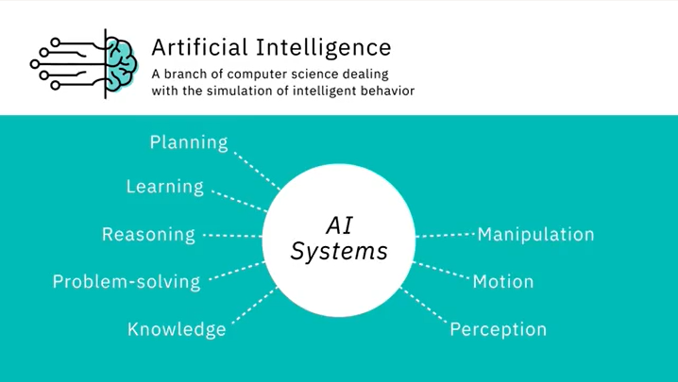
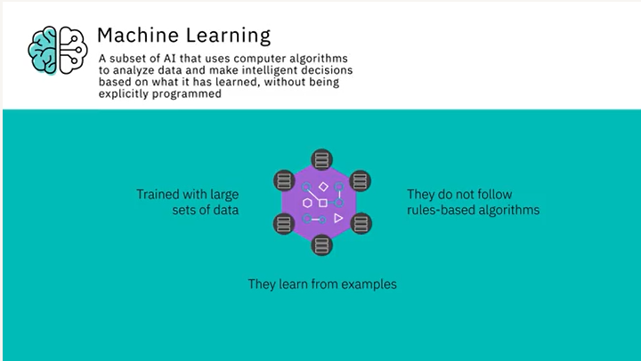
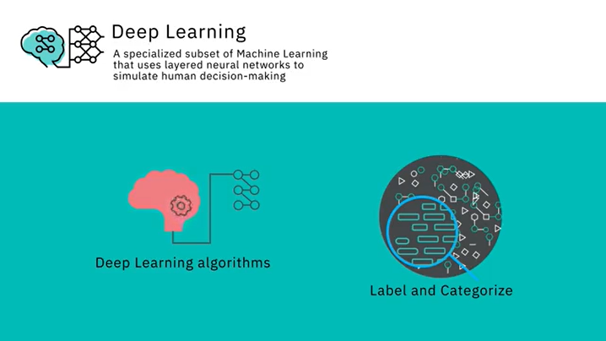
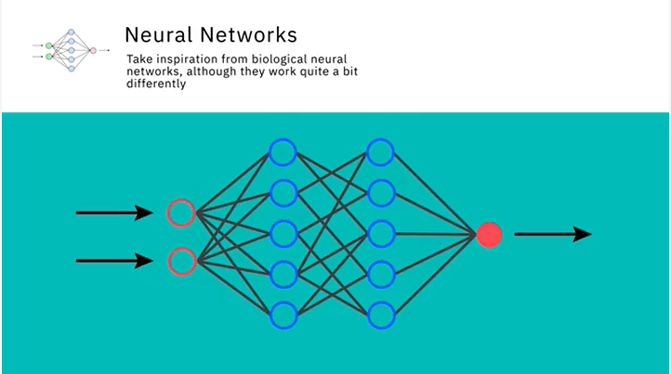
IBM: AI Professional Certification

Slide 5
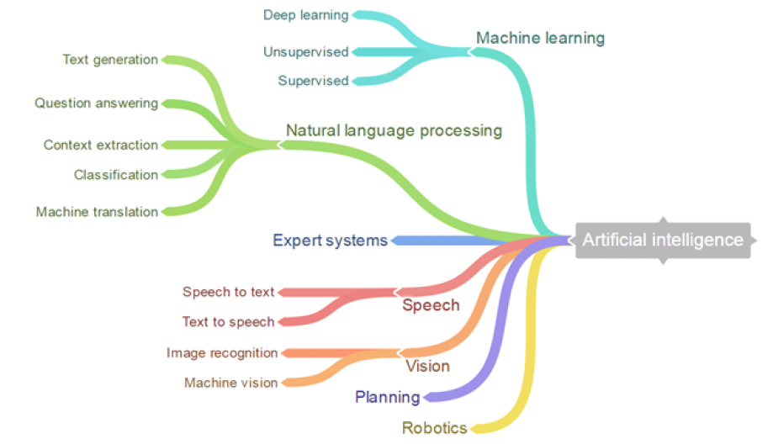
ODTUG 2020: Demystifying Machine Learning and Why You Should Jump on the Bandwagon Now

Slide 6
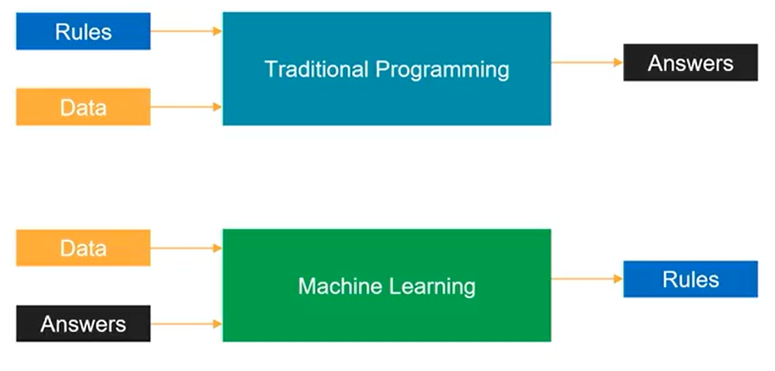
Udacity: Machine Learning Scholarship Program for Microsoft Azure

Slide 7
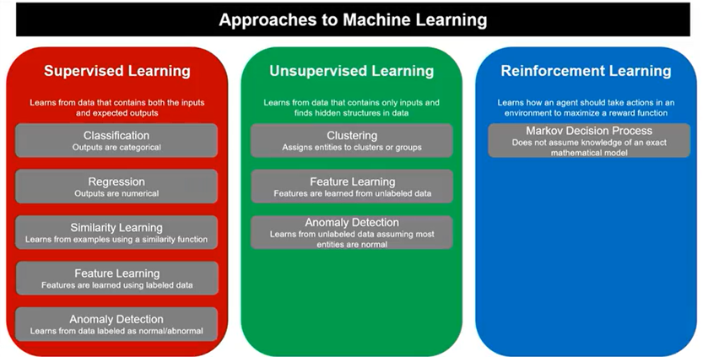
Udacity: Machine Learning Scholarship Program for Microsoft Azure

Slide 8
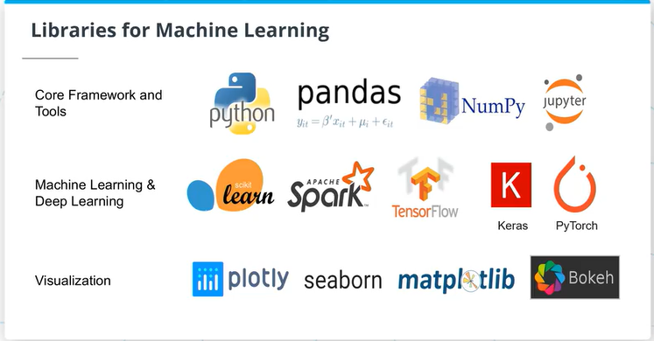
Udacity: Machine Learning Scholarship Program for Microsoft Azure

