Slide 1
Online Service Provider
(Sheba.XYZ)
Project By-
1605039 & 1605040
A Project under-
Nafis Irtiza Tripto,
Lecturer, Department of Computer Science and Engineering
BUET

Slide 2
ERD

Slide 3
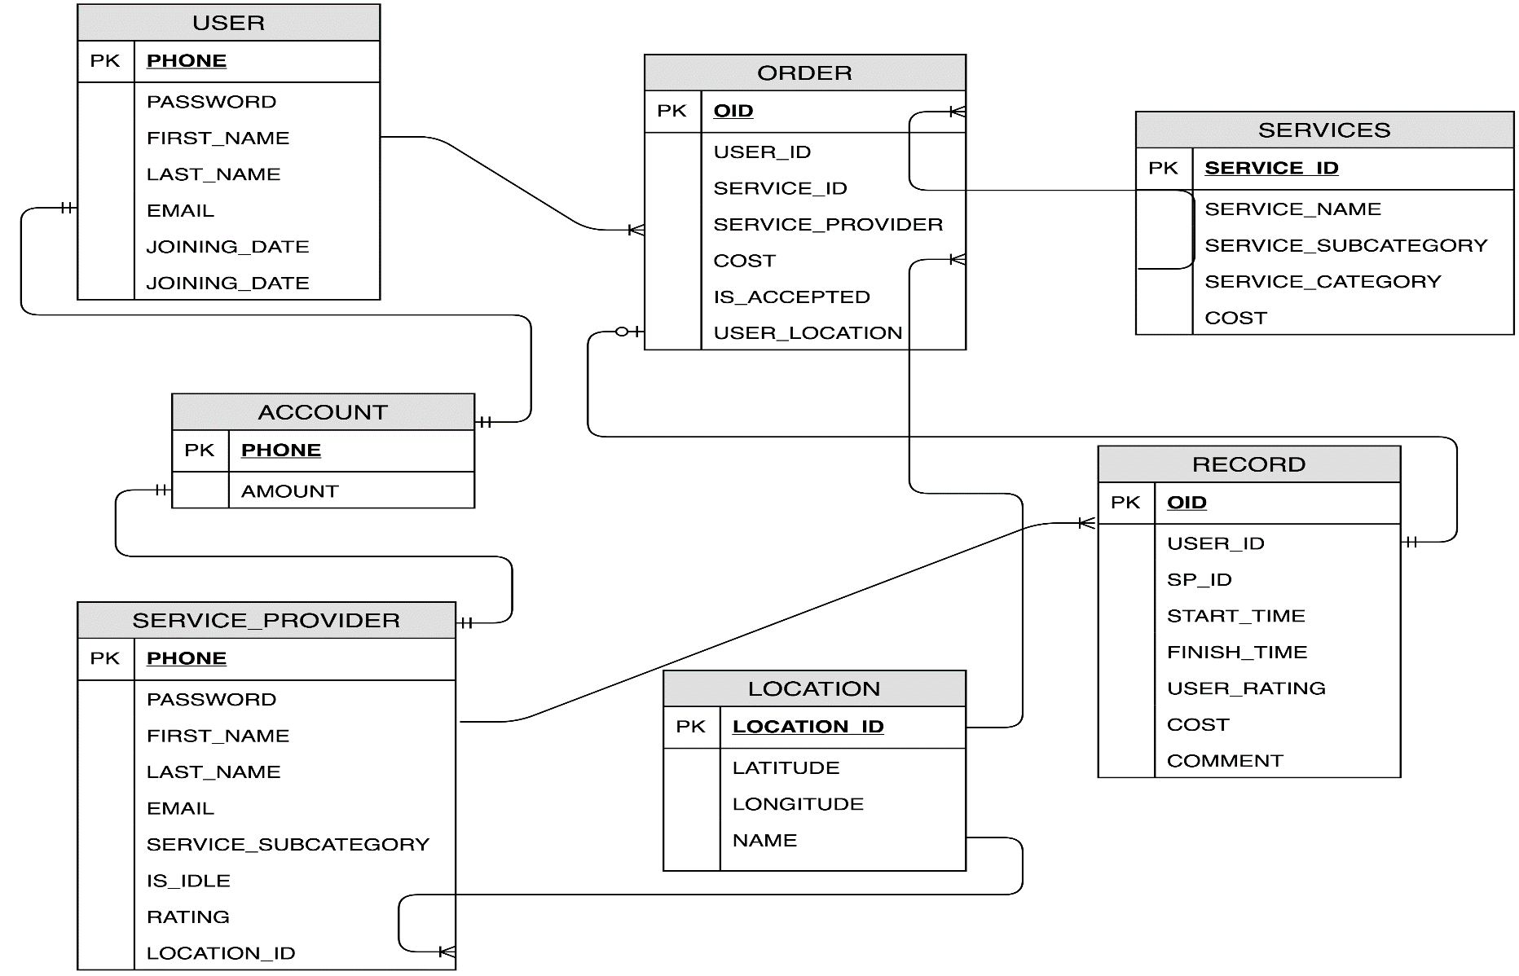

Slide 4
DDL

Slide 5
Table USER:
CREATE TABLE USER(
PHONE INTEGER PRIMARY KEY,
PASSWORD TEXT NOT NULL,
FIRST_NAME TEXT NOT NULL,
LAST_NAME TEXT NOT NULL,
EMAIL TEXT NOT NULL,
JOINING_DATE DATE NOT NULL
);

Slide 6
Table SERVICE_PROVIDER:
CREATE TABLE SERVICE_PROVIDER(
PHONE INTEGER PRIMARY KEY,
PASSWORD TEXT NOT NULL,
FIRST_NAME TEXT NOT NULL,
LAST_NAME TEXT NOT NULL,
EMAIL TEXT NOT NULL,
SERVICE_SUBCATEGORY TEXT NOT NULL,
IS_IDLE BOOLEAN NOT NULL,
RATING NUMERIC,
LOCATION_ID INTEGER NOT NULL
);

Slide 7
Table SERVICES:
CREATE TABLE SERVICES(
SERVICE_ID INTEGER PRIMARY KEY,
SERVICE_NAME TEXT NOT NULL,
SERVICE_SUBCATEGORY TEXT NOT NULL,
SERVICE_CATEGORY TEXT NOT NULL,
COST NUMERIC NOT NULL,
);

Slide 8
Table ACCOUNT:
CREATE TABLE ACCOUNT(
PHONE INTEGER PRIMARY KEY,
AMOUNT NUMERIC
);

Slide 9
Table LOCATION:
CREATE TABLE LOATION(
LOCATION_ID INTEGER PRIMARY KEY,
LATITUDE NUMERIC NOT NULL,
LONGITUDE NUMERIC NOT NULL,
NAME TEXT
);

Slide 10
Table ORDER:
CREATE TABLE ORDER(
OID INTEGER PRIMARY KEY,
USER_ID INTEGER NOT NULL,
SERVICE_ID INTEGER NOT NULL,
SERVICE_PROVIDER INTEGER NOT NULL,
COST INTEGER,
IS_ACCEPTED BOOLEAN,
USER_LOCATION INTEGER NOT NULL
);

Slide 11
Table RECORD:
CREATE TABLE RECORD(
OID INTEGER PRIMARY KEY,
USER_ID INTEGER NOT NULL,
SP_ID INTEGER NOT NULL,
START_TIME TIME NOT NULL,
FINISH_TIME TIME,
USER_RATING NUMERIC,
COST INTEGER,
COMMENT TEXT
);

Slide 12
Simple Query

Slide 13
1.SELECT * FROM \"USER\" WHERE \"PHONE\"="+phone+" AND \"PASSWORD\"='"+password+";
2.select \"SERVICE_CATEGORY\" from \"SERVICES\" GROUP BY \"SERVICE_CATEGORY\";
3.select \"SERVICE_ID\" From \"SERVICES\" WHERE \"SERVICE_NAME\"='"+str+“;
4.SELECT * FROM \"SERVICE_PROVIDER\" WHERE \"PHONE\"="+phone+" AND \"PASSWORD\"='"+password+"';

Slide 14
5.Select \"SERVICE_SUBCATEGORY\" FROM \"SERVICES\" WHERE \"SERVICE_CATEGORY\"='"+str+"'GROUP BY \"SERVICE_SUBCATEGORY\";
6.Select \"SERVICE_NAME\" FROM \"SERVICES\" WHERE \"SERVICE_SUBCATEGORY\"='"+str+"' GROUP BY \"SERVICE_NAME\";
7.Select * From \"LOCATION\" WHERE \"NAME\"='"+str+“;

Slide 15
Complex Query

Slide 16
complex query on pending service:
SELECT "RECORD"."OID" AS ordernumber , "SERVICES"."SERVICE_NAME" AS service,("SERVICE_PROVIDER"."FIRST_NAME" ||' '|| "SERVICE_PROVIDER"."LAST_NAME") AS worker ,"RECORD"."START_TIME" AS start_time
FROM "RECORD" JOIN "ORDER" ON "RECORD"."OID"="ORDER"."OID"
JOIN "SERVICE_PROVIDER" ON "SERVICE_PROVIDER"."PHONE"="ORDER"."SERVICE_PROVIDER"
JOIN "SERVICES" ON "ORDER"."SERVICE_ID"="SERVICES"."SERVICE_ID"
WHERE "RECORD"."OID" IN ( SELECT "OID" FROM "RECORD" WHERE "USER_ID"=1733202506);

Slide 17
complex query on worker
SELECT ("SERVICE_PROVIDER"."FIRST_NAME"||' '||"SERVICE_PROVIDER"."LAST_NAME") AS FULLNAME,
"SERVICE_PROVIDER"."PHONE" AS PHONE,"SERVICE_PROVIDER"."RATING" AS RATING,"SERVICES"."COST" AS PRICE,"LOCATION"."LATITUDE" AS LAT,"LOCATION"."LONGITUDE" AS LON
FROM "SERVICES" JOIN "SERVICE_PROVIDER" ON ("SERVICES"."SERVICE_SUBCATEGORY"="SERVICE_PROVIDER"."SERVICE_SUBCATEGORY")
JOIN "LOCATION" ON ( "SERVICE_PROVIDER"."LOCATION_ID"="LOCATION"."LOCATION_ID")
WHERE "SERVICES"."SERVICE_NAME"='Washing Machine' AND "SERVICE_PROVIDER"."IS_IDLE"=true;

Slide 18
complex query on provider view request
SELECT "ORDER"."OID" AS ORDERID,("USER"."FIRST_NAME"||' '||"USER"."LAST_NAME") AS USERNAME,
"USER"."PHONE" AS PHONE,"SERVICES"."SERVICE_NAME" AS SERVICE,"ORDER"."COST" AS PRICE,
"LOCATION"."NAME" AS ADDRESS
FROM "ORDER" JOIN "USER" ON ("ORDER"."USER_ID"="USER"."PHONE" )
JOIN "SERVICES" ON ( "ORDER"."SERVICE_ID"="SERVICES"."SERVICE_ID")
JOIN "LOCATION" ON ("ORDER"."USER_LOCATION"="LOCATION"."LOCATION_ID")
WHERE "ORDER"."SERVICE_PROVIDER"=1736598989 AND "ORDER"."IS_ACCEPTED" IS NULL;

Slide 19
complex query on cancelled services
SELECT "ORDER"."OID" AS OID,"SERVICES"."SERVICE_NAME" AS SERVICE,
"SERVICE_PROVIDER"."FIRST_NAME"||' '||"SERVICE_PROVIDER"."LAST_NAME" AS PROVIDER_NAME
FROM "ORDER" JOIN "SERVICES" ON "ORDER"."SERVICE_ID"="SERVICES"."SERVICE_ID"
JOIN "SERVICE_PROVIDER" ON "SERVICE_PROVIDER"."PHONE"="ORDER"."SERVICE_PROVIDER"
WHERE "ORDER"."USER_ID"=1733202506 AND "ORDER"."IS_ACCEPTED"=false;

Slide 20
Complex query on service processing
SELECT "ORDER"."OID" AS OID,"SERVICES"."SERVICE_NAME" AS SERVICE,
"SERVICE_PROVIDER"."FIRST_NAME"||' '||"SERVICE_PROVIDER"."LAST_NAME" AS PROVIDER_NAME
FROM "ORDER" JOIN "SERVICES" ON "ORDER"."SERVICE_ID"="SERVICES"."SERVICE_ID"
JOIN "SERVICE_PROVIDER" ON "SERVICE_PROVIDER"."PHONE"="ORDER"."SERVICE_PROVIDER"
WHERE "ORDER"."USER_ID"=1733202506 AND "ORDER"."IS_ACCEPTED" IS NULL;

Slide 21
Triggers

Slide 22
This trigger will run to free up a service provider to be ready for giving service again after the completion of his last task.
CREATE OR REPLACE FUNCTION GET_UPDATED_SP() RETURNS TRIGGER AS $RECORD$
DECLARE
S NUMERIC;
BEGIN
SELECT AVG("USER_RATING") INTO S FROM "RECORD" GROUP BY "SP_ID" HAVING "SP_ID"=NEW."SP_ID";
UPDATE "SERVICE_PROVIDER" SET "RATING"=S ,"IS_IDLE"=TRUE WHERE "PHONE"=NEW."SP_ID";
RETURN NEW;
END;
$RECORD$ LANGUAGE plpgsql;
CREATE TRIGGER UPDATE_SP AFTER UPDATE ON "RECORD"
FOR EACH ROW EXECUTE PROCEDURE GET_UPDATED_SP();

Slide 23
This trigger will load up the confirmed order into the RECORD table from ORDER table after the order has been accepted by the service provider.
CREATE OR REPLACE FUNCTION RECORD_ENTRY() RETURNS TRIGGER AS $ORDER$
DECLARE
BEGIN
IF NEW."IS_ACCEPTED"=TRUE THEN
INSERT INTO "RECORD" ("OID","USER_ID","SP_ID","START_TIME","COST")
VALUES (NEW."OID",NEW."USER_ID",NEW."SERVICE_PROVIDER",CURRENT_TIMESTAMP,NEW."COST");
END IF;
RETURN NEW;
END; $ORDER$ LANGUAGE plpgsql;
CREATE TRIGGER ORDER_CONFIRM AFTER UPDATE ON "ORDER"
FOR EACH ROW EXECUTE PROCEDURE RECORD_ENTRY();

Slide 24
This trigger will mark a service provider BUSY as soon as he is assigned to a task by the insertion of the RECORD table
CREATE OR REPLACE FUNCTION SET_SP_BUSY() RETURNS TRIGGER AS $RECORD$
DECLARE
BEGIN
UPDATE "SERVICE_PROVIDER" SET "IS_IDLE"=FALSE WHERE "PHONE"=NEW."SP_ID";
RETURN NEW;
END; $RECORD$ LANGUAGE plpgsql;
CREATE TRIGGER SET_BUSY AFTER INSERT ON "RECORD"
FOR EACH ROW EXECUTE PROCEDURE SET_SP_BUSY()

Slide 25
This trigger will automatically make an Sheba account as soon as a new user has been registered to us.
CREATE OR REPLACE FUNCTION CREATE_ACCOUNT() RETURNS TRIGGER AS $RECORD$
DECLARE
BEGIN
INSERT INTO "ACCOUNT" VALUES(NEW."PHONE",0.0);
RETURN NEW;
END;
$RECORD$ LANGUAGE plpgsql;
CREATE TRIGGER MAKEACCOUNT AFTER INSERT ON “USER"
FOR EACH ROW EXECUTE PROCEDURE CREATE_ACCOUNT()

Slide 26
This trigger will cancel concurrent service requests of the service providers on selection of a particular one.
CREATE OR REPLACE FUNCTION SET_OTHER_FALSE() RETURNS TRIGGER AS $ORDER$
DECLARE
BEGIN
IF NEW."IS_ACCEPTED"=TRUE THEN
UPDATE "ORDER" SET "IS_ACCEPTED"=FALSE WHERE "SERVICE_PROVIDER"=NEW."SERVICE_PROVIDER";
UPDATE "ORDER" SET "IS_ACCEPTED"=FALSE WHERE "OID"=NEW."OID";
END IF;
RETURN NEW;
END;
$ORDER$ LANGUAGE plpgsql;
CREATE TRIGGER T5 AFTER UPDATE ON "ORDER"
FOR EACH ROW EXECUTE PROCEDURE SET_OTHER_FALSE();

Slide 27
FUNCTIONS

Slide 28
CREATE OR REPLACE FUNCTION ENOUGH_BALANCE(OID INTEGER)
RETURNS BOOLEAN AS $YN$
declare
YN BOOLEAN;
TK INTEGER;
B NUMERIC;
BEGIN
SELECT "COST" INTO TK FROM "ORDER" WHERE "OID"=OID;
SELECT "AMOUNT" INTO B FROM "ACCOUNT" WHERE "PHONE"=(SELECT "USER_ID" FROM "ORDER" WHERE "OID"=OID);
IF TK>B THEN
YN=FALSE;
ELSE YN=TRUE;
END IF;
RETURN YN;
END;
$YN$ LANGUAGE plpgsql;

Slide 29
CREATE OR REPLACE FUNCTION TOTALSP(X TEXT)
RETURNS NUMBER AS $Y$
DECLARE Y INTEGER;
S TEXT;
BEGIN
SELECT COUNT(*) INTO Y FROM "SERVICE_PROVIDER" WHERE "SERVICE_SUBCATEGORY"=
(SELECT "SERVICE_SUBCATEGORY" FROM "SERVICES" WHERE "SERVICE_NAME"=X) AND "IS_IDLE"=TRUE;
RETURN Y;
END;
$Y$ LANGUAGE plpgsql;

Slide 30
CREATE OR REPLACE FUNCTION TRANSACT(OID INTEGER)
RETURNS TEXT AS $MSG$
declare
MSG TEXT;
TK INTEGER;
UB NUMERIC;
SPB NUMERIC;
BEGIN
SELECT "COST" INTO TK FROM "ORDER" WHERE "OID"=OID;
SELECT "AMOUNT" INTO UB FROM "ACCOUNT" WHERE "PHONE"=(SELECT "USER_ID" FROM "ORDER" WHERE "OID"=OID);
SELECT "AMOUNT" INTO SPB FROM "ACCOUNT" WHERE "PHONE"=(SELECT "SERVICE_PROVIDER" FROM "ORDER" WHERE "OID"=OID);
UPDATE "ACCOUNT" SET "AMOUNT"=UB-TK WHERE "PNONE"= (SELECT "USER_ID" FROM "ORDER" WHERE "OID"=OID);
UPDATE "ACCOUNT" SET "AMOUNT"=SPB+TK WHERE "PNONE"= (SELECT "SERVICE_PROVIDER" FROM "ORDER" WHERE "OID"=OID);
MSG='Transaction is Successful';
RETURN MSG;
END;
$MSG$ LANGUAGE plpgsql;

Slide 31
THANK YOU

