Slide 1
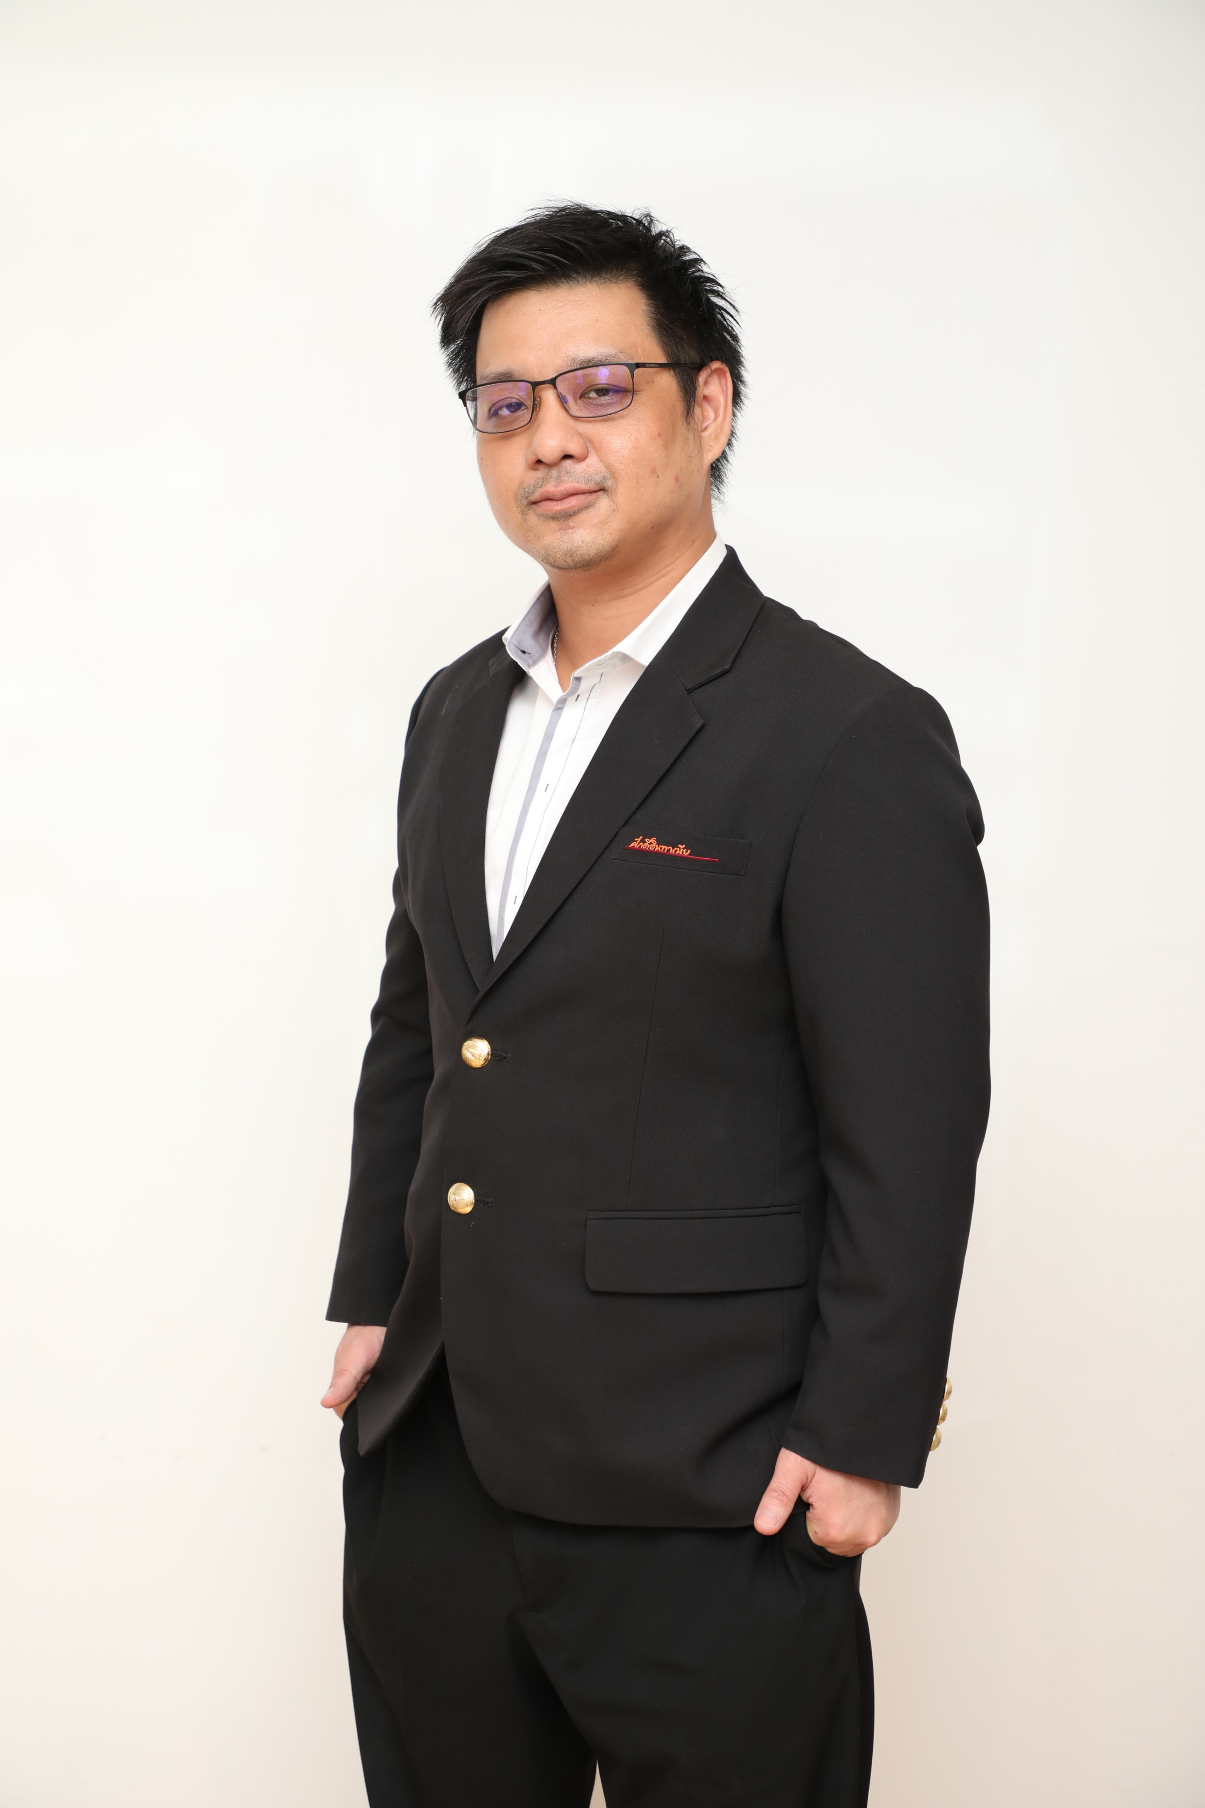


About Me
Professor at Department of Computer Engineering, Faculty of Engineering, Chulalongkorn University
Ph.D. in Computer Engineering, School of Engineering, University of Miami, U.S. in 2012
The Royal Thai Government Scholarship for Doctoral Degree in Computer Engineering with Specialization in Data Mining and Machine Learning
AI, Machine Learning, Deep Learning, Data Science, Natural Language Processing (NLP), Intelligent Medical Diagnosis, Big Data Platform, Data Warehousing, Database Management, Business Intelligence (BI)
Asst. Prof.Peerapon
Vateekul, Ph.D.
peerapon.v@chula.ac.th
090-974-5540

Slide 2





About Me
Instructor of AI/ML & related fields
Data Science and Data Engineering, Data Warehousing, Big Data Tools
Certified SAS instructors (10 years with SAS Thailand, 15+ SAS experience)
DLI ambassador for NVIDIA and be a part of NVAITC (Technology Center)
Co-founder for 4AM, which is a part of 4Plus Group
Asst. Prof.Peerapon
Vateekul, Ph.D.
peerapon.v@chula.ac.th
090-974-5540

Slide 3







Consultancy Experience
2021-Current
Customer Journey in 365 Days (C365)
Customer Data Platform
People Counting using Video Analytics
2021
Image Recognition
2020-2021
Big Data for MRTA Executive
Big Data, IoT
2019-
2020
IT Steering Committee and Advisor of CRM & Big Data Project
2017-
2018
Advanced Analytics – Sales Forecasting Model
time series forecasting
Asst. Prof.Peerapon
Vateekul, Ph.D.
peerapon.v@chula.ac.th
090-974-5540
Marketing Intelligence and Automation System
2016
association rule mining, direct target marketing, segmentation
Data scientist in the pilot project for the asset’s price estimation (house & condo)
2015

Slide 4
Research
Social Security Office (SSO): Data scientist in the fraud detection project
AIS: Network Analysis of Calling Data Records
Natural Language Processing for Thai
Question Answering
Toyota: Hamo – Vehicle Relocation
Hydro Informatics Institute (HII): Rainfall Forecasting
NBTC: Driver/passenger behavior analysis
GISTDA: Semantic segmentation on satellite images
CU Hospital:
Polyp detection
Activity analysis for Parkinson
Depression recognition
Asst. Prof.Peerapon
Vateekul, Ph.D.
peerapon.v@chula.ac.th
090-974-5540

