Slide 1
Rootcloud
Solution

Slide 2
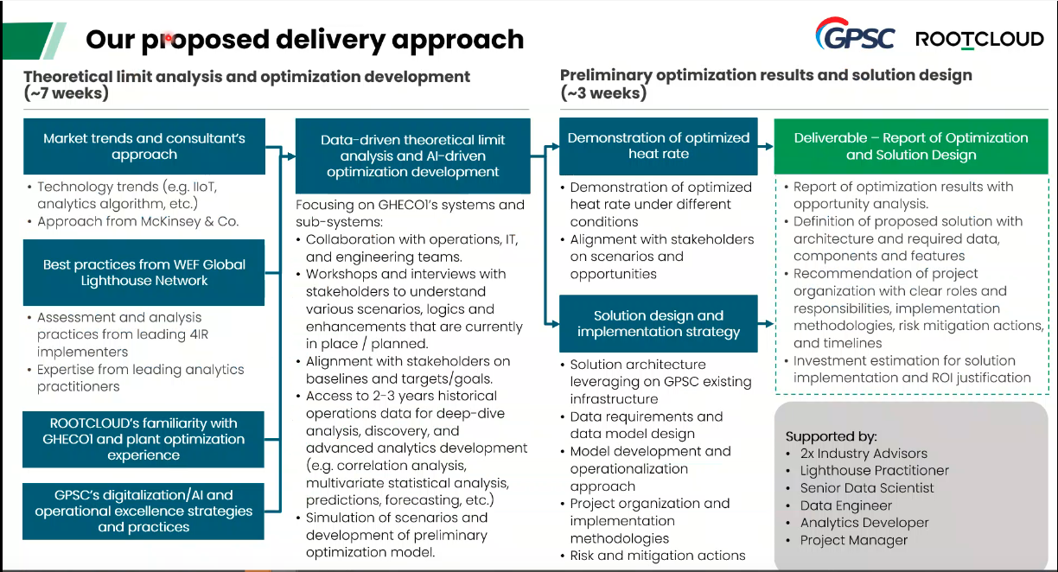

Slide 3
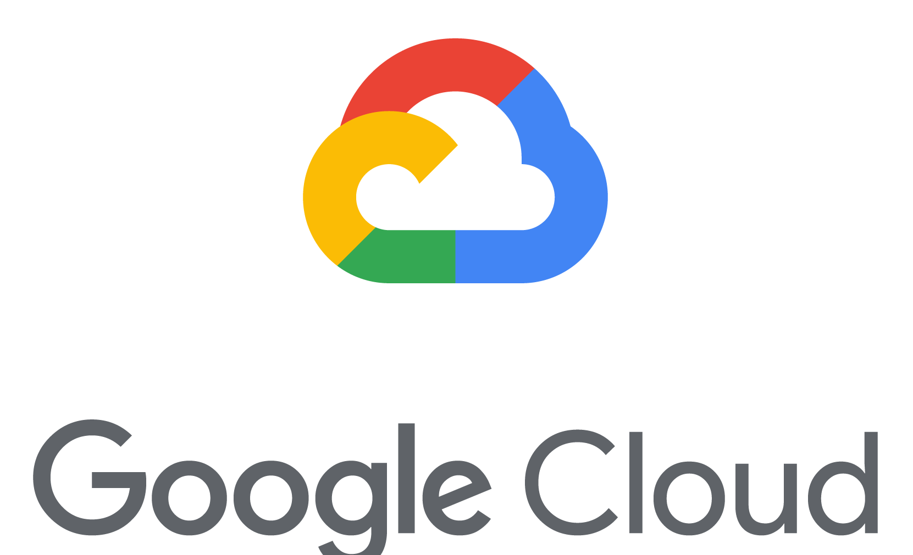
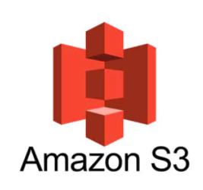
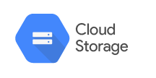



Proposed Solution: Google Colab
Data source
Boiler 5000 data tags
Boiler 2000 data tags

Slide 4
Project Timeline (10 Weeks)
PROJECT ACTIVITIES & DELIVERABLES | Timeline
 | Month 0 |  |  |  | Month 1 |  |  |  | Month 2 |  |  |  | Month 3
1. Project Management
Project Management
2. Solution Architect
Solution Design
3. Data Warehouse
Data Prep
Requirements
Model Development
Fine Tuning

Slide 5









4Plus Team
Expert Advisor
- - TBD - -
4Plus Resources
- - TBD - -
Client Resources
Working Team Level
Project Manager
- - TBD - -
Solution Architect
- - TBD - -
- - TBD - -
- - TBD - -
Analytic Developer
Data Science
Data Engineer
- - TBD - -
- - TBD - -
- - TBD - -
- - TBD - -
- - TBD - -
- - TBD - -

Slide 6
Assumption
Implement 1 plant
Project timeline is approximately 10 weeks
Client locate in Bangkok area
Rootcloud must provide power plant domain expert to come up with objective function (reward function)
Rootcloud provide assessment and analysis enhancements that are currently practices from leading 4IR implementers
Rootcloud manage coordination between 4Plus, Rootcloud, and GPSC
Rootcloud will conduct workshops and interviews with stakeholders to understand various scenarios, logics and as is requirement
Rootcloud will align with stakeholders on baselines and targets/goals/scenarios and opportunities
4Plus will assist Rootcloud to conduct workshops and interviews
4Plus will access to 2-3 years historical operations data for deep-analysis, discovery, and experience advanced analytics development (e.g. correlation analysis, multivariate statistical analysis, GPSC's digitalization/Al and predictions, forecasting, etc.)
4Plus will simulation of scenarios and and development of optimization model
4Plus will provide solution architecture leveraging on GPSC existing infrastructure
4Plus will provide Model development operationalization approach
4Plus will work with Rootcloud to provide project organization, implementation methodologies, risk, and mitigation plan

Slide 7
Scope of Work (Infrastructure)
In of scope
Out of scope
Provision Google Colab
Penetration & hardening test
Connect third party authenitcation (azure AD)
VA Scan and Penetration test
Hardening of Hypervisor (VM)
Network implementation
Hardware implementation
Installation, setup and configuration of Hypervisor (VM)
Hypervisor (VM) and OS backup implementation
Domain controller (MS AD) Setup and implementation
Performance testing and load Testing
Installation, setup and configuration, SAS Viya 4 for 1 environments (Prod)
Integration with 3rd party software including identity provider (MS AD) and integration with data sources
Install and config 1 environment
Production :24x7

Slide 8
Scope of Work
Implementation & Technical Execution
Set Architect related cloud infrastructure for data storage, processing, and model execution
Set up data ingestion pipelines for GPSC’s existing systems (7000 tags)
Manage and execute the end-to-end system integration
Implement visualization dashboards as per Rootcloud’s model output and operational needs
Data Engineering & Preprocessing Support
data ingestion, cleaning, and transformation to ensure quality input for the AI model
Set up ETL processes for structured and unstructured data as per Rootcloud’s model requirements
Maintain and monitor data pipelines for data updates and historical trend analysis
Perform data validation before feeding data into predictive models
AI Model Deployment & Integration
Work with Rootcloud to deploy and operationalize the AI model
Implement model retraining workflows, ensuring continuous learning and accuracy improvement
Support model inferencing, enabling predictive insights to trigger maintenance workflows

Slide 9
Q&A

