Slide 1
NHealth

Slide 2


Solution
Data Platform
Loyalty (CRM) – PAM + CDP (UID + Customer Care)
CDP
Data Platform
(Centralized All Nhealth Data)
Analytic Engine
(Sterilization)
UID Engine
Call Center
Customer Care
Support Data Format
Relational DB
Vector DB
Unstructured Data
Chatbot
Loyalty - PAM
Open Data
Data Lab

Slide 3
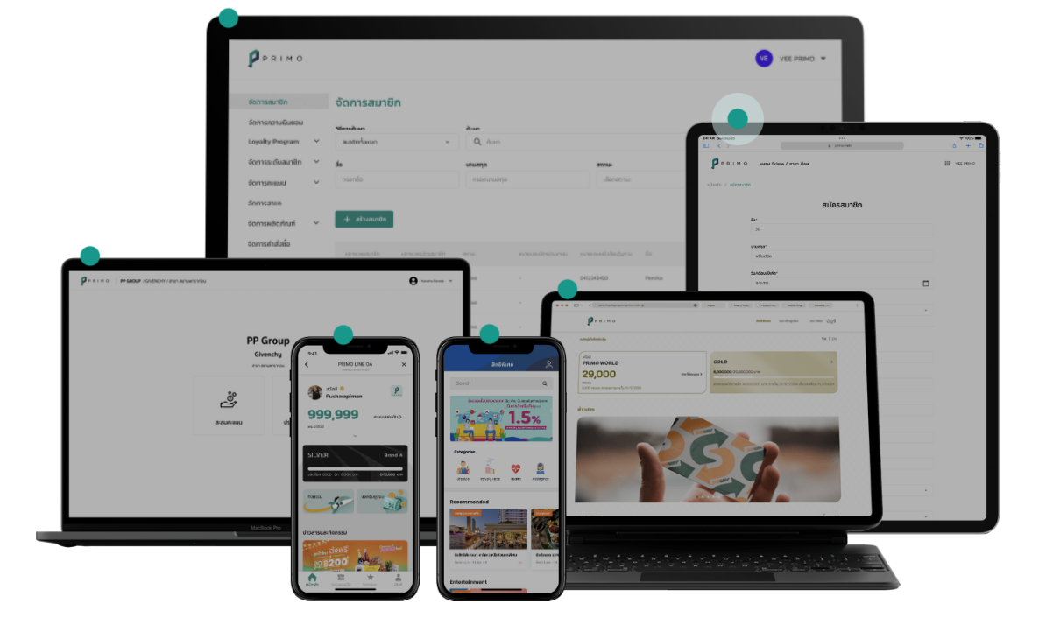
https://www.primo.mobi/

Slide 4
4Plus Unify Customer Data Platform
4our + Unique = 4ounix

Slide 5
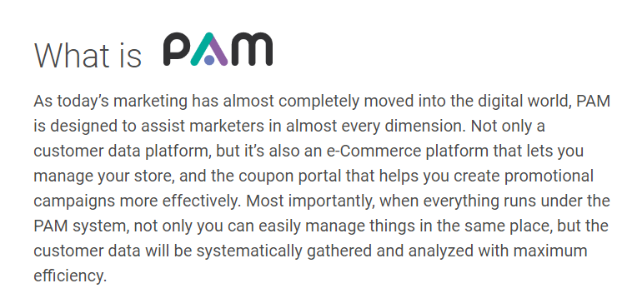
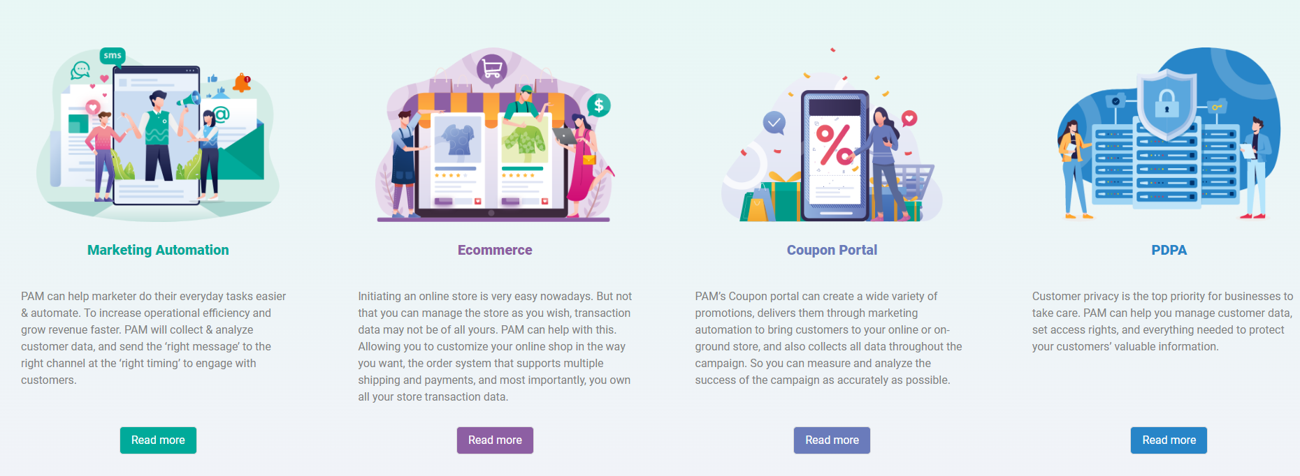
https://pams.ai/#whatispam

