Slide 1

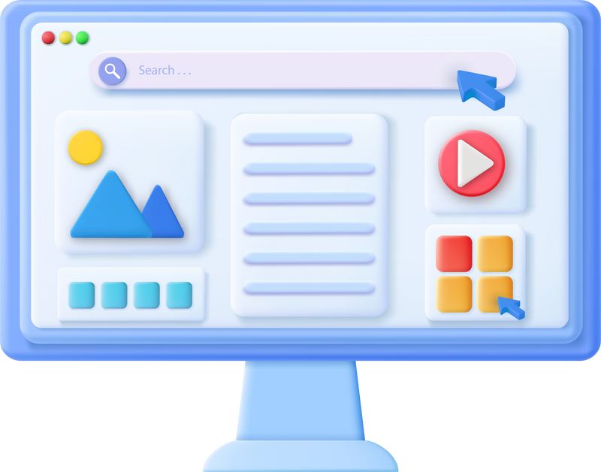



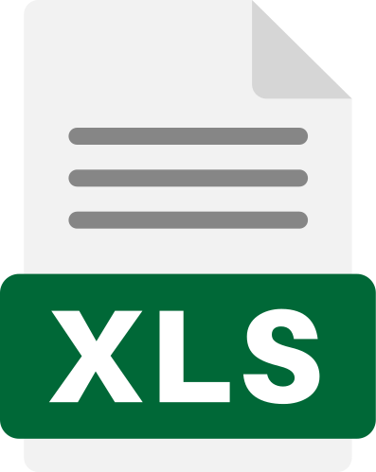
















4urney AI-KMS Solution Architecture
Knowledge
Integrations
AI-KMS Engine
User Channels
Document Processing
AI Classification Engine
Search Engine
Built-In
Ai-Assistant
Documents
Ingestion
File Parsing & Pre-Processing
Content Understanding
Keyword Search from Filename, Tags, Cate.
Live Chat
Support Structure & Unstructure Data
Support Text & Image
Auto Classification & Auto Tagging
Semantic Search
Social Network
AI-Chatbot Engine
Gen-Ai Chatbot
Vectorization
& Indexing
Knowledge Agent Connector
Use Cases
Prompt Template Configuration
Vector Embedding for Multiple File Formats
Connect Ai-Agent to Vector DB
Find Documents
Related to Inquiry
FAQ & Specific Documents Inquiry
Integration Options
Knowledge Governance for AI
User-Roles & Permission
File Access Control
Audit Logs
Safety & Guardrails
Public Data Service for External Party
(e.g., Check Employee Status)
Database
API
Support Features
Expanding Solution to Chat & Shop wite well Prepared Knowledge
Files
AI-KMS
Dashboard
System
Survey
Feedback
on AI Answer
User Help
Center

