Slide 1

Date – 19th Jan 2026
“High Performance Carry Save Adder Design : Based on Parallel Addition Technique”
Group - 5
Roll no.’s : 230102059 230102064 230102065
Names : Aditya Sharma Anuj Gupta Piyush Prasad

Slide 2
0.1 Abstract
Title -:
Design and Implementation of Carry Save Adder
Definition -:
A Carry Save Adder (CSA) is a high-speed arithmetic circuit used to add three or more binary numbers simultaneously by saving carry bits instead of propagating them immediately.
Working Principle -:
CSA performs bitwise addition using full adders without carry propagation.
Carry bits are stored separately and combined later using a final adder.

Slide 3
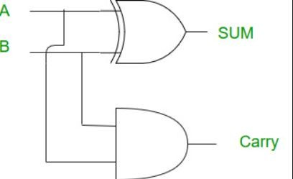
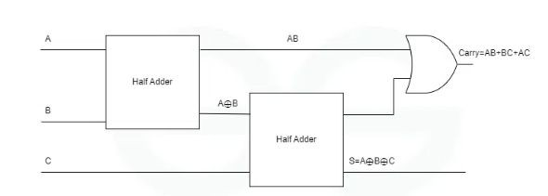
Half Adder -:
Half Adder (HA) → adds 2 bits
Sum = A⊕B Carry = A.B
Full Adder -:
S = A⊕B⊕C
Carry = c1+c2 =AB+AC+BC
✔ Now three bits have been added correctly

Slide 4
0.2 Introduction -:
Existing Works
Technique
History and Current Needs
Advantage
Limitation
Early digital systems used Ripple Carry Adders (slow).
Increasing demand for:
Ripple Carry Adder
Simple
High delay
High-speed processors
Low power consumption
Large bit-width arithmetic
Carry
Look-Ahead Adder
Fast
Complex
CSA introduced to overcome delay limitations.
Carry Select Adder
Moderate speed
Large area
Carry Save Adder
Very fast
Needs final adder

Slide 5
0.3 LITERATURE SURVEY AND BASIC PRINCIPLE
Basic Principle of CSA
Working Principle -:
Three input bits are added at each bit position.
Sum is generated using XOR logic.
Carry is generated using majority logic.
No carry is propagated between stages.
Mathematical Analysis
For each bit:
Sum = A⊕B⊕C
Carry=AB+BC+ACCarry = AB + BC + AC Carries are shifted left and added later.

Slide 6
0.4 DESIGN AND IMPLEMENTATION
Methodology
Analyze limitations of conventional adders
Design CSA architecture
Implement using Verilog HDL
Perform functional verification
Analyze performance
Architecture Description
Algorithm
Parallel full adder structure
Separate sum and carry vectors
Final adder for result generation
Input three N-bit operands
Apply CSA logic bit-wise
Generate sum and carry vectors
Shift carry left by one bit
Add using final adder

Slide 7
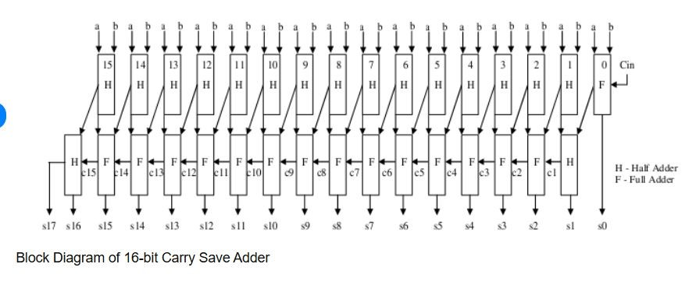

Slide 8
Advantages
Applications
Eliminates carry propagation during intermediate addition stages.
Provides very high speed for multi-operand addition.
Addition delay is independent of the number of bits.
Reduces critical path delay compared to Ripple Carry Adder.
Efficiently handles large bit-width arithmetic operations.
Implemented in Arithmetic Logic Units (ALUs) of processors.
Used in multiply–accumulate (MAC) units.
Applied in floating-point arithmetic units.
Applied in accumulator circuits.
Used in digital systems where carry delay must be minimized.
●

Slide 9
Conclusion
In this project, a 16-bit Carry Save Adder was designed and implemented using Verilog HDL to efficiently add multiple binary operands. The CSA architecture eliminates carry propagation during intermediate addition stages by generating separate sum and carry vectors, thereby significantly reducing computational delay.
References -:
M. Morris Mano and Michael D. Ciletti, Digital Design: With an Introduction to the Verilog HDL, 5th Edition, Pearson Education, 2013. & Google.
www.internationaljournalssrg.org/uploads/specialissuepdf/ICT-2020/2020/OTH ERS/P109.pdf

