Slide 1

“High Performance Carry Save Adder Design : Based on Parallel Addition Technique”
Group - 5
Roll no.’s : 230102059 230102064 230102065
Names : Aditya Sharma Anuj Gupta Piyush Prasad

Slide 2
1. Recap of Week 2-3
• Studied CSA concept and working principle based on selected paper
• Identified key building blocks:
• Pre-computation logic
• CSA unit
• Top-level module
• Designed a signal flow graph between modules
• Prepared design hierarchy for implementation
• Converted mathematical CSA equations into RTL logic structure
• Planned parallel full-adder array for multi-operand addition

Slide 3
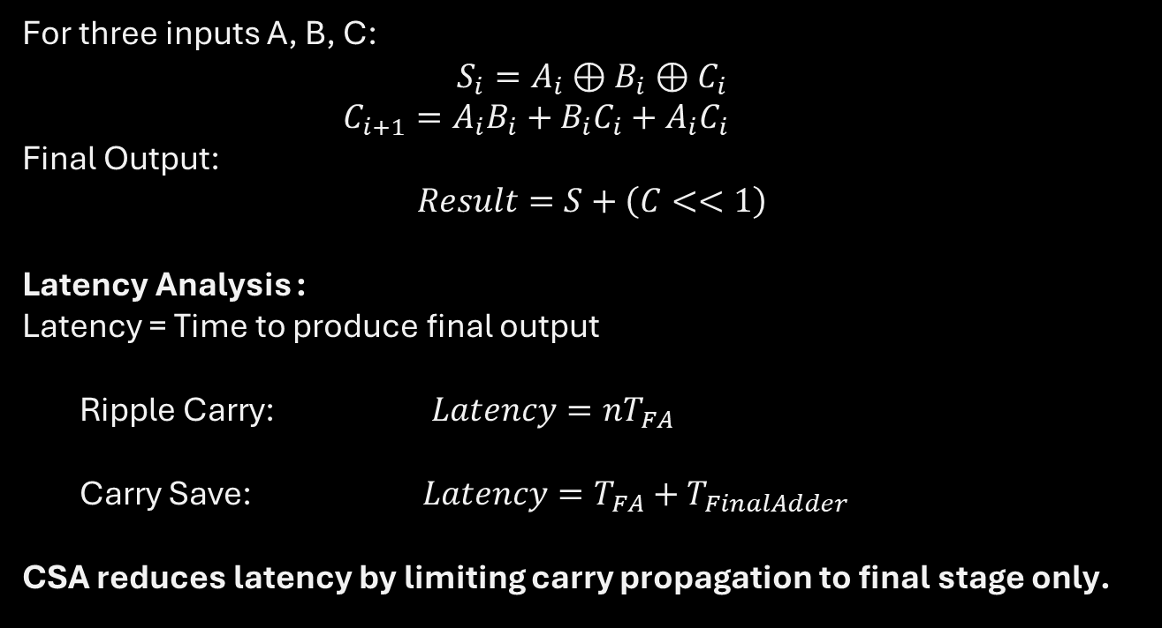
2. Mathematical Operation :
For three inputs A, B, C:
$$S_{i}=A_{i}⊕B_{i}⊕C_{i}$$
$C_{i+1}=A_{i}B_{i}+B_{i}C_{i}+A_{i}C_{i}$
Final Output:
$$Result=S+\left(C<<1\right)$$
Latency Analysis :
Latency = Time to produce final output
Ripple Carry: $Latency=nT_{FA}$
Carry Save: $Latency=T_{FA}+T_{FinalAdder}$
CSA reduces latency by limiting carry propagation to final stage only.
Reference - Digital Arithmetic by Miloš D. Ercegovac and Tomás Lang

Slide 4
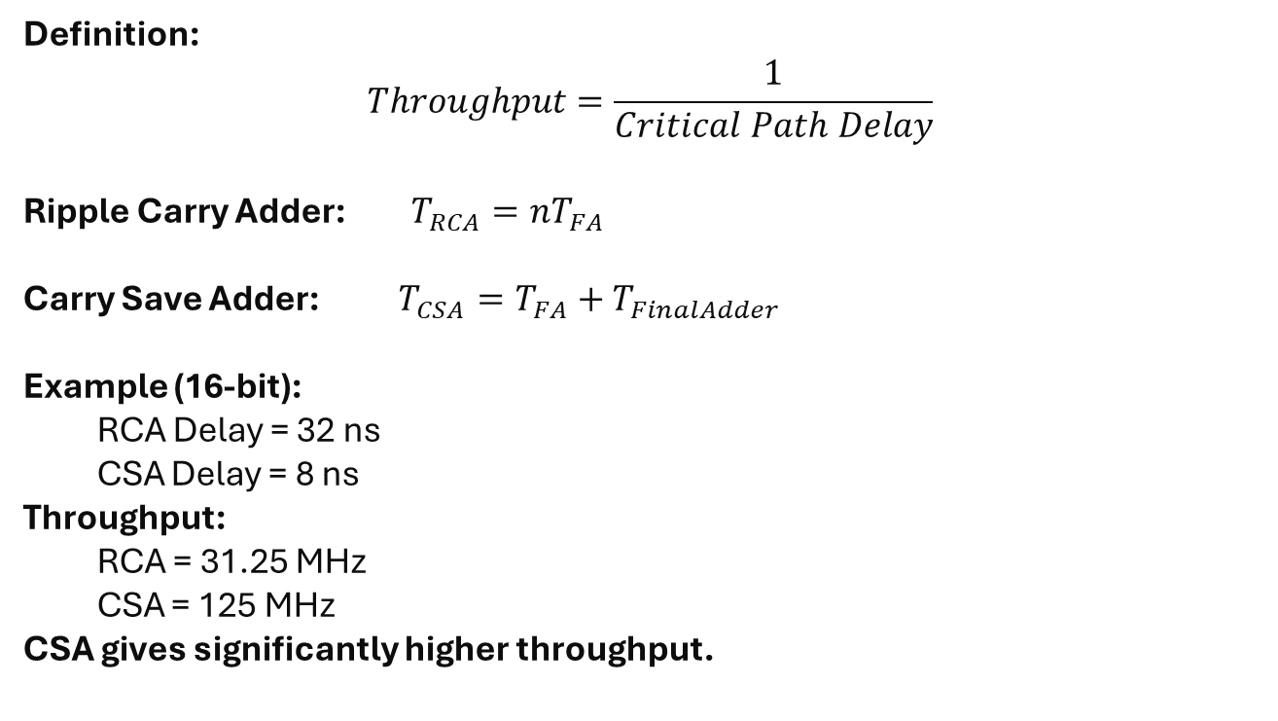
3. Throughput Analysis :
Definition:
$$Throughput=\frac{1}{Critical Path Delay}$$
Ripple Carry Adder: $T_{RCA}=nT_{FA}$
Carry Save Adder: $T_{CSA}=T_{FA}+T_{FinalAdder}$
Example (16-bit):
RCA Delay = 32 ns
CSA Delay = 8 ns
Throughput:
RCA = 31.25 MHz
CSA = 125 MHz
CSA gives significantly higher throughput.
Reference - Digital Arithmetic by Miloš D. Ercegovac and Tomás Lang

Slide 5
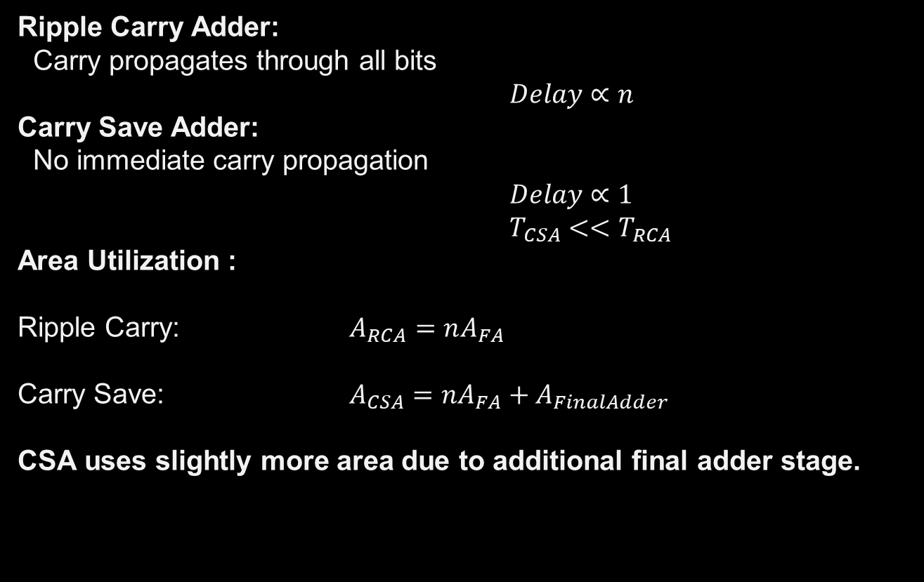
4. Propagation Delay :
Ripple Carry Adder:
Carry propagates through all bits
$Delay∝n$
Carry Save Adder:
No immediate carry propagation
$Delay∝1$
$T_{CSA}<<T_{RCA}$
Area Utilization :
Ripple Carry: $A_{RCA}=nA_{FA}$
Carry Save: $A_{CSA}=nA_{FA}+A_{FinalAdder}$
CSA uses slightly more area due to additional final adder stage.
Reference - Digital Arithmetic by Miloš D. Ercegovac and Tomás Lang

Slide 6
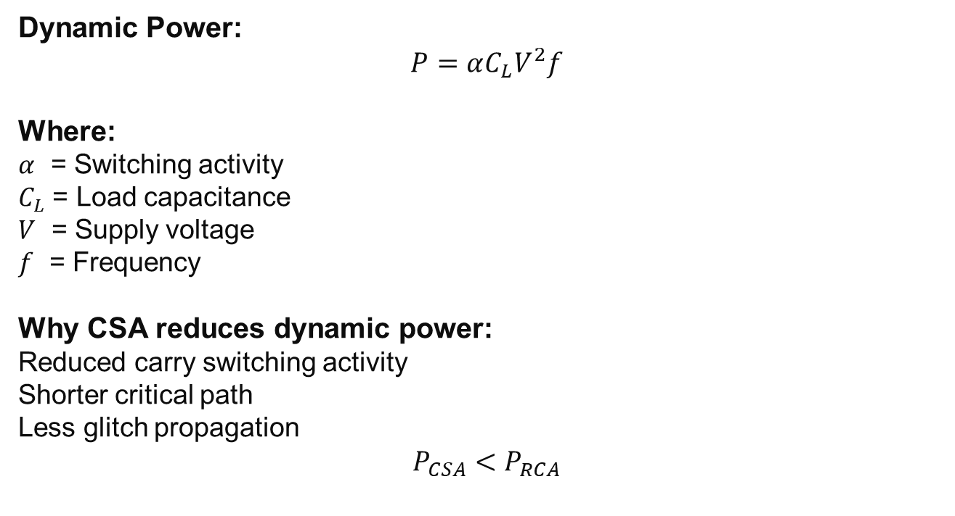
5. Power Consumption :
Dynamic Power:
$$P=αC_{L}V^{2}f$$
Where:
$α$ = Switching activity
$C_{L}$ = Load capacitance
$V$ = Supply voltage
$f$ = Frequency
Why CSA reduces dynamic power:
Reduced carry switching activity
Shorter critical path
Less glitch propagation
$$P_{CSA}<P_{RCA}$$
Reference - Digital Arithmetic by Miloš D. Ercegovac and Tomás Lang

Slide 7
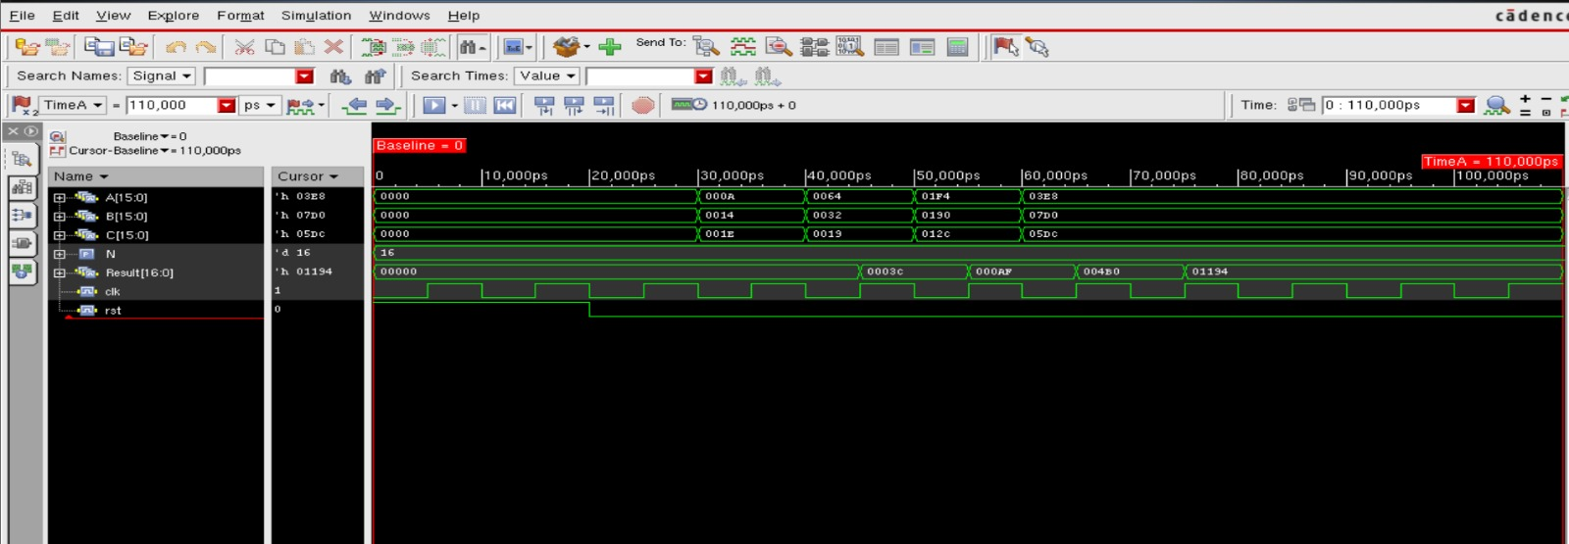

Slide 8
8. Timeline
Week 1 :- | Finalize Carry Save Adder specs, architecture selection , planning
Week 2 :- | Write modular Verilog (pre-computer, SA_unit, top module)
Week 3 :- | Build testbench, run behavioral simulation in Vivado/Xcelium
Week 4 :- | Functional verification, debug, waveform analysis
Week 5 :- | Write SDC constraints (timing, I/O), prepare for synthesis
Week 6 :- | Synthesize in Cadence Genus (with DFT/scan), review area/timing
Week 7 :- | Floor-planning and power planning in Innovus
Week 8 :- | Placement, clock tree synthesis (CTS), signal routing
Week 9 :- | Static Timing Analysis (STA), IR drop checks, power/area reporting
Week 10 :- | Final GDSII generation, documentation, PPT/report preparation

Slide 9
Conclusion :
Carry Save Adder improves speed by eliminating intermediate carry propagation.
Critical path delay becomes independent of bit width.
Provides high throughput and reduced latency.
Slight area increase but significant performance improvement.
Suitable for high-speed VLSI systems like multipliers and DSP processors.

