Slide 1

“High Performance Carry Save Adder Design : Based on Parallel Addition Technique”
Date – 16th Mar 26
Group - 5
Roll no.’s : 230102059 230102064 230102065
Names : Aditya Sharma Anuj Gupta Piyush Prasad

Slide 2
1. Recap of Week 4
• Derived the mathematical equations for sum and carry generation in CSA
• Analyzed important performance parameters including:
• Latency
• Throughput
• Propagation Delay
• Studied the impact on area utilization and power consumption
• Prepared design hierarchy for implementation
• Converted mathematical CSA equations into RTL logic structure
• Observed that CSA provides bit-width independent delay for intermediate addition stages
• Examined the relationship between switching activity and power consumption in digital circuits

Slide 3
2. Comparison Table
Parameters
Domino Logic CSA
CSA + CLA
Static CMOS CSA
Design Technique
Dynamic Logic
Hybrid Adder Architecture
Static CMOS
Main Objective
Increased Speed
Reduced Power and Area
Reduced Delay
Cadence/Xilinx
125nm Technology
Technology
Microwind
Highest
Moderate
Speed
Very High
Power
Low
Moderate
Very Low
Area
Reduced
Slightly Larger
Optimized
Reference - Low Power and Area Efficient Carry Save Adder Based on Static 125nm CMOS Technology , G. Naveen Balaj , M. Ishwarya

Slide 4
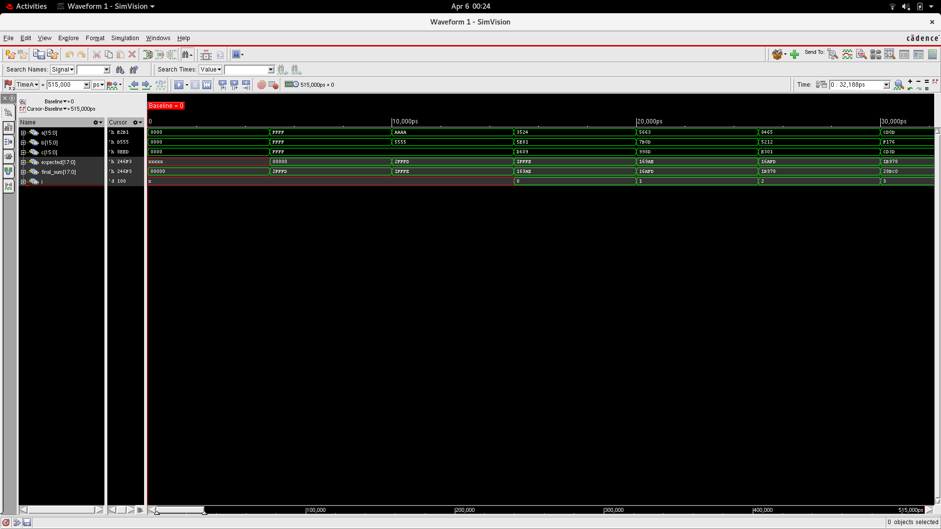

Slide 5
3. Mathematical Operation :
Mathematical Analysis
Result
Paper
22059.76 nW (2.20597e-05 W)
POWER ANALYSIS
~7.45% in total power increased significantly
23703.8 nW (2.37038e-05 W)
Reference - Design of High Speed Carry Save Adder , Ravikumar A Javali1, Ramanath J Nayak, Manjunath C Lakkannavar

Slide 6
3. Mathematical Operation :
Mathematical Analysis
Result
Paper
22059.76 nW (2.20597e-05 W)
POWER ANALYSIS
~257% in total power increased significantly
78912.5 nW (7.89125e-05 W)
Reference - Design of High Speed Carry Save Adder , Ravikumar A Javali1, Ramanath J Nayak, Manjunath C Lakkannavar

Slide 7
3. Mathematical Analysis :
Mathematical Analysis
Result
Paper
454 µm² using 54 standard cells.
AREA ANALYSIS
reduced the silicon footprint by ~8.67%
657.746 µm² using 76
standard cells.
Reference - Design of High Speed Carry Save Adder , Ravikumar A Javali1, Ramanath J Nayak, Manjunath C Lakkannavar

Slide 8
3. Mathematical Analysis :
Mathematical Analysis
Result
Paper
454 µm² using 54 standard cells.
AREA ANALYSIS
reduced the silicon footprint by ~8.67%
696.348 µm² using 81
standard cells.
Reference - Design of High Speed Carry Save Adder , Ravikumar A Javali1, Ramanath J Nayak, Manjunath C Lakkannavar

Slide 9
3. Mathematical Operation :
Mathematical Analysis
Result
Paper
1351ps
Timing ANALYSIS
~139% slower than proposed
3235ps
Reference - Design of High Speed Carry Save Adder , Ravikumar A Javali1, Ramanath J Nayak, Manjunath C Lakkannavar

Slide 10
3. Mathematical Operation :
Mathematical Analysis
Result
Paper
1351ps
Timing ANALYSIS
~107% slower than proposed
2800ps
Reference - Design of High Speed Carry Save Adder , Ravikumar A Javali1, Ramanath J Nayak, Manjunath C Lakkannavar

Slide 11
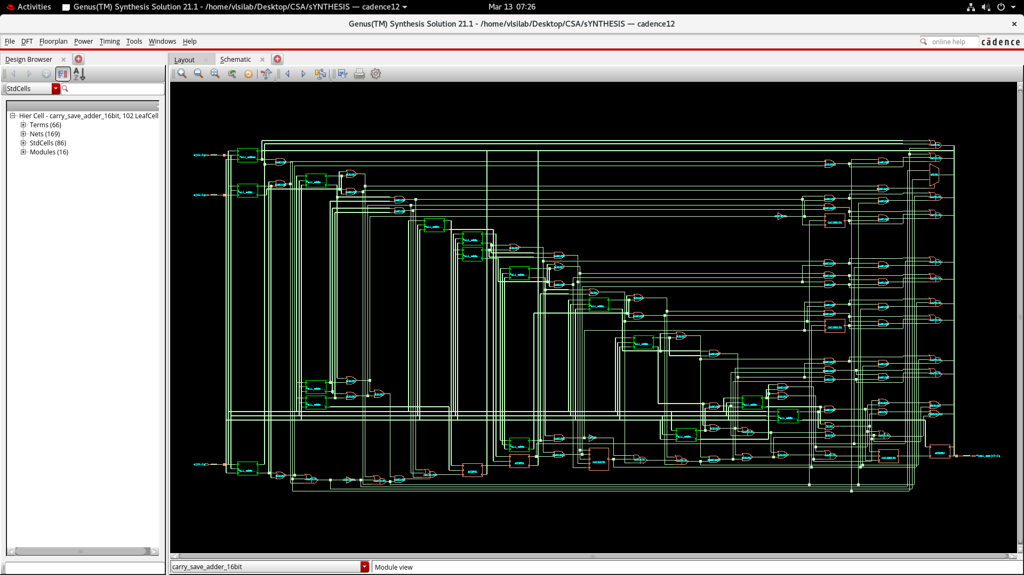

Slide 12
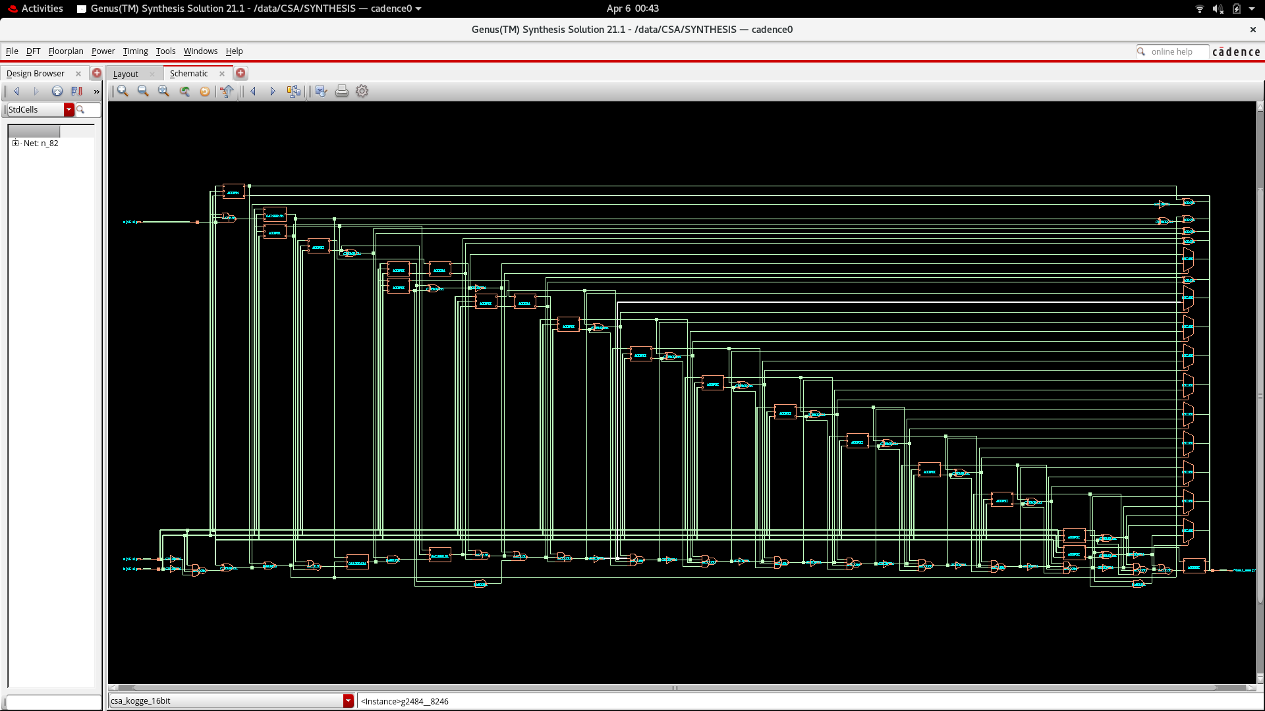

Slide 13
8. Timeline
Week 1 :- | Finalize Carry Save Adder specs, architecture selection , planning
Week 2 :- | Write modular Verilog (pre-computer, SA_unit, top module)
Week 3 :- | Build testbench, run behavioral simulation in Vivado/Xcelium
Week 4 :- | Functional verification, debug, waveform analysis
Week 5 :- | Write SDC constraints (timing, I/O), prepare for synthesis
Week 6 :- | Synthesize in Cadence Genus (with DFT/scan), review area/timing
Week 7 :- | Floor-planning and power planning in Innovus
Week 8 :- | Placement, clock tree synthesis (CTS), signal routing
Week 9 :- | Static Timing Analysis (STA), IR drop checks, power/area reporting
Week 10 :- | Final GDSII generation, documentation, PPT/report preparation

Slide 14
Conclusion :
Carry Save Adder architecture is highly efficient for multi-operand addition.
Research papers show that:
• Domino logic improves speed
• CLA improves final stage performance
• Static CMOS reduces power and area
These optimizations make CSA suitable for DSP processors, multipliers, and high-performance ALUs.
• CSA eliminates intermediate carry propagation
• CLA improves final stage performance
• CMOS optimization reduces power consumption
• Logic style selection impacts speed and area

