Slide 1
DRedrive INNOVATIVE PROJECT
A USB functionality tool designed for security

Slide 2

PROJECT TITLE
DRedrive is an USB functionality tool which allows you to do basic operations on USB without needing to plug it in multiple systems.
The name comes from my online alias ‘Red’.
DRedrive

Slide 3
1
ABOUT THE PROJECT

Slide 4

WHY IS IT NEEDED
81% of industrial malware can bring down entire industry
53% travels through USB
Risk of USB-borne attacks has gone up
Leveraging USB as attack vector
Topic of discussion amongst cyber attack groups
Lack of seriousness shown by employees
Assuming IT team will handle it all

Slide 5

HOW DOES DRedrive HELP
Built on understanding of why USB’s are used in first place
Give functionalities to better monitor system
Easy to understand
Great interactive GUI
Simple 15-20 min brief about use
Pair up with plugging USB ports

Slide 6



FUNCTIONALITIES PROVIDED
SCAN
HOST
FORMAT
Scan the drive with help of ClamAV and generate a VT report
Host the files as a HTTP File Server for access from all devices on local network
Completely format the drive according to preffered file system using Diskpart

Slide 7

FUTURE ENHANCEMENTS
The software currently is only at alpha stage
Bringing this device on Rpi 4 will reveal true potential
Switching to better and secure SFTP compared to HTTP FS
Running on much secure Linux Kernel

Slide 8
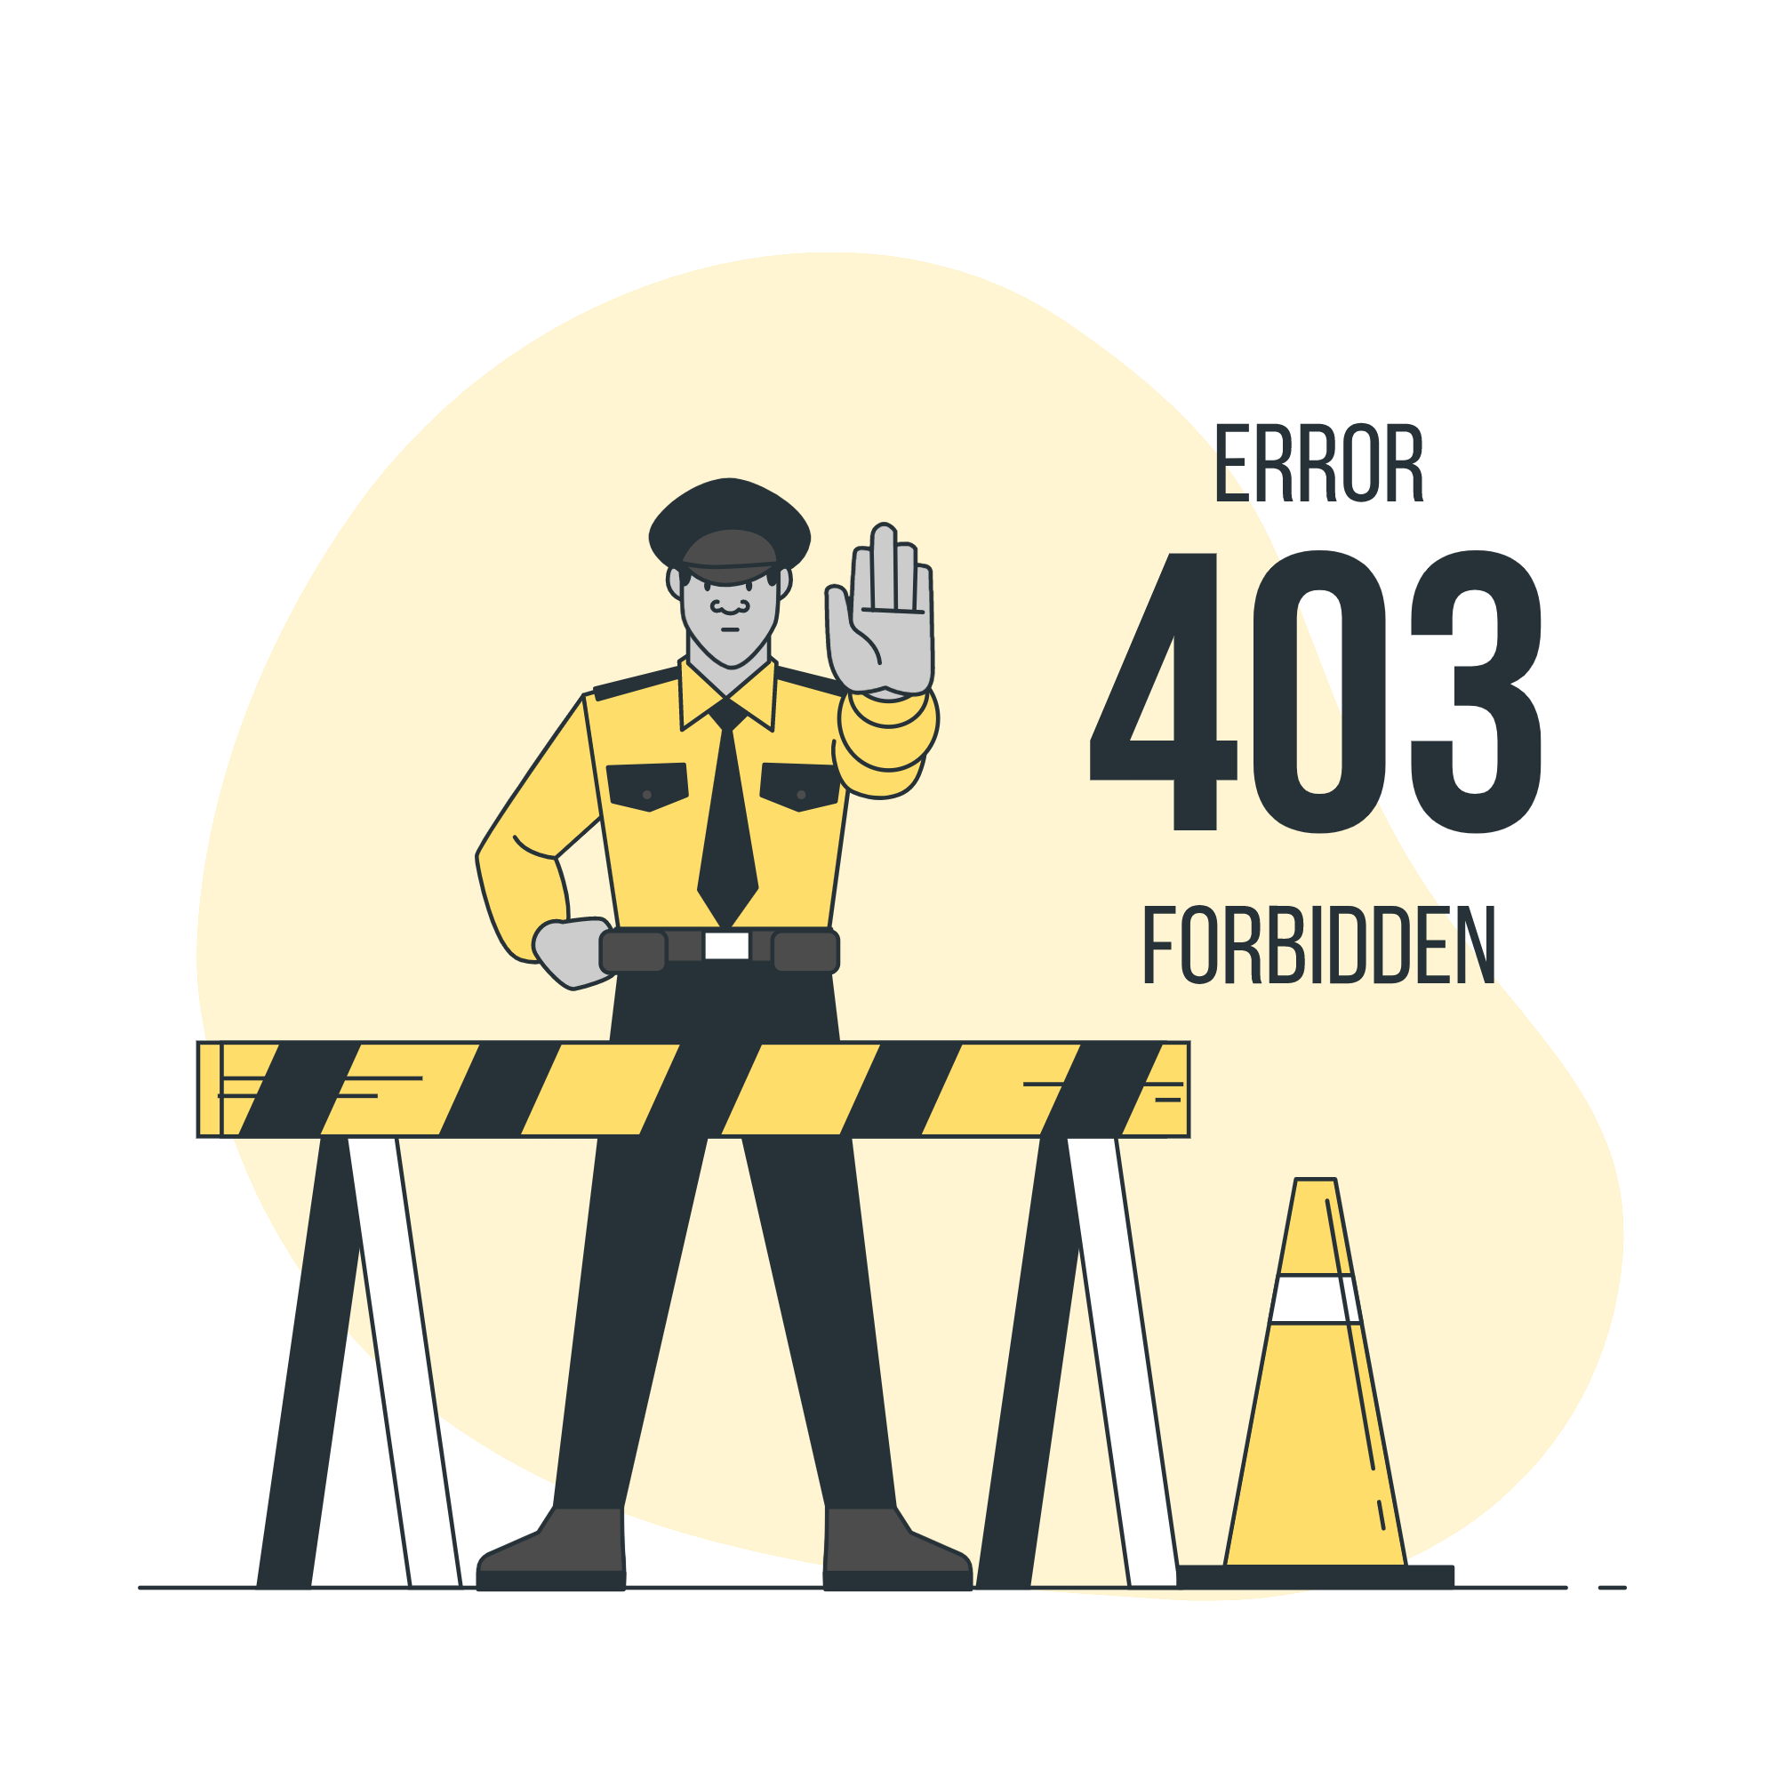
CURRENT LIMITATIONS
Problems installing PyQt5 on Raspberry Pi
Need more experience with threading
Exploring VT API in depth
Gain knowledge of hosting SFTS server using app

Slide 9


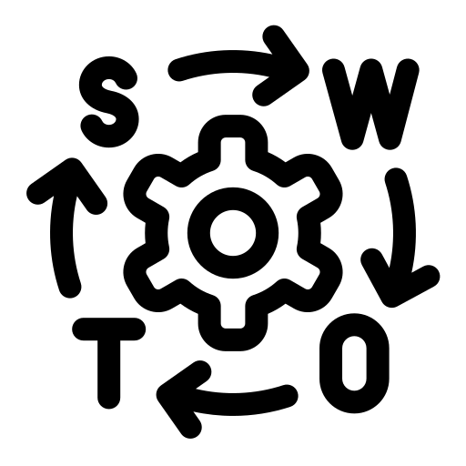


SWOT ANALYSIS
STRENGTHS
WEAKNESSES
Boasts a very interactive GUI enabling users to actually use system as intended
Bunch of Shell Scripting involved, have to validate inputs which run shell commands
OPPORTUNITIES
THREATS
Aimed at huge industries and labs having multiple PC networks
Staying upto date and doing software updates as new patches towards dependencies can crash the software

Slide 10
2
MAJOR REQUIREMENTS

Slide 11





CURRENT
The current requirements include:
Python 3.9
PyQt5
ClamAV
VT API
Windows

Slide 12

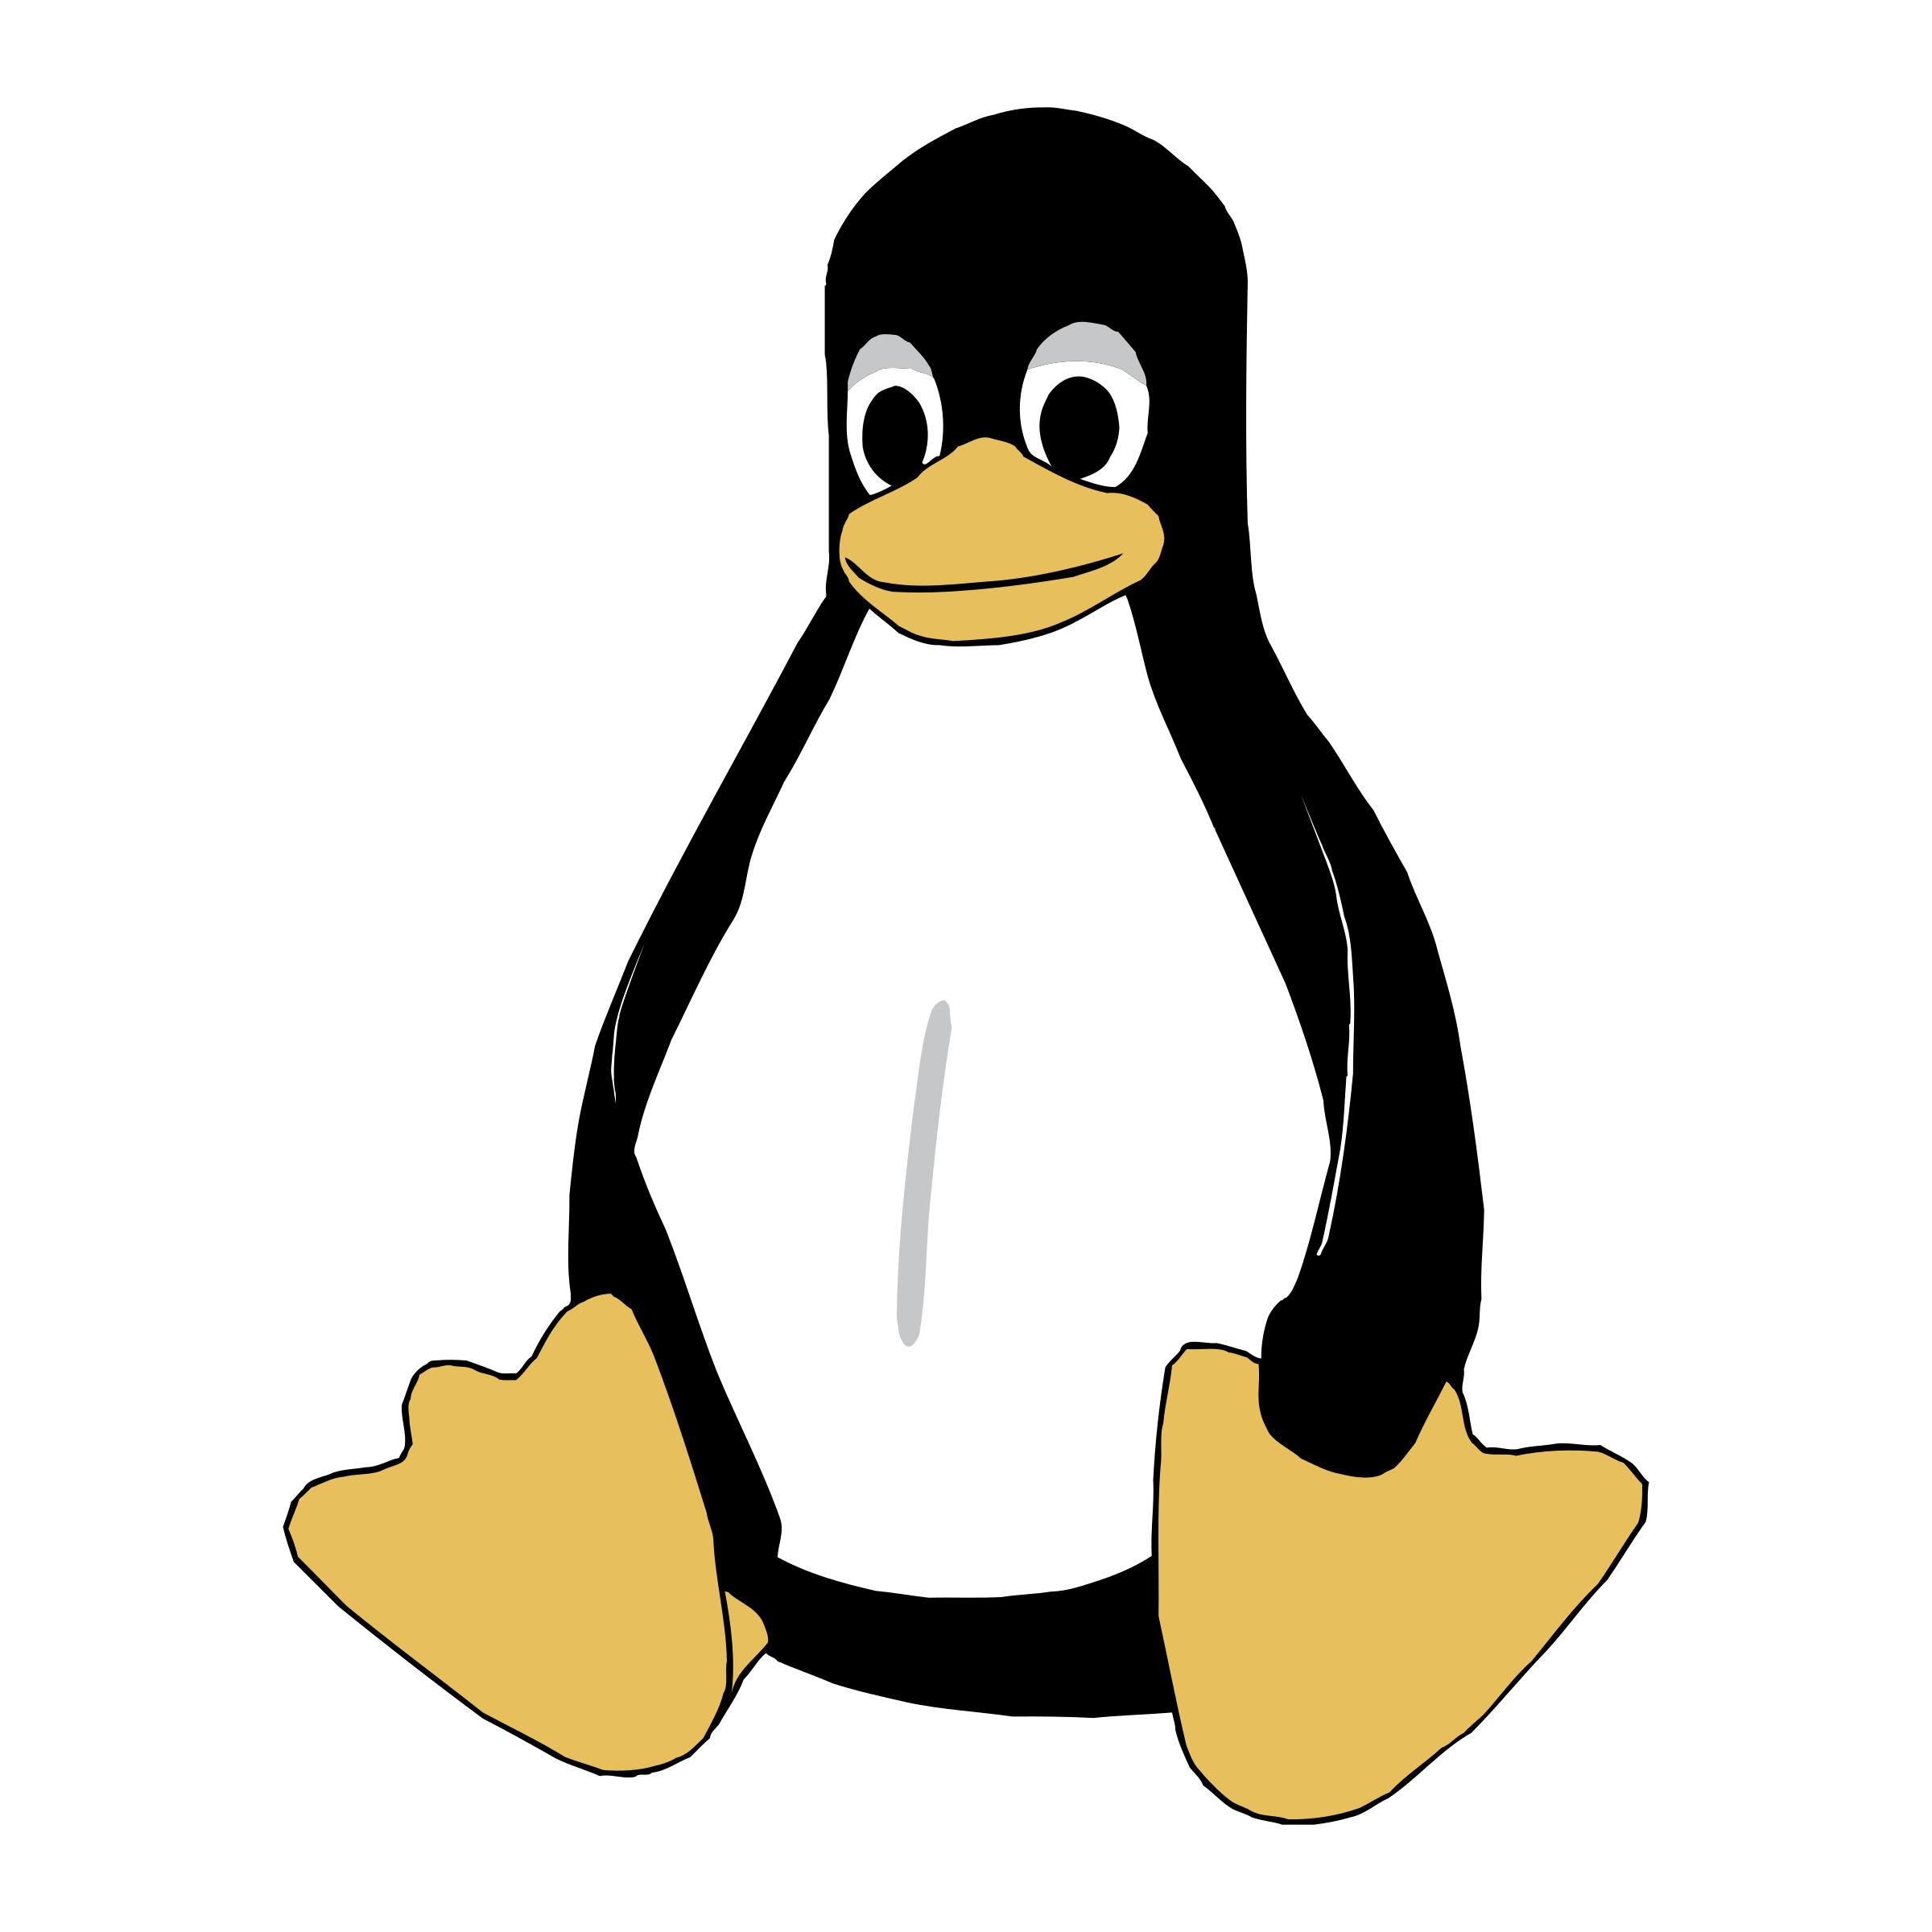


FUTURE
The future requirements include:
Python X.x
Linux
Raspberry Pi (or similar SBC’s)
Docker
Touch Display

Slide 13
3
BUSINESS-WISE INFORMATION

Slide 14
TIMELINE
DAY 1
DAY 4
DAY 12
Writing down basic layout and requirements
Developing code for scanning utility
Integration of all units and testing the software
DAY 2
DAY 8
DAY 16
Developing GUI for the software
Developing code for host and format utility
α developed. Waiting for proper support for arm64 processors

Slide 15
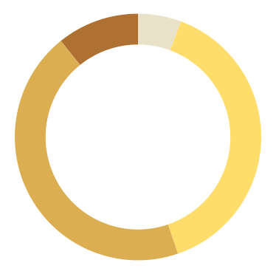

FINANCES OF FULL RELEASE PRODUCT *per 100 products
Total Costs of 100 products –
1. Qt Commercial licence: ₹ 42,000/-
2. VT Enterprise API: ₹ 80,000/-
3. Raspberry Pi 4: ₹ 2,90,000/-
4. Display: ₹ 3,30,000/-
₹ 7,42,000/-
VT
Qt
5.7%
10.8%
Display
RPi 4
44.5%
39.1%

Slide 16
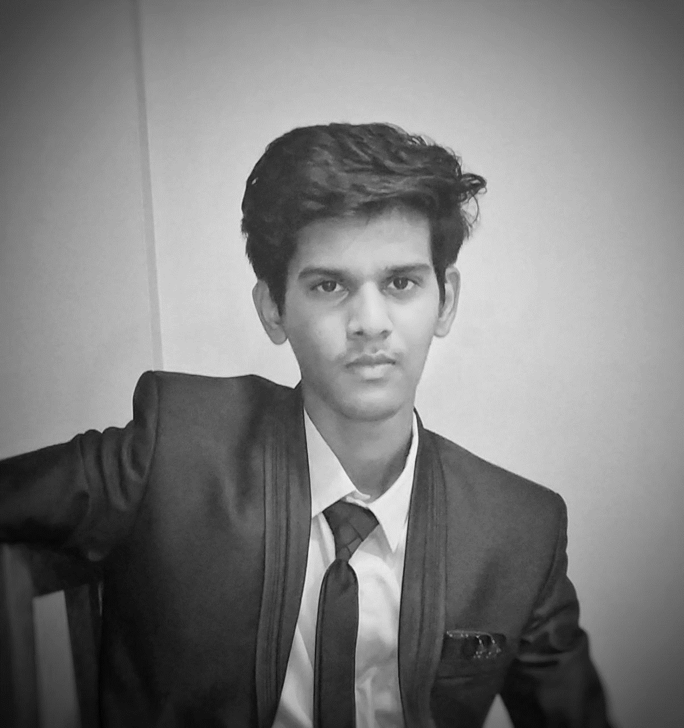



THE TEAM
ABHIJEET PAWAR
2nd PERSON
A computers and programming enthusiast
It was a solo project!
3rd PERSON
WAIT! IT’S ALL YOU?
No.. I am serious, there’s noone else
Always has been!!

Slide 17
—MAYA ANGELOU
“​​You can’t use up creativity. The more you use, the more you have.”

Slide 18

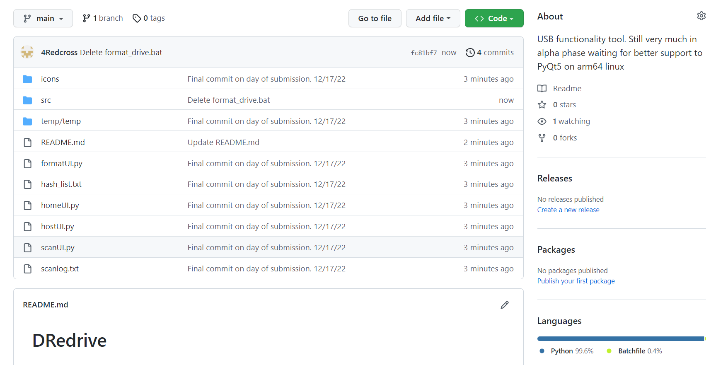
THE PROJECT IS LIVE ON GITHUB!! CLICK HERE

Slide 19
THANKS!
DO YOU HAVE ANY QUESTION?

Slide 20


