Slide 1
What is new in Cognoscenti?
Keith D Swenson
August 2015

Slide 2
Overview / Outline
Cleanup
New UI Framework
Meeting Support
Notes are now Topics
Comments everywhere
Proposals and Responses
Tag Labels

Slide 3
Cleanup
Over several generations of development, different tools and techniques had built up
Eliminated all GWT code
No need for GWT compile phase
Speed compile time 6x: from 2 minutes to now only 20 seconds
Eliminated all YUI framework support
Reduced source from 140MB to 100MB
Reduced backlog of technical debt

Slide 4
AngularJS Support
UI completely reimplemented in AngularJS
Client side MVC, smaller, lighter, more powerful
Access to AngularJS components
Much more modular
Much more interactive
Look and feel updated to Bootstrap UI classes

Slide 5
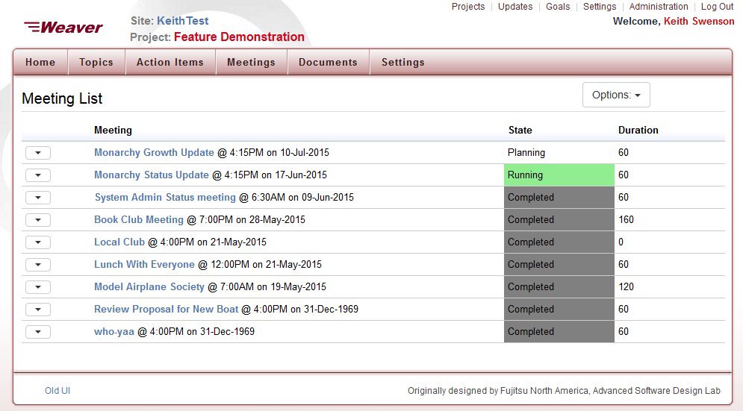
Meeting List

Slide 6
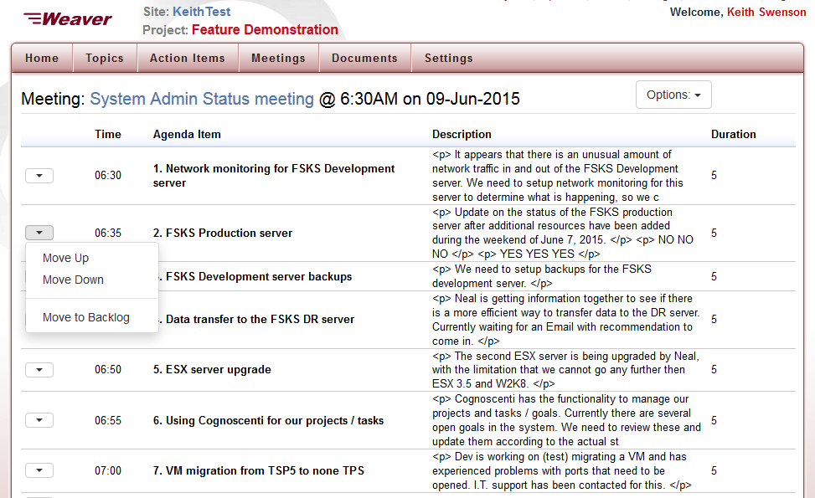
Meeting Agenda Planner

Slide 7
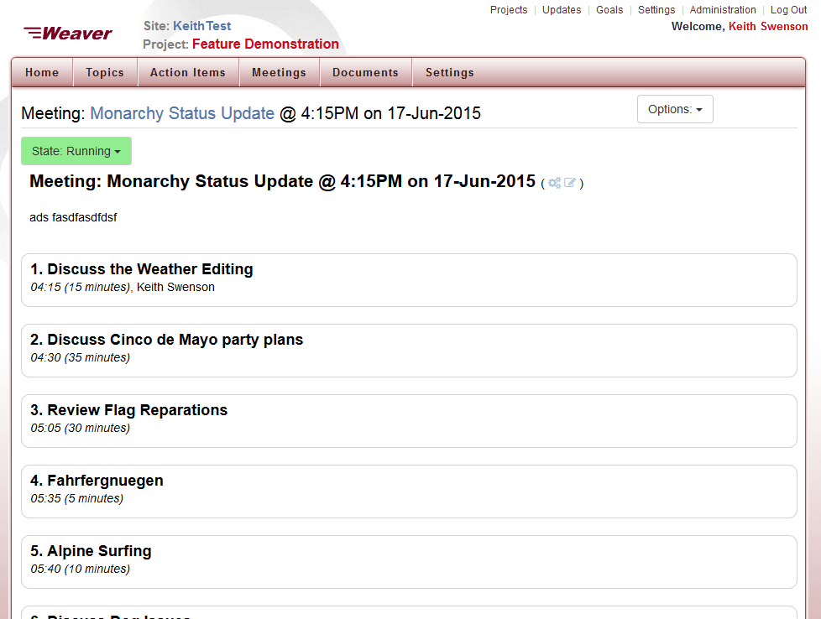
Run the Meeting

Slide 8
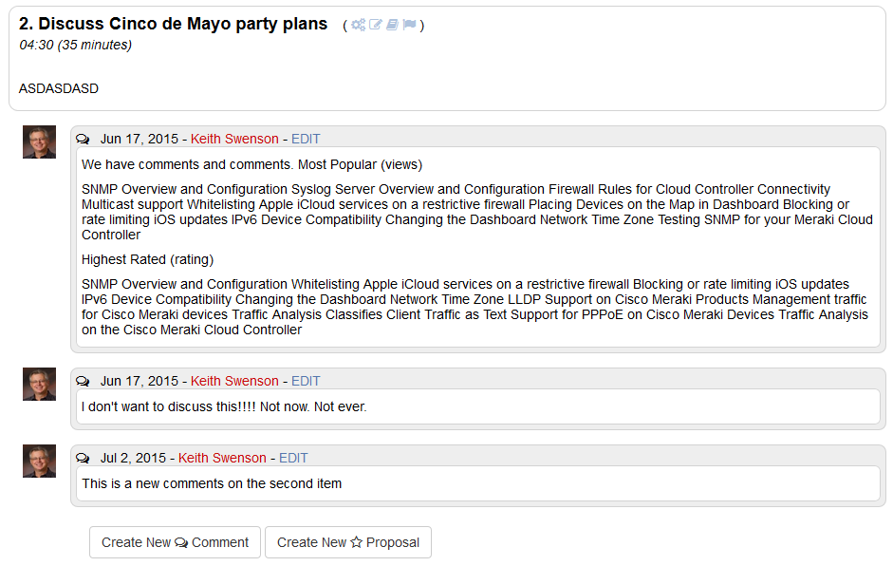
Comments on Agenda Items

Slide 9
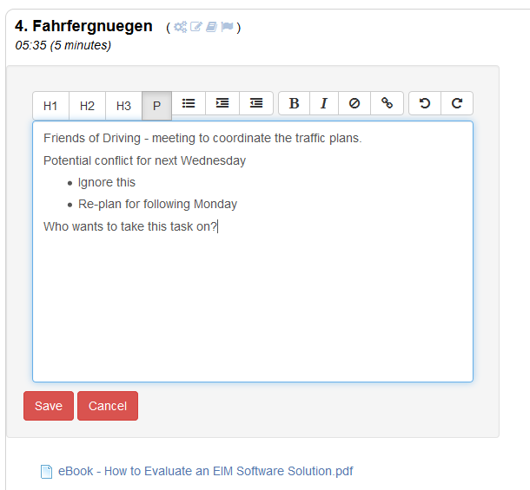
In-place Editing of Items
v

Slide 10
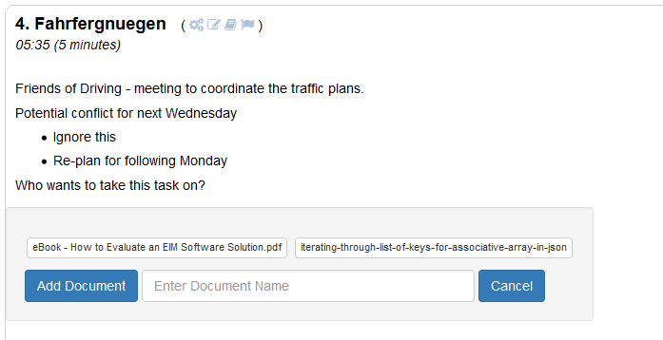
Attach Documents to Items
v

Slide 11
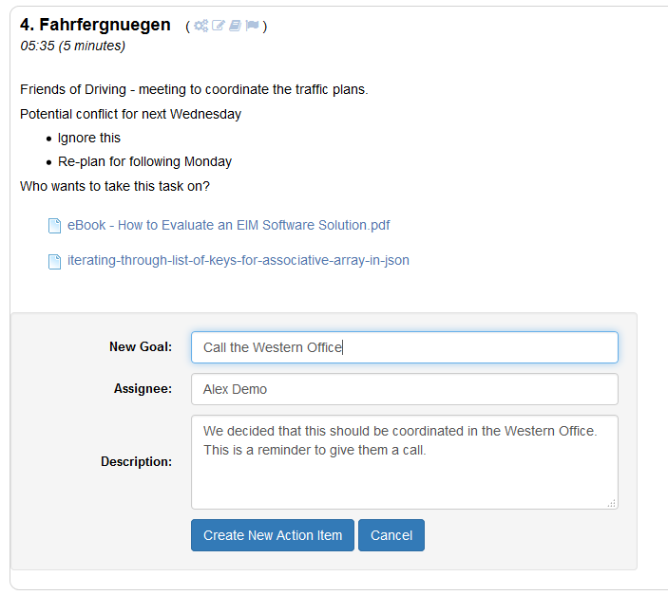
Generate Action Items in Meeting
v

Slide 12
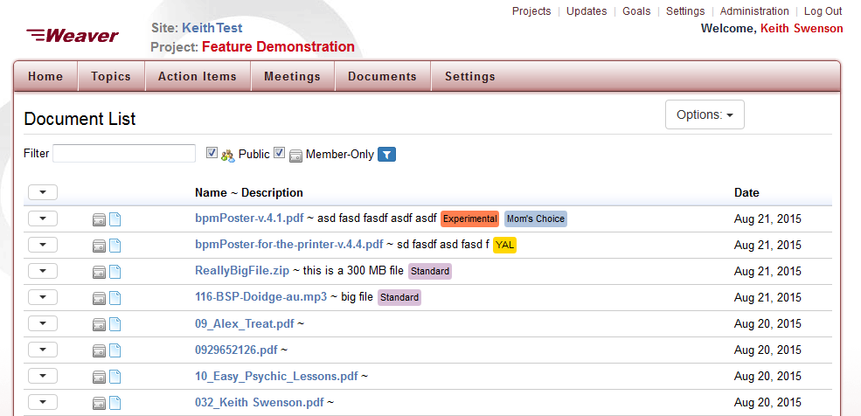
Document List Display
Colored Tags

Slide 13
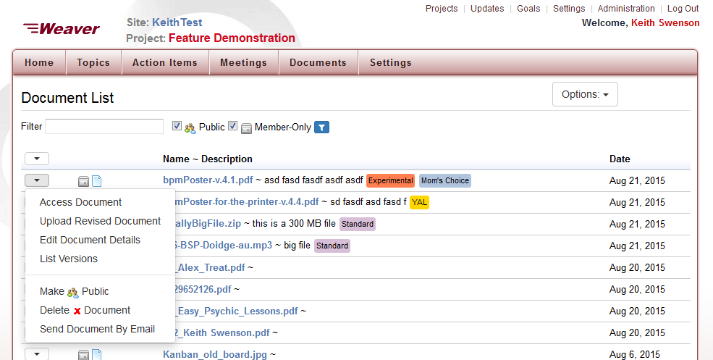
Document List Display
Clear, consistent, easier-to-user Context Menus

Slide 14
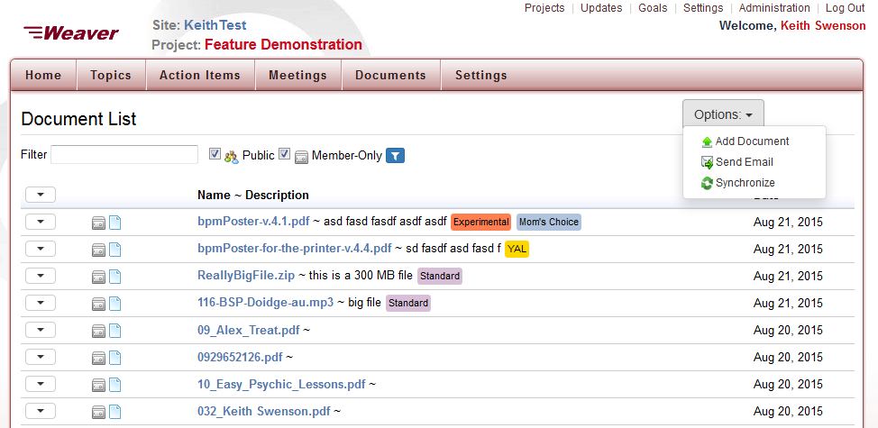
Document List Display
Convenient Options on each page

Slide 15
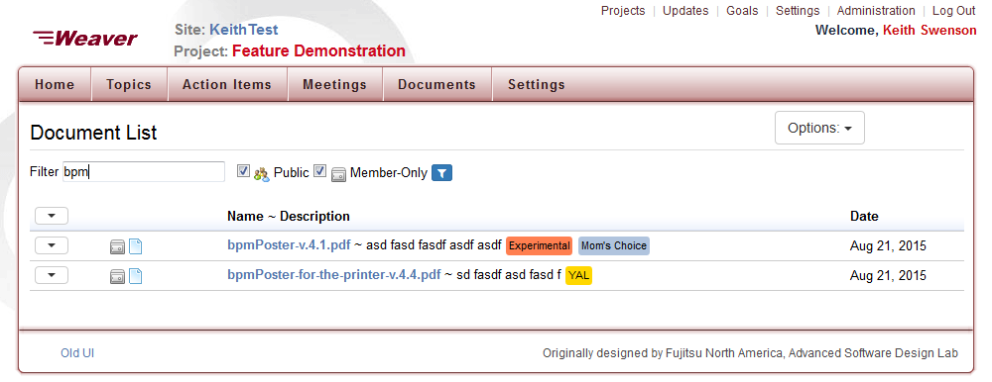
Document List Display
Instant Client-side Filtering,
type a few letters and any doc with those characters anywhere in the title or description immediately displayed

Slide 16
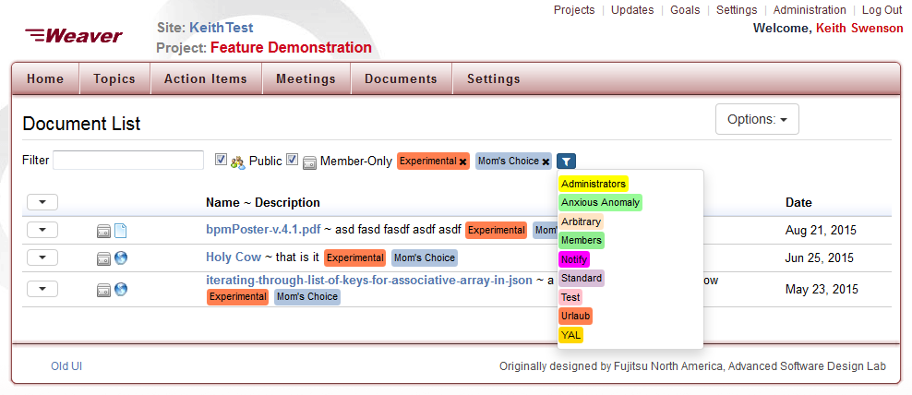
Document List Display
Instant Filtering, by tag selects all documents with that tag.

Slide 17
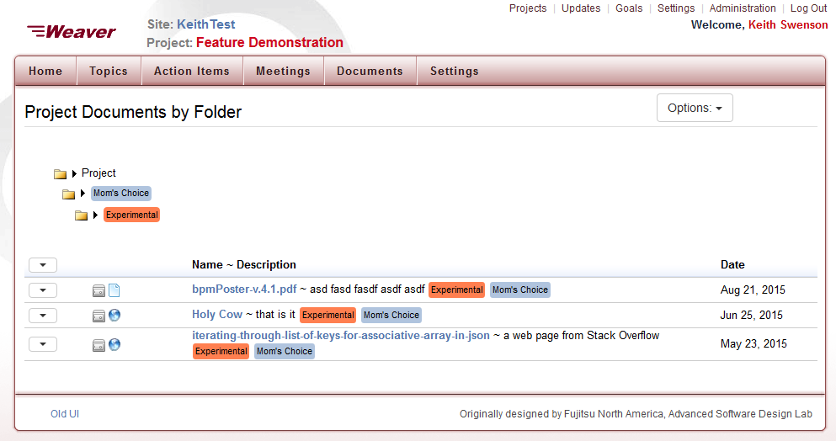
Folder-like Browsing of Tags

Slide 18
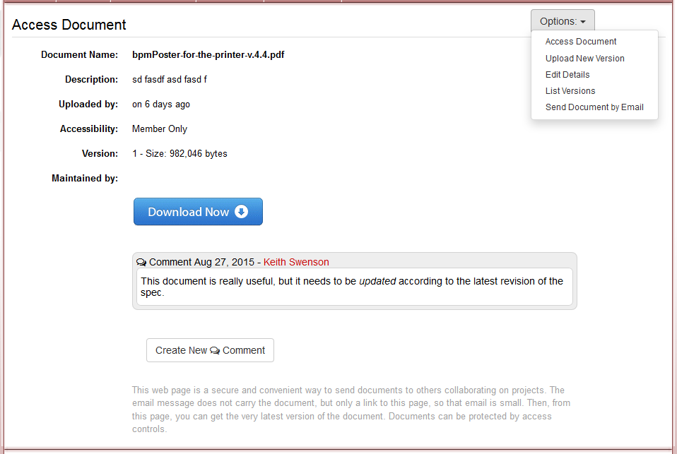
Comments on Documents

Slide 19
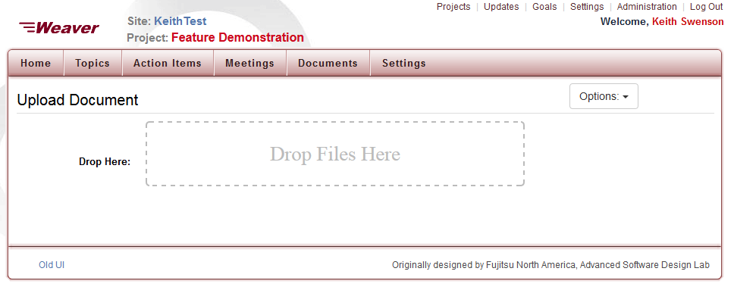
Drag-and-Drop File Upload

Slide 20
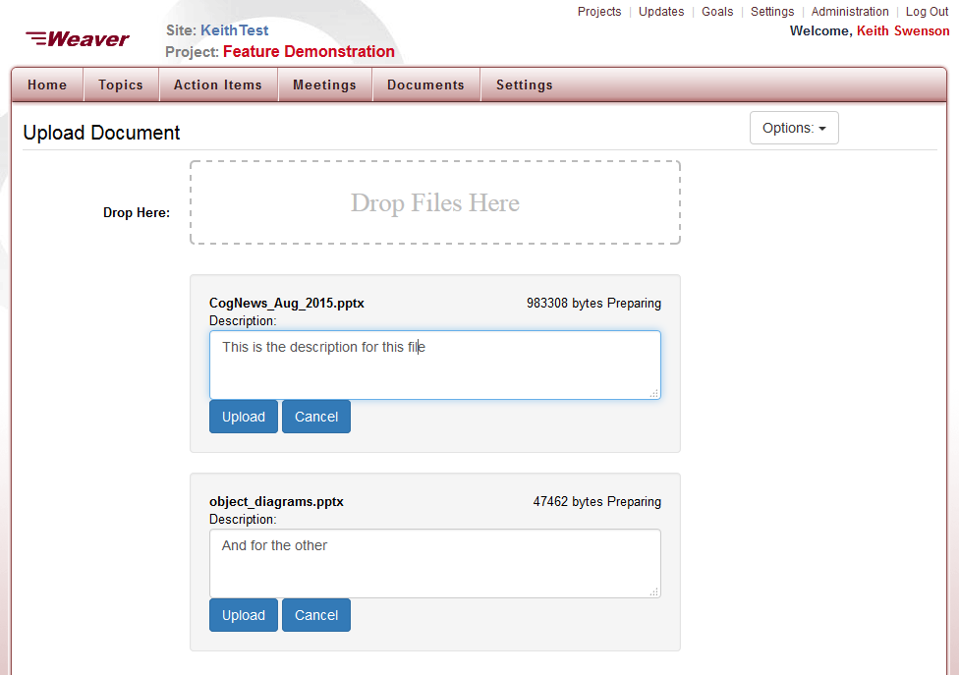
Multiple Files, Settings

Slide 21
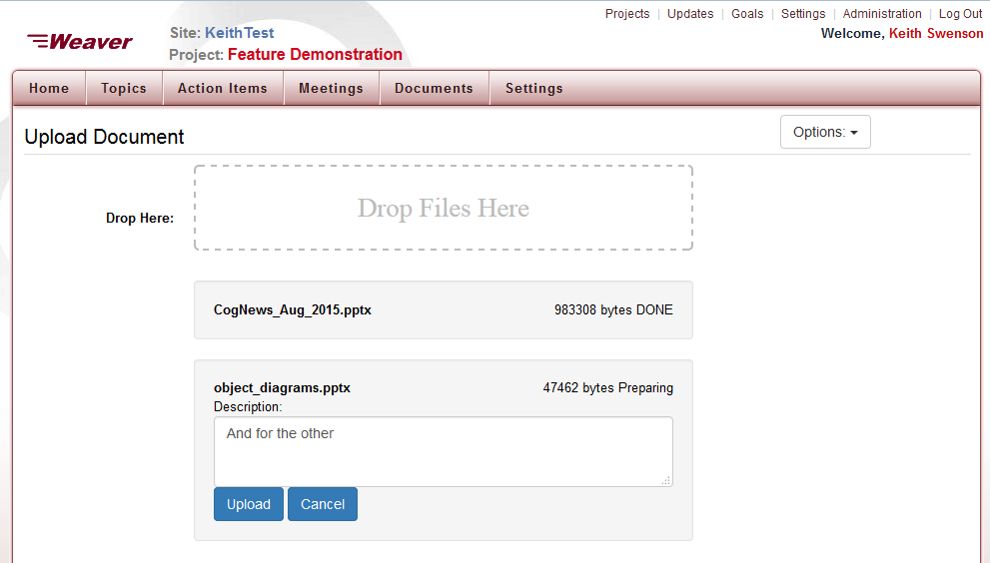
Upload Completed

Slide 22
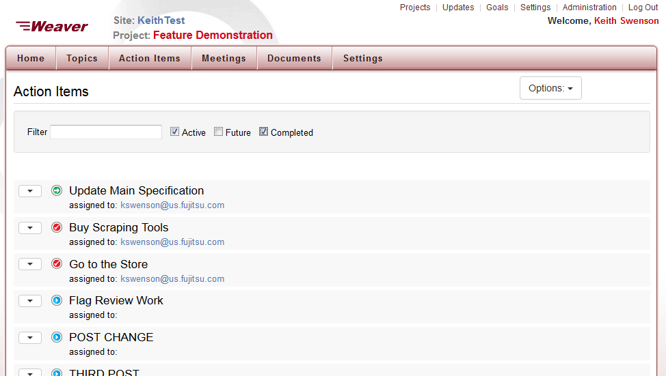
Updated Action Item List
Instant Client-side Filtering

Slide 23
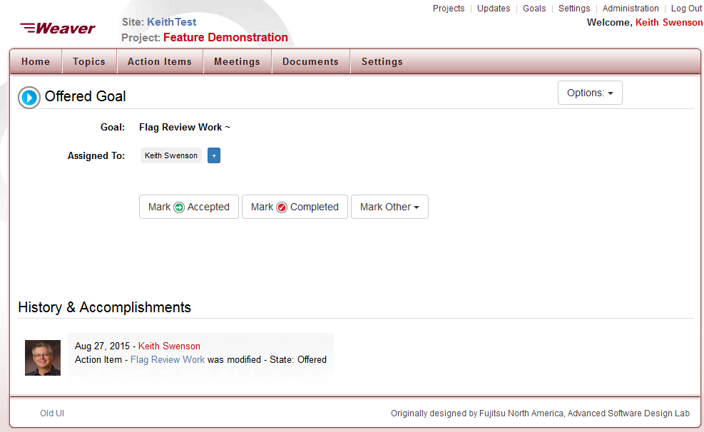
Simplified, Clean UI

Slide 24
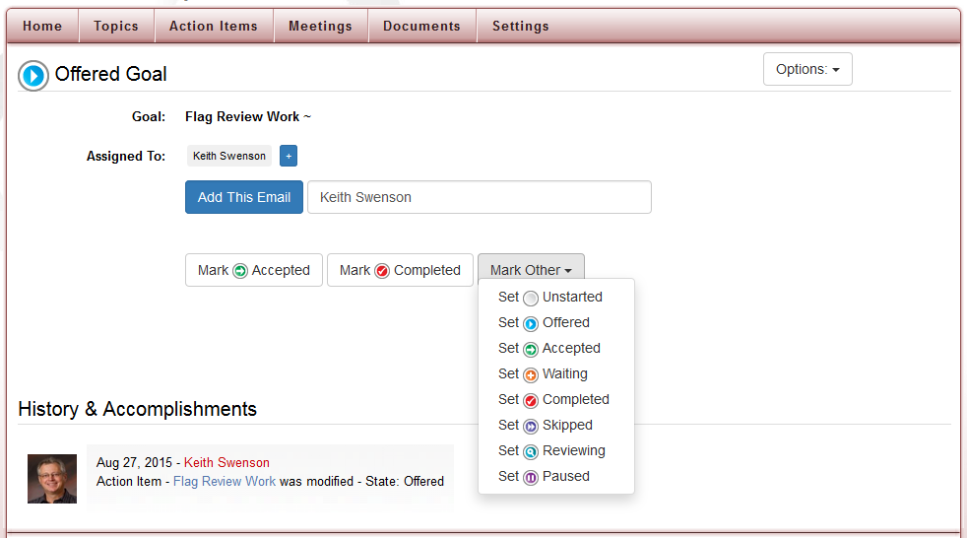

Slide 25
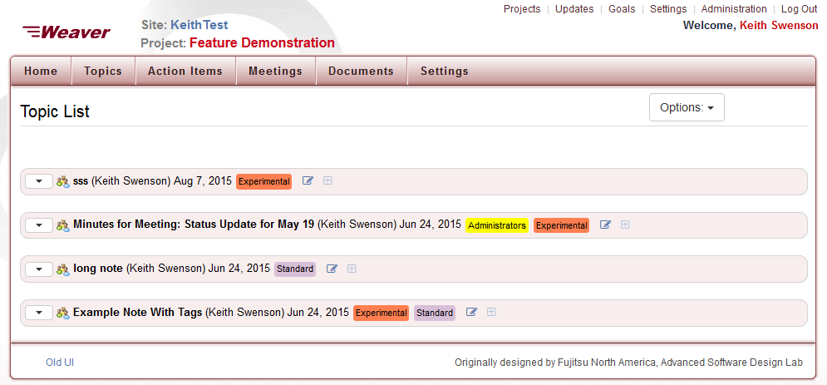
Notes are now “Topics”

Slide 26
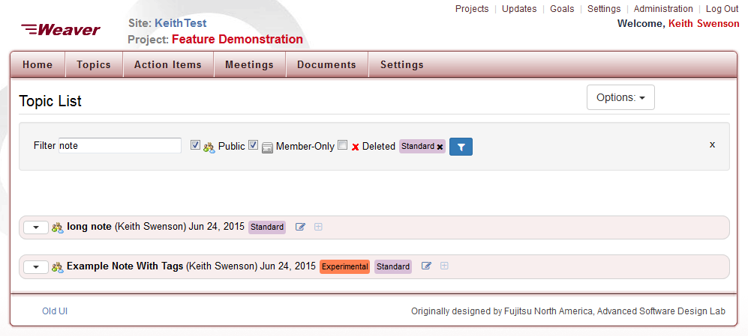
Filtered Topics
Instant Client-side Filtering
By text, and by tag

Slide 27
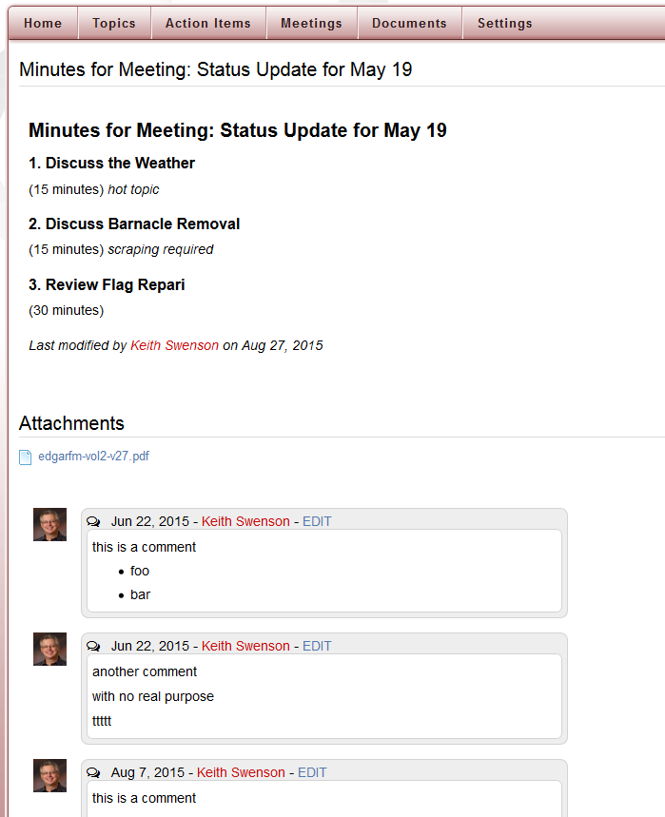
Topics have:
Notes Section
Attachment Docs
Comments and
Proposals

Slide 28
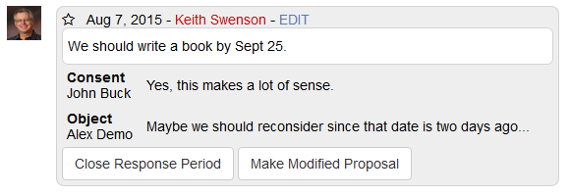
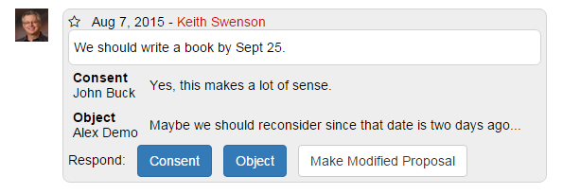
Request / response proposals
Proposer sees:
Based on the principle of gaining consensus, and not voting.
Others see:

Slide 29
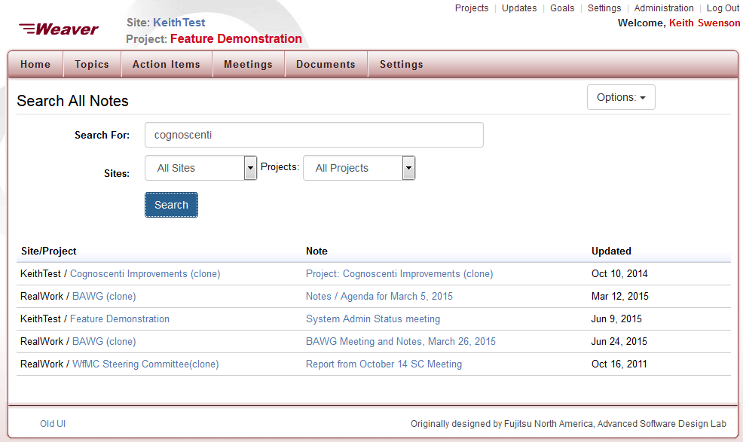
Search for any note, anywhere

Slide 30
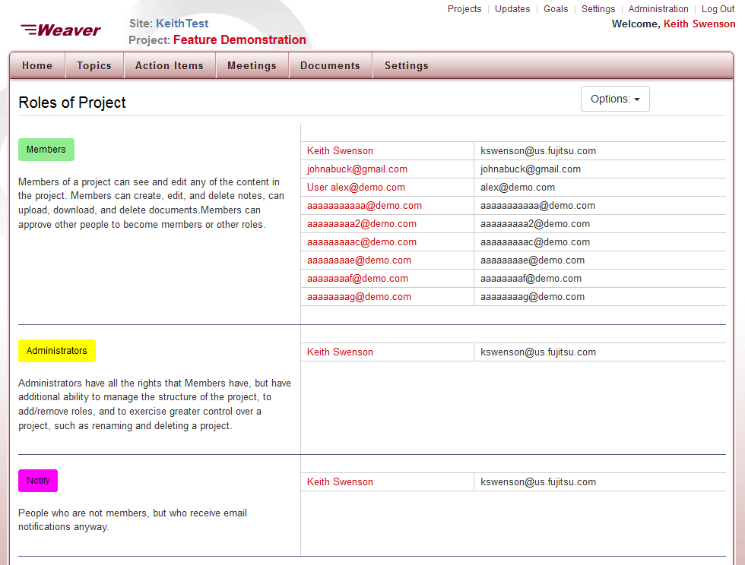
Manage Permissions

Slide 31
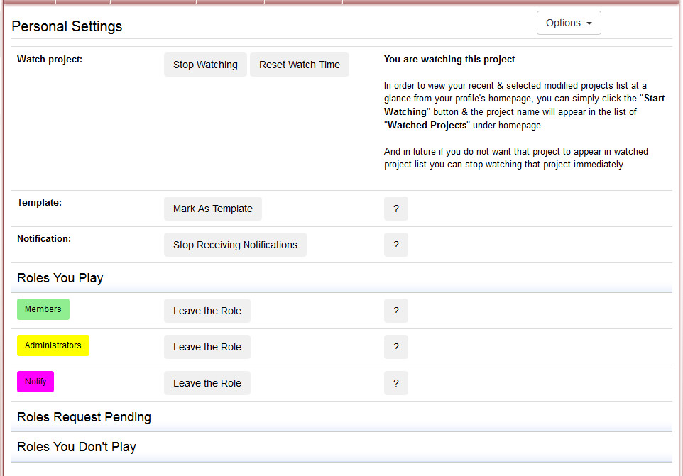
Personal Settings

Slide 32
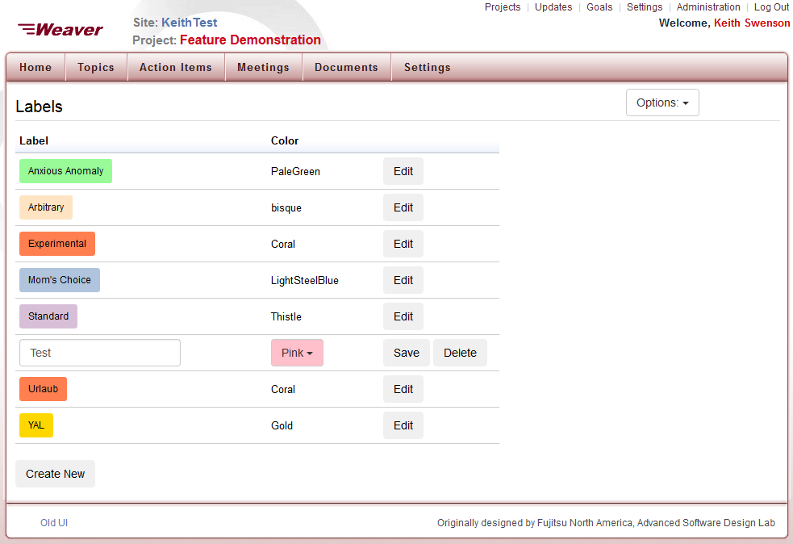
Manage Colored Tags

