Slide 1
App-PET-ite

Slide 2
Component List
Analog Water Sensor
Analog to Digital converter
RFID reader and key chain
https://www.amazon.co.uk/BUYGOO-Keychain-RC522-RFID-Arduino-Raspberry/dp/B07D9C82W8/ref=sr_1_5?ie=UTF8&qid=1548691336&sr=8-5&keywords=rfid+raspberry+pi

Slide 3


Slide 4
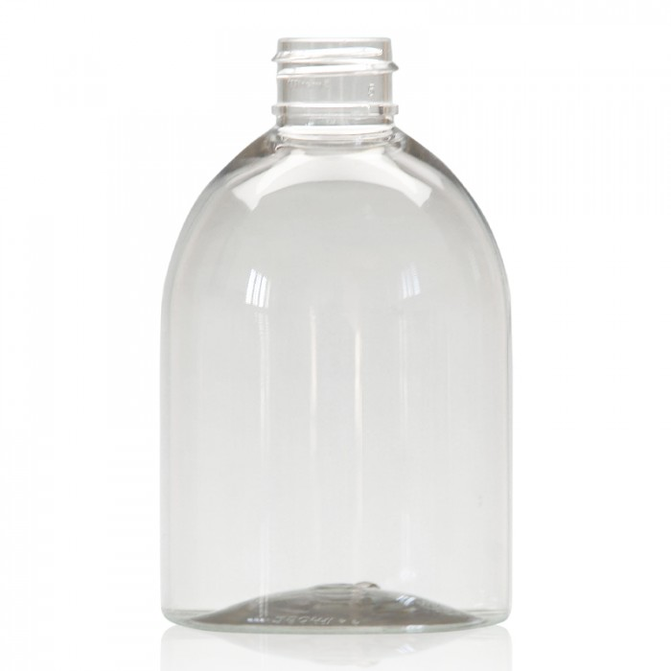
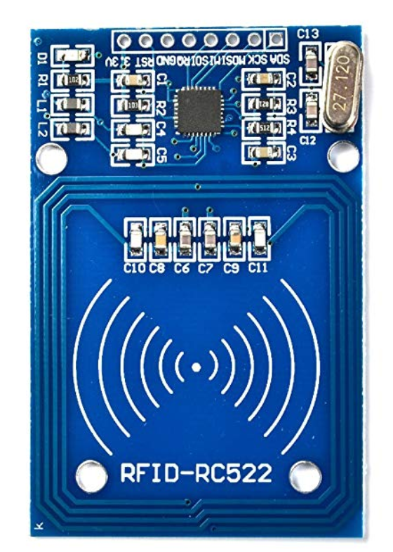
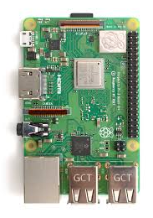



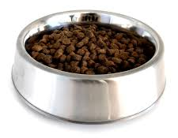
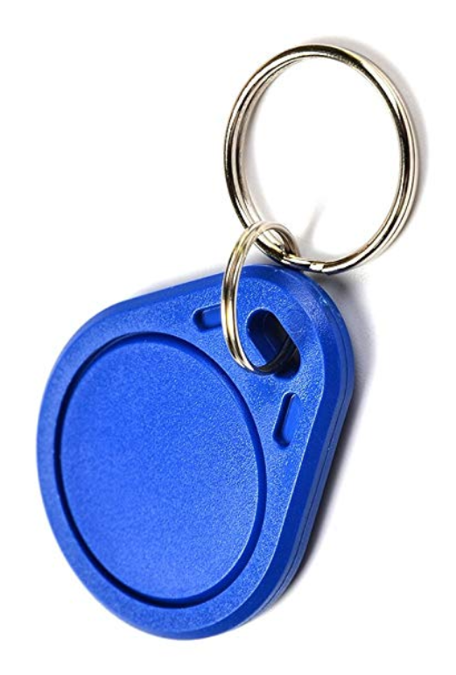
Pet Food Container
LCD Screen
RFID Receiver
Key Pad
User Interface
Pet Water Container
Motor
Water Level
Sensor
Water
Pet with RFID collar
Weight Sensor

Slide 5
