Slide 1

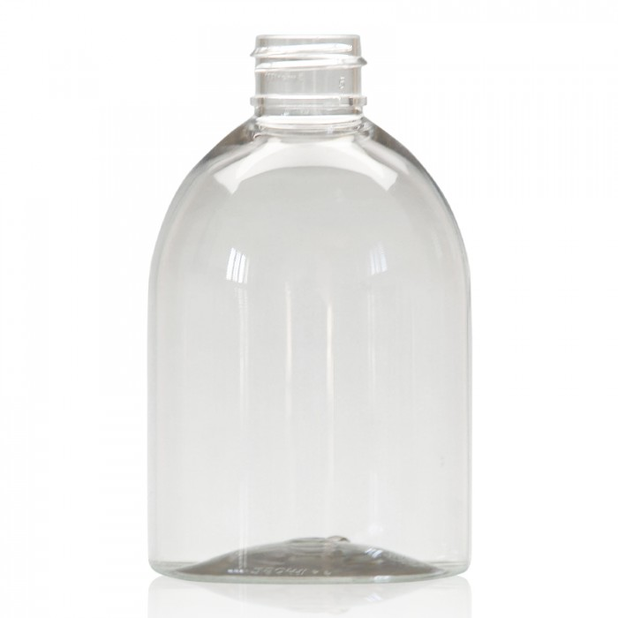
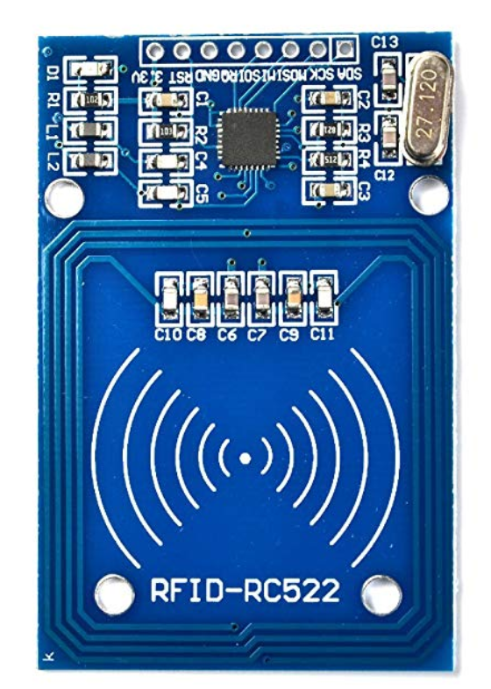
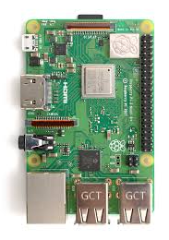




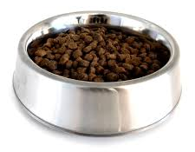
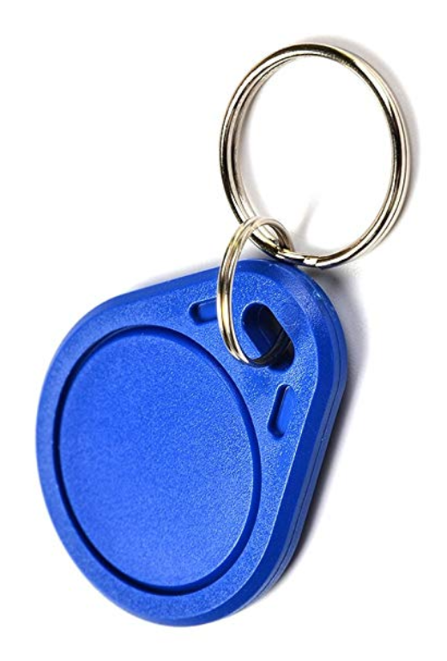
Project Overview
Pet Food
Container
LCD Screen
RFID Receiver
Key Pad
User Interface
Pet Water Container
Motor
ADC
Water Level
Sensor
Water
Pet with RFID collar
Weight Sensor

Slide 2

Project Overview
Pet Food
Container
LCD Screen
RFID Receiver
Key Pad
User Interface
Pet Water Container
Motor
ADC
Water Level
Sensor
Water
Pet with RFID collar
Weight Sensor

Slide 3

Project Overview
Pet Food
Container
LCD Screen
RFID Receiver
Key Pad
User Interface
Pet Water Container
Motor
ADC
Water Level
Sensor
Water
Pet with RFID collar
Weight Sensor

