Slide 1

MapReduce Analysis of Amazon Reviews using mrjob
 | NAME | REGISTRATION NUMBER
1. | NASSALI VICTOR | 2025/HD05/26362U
2. | NAKAZZI SOLOME | 2025/HD05/26358U
3. | SSENONO HENRY | 2025/HD05/26373U
Notes:
1

Slide 2
INTRODUCTION
Big data requires efficient processing techniques
Traditional methods cannot handle large datasets effectively
MapReduce solves this using distributed processing
Python simplifies MapReduce implementation
Notes:
2

Slide 3
ABOUT THE PROJECT
Preprocessing:
Dropped images column,
removed 51,057 duplicates,
standardized text,
engineered review_length feature,
capped helpful_vote outliers at 99th percentile (74 votes)
Approach: Load → Clean → Feature Engineering → 5 MapReduce Jobs (mrjob, Python)
Tool: Python mrjob library
Goal: Extract meaningful insights from reviews
Dataset
Amazon Software Reviews 2023 (JSONL) sourced from McAuley Lab, UCSD
Dataset Size: 4,880,181 raw reviews, 4,829,124 after cleaning
Fields: rating, title, text, asin, parent_asin, user_id, timestamp, helpful_vote, verified_purchase
Notes:
3

Slide 4
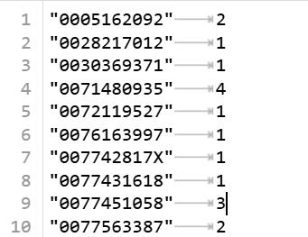
REVIEW COUNT PER PRODUCT
Solution
Mapper: extracts ASIN and emits (asin, 1)
Reducer: sums all reviews per product
Notes:
4

Slide 5
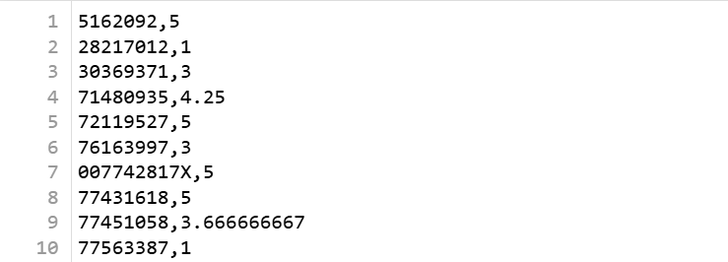
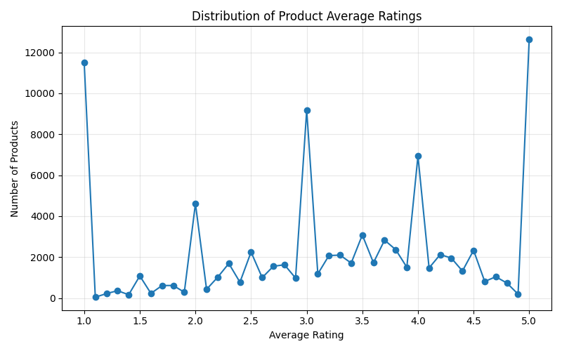
AVERAGE STAR RATING
Solution
Mapper emits (asin, rating)
Reducer computes average rating
Notes:
5

Slide 6
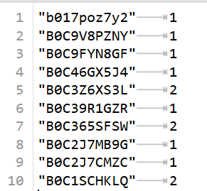
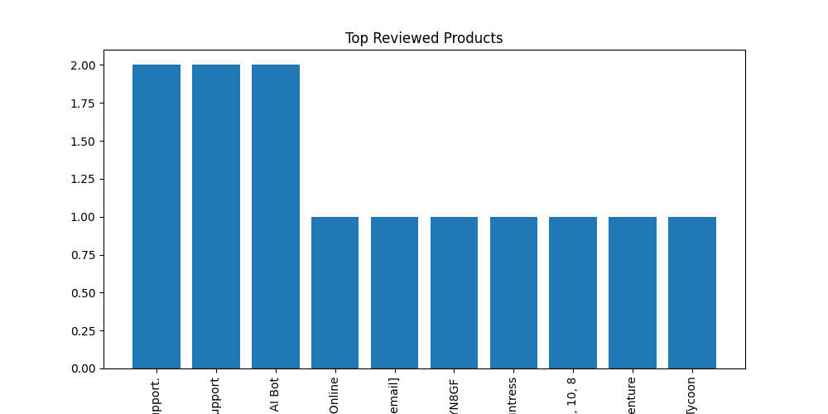
TOP 10 MOST REVIEWED PRODUCTS
Solution
Step 1: count reviews per product
Step 2: sort in descending order
Step 3: select top 10
Notes:
6

Slide 7
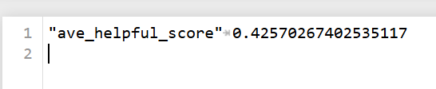
HELPFULNESS SCORE
Solution
Classify votes as helpful/unhelpful Compute ratio
Insight
Only ~42.6% of reviews are considered helpful
Indicates low review validation
Result
Notes:
7

Slide 8
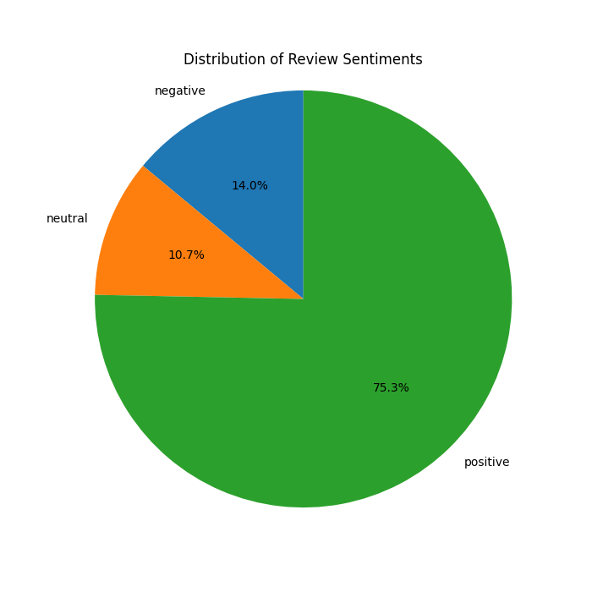

SENTIMENT ANALYSIS
Solution
Use VADER sentiment analysis Classify as positive, neutral, negative
Insight
Majority of reviews are positive
Strong customer satisfaction overall
Notes:
8

Slide 9
CONCLUSION
Implemented 5 MapReduce jobs using mrjob
Processed Amazon Reviews dataset successfully
Extracted key insights:
Product popularity
Customer ratings
Review usefulness
Sentiment trends
Notes:
9

