Slide 1
深度迁移学习
10-23
杜云涛

Slide 2
2.理论
7.理论 + 实验
8.理论 + 算法
4.算法 + 理论
6.实验 + 理论
1.实验
5.实验 + 算法
3.算法 + 实验
算法
理论
实验
1.实验
2.理论
3.算法 + 实验
4.算法 + 理论
5.实验 + 算法
6.实验 + 理论
7.理论 + 实验
8.理论 + 算法

Slide 3
2.理论
常见于STOC, FOCS 等
例子：PAC(Probably approximately correct learning) 理论 1972
7.理论 + 实验
常见于STOC,FOCS,ICML,NIPS 等。
例子：迁移学习理论2010年
8.理论 + 算法
常见于STOC,FOCS,ICML,NIPS 等。
例子：Bridging Theory and Algorithm for Domain Adaptation (龙明盛ICML 2019)
4.算法 + 理论
针对于集成学习(AdaBoost)的解释
6.实验 + 理论
1.实验
how-transferable-are-features-in-deep-neural-networks NIPS 2014
Taskonomy: Disentangling Task Transfer Learning CVPR 2018 best paper
5.实验 + 算法
Transferability vs. Discriminability: Batch Spectral Penalization for Adversarial Domain Adaptation
龙明盛 ICML 2019
3.算法 + 实验
anywhere
算法
理论
实验

Slide 4
DAN
所处背景
视频 VALSE 2019 (39:23开始）
https://www.iqiyi.com/v_19rsjxgml0.html
实验数据集
https://people.eecs.berkeley.edu/~jhoffman/domainadapt/

Slide 5
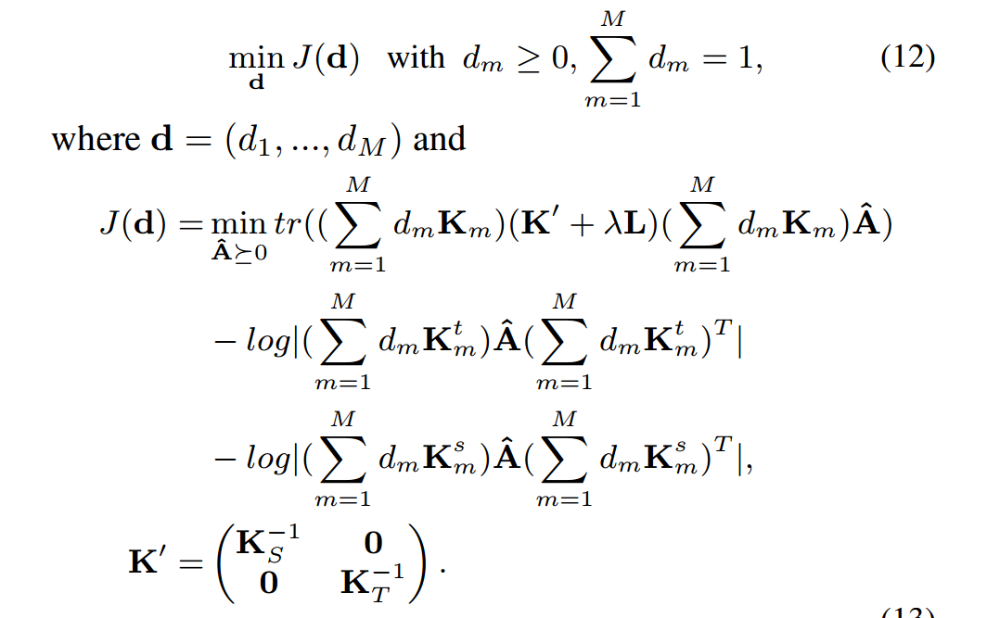
DAN – MK-MMD
TCA + 源域重构损失+目标域重构损失
Transfer Feature Representation via Multiple Kernel Learning AAAI 2015

Slide 6
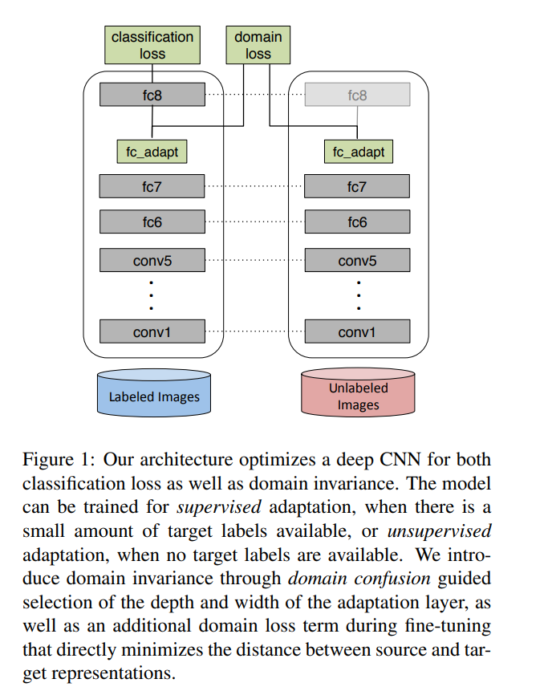
DAN – 参考
DDC

Slide 7
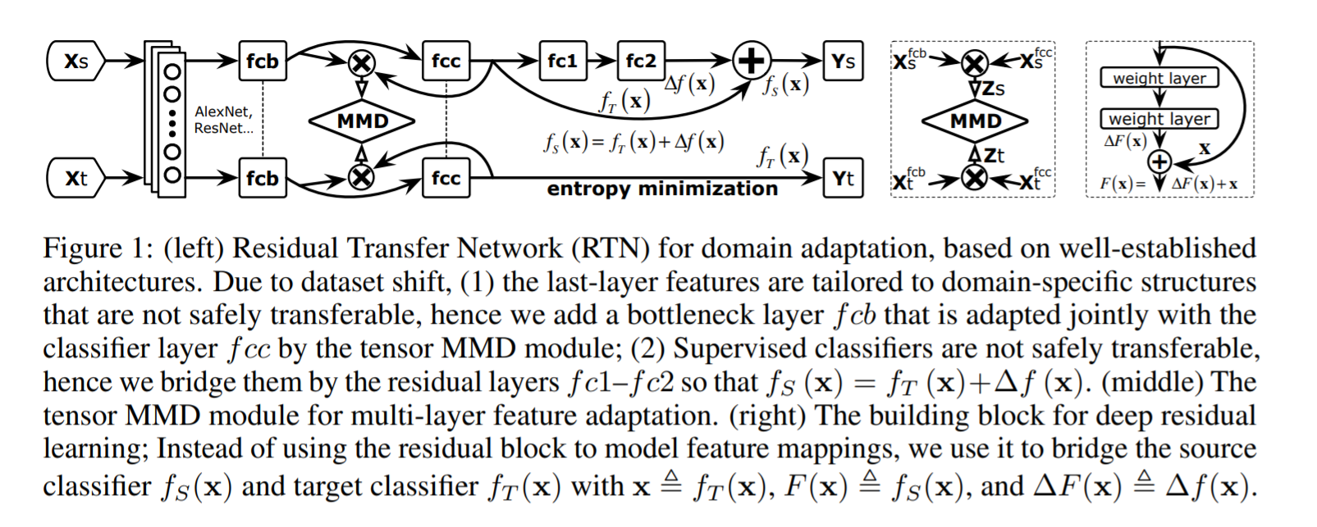
DAN – 后续1
RTN
Unsupervised Domain Adaptation with Residual Transfer Networks NIPS 2016

Slide 8
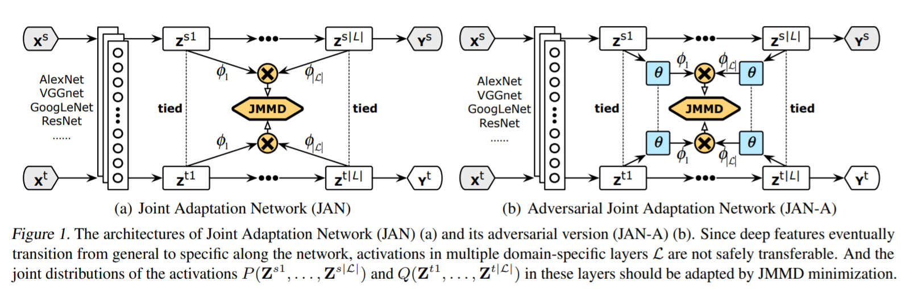
DAN – 后续2
JAN
Deep Transfer Learning with Joint Adaptation Networks ICML 2017

Slide 9
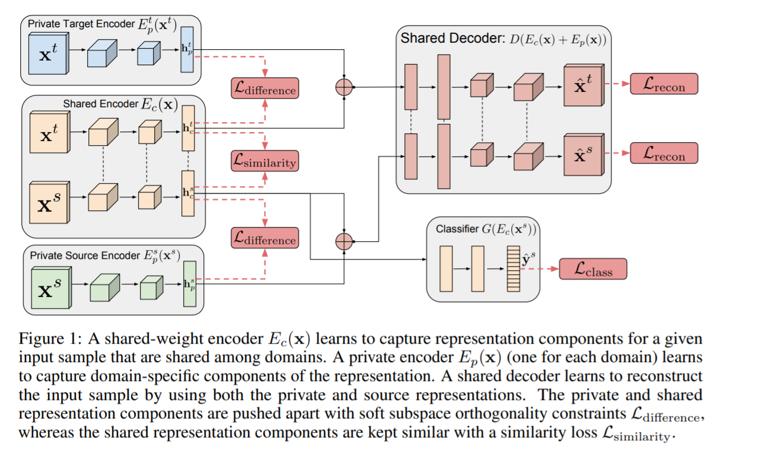
DAN – 后续4
DSN
Domain Separation Networks NIPS 2016

Slide 10
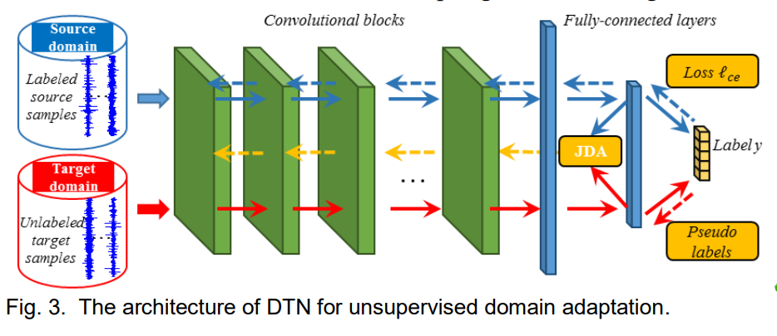
DAN – 后续5
JAN
https://arxiv.org/ftp/arxiv/papers/1804/1804.07265.pdf
More in survey

Slide 11
5.科研方法论
结果 = 方法 X 努力 X 正确方向 X 运气 X …
科研能力：
阅读论文：
Idea：
数学基础：
论文写作：
…

Slide 12
5.科研方法论
科研能力：
https://www.zhihu.com/question/60042037/answer/172675665
https://www.zhihu.com/question/317077307/answer/631104926
https://weibo.com/3235040884/I2yOmyHZS?type=comment
https://mp.weixin.qq.com/s/xF2MbV0ZbAMxTcHVrpjRZQ
https://weibo.com/3480913290/HwqNcjYLL?type=comment#_rnd1572160804797
https://weibo.com/3710258141/HrUIWEWCT?type=comment
https://blog.csdn.net/m0_37306360/article/details/101187597
阅读论文：
https://weibo.com/6660835434/IadQTgEfk?type=comment#_rnd1572159727500
Idea:
https://weibo.com/1401527553/I7sHh5e7n?type=comment#_rnd1572160157794

Slide 13
5.科研方法论
数学基础：
https://weibo.com/5819320755/HFH59qkk3?type=comment
论文写作：
https://weibo.com/1898112181/HkZdk0nfK?type=comment#_rnd1572161039795
https://weibo.com/1919289643/GigofbnM8?type=comment

Slide 14
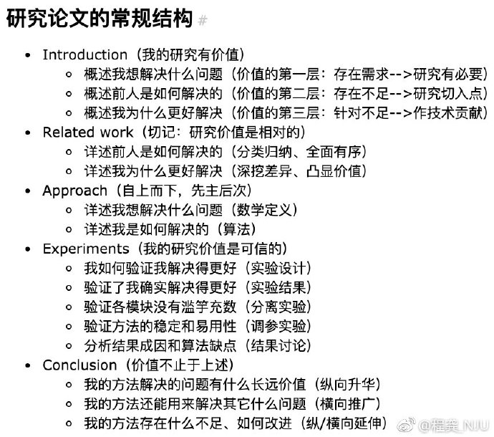
5.科研方法论
论文写作：
https://weibo.com/1898112181/HkZdk0nfK?type=comment#_rnd1572426978791

Slide 15
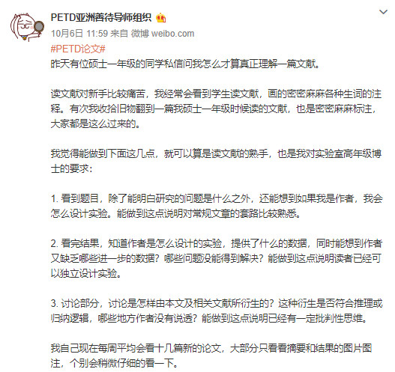
5.科研方法论
阅读论文：
https://weibo.com/6660835434/IadQTgEfk?type=comment#_rnd1572159727500

Slide 16
1.经典域适应方法
2.域适应理论
3.深度网络域适应
4.对抗网络域适应
[1]. TCA (2010)
[2]. JDA (2013) w1
[3]. BDA (2017) w1
[4]. 2006年 w2
[5]. 2010年 w2
[6]. 龙明盛博士论文第三章 (2014) w3
[8]. 实验文章 (2013) w4
[9]. DAN (2014) w4
[10]. JMMD (2017) w5
[11]. GAN (2014) w6
[12]. DANN (2014) w6
[13]. MCD (2018) w7
[7]. MDD (2019) w7
注：
1.阅读顺序为1-2-3-4 or 1-3-2-4
2.相邻的相同颜色论文安排在同一周
3.标红的文章表示需要进行实验

Slide 17
1.经典域适应方法
2.域适应理论
3.深度网络域适应
4.对抗网络域适应
[1]. TCA (AAAI 2010) w0
[2]. JDA (ICCV 2013) w1
[3]. BDA (ICDM 2017) w1
[4]. (NISP) 2006年 w7
[5]. (ML) 2010年 w7
[6]. 龙明盛博士论文第三章 (2014) w9
[7]. MDD (ICML 2019) w10
[8]. 实验文章 (NIPS 2014) w3
[9]. DAN (ICML 2015) w3
[10]. JMMD (ICML 2017) w9
[11]. GAN (NIPS 2014) w6
[12]. DANN (ICML 2014) w8
[13]. MCD (CVPR 2018) w8
Free 1 w4
[add_1]. MMCD (NPL 2019) w2
[add_2]. ARTL (TKDE 2014) w2
[add_3]. ACE(ICME 2019) w2
[add_4]. AlexNet (NIPS 2012) w5
[add_5]. VGG (CVPR 2014) w5
[add_6]. ResNet (CVPR 2015) w5
[add_7]. WGAN (ICML 2017) w6

Slide 18
[1] Pan, S. J., Tsang, I. W., Kwok, J. T., and Yang, Q. Domain adaptation via transfer component analysis. IEEE Transactions on Neural Networks and Learning Systems, 22(2):199–210, 2011.
[2] Long, M., Wang, J., Ding, G., Sun, J., and Yu, P. S. Transfer feature learning with joint distribution adaptation. In ICCV, 2013.
[3] J. Wang, Y. Chen, S. Hao, W. Feng, and Z. Shen, “Balanced distribution adaptation for transfer learning,” in ICDM 2017, 2017, pp. 1129–1134.
[4] Ben-David, S., Blitzer, J., Crammer, K., and Pereira, F. Analysis of representations for domain adaptation. NIPS, 2007.
[5] S. Ben-David, J. Blitzer, K. Crammer, A. Kulesza, F. Pereira, and J. W. Vaughan, “A theory of learning from different domains,” Machine Learning, vol. 79, no. 1-2, pp. 151–175, 2010.
[6] 龙明盛，迁移学习问题与方法研究
[7] Bridging Theory and Algorithm for Domain Adaptation ICML 2019
[8] J. Yosinski, J. Clune, Y. Bengio, and H. Lipson, “How transferable are features in deep neural networks?” in NIPS 2014, pp. 3320–3328.

Slide 19
[9] M. Long, Y. Cao, J. Wang, and M. I. Jordan, “Learning transferable features with deep adaptation networks,” in ICML 2015, pp. 97–105.
[10] M. Long, H. Zhu, J. Wang, and M. I. Jordan, “Deep transfer learning with joint adaptation networks,” in ICML 2017, pp. 2208–2217.
[11]Goodfellow, I., Pouget-Abadie, J., Mirza, M., Xu, B., Warde-Farley, D., Ozair, S., Courville, A., and Bengio, Y. Generative adversarial nets. In Advances in Neural Information Processing Systems (NeurIPS), 2014.
[12-1] Ganin, Y. and Lempitsky, V. Unsupervised domain adaptation by backpropagation. In International Conference on Machine Learning (ICML), 2015. Ganin, Y., Ustinova, E.,
[12-2 ]Ajakan, H., Germain, P., Larochelle, H., Laviolette, F., Marchand, M., and Lempitsky, V. Domain-adversarial training of neural networks. Journal of Machine Learning Research (JMLR), 17:2096–2030, 2016.
[13]Saito, K., Watanabe, K., Ushiku, Y., and Harada, T. Maximum classifier discrepancy for unsupervised domain adaptation. In IEEE Conference on Computer Vision and Pattern Recognition (CVPR), pp. 3723–3732, 2018.

Slide 20
[add_1] Zhang, Wenju et al. “Maximum Mean and Covariance Discrepancy for Unsupervised Domain Adaptation.” Neural Processing Letters (2019): 1 - 20.
[add_2] Long, Mingsheng et al. “Adaptation Regularization: A General Framework for Transfer Learning.” IEEE Transactions on Knowledge and Data Engineering 26 (2014): 1076-1089.
[add_4] Krizhevsky, Alex et al. “ImageNet Classification with Deep Convolutional Neural Networks.” Commun. ACM 60 (2012): 84-90.
[add_5] Simonyan, Karen and Andrew Zisserman. “Very Deep Convolutional Networks for Large-Scale Image Recognition.” CoRR abs/1409.1556 (2014): n. pag.
[add_6] He, Kaiming et al. “Deep Residual Learning for Image Recognition.” 2016 IEEE Conference on Computer Vision and Pattern Recognition (CVPR) (2015): 770-778.
[add_7] Arjovsky, Martín et al. “Wasserstein GAN.” ArXiv abs/1701.07875 (2017): n. pag.

