Slide 1
0. 发展脉络
[1] ML : loss + 正则项
[2] ML: loss + 正则化 + 流形假设
[3] TL: loss + 正则化 + 边缘MMD
[4] TL: loss + 正则项 + 边缘MMD + 图正则
[5] TL: loss + 正则项 + 边缘MMD + 条件MMD + 图正则
[1] Schölkopf, Bernhard et al. “A Generalized Representer Theorem.” COLT/EuroCOLT (2001).
[2] Belkin, Mikhail et al. “Manifold Regularization: A Geometric Framework for Learning from Labeled and Unlabeled Examples.” J. Mach. Learn. Res. 7 (2006): 2399-2434.
[3] Quanz, Brian and Jun Huan. “Large margin transductive transfer learning.” CIKM (2009).
[4] Xiao, Min and Yuhong Guo. “Semi-Supervised Kernel Matching for Domain Adaptation.” AAAI (2012).
[5]Long, Mingsheng et al. “Adaptation Regularization: A General Framework for Transfer Learning.” IEEE Transactions on Knowledge and Data Engineering 26 (2014): 1076-1089.

Slide 2
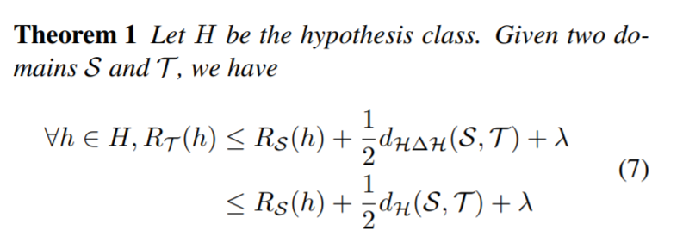
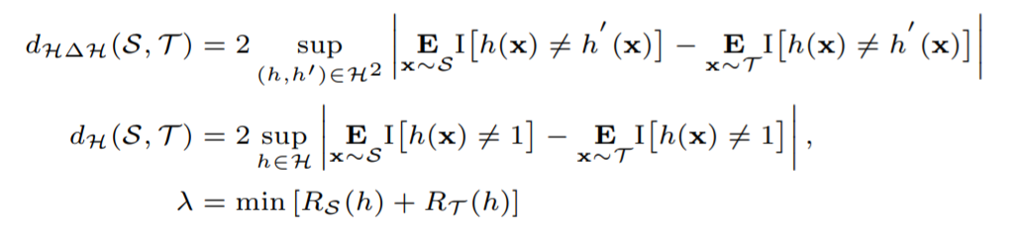
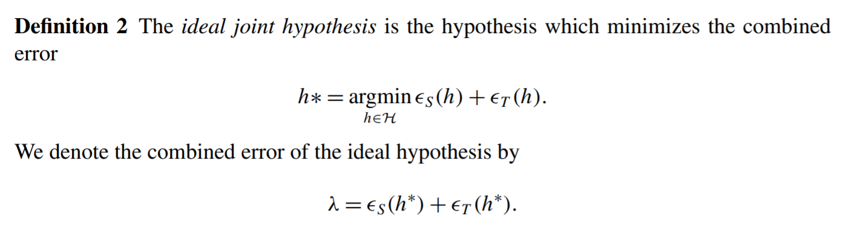
2.理论指导
Ben-David, Shai et al. “A theory of learning from different domains.” Machine Learning 79 (2009): 151-175.

Slide 3
2.理论指导
Ben-David, Shai et al. “A theory of learning from different domains.” Machine Learning 79 (2009): 151-175.

Slide 4
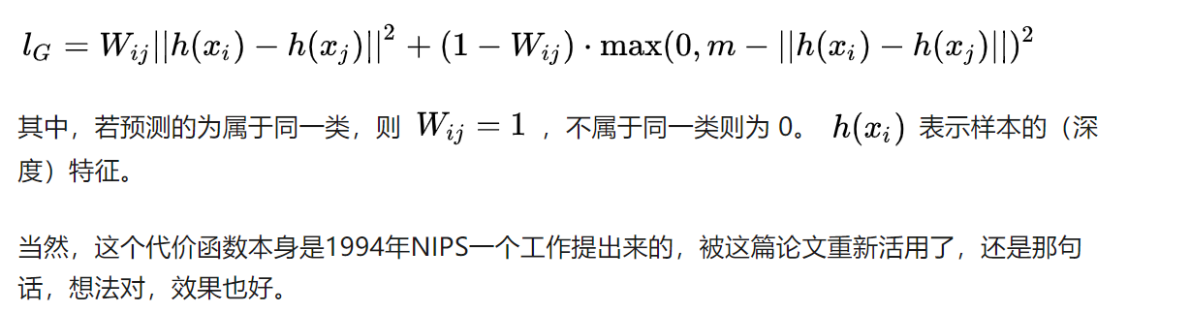
1.SSL 正则
Belkin, Mikhail et al. “Manifold Regularization: A Geometric Framework for Learning from Labeled and Unlabeled Examples.” J. Mach. Learn. Res. 7 (2006): 2399-2434.

Slide 5
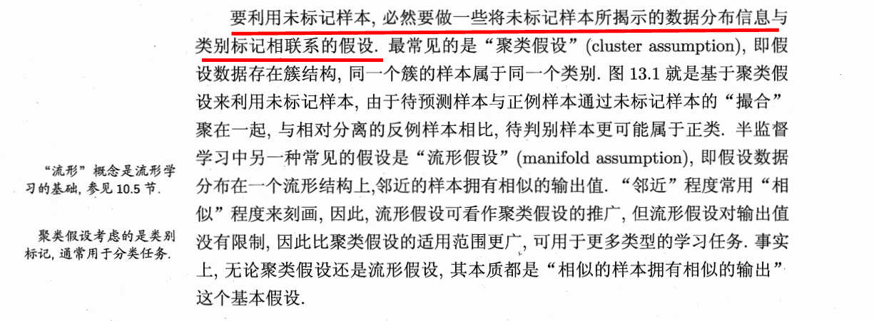
1.SSL 正则
《机器学习》 第13章 周志华

Slide 6
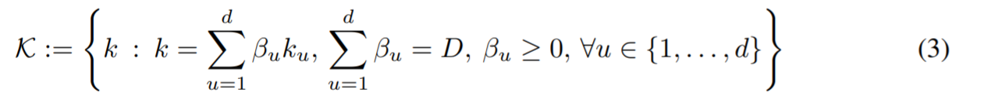
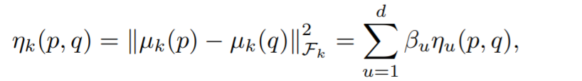
3.MK-MMD
Gretton, A., Sriperumbudur, B., Sejdinovic, D., Strathmann, H., Balakrishnan, S., Pontil, M., and Fukumizu, K. Optimal kernel choice for large-scale two-sample tests. In NIPS, 2012b.
Long, Mingsheng et al. “Learning Transferable Features with Deep Adaptation Networks.” ICML (2015).

Slide 7
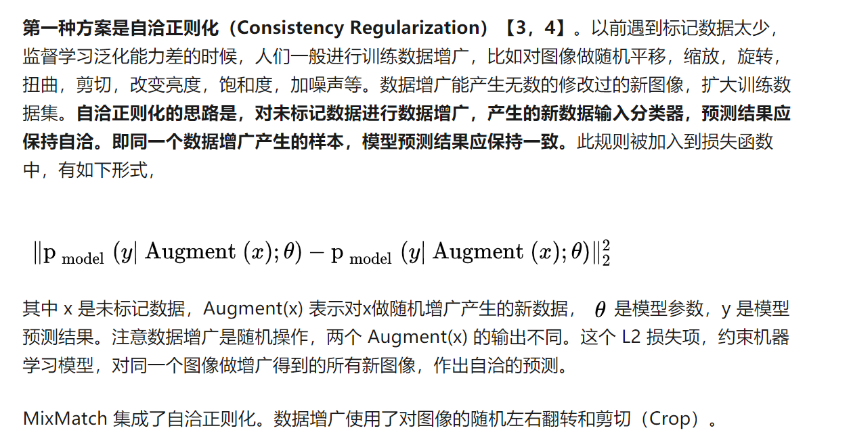
4.SSL 正则 -1
Berthelot, David et al. “MixMatch: A Holistic Approach to Semi-Supervised Learning.” ArXiv abs/1905.02249 (2019): n. pag.

Slide 8
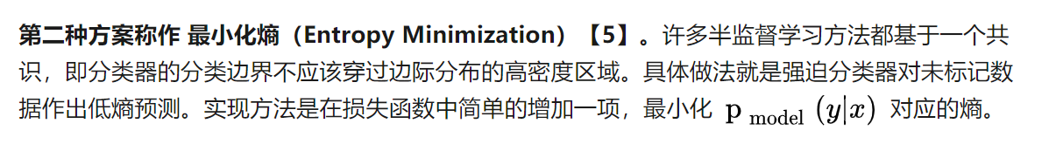
4.SSL 正则 -2
Berthelot, David et al. “MixMatch: A Holistic Approach to Semi-Supervised Learning.” ArXiv abs/1905.02249 (2019): n. pag.

Slide 9
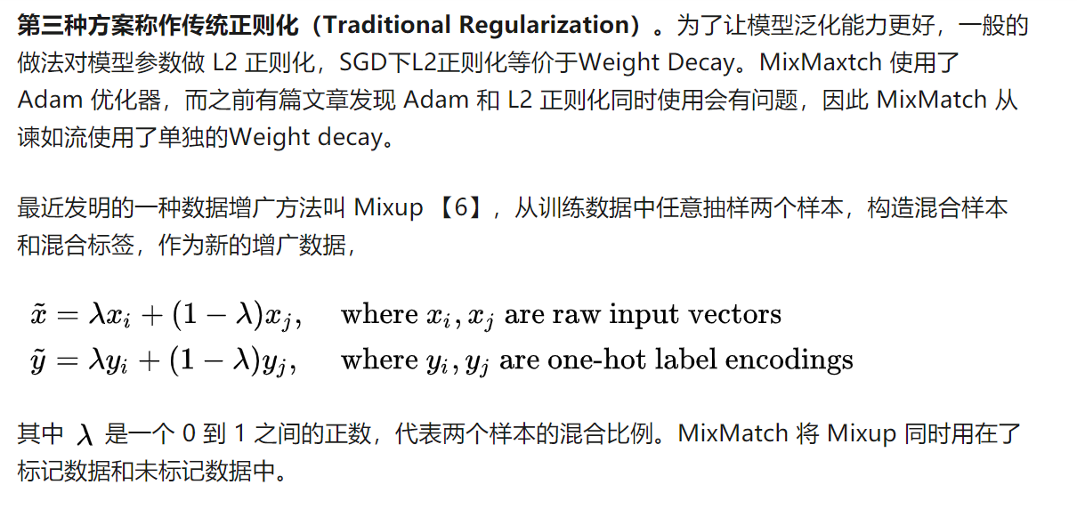
4.SSL 正则 -3
Berthelot, David et al. “MixMatch: A Holistic Approach to Semi-Supervised Learning.” ArXiv abs/1905.02249 (2019): n. pag.

Slide 10
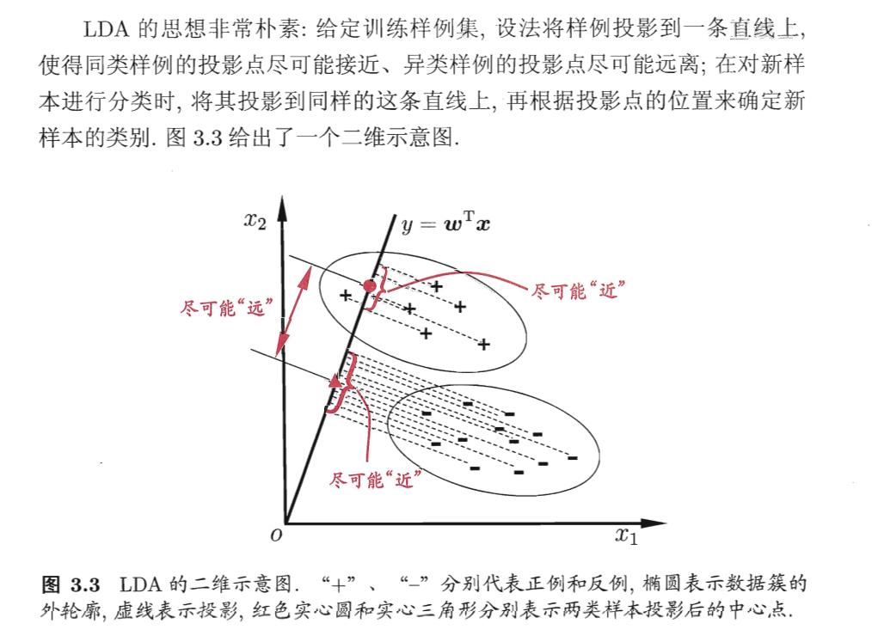
5.LDA 假设
《机器学习》 第三章 周志华

Slide 11
6. 迁移学习 vs 半监督学习
半监督学习：存在少量的有标签数据，以及大量的无标签数据，
基本假设：有标签数据和无标签数据服从相同数据分布。
无监督域适应：源域中存在大量的有标签数据，目标域中存在大量的无标签数据，
基本假设：源域和目标域服从不同数据分布。
《机器学习》 第三章 周志华

Slide 12
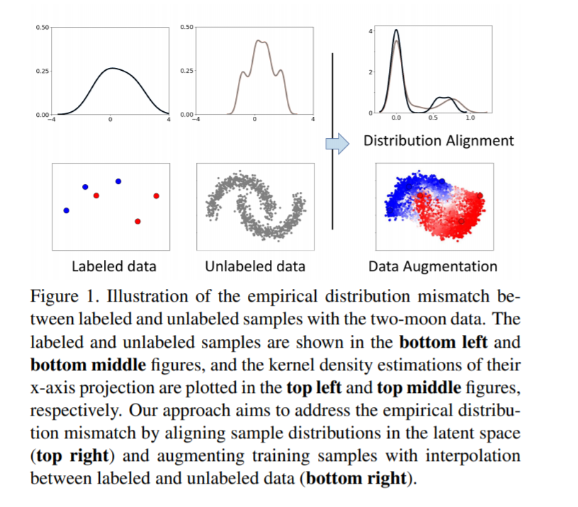
6. 迁移学习 vs 半监督学习
Wang, Qin et al. “Semi-Supervised Learning by Augmented Distribution Alignment.” ArXiv abs/1905.08171 (2019): n. pag.

Slide 13
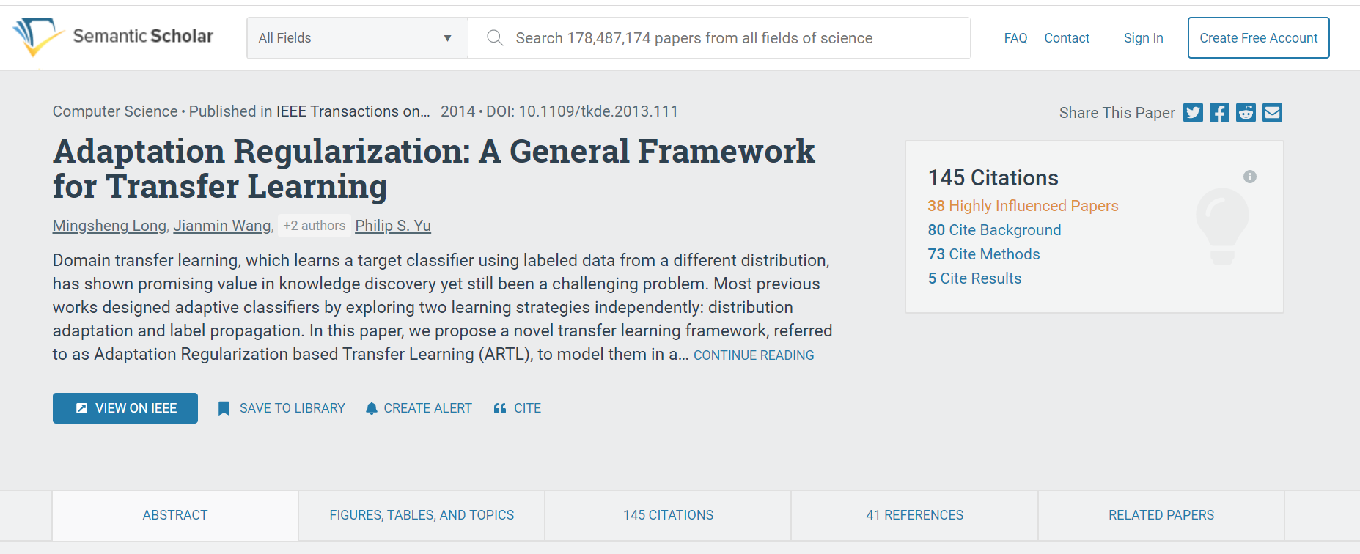
7. 论文索引
https://www.semanticscholar.org/

