Slide 1
How transferable are features in deep neural networks?
Jason Yosinski, Jeff Clune, Yoshua Bengio, and Hod Lipson

Slide 2
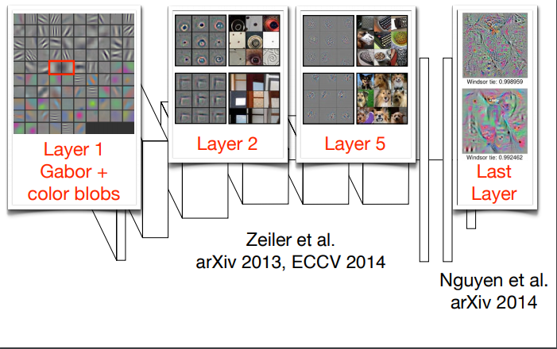
Background & Motivation
Many deep neural networks trained on natural images exhibit a curious phenomenon in common: on the first layer they learn features similar to Gabor filters and color blobs. Such first-layer features appear not to be specific to a particular dataset or task, but general in that they are applicable to many datasets and tasks.

Slide 3
Background & Motivation
general vs specific
Can we quantify the degree to which a particular layer is general or specific?
Does the transition occur suddenly at a single layer, or is it spread out over several layers?
Where does this transition take place: near the first, middle, or last layer of the network?

Slide 4
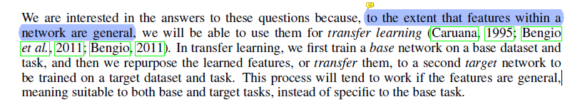
Transfer Learning
Transferring knowledge from one area to another (usually related) domain/problem
怎么确定神经网络中某一层的可迁移性?
在一个数据集上训练得到的网络的特征层，能迁移到在另一个数据集上训练的网络吗？

Slide 5
The paper work
In this paper we experimentally quantify the generality versus specificity of neurons in each layer of a deep convolutional neural network
首先定义了一组特征的通用程度
In this study, we define the degree of generality of a set of features learned on task A as the extent to which the features can be used for another task B. It is important to note that this definition depends on the similarity between A and B.

Slide 6
Dataset
ImageNet
1000 classes
~1.2 million images, 50,000 test images
Images organized in hierarchal manner
构造在ImageNet数据集上不重叠的子集对儿，来创建分类任务A和B
Notes:
ImageNet含有1000类，分成A和b两部分,各含有500个类

Slide 7
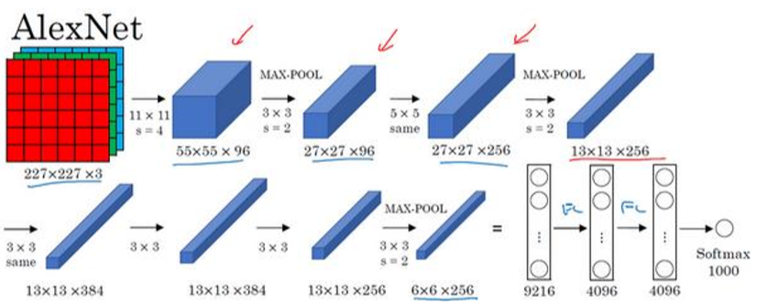
Network Architecture
AlexNet
8 layers CNN
Implemention on Caffe

Slide 8
Experiment 1: Similar Datasets
Random 50-50 A/B splits of ImageNet classes
Networks Trained
BaseA: Trained on set A
BaseB: Trained on set B
BnB/BnB+: Trained on set B, then transferred first n layers and retrained on set B.
AnB/AnB+: Trained on set A, then transferred first n layers and retrained on set B.
– Plus superscript indicates transferred layers were fine-tuned on new dataset.

Slide 9
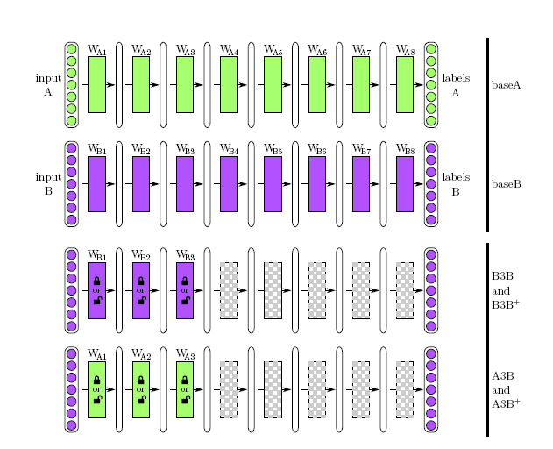
Network

Slide 10
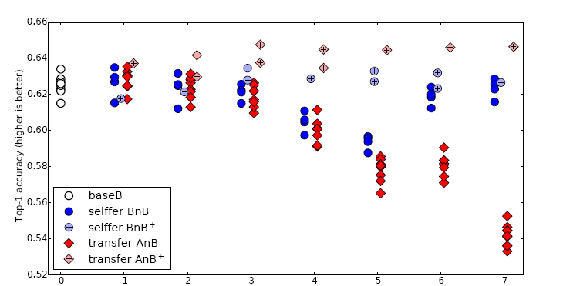
Results
performance drop
the drop from lost co-adaptation
drop from features that are less and less general.
Notes:
BnB 4 5层最差 存在co-adaptation 78层 需要学习的层变少 优化困难在网络中间最难
BnB+ fine-tune可以防止co-adaptation导致的性能下降
AnB 前两层是general的，4-7层严重下降 导致性能下降的两个独立因素 345前者 67后者
AnB+ 迁移特征然后fine-tune要比直接在目标数据集上训练效果更好，即使目标数据集很大
迁移特征初始化总能提高分类表现，不依赖于迁移多少层网络

Slide 11
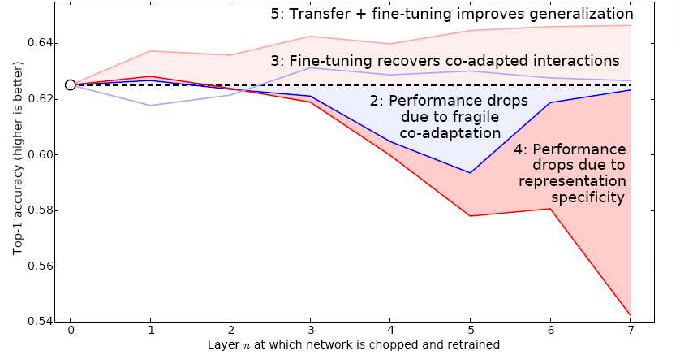
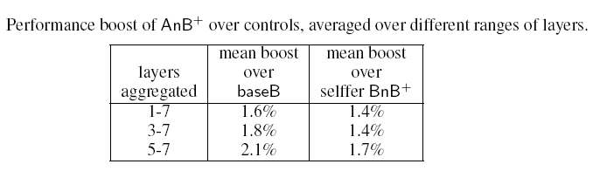
Results

Slide 12
Experiment 2: Dissimilar Datasets
Splitting Man-made and Natural Classes Into Separate 2 Datasets
set A: manual entities 551classes
set B: natural entities 449 classes
Transferability of features between dissimilar tasks

Slide 13
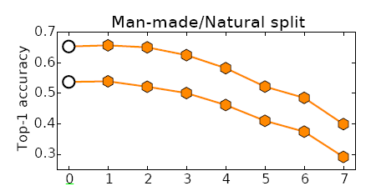
Results
Top curve is for predicting class B (natural images).
Bottom is predicting class A (manmade images).
Notes:
B比A好，作者说B类更少

Slide 14
Experiment 3: random weights
Precedent for random weights working in small dataset. (Jarrett et al.)
随机权重在大规模数据集和深度网络上的表现，以及和迁移特征层的比较

Slide 15
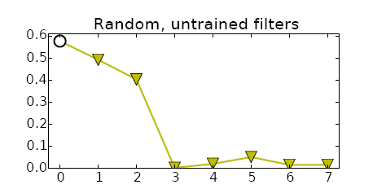
Results
Notes:
随机权重在大的数据集上表现不好

Slide 16
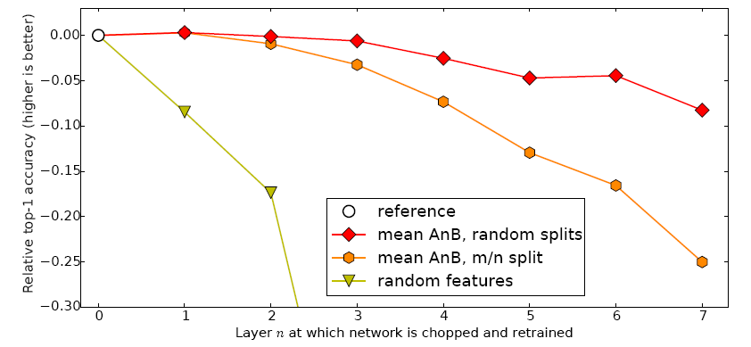
Overall Results
Notes:
当使用冻结特征时，可迁移性在不相似的任务上下降的更快。
迁移特征要比随机过滤器表现更好

Slide 17
Conclusion
神经网络的每一层特征的可迁移性（或者通用性）
影响特征的可迁移性的三个因素：
co-adaptation
specificity of features
the distance between datasets
fine-tune有助于消除co-adaptation和数据集差异的影响
迁移特征并进行fine-tune能提高网络泛化性能
使用迁移特征初始化要比随机权重表现更好
Notes:
神经网络的前3层基本都是general feature，进行迁移的效果会比较好；
深度迁移网络中加入fine-tune，效果会提升比较大，可能会比原网络效果还好；
Fine-tune可以比较好地克服数据之间的差异性；
深度迁移网络要比随机初始化权重效果好；
网络层数的迁移可以加速网络的学习和优化。

