Slide 1
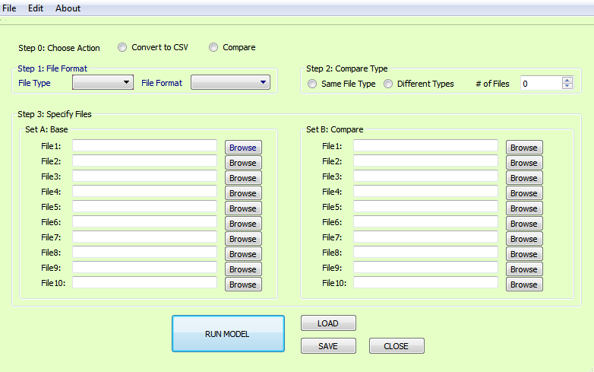
Convert or Compare

Slide 2
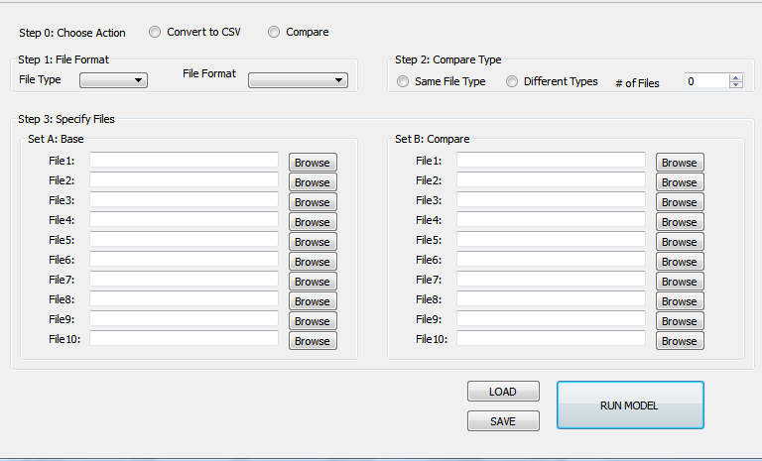
GUI Settings
Step 0: Action
Convert to CSV:
Compare: Compares file
Step 1:
File Type: zone, hwy, trn
File Format: CUBE, TCAD, GTFS, EMME,…
Step 2: 2Way compare
Same Type: Compares one file or file type across various scenarios or versions
Different Types: Compares multiple file types across two scenarios
# of Files: Number of Files to compare
Step 3: Choose Files
Set A: Always enabled but
File<#>: The file browsers are enabled based on the Step 2:<# of Files>
Set B: Enabled olny when Step 2 <Different Types> is active.
Step 4: Run Settings
SAVE: Saves the settings
LOAD: Loads the settings
RUN: Runs the action

Slide 3
GUI Design Needs
Step 0: What do you want?
Convert to CSV Format
Compare Files
Notes:
The model files in CSV format are much needed for external programs (such as Python, Java, R, and Excel)
Often times we just want to know the difference between or across files (could be scenarios or just versions)

Slide 4
GUI Design Needs
Step 1: Okay, Now that you have decided, what do you what to compare ?
File Type
File Format
Notes:
File Type: Model Parameters(txt), Zone Data , Highway Network, Transit Network or Skims and Matrices.
File Formats: TranPlan, TP+, Cube <*TRNBUILD, *PT>, TransCAD, EMME, GTFS* (*only for transit networks).

Slide 5
GUI Design Needs
Step 1: More about the file types…
Most our model inputs and outputs can be classified into 5 formats:
CSV : Popular choice of modern programs
TXT : Model parameters, properties, log files
BIN : Zonal and network attributes and other table data
FFA : Fixed format text files, where columns are separated by at least 4 spaces
DBF : Zonal and network attributes and other table data

Slide 6
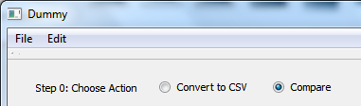
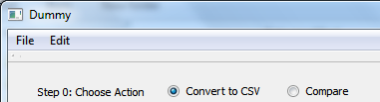
GUI: Choose Action
Step 0: To convert files to CSV format
Step 0: To compare files

Slide 7
GUI Design Needs
File Type | File Formats | Extension | Platform
General (Zone or Highway) | BIN | *.bin | TransCAD
General (Zone or Highway) | DBF | *.dbf | CUBE
General (Zone or Highway) | CSV | *.csv | General
General (Zone or Highway) | TXT | *.txt | CUBE
Transit | CSV | *.csv | General
Transit | TXT | *.txt | CUBE
Transit | DBF | *.DBF | CUBE
Transit | TCAD | *.rts | TransCAD
Transit | CUBE-PT | *.lin | CUBE
Transit | CUBE-TRNBUILD | *.* | CUBE
Transit | TPPLUS | *.* | CUBE
Transit | TRANPLAN | *.* | CUBE
Transit | EMME2 | *.* (Not sure) | EMME
Transit | EMME3 | *.* (Not sure) | EMME
Transit | GTFS | *.txt | General
Matrices | CUBE Matrices | *.mat or *.skm | CUBE
Matrices | TCAD Matrices | *.mtx | TransCAD

Slide 8
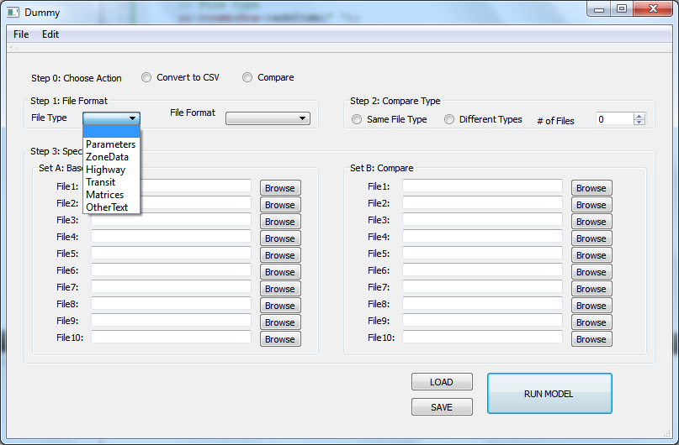
GUI: File Types

Slide 9
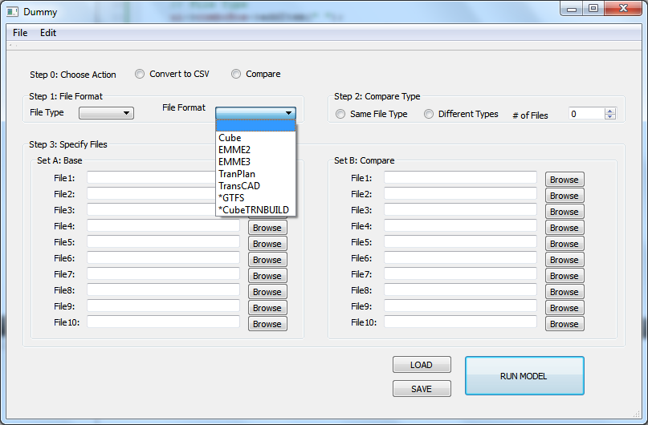
GUI: File Formats

