Slide 1
Travel Demand NotePad
Amar Sarvepalli
Parsons Brinckerhoff
Sarvepalli@pbworld.com
Date: Nov 29, 2013

Slide 2
Few Questions…..
What do we do most of the time?
Code, code, code. ….: from pilots->surveys-> estimations->model implementations
What kind of code ?
Technical softwares: CUBE, GISDK, Alogit, GAWK
Functional programs: R, STATA, SAS
Programming languages: FORTRAN, C++, JAVA, Python
What do we use to write code?
Scripts: Text editors (UltraEdit, NotePad++, TextPad)
Programs: SDK/JDK (Eclipse, BlueJ, Code::Blocks, MSVC)
What do we have to document the code?
No standard approach

Slide 3
Review of Current Note Pads
Popular Note Pads used by PB’ers
Ultra Edit
NotePad++
TextPad
Cube Script Editor (CUBE only)
SKD & JDK (Code::blocks & Eclipse)

Slide 4
Review of Current Note Pads
Ultra Edit (paid):
Highlights:
String search and replace across all files (in the directory) and string count
Column edit
Syntax highlighting
Compare text files
Drawbacks:
No keyword highlight
No functional arguments

Slide 5
Review of Current Note Pads
NotePad++ (free):
Highlights:
Keyword highlight
Syntax highlighter (xml input)
Function arguments (xml input)
Drawbacks:
No column edit
No string search across files (in the directory)
No file compare feature
TextPad (free):
Same as NotePad++, no key highlights or drawbacks

Slide 6
Review of Current Note Pads
Cube Script:
Highlights: Highlights keywords of Cube
Drawbacks: Too many to describe
SDK & JDK Based (Code::Blocks & Eclipse):
Highlights (Simply outstanding):
Function prototypes
Hyperlinks methods (implementation to declaration) , Pre-complier variable checks
Of course syntax highlighting, keyword highlights
Drawbacks:
No keyword search function
Not extendable to scripting languages like GISDK or CUBE, R (maybe some python)

Slide 7
Design Needs- What do I want?
Basic Features (Best of all 3 text editors):
Guideline: View line numbers (rows) and width (column)
Formatting: Tabs to Spaces, String functions (case), trim whitespaces
RegExp: Search and replace across all files in the directory
Column Edit
Syntax Highlighting: know the file type (*.ext) and apply syntax highlighting
Highlight keywords:
Auto-update: Reload opened files whenever user activates the widow
Compare: Two text files (lite version of Convert-N-Compare)
Functions Prototypes: R, Cube, GISDK, predefined via XML)

Slide 8
Design Needs- What else ?
Advanced Features
Hyperlink across all macros & functions in the directory (implementation to declaration)
Code documentation
Read table formats (binary and DBF)
Convert-N-Compare

Slide 9
Design Needs 1. Hyperlink Approach
Pointers (*p) and References(&R)
*p = pointer to R [Macro: filename + Line number]
p = reference to R [RunMacro: get address of Macro]
RunMacro
Macro
 |  |  | p |  |  | R
Address
*p
&R

Slide 10
Design Needs 2. Code Documentation
Classic Approach (Limited to comments in code)
Knows comment keys by extension
Reads through all block comments and inline comments
Outputs are either XML style document with description (based on what’s in the
Limitations: No Inputs and outputs to the macros/methods/functions
(Limited to comments in code).

Slide 11
Design Needs 2. Code Documentation
Advanced Approach: to identify input and outputs
TCAD Standard - Read tokens from *.BIN file to identify the parameters of the macros and functions
Non Standard – Read tokens from *.properties file (text)
Four Challenges:
How to identify input versus output token ?
How to identify the tokens passed (as variables) into the sub-macros (nested macros)
How to handle partial tokens (meaning token is hbw.zeroauto = “hbw_a0.mtx” but variable assignment is fileName = purpose[p]+”.”+autosuffieciency[s] )
Output file = parsed input filename + “.”+extension

Slide 12
Design Needs 2. Code Documentation
Pre-compiler mechanism
Challenge 1: To identify input and outputs
keep track of variables, token and assigned values by creating a dictionary (hash table and linked list)
Dictionary to hold all variables found in the macro, local scope but does carry the global scope variables.
Ex: {variable, token , token value} = {fileName, hbw.autosufficieny, “hbw.a0.mtx”}
Input versus Output arguments: From functional prototypes
Return Types: Outputs can also be identified by tracking the returned and how it is applied.

Slide 13
Design Needs 2. Code Documentation
Challenge 2: To identify child macro input and outputs
Same as above, keep track of variables, token and assigned values.
Challenge 3: To handle partial tokens and referred tokens ?
Read the variable assignment and identify the counter part’s original value.
Ex: fileName = purpose[p]+autosufficiency[s]
Check for purpose and autosufficiency in the dictionary (remember the dictionary holds all previously declared variables, tokens and token value)
Once found, construct the right-hand side value (as purpose[0]+”.”+autosufficiency[0]) and check the token value for it.
Once found we keep track of the fileName and it’s values

Slide 14
Design Needs 2. Code Documentation
Challenge 4: How to know what is the return value of string split function?
Must need to know this to identify the output files.
Only way is to replicate the string split function itself and use the retuned array to further identify the values.

Slide 15
Design Needs 3. Read table formats
Table Styles (row/ columns tabular data)
Open/ Read Binary, DBF files in the viewer
Edit/ Write Binary, DBF files
Capability to open a CSV file with header information in first row and auto convert alphabetical fields to Stings, numeric to either Integer or Double.
Add Row or Column and save files
Ability to do some basic stats on the table view

Slide 16
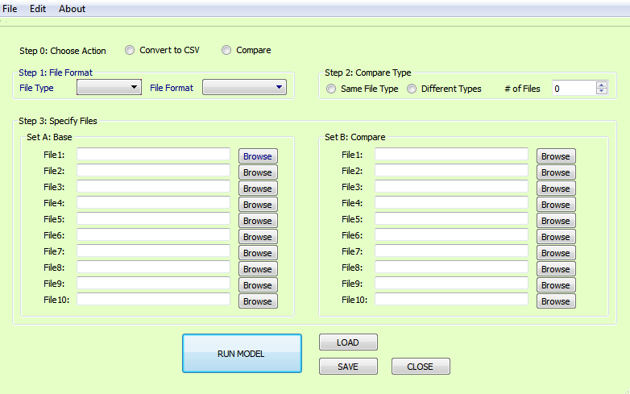
Design Needs 4. Convert or Compare

Slide 17
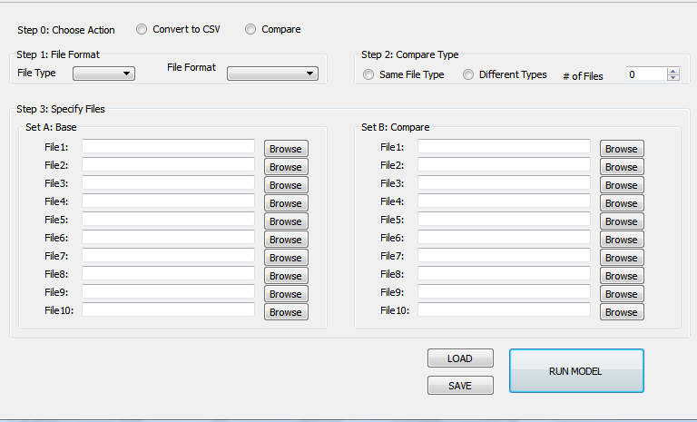
Design Needs 4. Convert or Compare
Step 0: Action
Convert to CSV:
Compare: Compares file
Step 1:
File Type: zone, hwy, trn
File Format: CUBE, TCAD, GTFS, EMME,…
Step 2: 2Way compare
Same Type: Compares one file or file type across various scenarios or versions
Different Types: Compares multiple file types across two scenarios
# of Files: Number of Files to compare
Step 3: Choose Files
Set A: Always enabled but
File<#>: The file browsers are enabled based on the Step 2:<# of Files>
Set B: Enabled olny when Step 2 <Different Types> is active.
Step 4: Run Settings
SAVE: Saves the settings
LOAD: Loads the settings
RUN: Runs the action

Slide 18
GUI Design Needs
Step 0: What do you want?
Convert to CSV Format
Compare Files
Notes:
The model files in CSV format are much needed for external programs (such as Python, Java, R, and Excel)
Often times we just want to know the difference between or across files (could be scenarios or just versions)

Slide 19
GUI Design Needs
Step 1: Okay, Now that you have decided, what do you what to compare ?
File Type
File Format
Notes:
File Type: Model Parameters(txt), Zone Data , Highway Network, Transit Network or Skims and Matrices.
File Formats: TranPlan, TP+, Cube <*TRNBUILD, *PT>, TransCAD, EMME, GTFS* (*only for transit networks).

Slide 20
GUI Design Needs
Step 1: More about the file types…
Most our model inputs and outputs can be classified into 5 formats:
CSV : Popular choice of modern programs
TXT : Model parameters, properties, log files
BIN : Zonal and network attributes and other table data
FFA : Fixed format text files, where columns are separated by at least 4 spaces
DBF : Zonal and network attributes and other table data

Slide 21
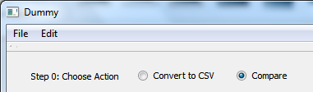
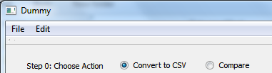
GUI: Choose Action
Step 0: To convert files to CSV format
Step 0: To compare files

Slide 22
GUI Design Needs
File Type | File Formats | Extension | Platform
General (Zone or Highway) | BIN | *.bin | TransCAD
General (Zone or Highway) | DBF | *.dbf | CUBE
General (Zone or Highway) | CSV | *.csv | General
General (Zone or Highway) | TXT | *.txt | CUBE
Transit | CSV | *.csv | General
Transit | TXT | *.txt | CUBE
Transit | DBF | *.DBF | CUBE
Transit | TCAD | *.rts | TransCAD
Transit | CUBE-PT | *.lin | CUBE
Transit | CUBE-TRNBUILD | *.* | CUBE
Transit | TPPLUS | *.* | CUBE
Transit | TRANPLAN | *.* | CUBE
Transit | EMME2 | *.* (Not sure) | EMME
Transit | EMME3 | *.* (Not sure) | EMME
Transit | GTFS | *.txt | General
Matrices | CUBE Matrices | *.mat or *.skm | CUBE
Matrices | TCAD Matrices | *.mtx | TransCAD

Slide 23
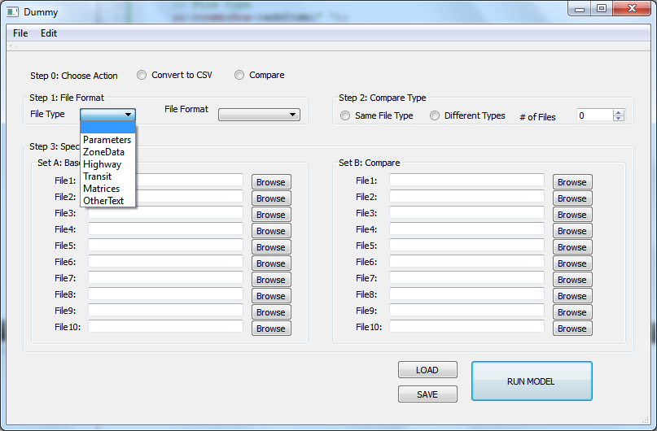
GUI: File Types

Slide 24
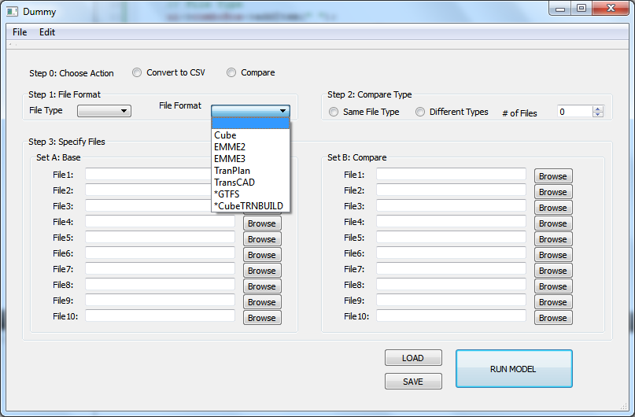
GUI: File Formats

