Slide 1
VETERANS
Scaling Hourly Constants

Slide 2
Hourly OD Trip Tables: Hourly Factoring vs ODME

Slide 3
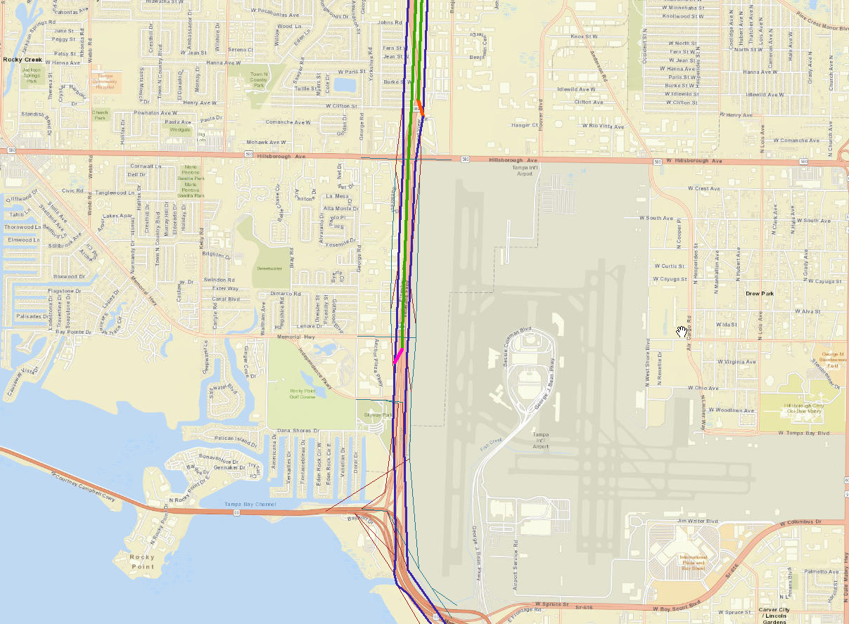
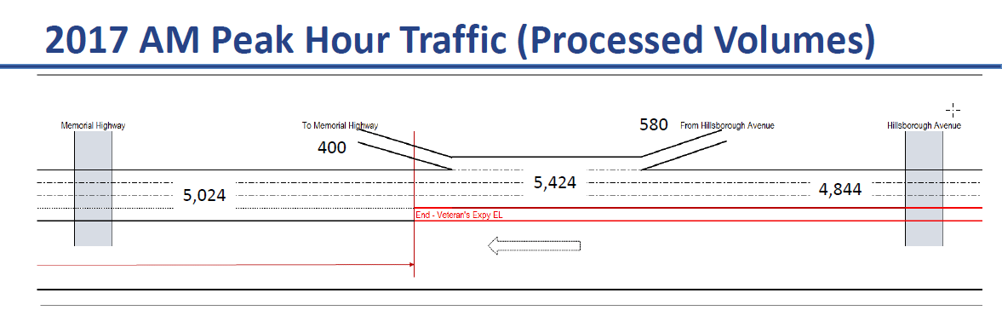
Processed Volume vs Modeled (8:00 AM)
One hour Model Assigned volume is about ~7000 on SB between Hillsborough and Memorial (5900 GL + 850 EL)
Issue:
Processed volumes show ~ 5,400 trips between Hillsborough Avenue and Memorial Hwy where the modeled assignment for one hour (8:00 AM) shows ~7,000 trips

Slide 4
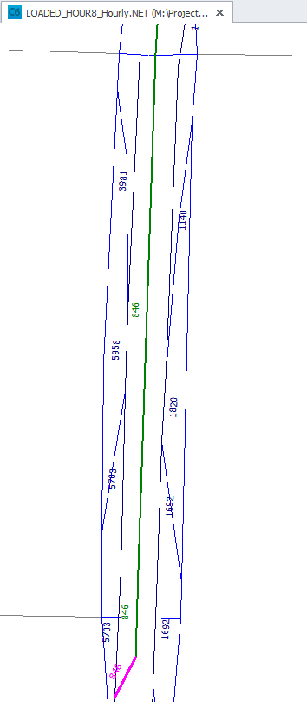
Processed Volume vs Modeled (8:00 AM)
Why are loaded volumes different:
Profile shows 83,600 (NB + SB) and 13% is 8:00 AM shares. This computes to 41,000 Daily SB and 5,434 8:00 AM hourly volumes.
However, the trip tables are ODME’d at daily to match 41,000 (SB) and the trip table is apportioned to hourly factor, which when assigned estimates ~7,000 trips instead of ~5,400.
ODME should be performed at each of the 24 hours
One hour Model Assigned volume is about ~7000 on SB between Hillsborough and Memorial (5900 GL + 850 EL)

Slide 5
Assigning Factored Trip Tables
Toll Constants same as I-95 Express

Slide 6
Hourly (SB) Traffic
Solution:
ODME each hour with control total developed from same profile and hourly distribution.
This should address the inconsistency in the matrix apportion vs actual period distribution.

Slide 7
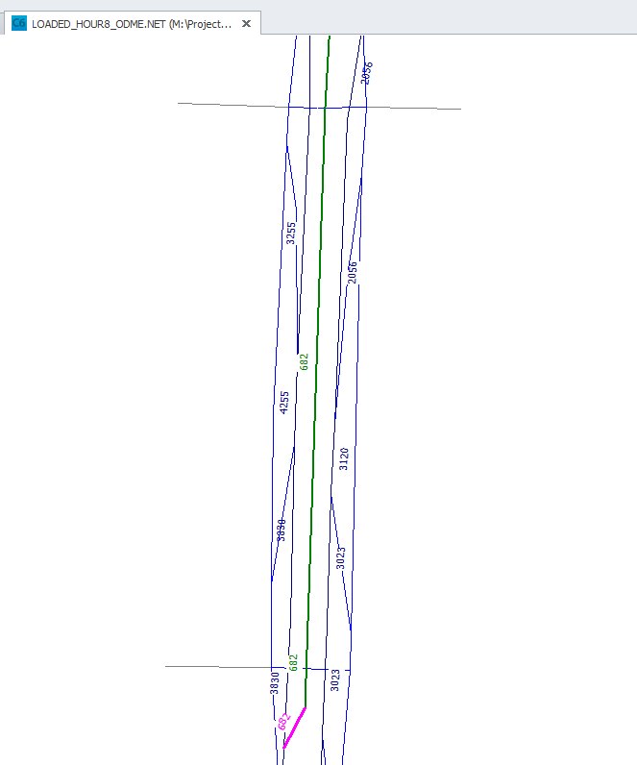
Hourly ODME Trip Table: 8:00 AM
One hour Model Assigned volume is about ~4900 on SB (4200 GL + 680 EL)

Slide 8
Assigning ODME Trip Tables (8:00 AM OD)
Solution:
ODME each hour with control total developed from same profile and hourly distribution.
This gets the .
NOTE:
Only 8:00 AM is ODME’d Trip Table
Need to repeat this for all 24 hour trip tables (time consuming, at least do it for peak hours)

Slide 9
Assigning ODME Trip Tables (all hours)
ODME each hour:
Assigning ODME trip tables to the network produce more reasonable EL trips (in range of ~500 to ~600) for SB
NB is too high:
The ODME control totals by hour should be rechecked and revised. These seem too high.

Slide 10
Assigning ODME Trip Tables (Period)
ODME each hour:
Assigning ODME by period trip tables to the network produce more reasonable EL trips (in range of ~400 to ~500) for SB AM
NB is still too high:
The ODME control totals by period produced higher trips but are slightly lower than hourly ODME trips.

Slide 11
Investigate High EL Trips
By Peak Direction: Issues is more so with NB than SB

Slide 12
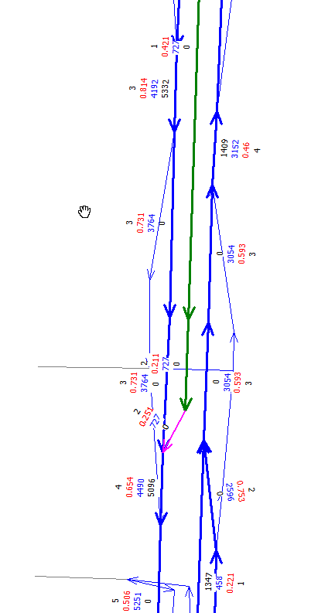
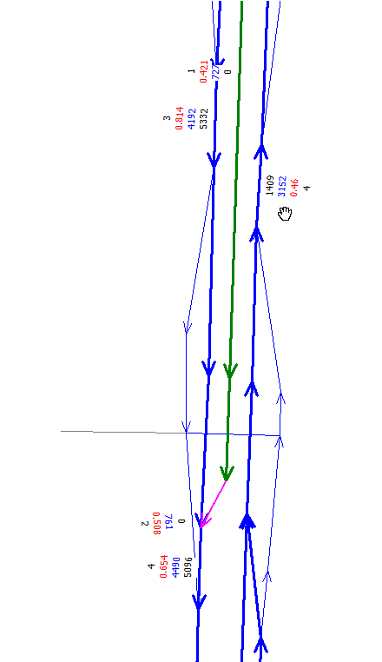
Investigate – SB EL Trips
Peak hour trip assignment
ODME by hour
Hour 8: AM – peak direction is SB
Black = Hourly Count
Blue = Assigned Volume
Red is VDF and
N is number of lanes
Ignore NB direction
Slightly over-assigned but that’s not our focus issue
The two highlighted circles on either ends of SB shows we have right assignment totals
Shows a congested mainline with v/c ~0.73 – 0.8 between Hillsborough Ave and Memorial Hwy.
Shows a relatively less congested v/c of 0.65 on mainline between Independence & Memorial -> Hillsborough.

Slide 13
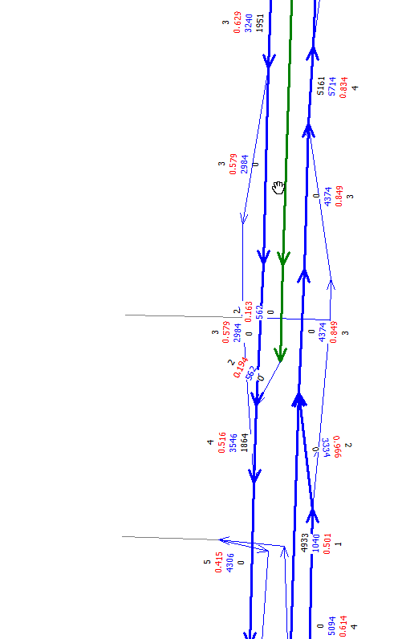
Investigate – NB EL Trips
Peak hour trip assignment
ODME by hour
Hour 17: PM – peak direction is NB
Black = Hourly Count
Blue = Assigned Volume
Red is VDF and
N is number of lanes
Ignore SB direction
Slightly over-assigned but that’s not our focus issue
The two highlighted circles on either ends of NB shows we have right assignment totals
Shows a consistent v/c over 0.8 (even 0.9) on the mainline between Independence / Memorial -> Hillsborough.

