Slide 1
VETERANS
Scaling Hourly Constants

Slide 2
Hourly OD Trip Tables: Hourly Factoring vs ODME

Slide 3
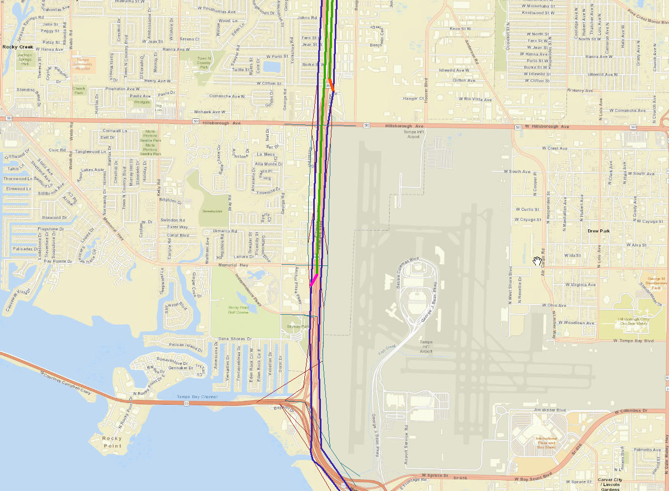
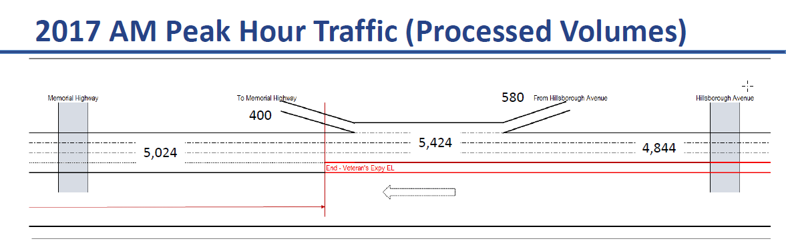
Processed Volume vs Modeled (8:00 AM)
One hour Model Assigned volume is about ~7000 on SB between Hillsborough and Memorial (5900 GL + 850 EL)
Issue:
Processed volumes show ~ 5,400 trips between Hillsborough Avenue and Memorial Hwy where the modeled assignment for one hour (8:00 AM) shows ~7,000 trips

Slide 4
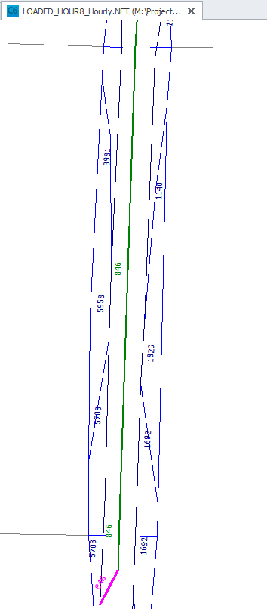
Processed Volume vs Modeled (8:00 AM)
Why are loaded volumes different:
Profile shows 83,600 (NB + SB) and 13% is 8:00 AM shares. This computes to 41,000 Daily SB and 5,434 8:00 AM hourly volumes.
However, the trip tables are ODME’d at daily to match 41,000 (SB) and the trip table is apportioned to hourly factor, which when assigned estimates ~7,000 trips instead of ~5,400.
ODME should be performed at each of the 24 hours
One hour Model Assigned volume is about ~7000 on SB between Hillsborough and Memorial (5900 GL + 850 EL)

Slide 5
Assigning Factored Trip Tables
Toll Constants same as I-95 Express

Slide 6
Hourly (SB) Traffic
Solution:
ODME each hour with control total developed from same profile and hourly distribution.
This should address the inconsistency in the matrix apportion vs actual period distribution.

Slide 7
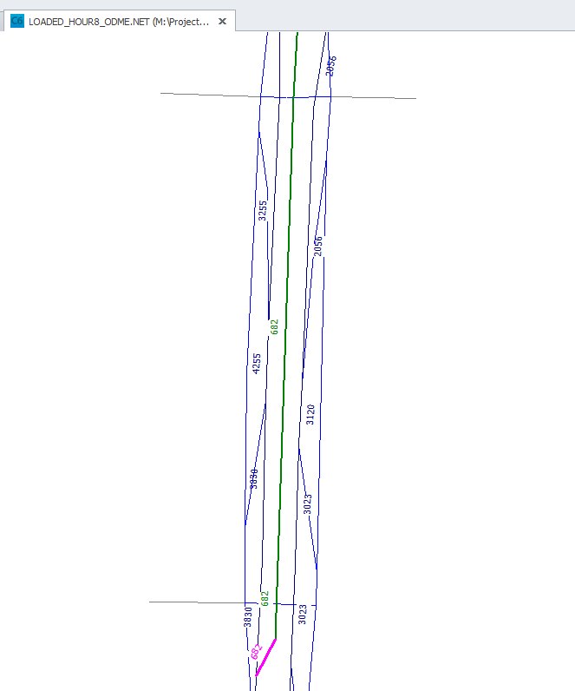
Hourly ODME Trip Table: 8:00 AM
One hour Model Assigned volume is about ~4900 on SB (4200 GL + 680 EL)

Slide 8
Assigning ODME Trip Tables (8:00 AM OD)
Solution:
ODME each hour with control total developed from same profile and hourly distribution.
This gets the .
NOTE:
Only 8:00 AM is ODME’d Trip Table
Need to repeat this for all 24 hour trip tables (time consuming, at least do it for peak hours)

Slide 9
Assigning ODME Trip Tables (all hours)
ODME each hour:
Assigning ODME trip tables to the network produce more reasonable EL trips (in range of ~500 to ~600) for SB
NB is too high:
The ODME control totals by hour should be rechecked and revised. These seem too high.

Slide 10
Assigning ODME Trip Tables (Period)
ODME each hour:
Assigning ODME by period trip tables to the network produce more reasonable EL trips (in range of ~400 to ~500) for SB AM
NB is still too high:
The ODME control totals by period produced higher trips but are slightly lower than hourly ODME trips.

Slide 11
Investigate High EL Trips
By Peak Direction: Issues is more so with NB than SB
1. NB Issue: EL trips are more here (~1000) compared to SB (~700) ?
2. Logit Model Construct
3. Delay can be added to the model to reflect queue

Slide 12
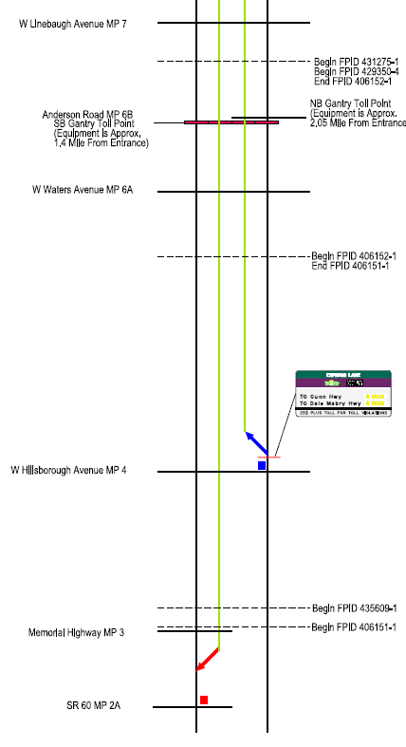
1. NB Issue: EL trips are high in NB peak (~1000) compared to SB peak (~700) ?
Similar speeds and capacities in both directions
Same ourly distributions
Hillsborough and Memorial – 2020 AWDT 86,000 (both directions)
SB: AM peak direction = 12.76 % (~5400)
NB: PM peak direction = 12.72 % (~5400)
Not a directional distribution issue but a ODME distribution issue ?
Eligible Trip Issue: There are more eligible trips (~1200) for NB than SB due to the location of NB access point.
Eligible AM_SB Eligible PM_NB
2,365 3,527

Slide 13
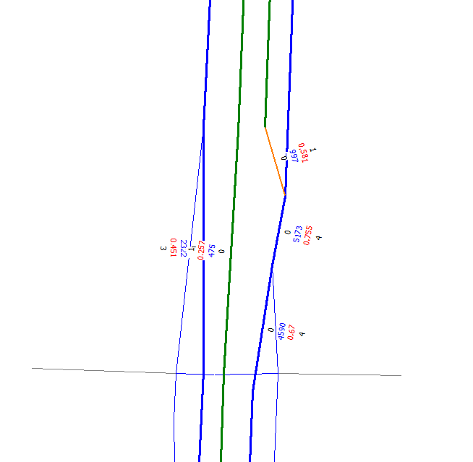
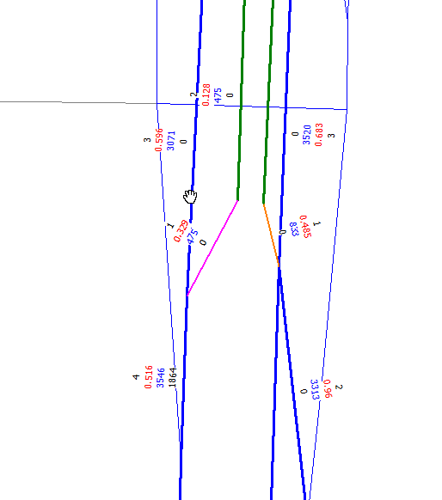
1. NB Issue: EL trips are high in NB peak (~1000) compared to SB peak (~700) ?
Toll Plan EL Access location north of Hillsborough Blvd results in ~1000 EL Trips
Moving Northbound EL Access to south of Memorial Hwy drops EL trips to ~800 EL Trips
EL Trips:
Although, still there are more EL trips than SB peak direction (~700) this elucidates the Eligible trip issue due to EL access / entry location

Slide 14
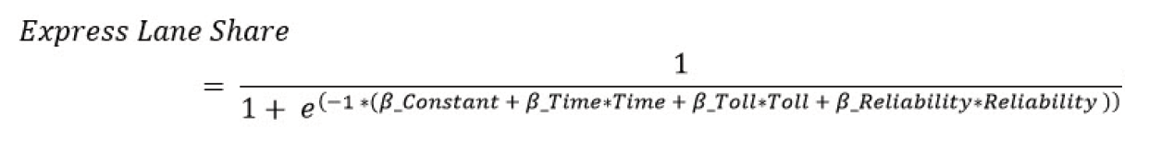
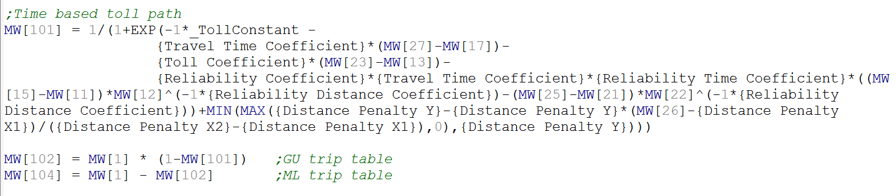
2. Logit Model Construct:
Excel Debugger
Logit Model Construct
CUBE Application

Slide 15
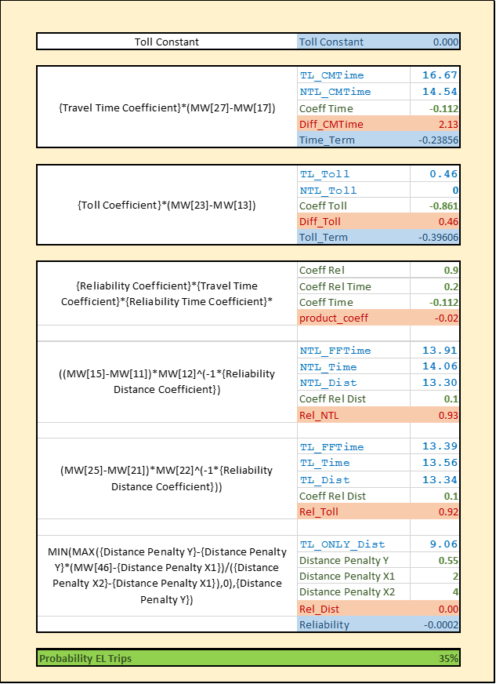
2. Logit Model Construct:
Excel Debugger
Time Term:
Congested Toll Paths should be significantly better to see benefit resulting from time savings
Toll Cost Term:
Toll costs should be significantly higher to offset toll paths (dependent function of VDF Curve)
Reliability:
Comes into play only if there is congestion
Toll Constant:
Error term or Calibration Constant
Error Term
Perceived Time Savings
Toll Cost Term
Reliability Term
NB Case: The facility is not congested making
Reliability term inapplicable
Time savings NOT significant
Toll costs NOT significant
Toll constant impacts are TOO significant
Green = Input Parameters (skims)
Blue = Input variables (skims)
Red = Computed Terms
EL Probability

Slide 16
2. Logit Model Construct:
Excel Debugger
No Toll Constant
Perceived Time Savings = 0
No Toll Cost
NB Case -1: Everything is identical
Share is 50%
Reliability shows no effect
Green = Input Parameters (skims)
Blue = Input variables (skims)
Red = Computed Terms
Probability is 50%

Slide 17
2. Logit Model Construct:
NB Case -2: Toll Constant Eqiv Minutes
Toll constants acts as unexplainable travel time savings (or cost).
Time Savings: 2 Minutes
Toll Constant: 2 Minute (Eqiv)
Time Savings vs Toll Constant
2 minute travel time savings
or
2 minute equivalent (toll constant / time coefficient) mean the same
NB Case -3: Delay can be added the same way
A delay (expressed as lost time on GL lane) can be expressed the same way

Slide 18
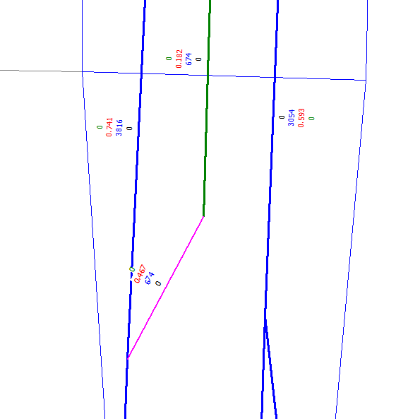
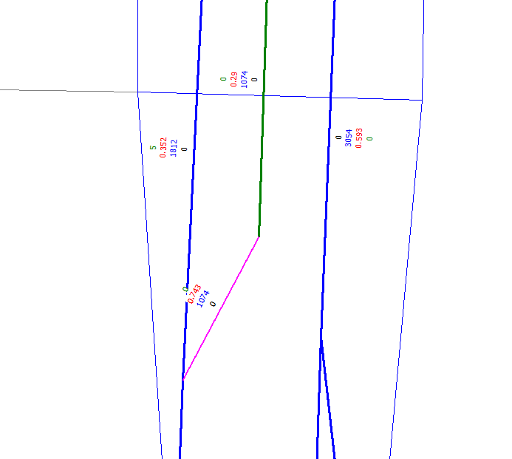
3. Southbound Delay Implementation:
Before Delay = ~670 EL Trips
After Delay = ~1074 EL Trips
A 5 minute delay is added to the GL link before EL merge

Slide 19
3. Southbound Delay Implementation:
Delay impact on EL Share
Delay is added is to the GL link before EL merge (egress).
Delay is tested in one minute increments to study the EL trip share.
The same is computed in Excel to understand what can be captured at OD and Corridor Levels:
OD : Both Model estimated and Excel computed OD shares produced nearly identical results with the exception of last 3 (Delay 8 – 10) where the toll costs escalated from 46 cents to 58 cents (excel used the tolls at 46 cents)
Corridor Level: At the corridor level trips were estimated by multiplying total eligible trips and computed OD share (from above #3.1). Given that the OD share applied is from only one path (OD path with most eligible trips), the estimate varies significantly if the other OD paths are too different.
Actual model estimate vs Excel approximation

