Slide 1
A “reconciliation workflow” between Pure and 4TU.ResearchData
(Using the API)
Identification of inconsistencies in dataset–publication relationships
across both systems and generates actionable outputs for correction.

Slide 2
High level use case
What do we want to solve?
How do we want to solve it?
What do we have?
Cross-system metadata mismatches, between Pure and 4TU.ResearchData.
Identify and fix them in a automate way.
A csv of each dataset with 4TU.RD and Pure deposit information.
A public API to endpoints to harvest information about datasets in 4TU.RD.

Slide 3
In particular
Case 1: Detecting datasets where publication links are missing in Pure but exist in 4TU.RD
Case 2: Detecting datasets where publication links exists in Pure but are missing in 4TU.RD
Producing structured CSV outputs for manual validation for each case
Presenting the info in the dashboard (streamlit)
API request + Database reconciliation
Parsing the response with Python
Data Access
Data Transformation
Data Visualization

Slide 4

Schedule
Activity | Time
Intro to APIs | 09:30- 10:00
Live coding session Case 1 | 10:00 – 10:25
Live coding session Case 2 | 10:25 – 10:45
Break | 10:45 – 10:55
Try the integration of Case1 and Case 2 | 10:55 – 11:30
Visualizing the reconciliation workflow (via streamlit) | 11:30 – 11:55
Deploy your dashboard using GitHub + Streamlit Cloud | 11:55 – 12:20
Feedback | 12:20 – 12:30
Notes:
HTTP - Hyper text transfer protocol
JSON – Java Script Object notation

Slide 5

01
What are APIs
API (Application Programming Interface):
- A bridge that allows different software systems to communicate.
- APIs define how software components interact.
Introduction to APIs

Slide 6
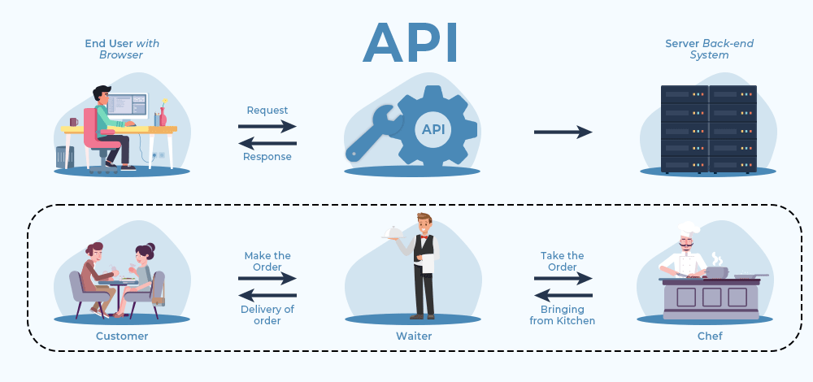
Client
Server
Notes:
An API is like a waiter in a restaurant. You don’t go into the kitchen and cook the meal yourself. You just place an order and hope the kitchen doesn’t return a 500 Internal Server Error

Slide 7

APIs are like coffee machines in research labs. Everyone depends on them, nobody knows exactly how they work, and when they break… the whole lab stops functioning

Slide 8
02
Common language for APIs
Web API is an API that allows different software systems to communicate via the web, using HTTP protocol.
They use a shared vocabulary of methods: GET, POST, PUT, DELETE to define how to exchange resources across the web.
Resources are something the API makes available and lets you interact with, e.g. (datasets, authors, collections).
Most Web APIs today use the JSON format to exchange data.
Introduction to APIs
Notes:
HTTP - Hyper text transfer protocol
JSON – Java Script Object notation

Slide 9
03
Why APIs are relevant for research
(In general) APIs enable automation, integration, and reuse of data and services.
Enable programmatic access to research data (no manual downloads)
Facilitate reproducibility and automation of workflows
Support interoperability across systems and tools
Example: Retrieve datasets via API → analyze in Python/R → publish results
Introduction to APIs
Notes:
HTTP - Hyper text transfer protocol
JSON – Java Script Object notation

Slide 10
04
Using the Unix terminal with REST APIs
The Unix terminal allows HTTP requests using `curl`.
`curl` = client URL: send requests and receive responses.
Examples:
curl -X <HTTP_METHOD> <URL> \
-H "<HEADER_KEY>: <HEADER_VALUE>" \
-d '<BODY_DATA>'
<HTTP_METHOD>:
Introduction to APIs
GET → retrieve data (default method)
POST → send data
PUT → update data
DELETE → remove data
Notes:
HTTP - Hyper text transfer protocol
JSON – Java Script Object notation

Slide 11

05
The Web API of 4TU.ResearchData
[base URL] : https://data.4tu.nl
[specific resource URL:endpoint]: https://data.4tu.nl/v2/articles
List of (documented) endpoints: https://djehuty.4tu.nl/
Introduction to APIs
Link to the workshop on how to use the API of 4TU.ResearchData
Exercise #1 : Checking the connection with the server using the web browser and CURL in the Unix terminal
Open a web browser and write: https://data.4tu.nl/v2/articles
One the Unix terminal and write: curl –X GET https://data.4tu.nl/v2/articles | jq
How are both responses compared to each other?
Notes:
HTTP - Hyper text transfer protocol
JSON – Java Script Object notation

Slide 12
Activity | Time
Intro to APIs | 09:30- 10:00
Live coding session Case 1 | 10:00 – 10:25
Live coding session Case 2 | 10:25 – 10:45
Break | 10:45 – 10:55
Try the integration of Case1 and Case 2 | 10:55 – 11:30
Visualizing the reconciliation workflow (via streamlit) | 11:30 – 11:55
Deploy your dashboard using GitHub + Streamlit Cloud | 11:55 – 12:20
Feedback | 12:20 – 12:30
Let's start

Slide 13
Environment installation

Slide 14
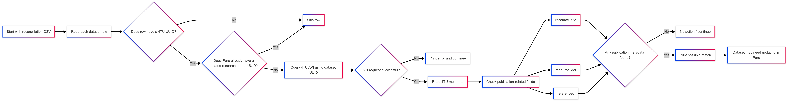
Case 1
Flowchart

Slide 15
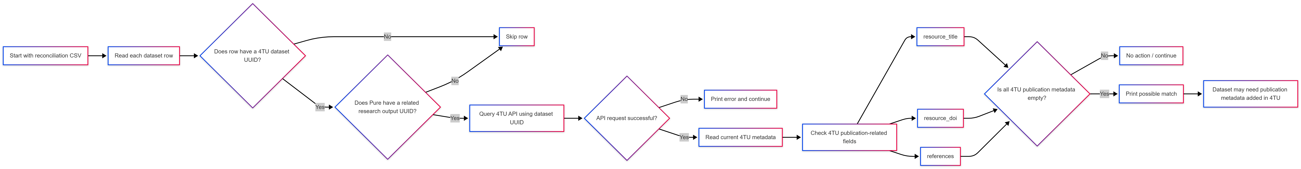
Case 2
Flowchart

Slide 16
Activity | Time
Intro to APIs | 09:30- 10:00
Live coding session Case 1 | 10:00 – 10:25
Live coding session Case 2 | 10:25 – 10:45
Break | 10:45 – 10:55
Try the integration of Case1 and Case 2 | 10:55 – 11:30
Visualizing the reconciliation workflow (via streamlit) | 11:30 – 11:55
Deploy your dashboard using GitHub + Streamlit Cloud | 11:55 – 12:20
Feedback | 12:20 – 12:30
Let's start

Slide 17
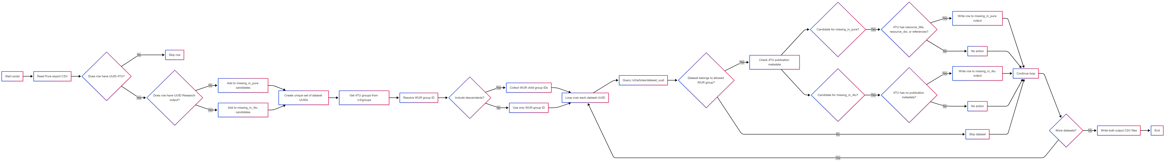
Integrative command line tool
Flowchart

Slide 18
Activity | Time
Intro to APIs | 09:30- 10:00
Live coding session Case 1 | 10:00 – 10:25
Live coding session Case 2 | 10:25 – 10:45
Break | 10:45 – 10:55
Try the integration of Case1 and Case 2 | 10:55 – 11:30
Visualizing the reconciliation workflow (via streamlit) | 11:30 – 11:55
Deploy your dashboard using GitHub + Streamlit Cloud | 11:55 – 12:20
Feedback | 12:20 – 12:30
Let's start

Slide 19
How to deploy the app as a live web app
(one option)
- Host the code in Github (Push the dashboard app to Github)
- Add a requirements.txt
- Go to https://share.streamlit.io
- Connect repo
- Deploy
Advantages:
free
no server
automatic deployment
Example of a live web app
https://apiusecasepure4tusync-ckjc6yq7wj7guyh4nqecop.streamlit.app/
Notes:
HTTP - Hyper text transfer protocol
JSON – Java Script Object notation

Slide 20
Wrap up
Understanding cross-system metadata mismatches: metadata about publications can exist in multiple systems (e.g., 4TU.ResearchData and Pure) and that inconsistencies are common.
Working with structured data for decision making (CSV to filter): Data should have key fields to be reusable like the UUID
Using APIs to enrich and validate metadata : APIs are key tools for data validation and integration.
From scripts to usable tools: deploying a dashboard
Feedback : https://hackmd.io/cLKNCbDwTBi15suQ3cvJHA
Notes:
HTTP - Hyper text transfer protocol
JSON – Java Script Object notation

Slide 21
Thank you.

