Slide 1
Building a dashboard to visualize information from 4TU.ResearchData
(Using the API)
Key components:
API endpoints
Python
Streamlit
Dashboard

Slide 2
Process
Data Access
Data Transformation
Data Visualization
Presenting the info in the dashboard (streamlit)
API request
Parsing the response with Python
RUNNING TITLE
DATE

Slide 3

Schedule
Activity | Time
Intro to APIs | 09:30- 10:00
Build the simplest dashboard (live code) | 10:00 – 10:25
Try a script with more features | 10:25 – 10:45
Break | 10:45 – 10:55
Tweak exercises | 10:55 – 11:30
Try a different example (with more features) | 11:30 – 11:55
Deploy your dashboard using GitHub + Streamlit Cloud | 11:55 – 12:20
Wrap up and questions | 12:20 – 12:30
Notes:
HTTP - Hyper text transfer protocol
JSON – Java Script Object notation

Slide 4

01
What are APIs
API (Application Programming Interface):
- A bridge that allows different software systems to communicate.
- APIs define how software components interact.
Introduction to APIs

Slide 5
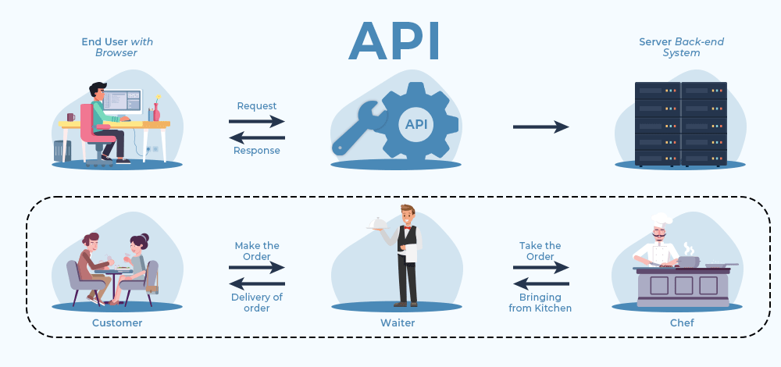
Client
Server
Notes:
An API is like a waiter in a restaurant. You don’t go into the kitchen and cook the meal yourself. You just place an order and hope the kitchen doesn’t return a 500 Internal Server Error

Slide 6

APIs are like coffee machines in research labs. Everyone depends on them, nobody knows exactly how they work, and when they break… the whole lab stops functioning

Slide 7
02
Common language for APIs
Web API is an API that allows different software systems to communicate via the web, using HTTP protocol.
They use a shared vocabulary of methods: GET, POST, PUT, DELETE to define how to exchange resources across the web.
Resources are something the API makes available and lets you interact with, e.g. (datasets, authors, collections).
Most Web APIs today use the JSON format to exchange data.
Introduction to APIs
Notes:
HTTP - Hyper text transfer protocol
JSON – Java Script Object notation

Slide 8
03
Why APIs are relevant for research
(In general) APIs enable automation, integration, and reuse of data and services.
Enable programmatic access to research data (no manual downloads)
Facilitate reproducibility and automation of workflows
Support interoperability across systems and tools
Example: Retrieve datasets via API → analyze in Python/R → publish results
Introduction to APIs
Notes:
HTTP - Hyper text transfer protocol
JSON – Java Script Object notation

Slide 9
04
Using the Unix terminal with REST APIs
The Unix terminal allows HTTP requests using `curl`.
`curl` = client URL: send requests and receive responses.
Examples:
curl -X <HTTP_METHOD> <URL> \
-H "<HEADER_KEY>: <HEADER_VALUE>" \
-d '<BODY_DATA>'
<HTTP_METHOD>:
Introduction to APIs
GET → retrieve data (default method)
POST → send data
PUT → update data
DELETE → remove data
Notes:
HTTP - Hyper text transfer protocol
JSON – Java Script Object notation

Slide 10

05
The Web API of 4TU.ResearchData
[base URL] : https://data.4tu.nl
[specific resource URL:endpoint]: https://data.4tu.nl/v2/articles
List of (documented) endpoints: https://djehuty.4tu.nl/
Introduction to APIs
Link to the workshop on how to use the API of 4TU.ResearchData
Exercise #1 : Checking the connection with the server using the web browser and CURL in the Unix terminal
Open a web browser and write: https://data.4tu.nl/v2/articles
One the Unix terminal and write: curl –X GET https://data.4tu.nl/v2/articles | jq
How are both responses compared to each other?
Notes:
HTTP - Hyper text transfer protocol
JSON – Java Script Object notation

Slide 11
Activity | Time
Intro to APIs | 09:30- 10:00
Build the simplest dashboard (live code) | 10:00 – 10:25
Try a script with more features | 10:25 – 10:45
Break | 10:45 – 10:55
Tweak exercises | 10:55 – 11:30
Try a different example (with more features) | 11:30 – 11:55
Deploy your dashboard using GitHub + Streamlit Cloud | 11:55 – 12:20
Wrap up and questions | 12:20 – 12:30
Let's start

Slide 12
Activity | Time
Intro to APIs | 09:30- 10:00
Build the simplest dashboard (live code) | 10:00 – 10:25
Try a script with more features | 10:25 – 10:45
Break | 10:45 – 10:55
Tweak exercises | 10:55 – 11:30
Try a different example (with more features) | 11:30 – 11:55
Deploy your dashboard using GitHub + Streamlit Cloud | 11:55 – 12:20
Wrap up and questions | 12:20 – 12:30

Slide 13
Modify the minimal dashboard script so that the dashboard
only displays datasets published after 2020. (Data filtering)
2. Allow users to search datasets by title. Add a search box
so, users can filter datasets containing a word in the title. (UI widgets)
3. Add a chart showing the number of datasets per institution. (Aggregation and visualization)
Exercises
https://mu3ydfdkaczsgm3u7mbx2q.streamlit.app/

Slide 14
Activity | Time
Intro to APIs | 09:30- 10:00
Build the simplest dashboard (live code) | 10:00 – 10:25
Try a script with more features | 10:25 – 10:45
Break | 10:45 – 10:55
Tweak exercises | 10:55 – 11:30
Try a different example (with more features) | 11:30 – 11:55
Deploy your dashboard using GitHub + Streamlit Cloud | 11:55 – 12:20
Wrap up and questions | 12:20 – 12:30

Slide 15
How to deploy the app as a live web app
(one option)
- Host the code in Github (Push the dashboard app to Github)
- Add a requirements.txt
- Go to https://share.streamlit.io
- Connect repo
- Deploy
Advantages:
free
no server
automatic deployment
Example of a live web app
https://9lscwwsuhw2dkugffukt2t.streamlit.app/
Notes:
HTTP - Hyper text transfer protocol
JSON – Java Script Object notation

Slide 16

Wrap up
APIs enable automated data access
Python transform API data
Streamlit turns scripts into dashboards
Github+Streamlit deploy apps (live web app)
Feedback :
Notes:
HTTP - Hyper text transfer protocol
JSON – Java Script Object notation

Slide 17
Thank you.

