Slide 1

Cloud Native Layouts
Interoperability in Climate and Atmospheric sciences
FAIR NetCDF Data

Slide 2

The Problem
Is my data optimised for access even if it is stored in the cloud with a predictable format and following standard metadata conventions?
Climate datasets are often huge , but researchers usually need only a small subset.
Example : In the Climate Data store from Copernicus, you are allowed to:
Select datasets
Select variables
Select regions
Select time-period
Notes:
Large data collections such as [ERA5](https://cds.climate.copernicus.eu/datasets/reanalysis-era5-single-levels?tab=overview) or [CMIP6](https://wcrp-cmip.org/cmip-phases/cmip6/) can extend across terabytes or petabytes of data.
Researchers, however, rarely need an entire collection for a particular analysis. A researcher might only need one variable, a short time period, one pressure level, or a small geographical region.

Slide 3
But how can that be achieved?
Notes:
Large data collections such as [ERA5](https://cds.climate.copernicus.eu/datasets/reanalysis-era5-single-levels?tab=overview) or [CMIP6](https://wcrp-cmip.org/cmip-phases/cmip6/) can extend across terabytes or petabytes of data.
Researchers, however, rarely need an entire collection for a particular analysis. A researcher might only need one variable, a short time period, one pressure level, or a small geographical region.

Slide 4
Cloud native does not just mean “in the cloud”
Cloud native is about the access model
Cloud native layouts support workflows in which software retrieves only selected parts of a dataset and can perform multiple reads in parallel.
The important idea is therefore not simply where the data are stored, but how the data are organised for access.

Slide 5
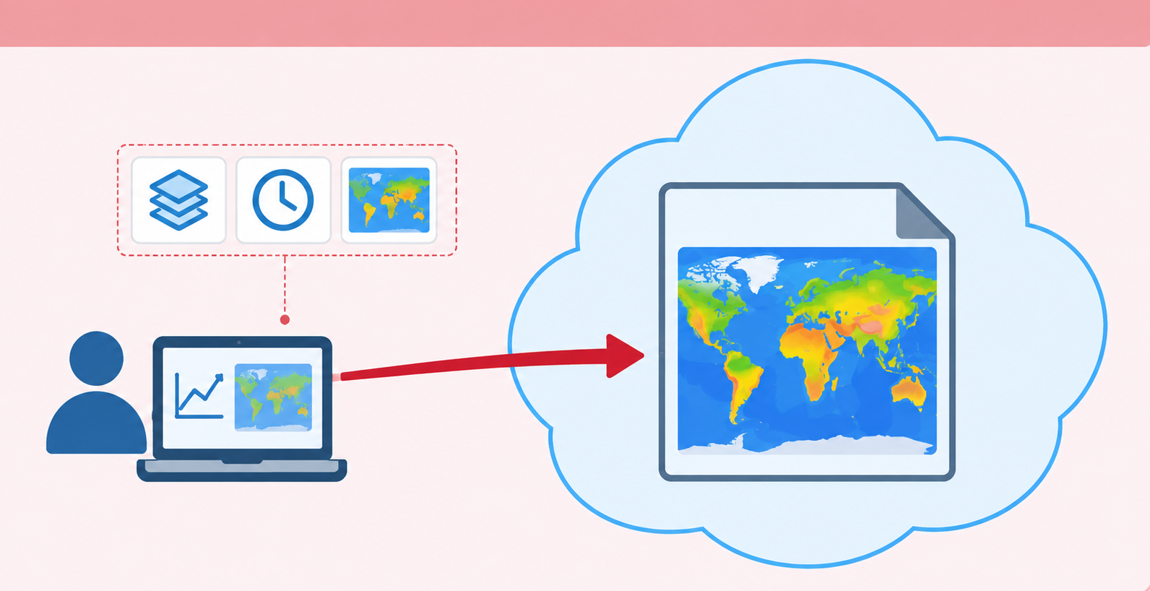
The traditional file-based workflow
Rationale: One file , one unit of access
Notes:
Many traditional scientific workflows are organised around files. A researcher finds a file on a repository or server, downloads or opens it, selects the required observations, and then performs the analysis.

Slide 6
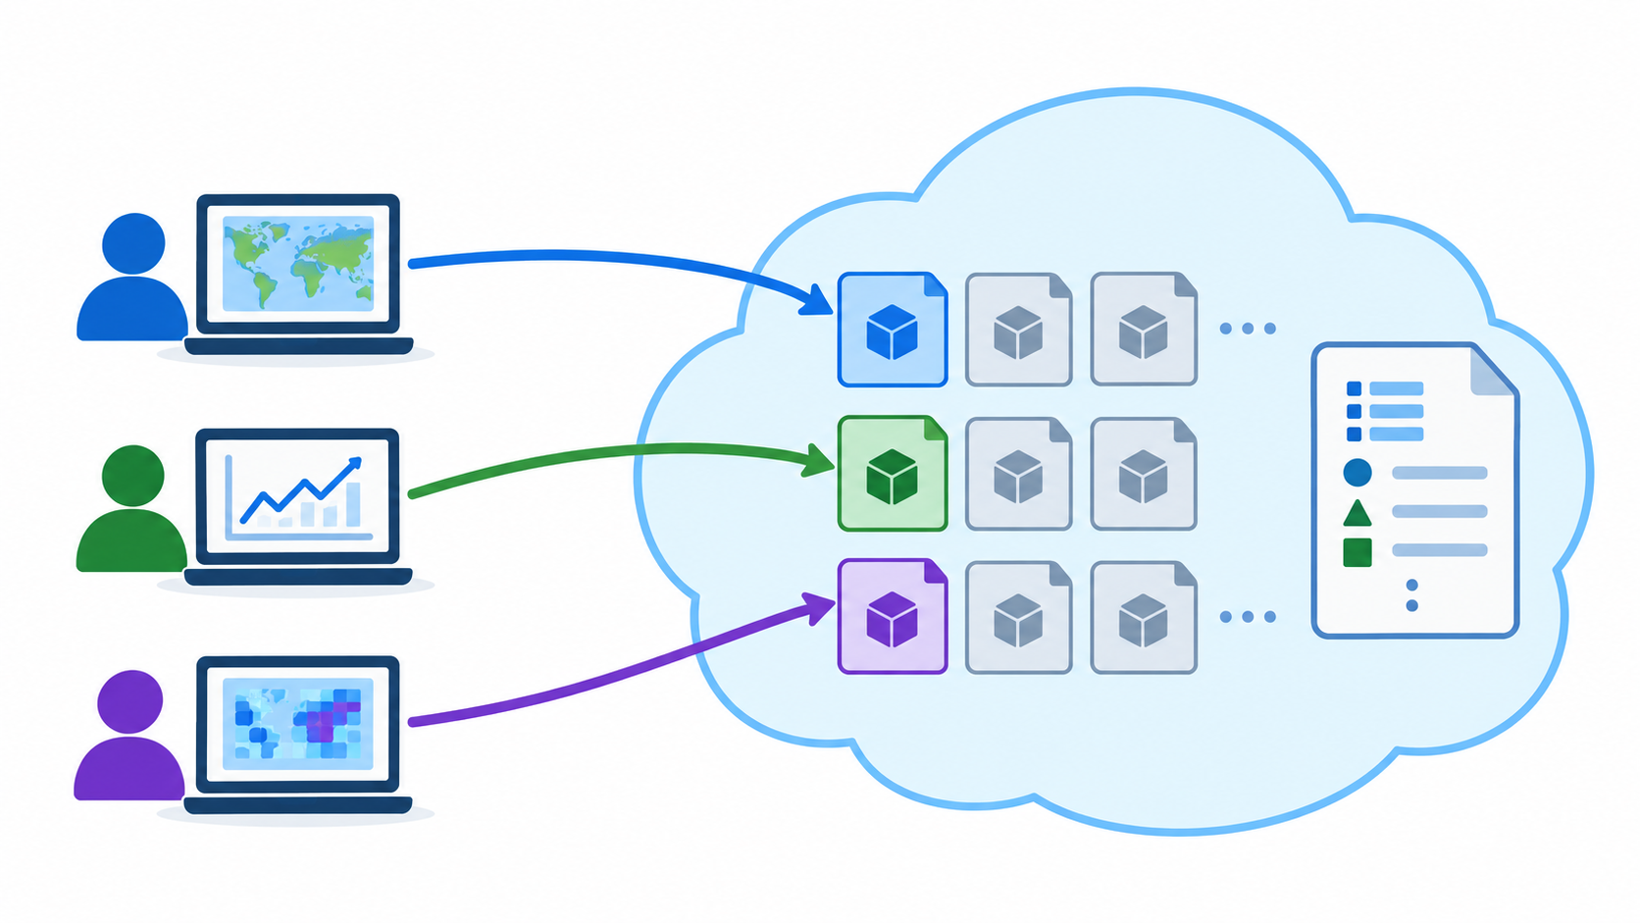
Cloud native layouts
Rationale: Break down each file into smaller independently accessible parts
Notes:
Many traditional scientific workflows are organised around files. A researcher finds a file on a repository or server, downloads or opens it, selects the required observations, and then performs the analysis.

Slide 7
NetCDF vs Zarr
NetCDF:
a primarily file-oriented representation
Remote access is possible
Software can use HTTP byte-range requests to retrieve regions of the file.
A NetCDF dataset is commonly packaged into a single binary file.
It gets uploaded to an object storage cloud infrastructure
But it is not a scalable model for workflows involving many repeated subsets , many paralell readers
Notes:
This definition does not require every explanation to be written directly inside one file. Meaning may also be expressed through persistent identifiers that resolve to external vocabularies, code lists, specifications, instruments, methods, or provenance records. What matters is that the references and relationships are explicit and machine-actionable rather than hidden in personal knowledge, filenames, or informal documentation.

Slide 8
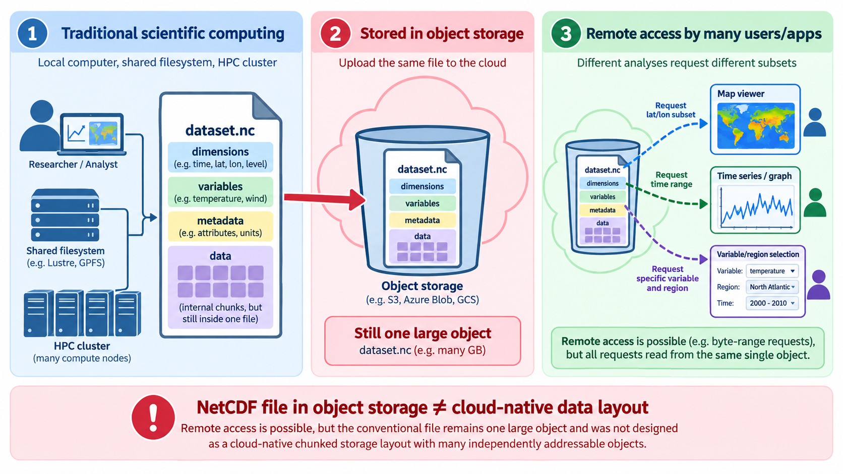

Slide 9
NetCDF vs Zarr
Zarr:
a cloud-oriented chunked representation
Remote access is possible.
Each chunk can be retrieved independently
Supports parallel access
It gets uploaded to an object storage cloud infrastructure
Zarr divides arrays into smaller pieces called chunks. A chunk represents a region of a multidimensional array, can be read independently from the others and it size is a design choice that should match the expected access pattern.
The key difference from a cloud perspective is that a Zarr storage layout can expose those chunks as independently addressable parts of the storage system
Notes:
Zarr is a format for storing multidimensional arrays together with the metadata needed to interpret them. Like NetCDF, it can represent scientific data with multiple dimensions and variables, but it uses a different physical storage model.

Slide 10
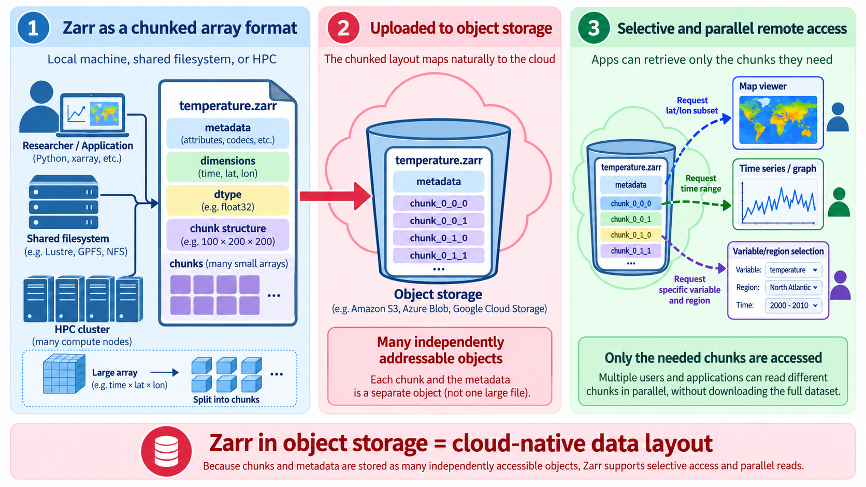

Slide 11
So, then:
Zarr should not be understood simply as a replacement for NetCDF
NetCDF remains fundamental to climate and atmospheric sciences, large scientific archives, established tools, community conventions, repositories, and existing research workflows depend on it.
Zarr becomes particularly relevant when multidimensional datasets need to be accessed repeatedly over a network
Both can represent multidimensional scientific data. What changes is how that data is physically organised and retrieved.
Notes:
Many traditional scientific workflows are organised around files. A researcher finds a file on a repository or server, downloads or opens it, selects the required observations, and then performs the analysis.

Slide 12
Exercise:
What changes in interoperability?
Imagine that the same scientific dataset is moved from a conventional NetCDF file representation to a cloud-native layout such as Zarr. Think individually for 1–2 minutes, then discuss with a partner:
Which aspects of interoperability change when moving from a conventional NetCDF file representation to a cloud-native layout such as Zarr? Which aspect is not automatically changed or improved by this move?
Be prepared to explain your reasoning to the group.
Notes:
Many traditional scientific workflows are organised around files. A researcher finds a file on a repository or server, downloads or opens it, selects the required observations, and then performs the analysis.

Slide 13
Self-paced demo:
Hands-on:
NetCDF to virtual Zarr-compatible access with Kerchunk
Notes:
Many traditional scientific workflows are organised around files. A researcher finds a file on a repository or server, downloads or opens it, selects the required observations, and then performs the analysis.

