Slide 1

Semantic interoperability
Interoperability in Climate and Atmospheric sciences
FAIR NetCDF Data

Slide 2

The Problem
Can others understand and reuse the data correctly without making unnecessary assumptions?

Slide 3
Semantic interoperability
Shared and explicit meaning
Notes:
This definition does not require every explanation to be written directly inside one file. Meaning may also be expressed through persistent identifiers that resolve to external vocabularies, code lists, specifications, instruments, methods, or provenance records. What matters is that the references and relationships are explicit and machine-actionable rather than hidden in personal knowledge, filenames, or informal documentation.

Slide 4
Semantic interoperability
Shared and explicit meaning
Free-text label
Controlled vocabularies
Code lists
Taxonomy
Ontology
Human-readable description without controlled meaning, e.g. long name=“radar velocity”
Approved terms with definitions and governance e.g. CF
Permitted values or codes for a particular field
Concepts organised through broader, narrower, or related links
Formal concepts, properties, and relationships that may support logical reasoning
Notes:
This definition does not require every explanation to be written directly inside one file. Meaning may also be expressed through persistent identifiers that resolve to external vocabularies, code lists, specifications, instruments, methods, or provenance records. What matters is that the references and relationships are explicit and machine-actionable rather than hidden in personal knowledge, filenames, or informal documentation.

Slide 5

A semantic resource is more useful when:
its terms have stable identifiers;
definitions are publicly accessible;
versions and changes are documented;
synonyms and deprecated terms are managed;
relationships between concepts are explicit where needed; and
the resource is maintained through an open community process.

Slide 6



Relevant resources
The CF metadata conventions are designed to promote the processing and sharing of NetCDF files.The conventions define metadata that provide a definitive description of what the data in each variable represents, and the spatial and temporal properties of the data.
The home of ontologies and semantic artefacts in Earth System, environment and related domains.
https://earthportal.eu/
https://cfconventions.org/
The authoritative resource that governs the standard
names used in CF-compliant datasets
https://cfconventions.org/Data/cf-standard-names/current/build/cf-standard-name-table.html

Slide 7
Exercise
Can these variables be compared? (Think-Pair-Discuss)
https://4turesearchdata-carpentries.github.io/interoperability-climate-sciences/semantic-interoperability.html#semantic-interoperability-through-the-cf-conventions
Notes:
“easy” means with the less assumptions as possible about how to integrate them and also less manual intervention

Slide 8
Exercise (plenum)
Semantic interoperability : True or False?
https://4turesearchdata-carpentries.github.io/interoperability-climate-sciences/semantic-interoperability.html#semantic-interoperability-through-the-cf-conventions
Notes:
“easy” means with the less assumptions as possible about how to integrate them and also less manual intervention

Slide 9
standard_name
long_name
Feature_Type
What is being measured?
How can we describe it for people?
What kind of observations are these? E.g. time series, profiles , trajectories
Main elements Climate and Forecast Convention
units
How are the values expressed? (must be compatible with the canonical units of the standard_name)
Ancillary variables
What additional information is associated with the values?, e.g. instrument, quality-control flags
bounds/cell_methods
Coordinates
What does each value represent?
Where and when?

Slide 10
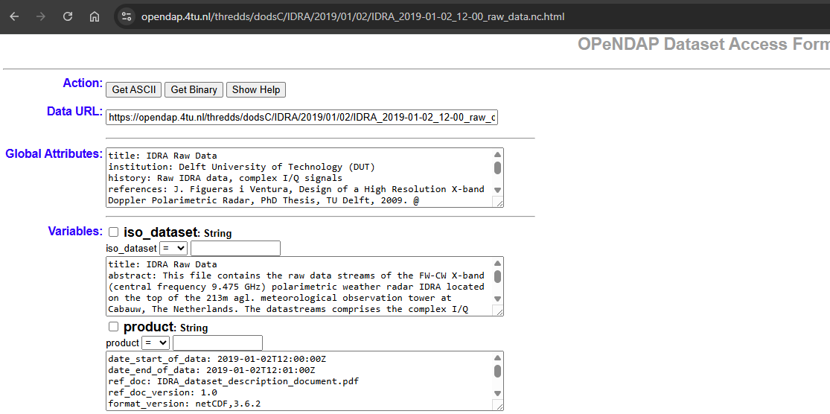

Compliance check
Data
Tool
https://opendap.4tu.nl/thredds/catalog/IDRA/2019/01/02/catalog.html?dataset=IDRA_scan/2019/01/02/IDRA_2019-01-02_12-00_raw_data.nc
https://compliance.ioos.us/index.html
Report
Notes:
“easy” means with the less assumptions as possible about how to integrate them and also less manual intervention

