Slide 1


Interoperability in Climate and Atmospheric sciences
FAIR NetCDF Data
Pilot workshop
October 22nd , 2026

Slide 2



Who are we
Leila Iñigo de la Cruz Digital Competences Trainer E: L.M.InigoDeLaCruz@tudelft.nl
Aleksandra Wilczynska Data Solutions Engineer E: A.E.Wilczynska@tudelft.nl

Slide 3


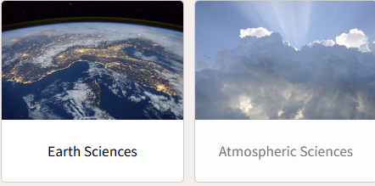
Context
The repository for Natural , Engineering and Design sciences in NL
A national need on having best practices to embed interoperability into everyday research workflows of different disciplines.
Opportunity to build accessible, and reusable lesson materials for the community
Domain specific training needs
Notes:
We have many inititiaves in the NL that revolves around building awareness on interoperability from a specific discipline standpoint

Slide 4
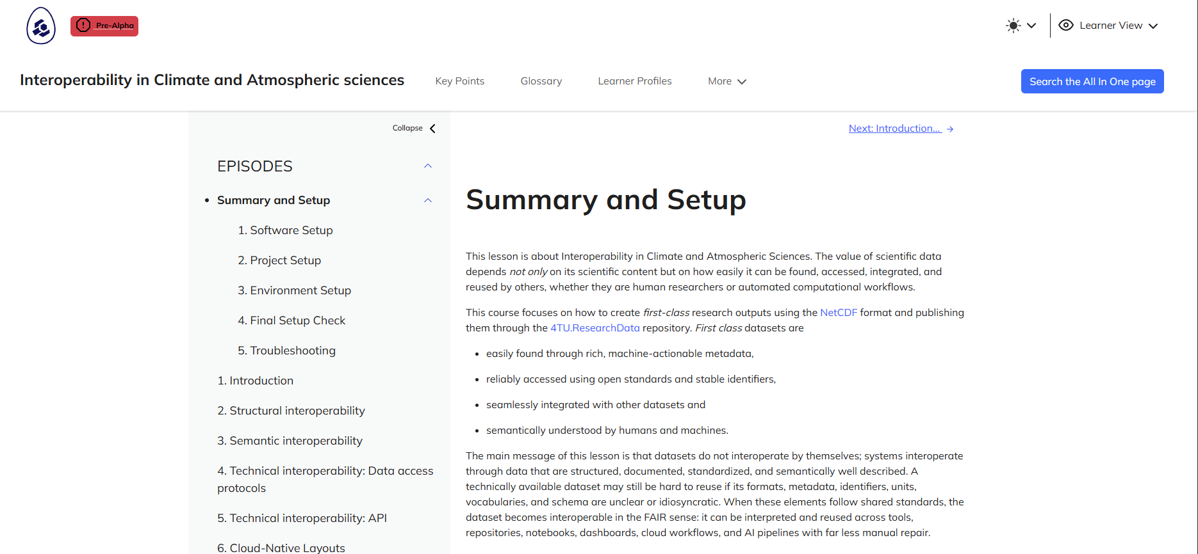
Interoperability in Climate and Atmospheric sciences
https://4turesearchdata-carpentries.github.io/interoperability-climate-sciences/index.html

Slide 5
Interoperability in Climate and Atmospheric sciences
Today is the Pilot of the lesson, thanks for participating!

Slide 6
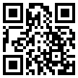
Interoperability in Climate and Atmospheric sciences
Who are you?
https://vevox.app/#/m/144372812

