Slide 1

Technical interoperability II : API
Interoperability in Climate and Atmospheric sciences
FAIR NetCDF Data

Slide 2

The Problem
How can one computer system access data held by another system?
How can software interact programmatically with the functions and resources provided by another system?

Slide 3
Tecnical interoperability
ensures
Software systems can reliably exchange data and metadata without human intervention
Notes:
This definition does not require every explanation to be written directly inside one file. Meaning may also be expressed through persistent identifiers that resolve to external vocabularies, code lists, specifications, instruments, methods, or provenance records. What matters is that the references and relationships are explicit and machine-actionable rather than hidden in personal knowledge, filenames, or informal documentation.

Slide 4
Tecnical interoperability
ensures
Software systems can reliably exchange data and metadata without human intervention
Is achieved by
standardize protocols, e.g. API
Notes:
This definition does not require every explanation to be written directly inside one file. Meaning may also be expressed through persistent identifiers that resolve to external vocabularies, code lists, specifications, instruments, methods, or provenance records. What matters is that the references and relationships are explicit and machine-actionable rather than hidden in personal knowledge, filenames, or informal documentation.

Slide 5
01
What are APIs
An API (Application Programming Interface) defines
defines how one software system can interact with another in a structured and predictable way.

Slide 6
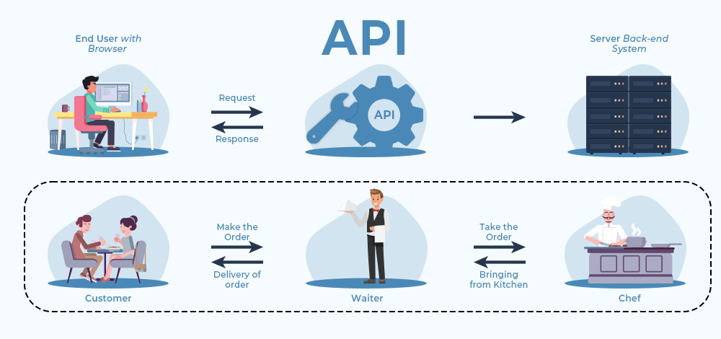
Client
Server
Notes:
An API is like a waiter in a restaurant.
You don’t go into the kitchen and cook the meal yourself.
You just place an order and hope the kitchen doesn’t return a 500 Internal Server Error

Slide 7
APIs can take different forms depending on where and how systems communicate
02
Library APIs
OS APIs
APIs examples
Database APIs
Web APIs
Notes:
**Library or programming APIs** allow software code to interact with functions, classes, or modules provided by a software package.
**Operating system APIs** allow applications to interact with system resources such as files, memory, or hardware.
* **Database APIs** allow applications to query and modify information stored in databases.
* **Web APIs** allow applications and services to communicate over a network, usually using standard web technologies.
A **Web API** provides a machine-accessible interface through which one system can request data or services from another over the web.
Web APIs are an important mechanism for **technical interoperability** because they allow systems to exchange data and metadata programmatically, without requiring a person to interact manually with a website.

Slide 8
03
Web APIs usually defines:
Endpoints : the address of the resource exposed by the API
HTTP methods:They use a shared vocabulary of methods. GET, POST, PUT, DELETE to define how to exchange resources across the web.
Parameters: Additional information to refine the request
Representation: Most Web APIs today use the JSON format to exchange data.
Authentication: Mechanism to identify users or software and determine which operations they are allowed to perform.
Core concepts
of Web APIs
Notes:
HTTP - Hyper text transfer protocol
JSON – Java Script Object notation

Slide 9
Structural interoperability
Semantic interoperability
Metadata fields, controlled terms ensure that machines interpret content consistently
APIs
JSON responses must follow well defined schemas
Without structural and semantic agreement, an API may be technically functional but scientifically meaningless.
Notes:
Without structural and semantic agreement, an API may be technically functional but scientifically meaningless.

Slide 10
04
Why APIs are relevant for research
Climate and atmospheric research often depends on large, distributed, and continuously updated datasets produced by satellites, radar systems, weather stations, numerical models, and research infrastructures.
Relevance of APIs for your discipline
Notes:
HTTP - Hyper text transfer protocol
JSON – Java Script Object notation

Slide 11
04
Why APIs are relevant for research
Climate and atmospheric research often depends on large, distributed, and continuously updated datasets produced by satellites, radar systems, weather stations, numerical models, and research infrastructures.
Relevance of APIs for your discipline
A typical workflow:
Query a data service from radar observations
Retrieve metadata and identify data files
Process the selected data in Python
Publish the results and metadata to a research repository
Generate derived products
Notes:
HTTP - Hyper text transfer protocol
JSON – Java Script Object notation

Slide 12
True or False Exercise
https://4turesearchdata-carpentries.github.io/interoperability-climate-sciences/technical-interoperability.html
Notes:
HTTP - Hyper text transfer protocol
JSON – Java Script Object notation

Slide 13
Hands on 4TU.ResearchData Web API
The Unix terminal allows HTTP requests using `curl`.
`curl` = client URL: send requests and receive responses.
CURL Anatomy:
curl -X <HTTP_METHOD> <URL> -H "<HEADER_KEY>: <HEADER_VALUE>" -d '<BODY_DATA>'
Notes:
HTTP - Hyper text transfer protocol
JSON – Java Script Object notation

Slide 14
Hands on 4TU.ResearchData Web API
base URL] : https://data.4tu.nl
[specific resource URL:endpoint]: https://data.4tu.nl/v2/articles
- Open your Unix terminal
Exercise : Checking the connection with the
server using the web browser and CURL in the Unix terminal
Open a web browser and write: https://data.4tu.nl/v2/articles
One the Unix terminal and write:
curl –X GET https://data.4tu.nl/v2/articles | jq
How are both responses compared to each other?
Notes:
HTTP - Hyper text transfer protocol
JSON – Java Script Object notation

