Slide 1


Data organization in spreadsheets
Kristina Hettne, 30 Sept 2024
Adapted from: Esther Plomp. (2021, October 25). Data Carpentry: Data Organization in Spreadsheets for Social Scientists. Zenodo. https://doi.org/10.5281/zenodo.5593434

Slide 2
Lesson outline
Good data entry practices
Formatting data tables in spreadsheets
How to avoid common formatting mistakes
Recognizing and reformatting dates in spreadsheets
Basic quality control and data manipulation in spreadsheets
Importing and exporting data from speadsheets
https://datacarpentry.org/spreadsheets-socialsci/

Slide 3


Software needed
Microsoft Excel
OR
LibreOffice

Slide 4
Spreadsheets use
Data entry
Tables for publications
Generate summary statistics
Figures
But…
Manual: Easy to make mistakes and not machine readable
Copy-pasting the wrong cells
Messing up formula
Accidental deletion

Slide 5
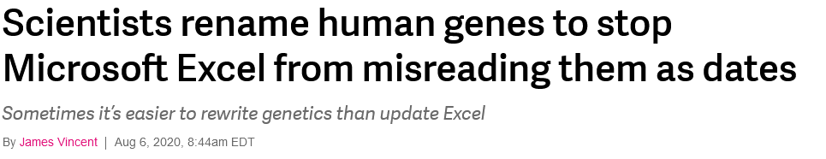
Machine readable?
“Everybody” knows that MARCH1 is a gene name, except the computer…
Software can’t process information that
Relies on context
Contain notes in the margin
Uses spatial layout of data
Uses field formatting
MARCH1 = 1-Mar?
https://www.theverge.com/2020/8/6/21355674/human-genes-rename-microsoft-excel-misreading-dates

Slide 6
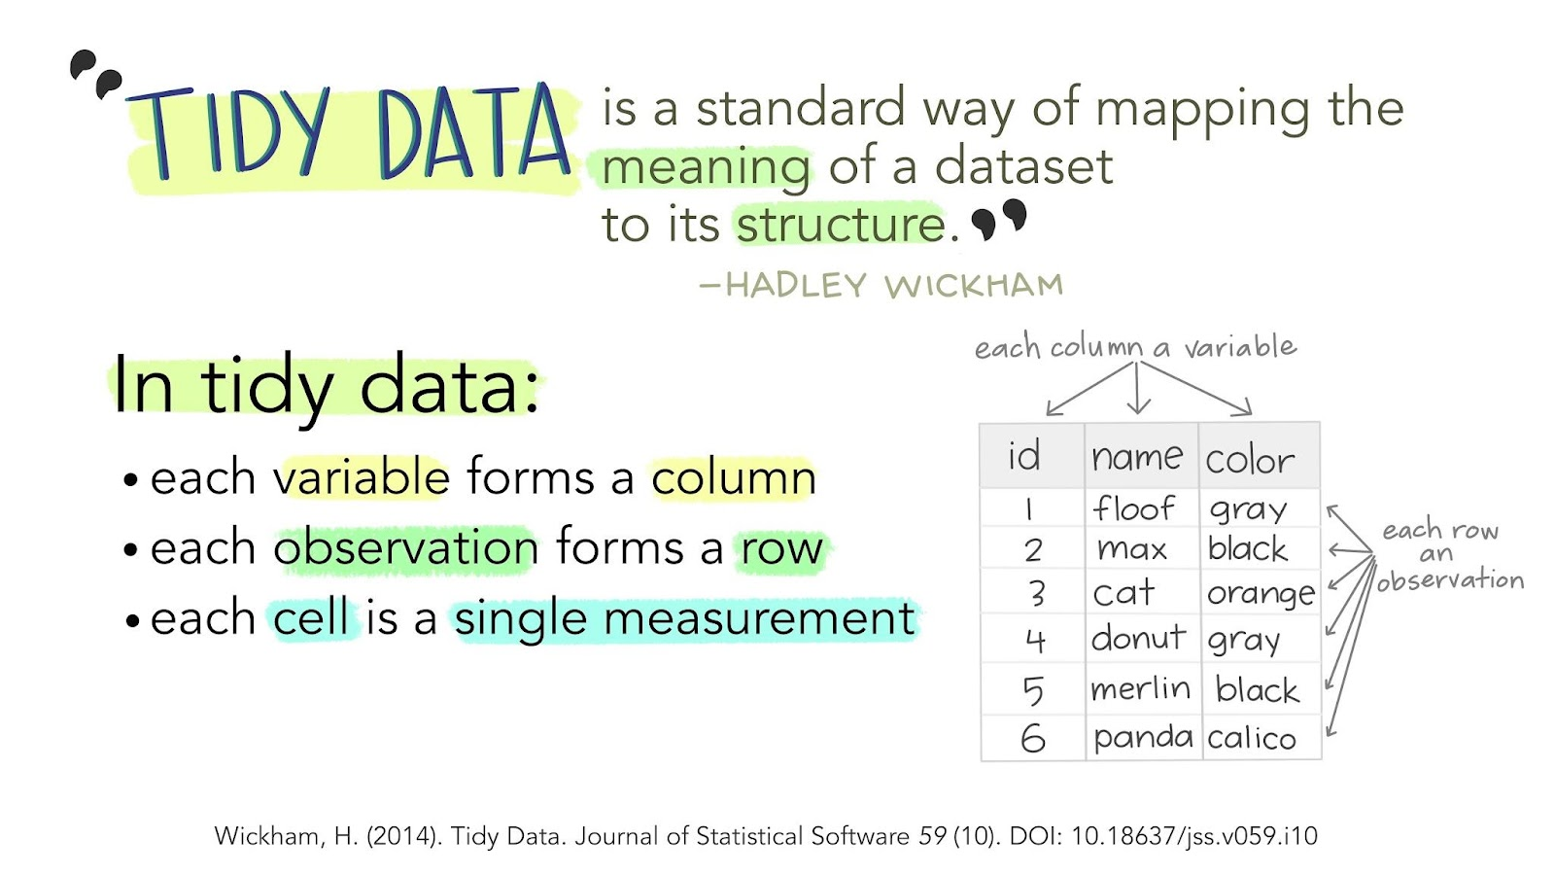
Tidy Data Paper by Wickham (see here for a R code version)

Slide 7
Good practice for spreadsheets
Be consistent
Write dates like YYYYMMDD (consider to split info)
Do not leave empty values (use NA)
Put as little information possible in a single cell and one observation per row
Create a README file that describes the spreadsheet and any cleaning steps you took
Leave the raw data alone!
Do not use formatting (colours, font, bolding)
Use data validation to avoid errors
References and extra reading:
Broman and Woo 2018
Spreadsheets for Ecologists or Social Scientists)
Cornell University README file template

Slide 8
Workshop dataset
Interviews of farmers in two countries in eastern sub-Saharan Africa (Mozambique and Tanzania), conducted between November 2016 and June 2017
Topics:
household features (construction materials used, number of household members)
agricultural practices (water usage)
assets (number and types of livestock)
This is a simplified version of a real dataset!
Studying African Farmer-led Irrigation (SAFI) Dataset

Slide 9
Exercise (15 min)
Work in pairs if possible
Download the messy data
Open the data in a spreadsheet program
Notice that there are two tabs. Two researchers conducted the interviews, one in Mozambique and the other in Tanzania. They both structured their data tables in a different way. Now, you’re the person in charge of this project and you want to be able to start analysing the data!
Clean up the spreadsheet (10 minutes)
Classroom discussion: talk about the mistake that annoyed or confused you the most (5 minutes)

Slide 10
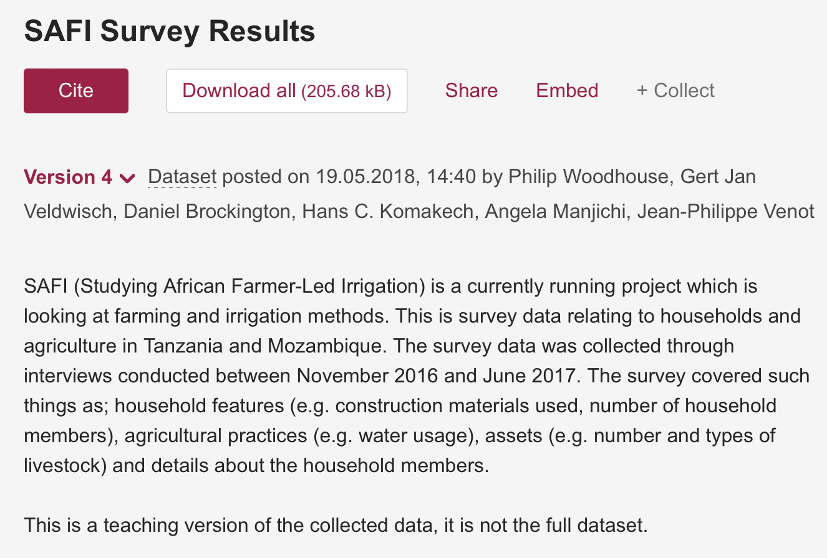
Metadata = data about your data
What information will help someone to understand the data?
Who created the data?
What is the data about?
Where can I find the data?
When were they created?
How were they created?
Why were they created?
Studying African Farmer-led Irrigation (SAFI) Dataset

Slide 11
The need for controlled vocabularies to encode data
How many ways can you say “female”?
Slide adapted from Christine Staiger
https://doi.org/10.5281/zenodo.2585691

Slide 12
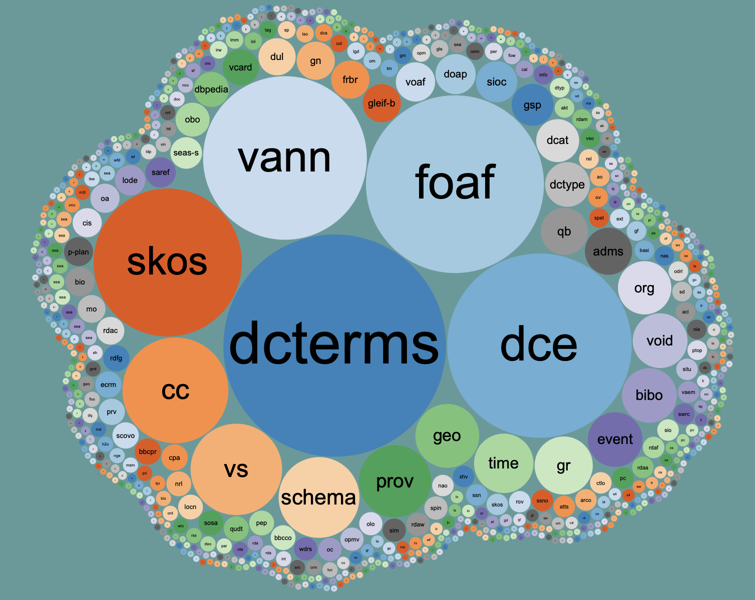
Resources for metadata standards and controlled vocabularies
RDA metadata directory: http://rd-alliance.github.io/metadata-directory/
FAIRsharing: https://fairsharing.org/standards/
Linked Open Vocabularies: https://lov.linkeddata.es/dataset/lov/
Digital Curation Center: https://www.dcc.ac.uk/guidance/standards/metadata
Image source: https://lov.linkeddata.es/dataset/lov/

Slide 13
Documentation is key!
README files
(Electronic) Labbooks
Guide for data documentation
Data Dictionary
Code Book
See the dataset info page
Check the standard at your working place!

Slide 14
Importing .csv into Excel
Download the clean version of the SAFI dataset
Excel: Open a new/empty workbook in Excel / Libre: select the right options in Text Import and click Ok
Select ‘File’ -> ’Import’ and select CSV in the popup. Click ‘Next”. Select ‘Comma’ as delimiter. Click ‘Next’ and ‘Import’.
Alternatively: Select ‘Data/Gegevens’ on the ribbon, and then ‘Get External Data/Gegevens ophalen’ -> ‘From Text/CSV’
Select the SAFI dataset and click Import/Laden
Earlier Excel versions only: In the Text import wizard, ensure the ‘Delimited’ option (step 1), Tick ‘Comma’ (step 2) and in step 3, keep ‘General’ ticked and ‘Finish’
Follow along with screenshots or Libre: Importing and Exporting CSV Files

Slide 15
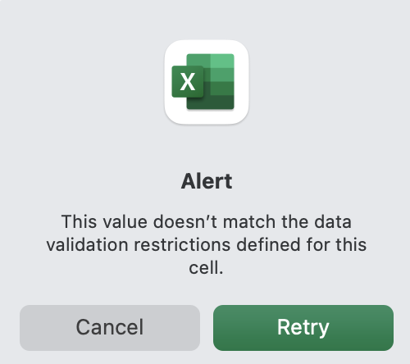
Quality assurance: data validation
Excel allows us to specify a variety of data validations to be applied to cell contents.
If the validation fails, an error is raised and the data we entered does not go into the particular cell.

Slide 16
Restricting data to a numeric range
Select the no_membrs column
In Data/Gegevens tab select Data Tools and then Data Validation/Gegevensvalidatie (Libre: Data menu, select Validity... )
Select ‘Whole number/Geheel getal’ from the Allow/Toestaan drop down options (Libre: Allow: Whole Numbers and then Data: valid range)
Minimum and Maximum boxes appear (fill in 1-30)
Enter a message in the Input Message/Invoerbericht tab (Libre: Input Help)
(You can change the error/warning in the Style/Stijl option on the Error Alert/Foutmelding tab.)
Follow along with screenshots

Slide 17
Tips
Data validation rules are not applied retroactively (to data already in cells)
Existing data will not be flagged with a warning
In some versions of Excel, you can click in the Data tab on Data Validation/Gegevensvalidatie and then “Circle invalid data/Ongeldige gegevens omcircelen”. This will put red circles around invalid data entries.
Set up data validation rules for each column when you set up your spreadsheet (before data collection)

Slide 18
Restricting data to entries from a list
Select the respondent_wall_type column
In Data tab select Data Tools and then Data Validation/Gegevensvalidatie (Libre: Data menu, select Validity... )
Select List/Lijst from the Allow/Toestaan drop-down menu (Libre: choose the List option), to pop up a Source/Bron box
Type a list of all the values that you want to be accepted in this column, separated by a comma
grass, muddaub, burntbricks, sunbricks, cement
Libre: enter the words on seperate lines
Excel: create a meaningful input message, then click OK
Follow along with screenshots

Slide 19
Data validation: lists
Typing a list of values where only a few possible values exist (like “grass, muddaub, burntbricks, sunbricks, cement”)
OR
create it as a small table (in a separate tab of the workbook). give the table a name and reference the table name as the source of acceptable inputs.
-> makes the data entry process more flexible. If you add or remove contents from the table, these are immediately reflected in any new cell entries based on this source. You can also have different cells refer to the same table of acceptable inputs.

Slide 20
Exporting data in an open format
Comma Separated Value files (.csv) are plain text files where the columns are separated by commas
Accessible: Useable by multiple types of software that are freely available (Microsoft requires a paid license)
Life expectancy: Open formats are more suitable for long term preservation because they don’t rely on a single software product
Publishing: Data repositories, journals and funding agencies may have requirements for open formats
Universal format: Interoperable format that produces the same results when it is imported by various software, including plain text editors (Notepad) and R!

Slide 21
Exporting from Excel to .csv
From the top menu select File and Save as.
In the Format field, from the list, select Comma Separated Values (*.csv).
Double check the file name and the location where you want to save it and hit Save.
Does your data contain commas?
Enclose the data fields with double quotes
Double check that the file you are exporting can be read in correctly!

Slide 22
Thank you!

