Slide 1
Data Wrangling
Peter Verhaar

Slide 2
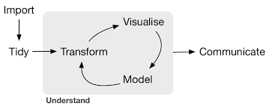
Data acquisition
Data visualisation
Data analysis
Hadley Wickham, R for Data Science (O’Reilly, 2016)
Notes:
https://r4ds.had.co.nz/

Slide 3

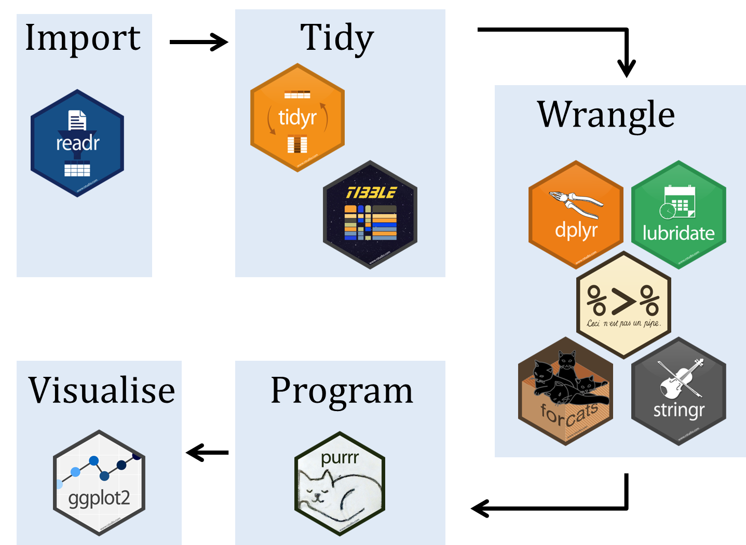
“an opinionated collection of R packages designed for data science. All packages share an underlying design philosophy, grammar, and data structures” (https://www.tidyverse.org/)

Slide 4
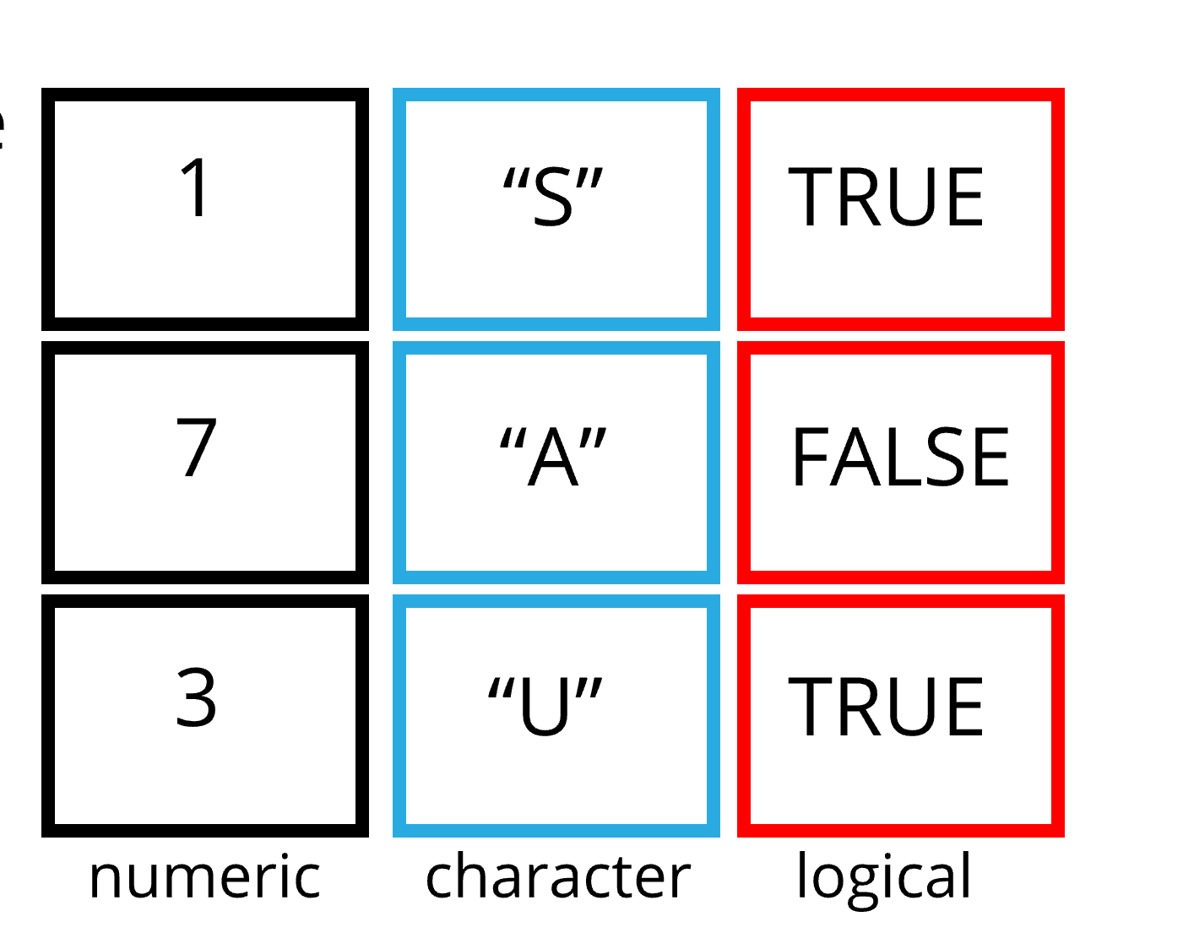
Data frame
Data structure used to store tabular data
Each column (variable) is also a vector
Tidyverse uses the term ‘Tibble’

Slide 5
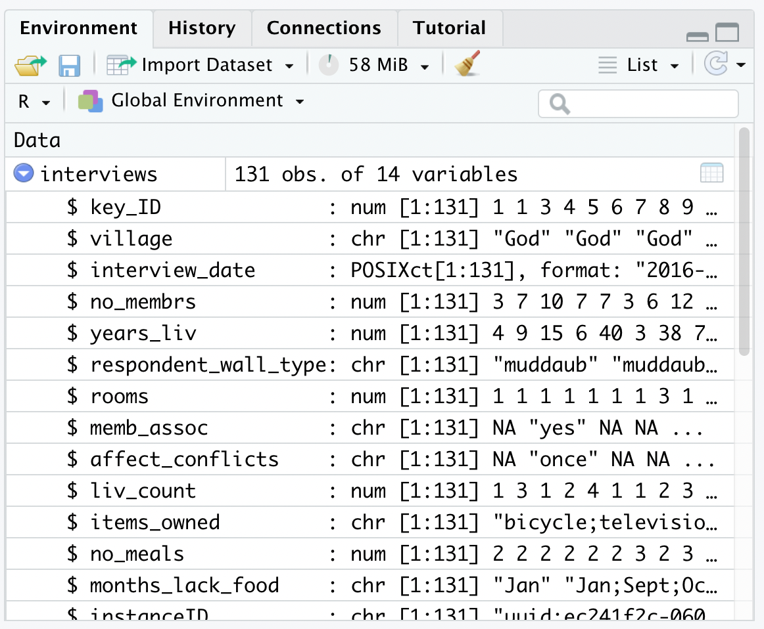

Slide 6
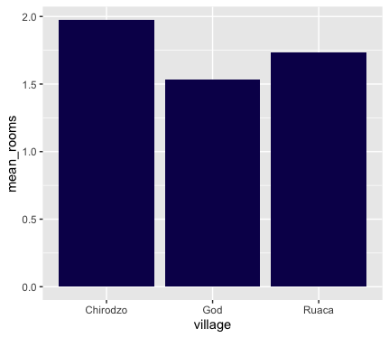
Average number of rooms in each village

Slide 7
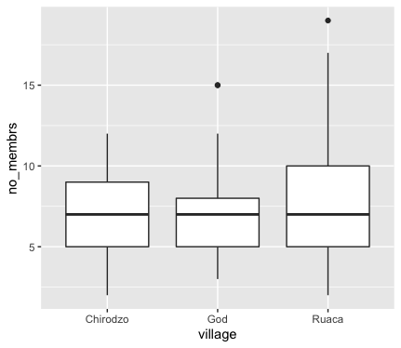
Number of people living in houses

Slide 8

select
filter
mutate
group_by
summarise

Slide 9
Exercise 1
Using pipes, subset the interviews data set:
Include interviews with respondents who were members of an irrigation association only (see the column ‘memb_assoc’)
Retain only the columns ‘affect_conflicts’, ‘liv_count’, and ‘no_meals’.

Slide 10
Exercise 2
Create a new dataframe from the interviews data (name it, for instance ‘exercise2’) that meets the following criteria:
Contains only the ‘village’ column and a new column called ‘total_meals’. This new column should specify the total number of meals served in the household per day on average (no_membrs times no_meals).
The final dataframe should only contain the rows where ‘total_meals’ is greater than 20.
Hint: think about how the commands should be ordered to produce this data frame!

Slide 11
Exercise 3
Answer the following questions:
How many households in the survey have two meals per day? How many households have three meals per day? Are there any other numbers of meals represented? (In other words: create a list of the various options for the number of meals per day, together with a count of the number of households for each of these options) Tip: Use count()

Slide 12
Exercise 4
Find the mean, min, and max number of household members for each village. Also add the number of observations per village.
(hint: use group_by() and summarize(). Also use the statistical functions man(), min(), max() and n()).

Slide 13
Exercise 5
How many interviews were conducted each month?
In order word, list the various months in which these interviews took place, and list the number of interviews for each of these months.

