Slide 1
R - Starting with data
Pascal Flohr
slides reused from Peter Verhaar
Data Carpentry, Erasmus University Rotterdam, 27 October 2026

Slide 2

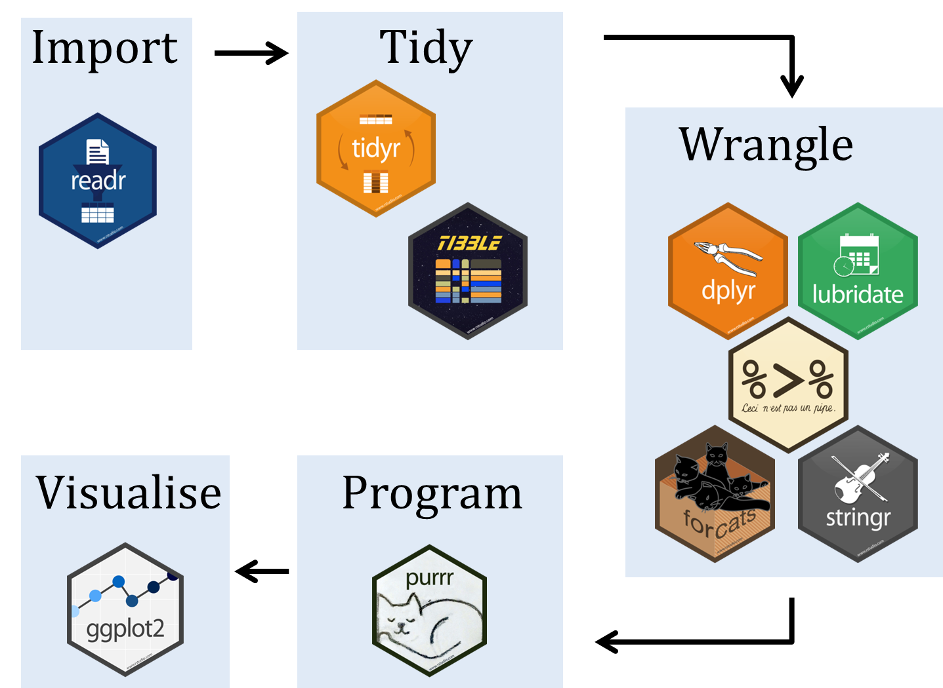
“an opinionated collection of R packages designed for data science. All packages share an underlying design philosophy, grammar, and data structures” (https://www.tidyverse.org/)

Slide 3
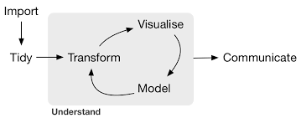
Data acquisition
Data visualisation
Data analysis
Hadley Wickham, R for Data Science (O’Reilly, 2016)
Notes:
https://r4ds.had.co.nz/

Slide 4
Data frame
Data structure used to store tabular data
Each column (variable) is also a vector
Tidyverse uses the term ‘Tibble’

Slide 5
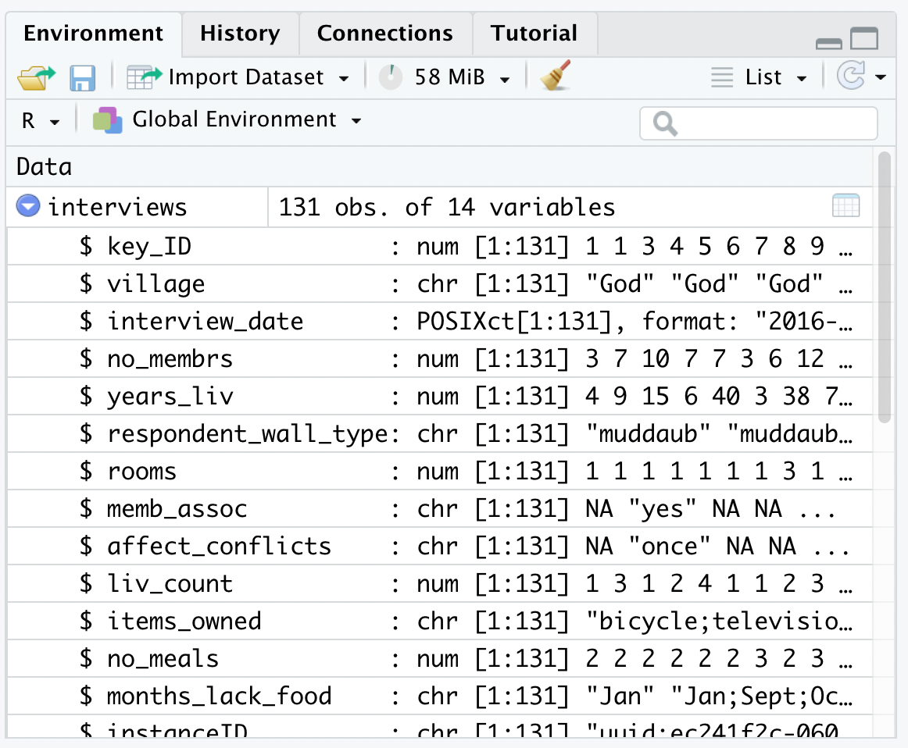

Slide 6
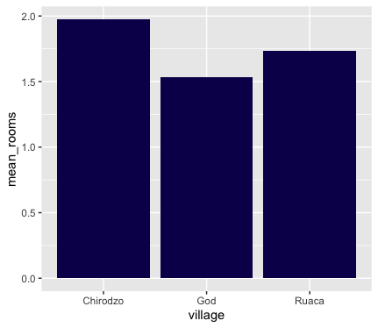
Average number of rooms in each village

Slide 7
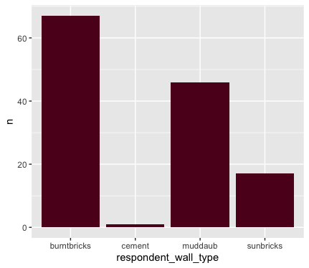
Wall types

Slide 8
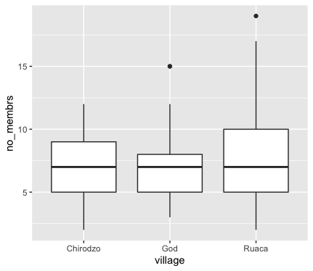
Number of people living in houses

Slide 9
Exercise 1
Create a new tibble (named interviews_100) containing only the data in row 100 of the interviews dataset.
Create a new tibble (named interview_last) containing only the data from the last row. Use nrow() to find the index of the last row. You can use the tail() function to check your results.

Slide 10
Exercise 2
Extract the row that is in the middle of the dataset. Store the data on this middle row in a tibble named interview_middle.
To find the index of the middle row, you can work with the median() function, which takes a vector as a parameter. This vector needs to start at index 1, and needs to end at the index of the last row. Tip: use the nrow() function.
Combine nrow() with the minus (‘-’) notation to reproduce the behaviour of head(interviews), keeping the first 6 rows of the interviews dataset only. Assign the result to interview_head

Slide 11
Exercise 3
How do the numbers of people that are and that aren’t members of an irrigation association compare? (are there more member or non-members?)
Make a bar chart, with two values on the X-axis: “No” and “Yes”. The dataset contains the words ‘yes’ and ‘no’ in lower case, but these words need to be capitalised in the plot. Missing values (NA values) can be ignored.
Can you recreate the bar plot such that “Yes” comes first and “No” last?

