Slide 1
Data Visualisation
Peter Verhaar

Slide 2
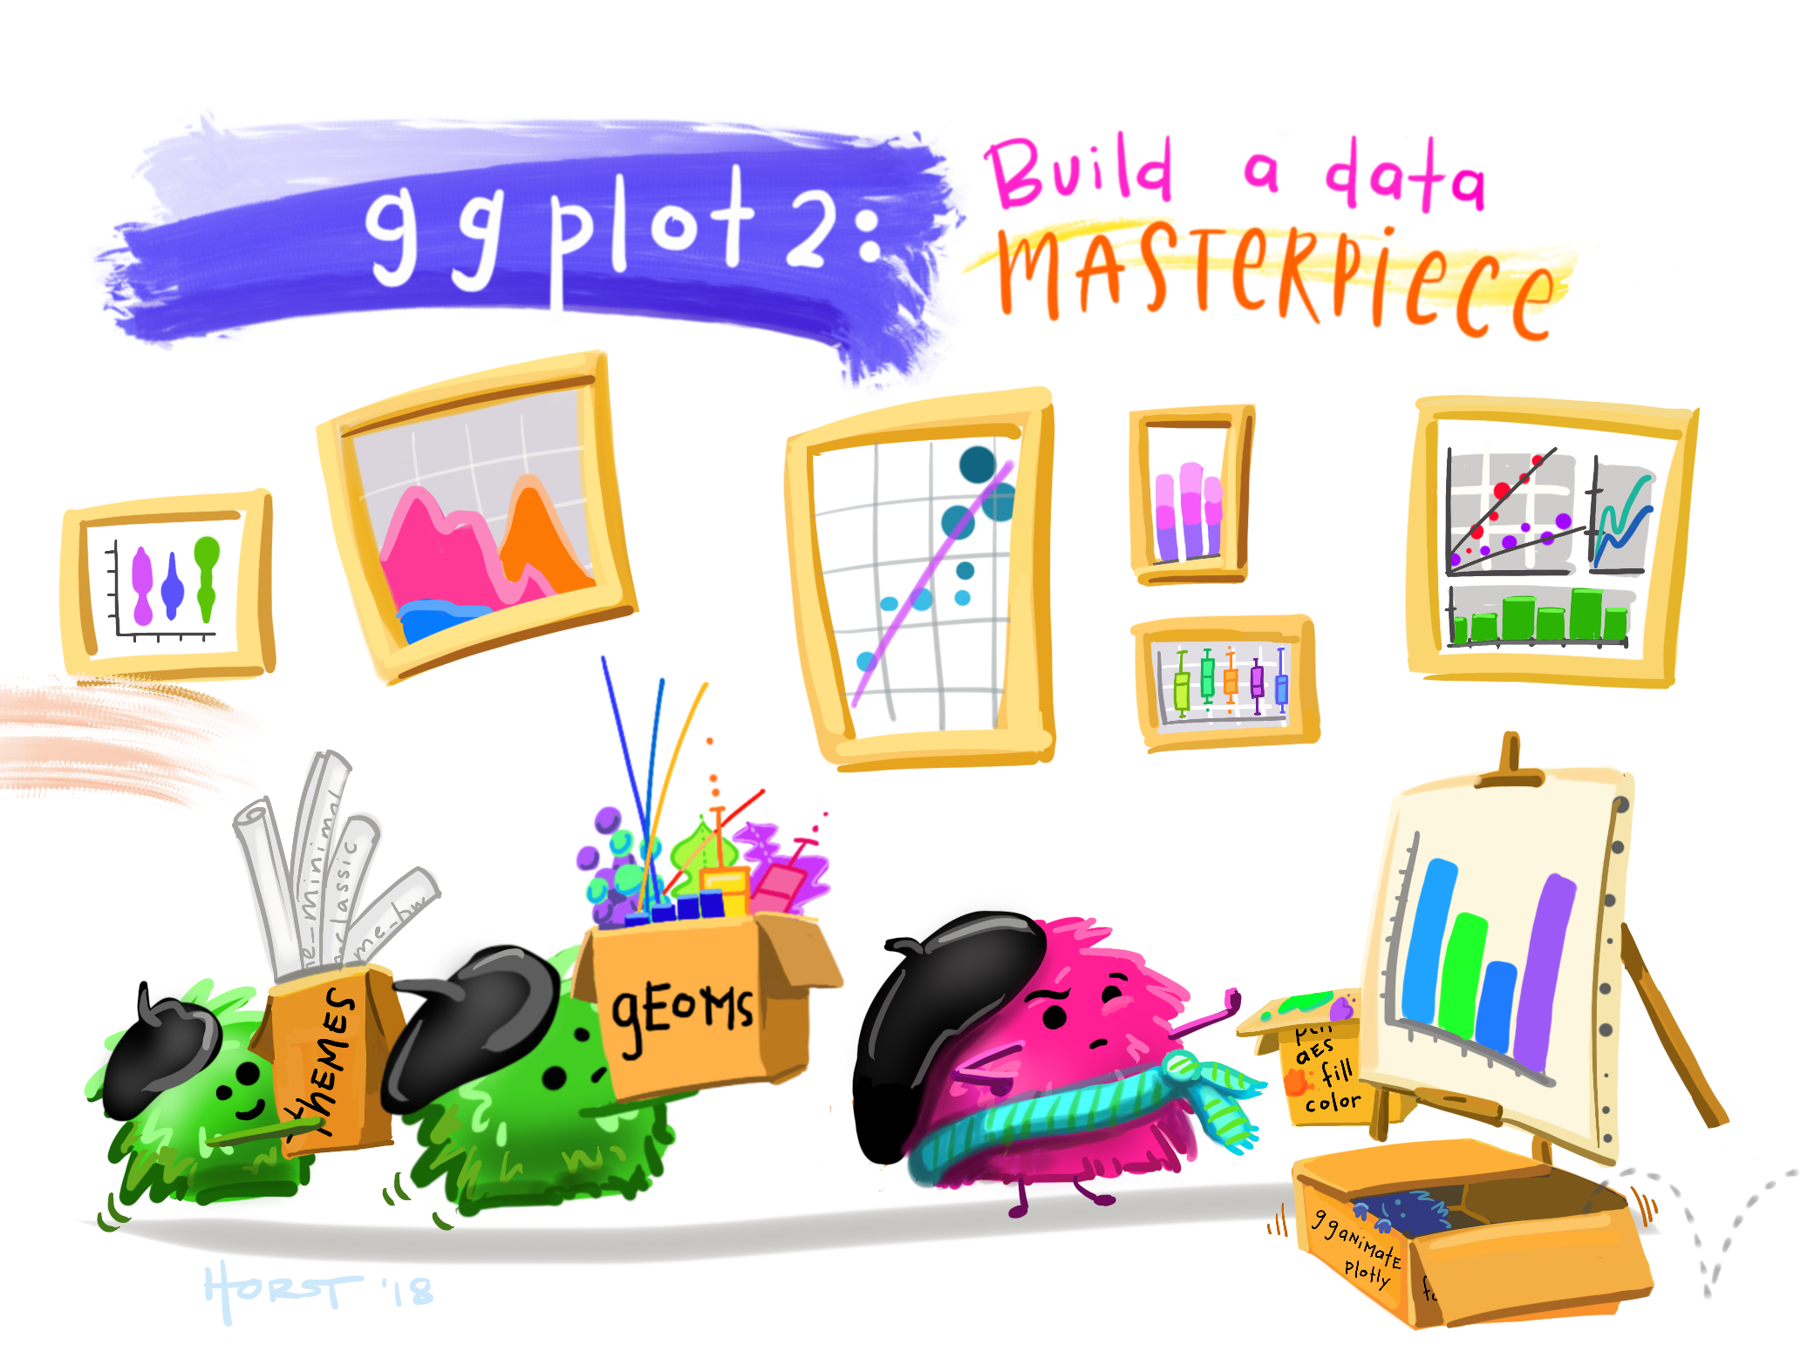
Artwork by @allison_horst https://x.com/allison_horst/status/1367866823031488513?mx=2

Slide 3

ggplot2 is a package (included in tidyverse) for creating highly customisable plots that are built step-by-step by adding layers
Technical implementation of Leland Wilkinson’s Grammar of Graphics

Slide 4
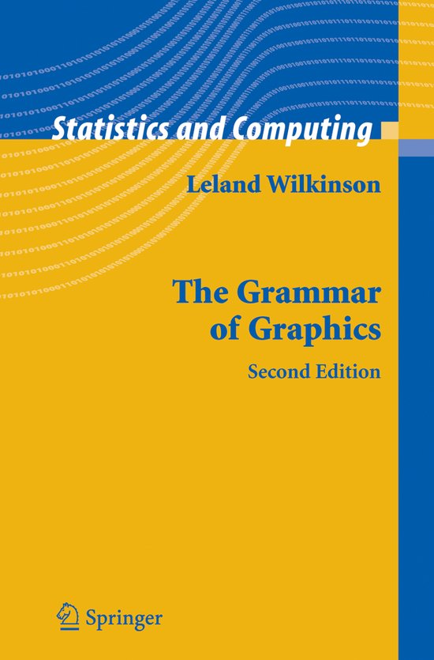
A graphic is “a mapping from data to aesthetic attributes (colour, shape, size) of geometric objects (points, lines, bars)”

Slide 5
<DATA> %>%
ggplot(aes(<MAPPINGS>)) +
<GEOM_FUNCTION>()
Aesthetic mapping
x = rooms
y = no_membrs
color = village
Geometric functions
geom_point() geom_boxplot() geom_line()

Slide 6
Exercise 1
Use what you just learned to create a scatter plot of rooms by village with the respondent_wall_type showing in different colours.
Does this seem like a good way to display the relationship between these variables? What other kinds of plots might you use to show this type of data?

Slide 7
Exercise 2
Boxplots are useful summaries, but hide the shape of the distribution. For example, if the distribution is bimodal, we would not see it in a boxplot. An alternative to the boxplot is the violin plot, where the shape (of the density of points) is drawn.
Replace the box plot with a violin plot; see geom_violin().
Use geom_jitter() to show the points as well. The points should be given a green colour, and an opacity of 0.5

Slide 8
Exercise 3
Create a stacked bar chart giving information about the number of interview respondents who were members of irrigation association.
The bar chart should show three options: ‘yes’, ‘no’ or ‘NA’.
The colours of the bars should give information of the number of respondents per village.

Slide 9
Exercise 4
Find the mean, min, and max number of household members for each village. Also add the number of observations per village.
(hint: use group_by() and summarize(). Also use the statistical functions man(), min(), max() and n()).

Slide 10
Exercise 5
How many interviews were conducted each month?
In order word, list the various months in which these interviews took place, and list the number of interviews for each of these months.

