Slide 1
Data Visualisation
Peter Verhaar

Slide 2
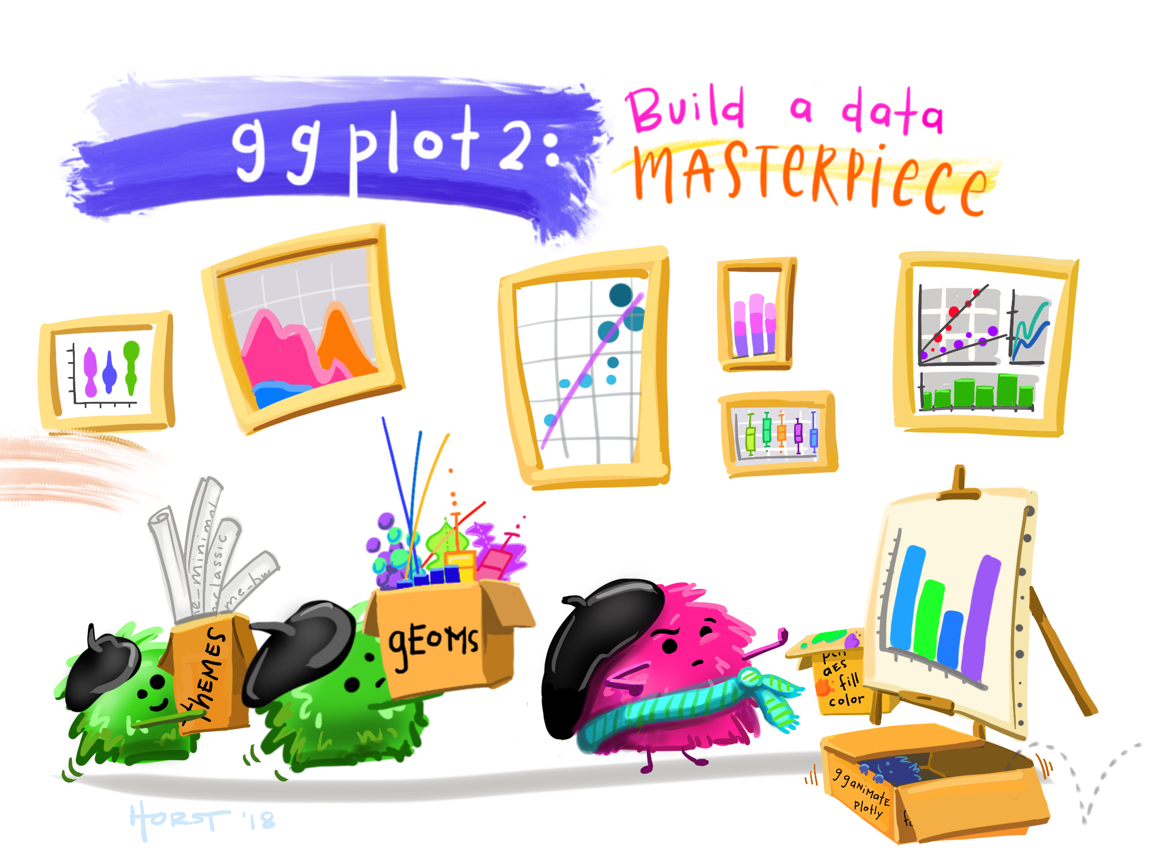
Artwork by @allison_horst https://x.com/allison_horst/status/1367866823031488513?mx=2

Slide 3
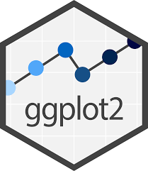
ggplot2 is a package (included in tidyverse) for creating highly customisable plots that are built step-by-step by adding layers
Technical implementation of Leland Wilkinson’s Grammar of Graphics

Slide 4
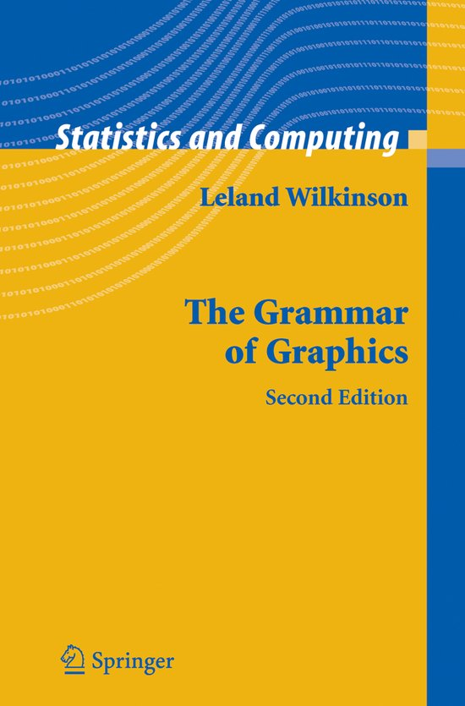
A graphic is “a mapping from data to aesthetic attributes (colour, shape, size) of geometric objects (points, lines, bars)”

Slide 5
<DATA> %>%
ggplot(aes(<MAPPINGS>)) +
<GEOM_FUNCTION>()
Aesthetic mapping
x = rooms
y = no_membrs
color = village
Geometric functions
geom_point() geom_boxplot() geom_line()

Slide 6
Exercise 1
Use what you just learned to create a scatter plot of rooms by village with the respondent_wall_type showing in different colours.
Does this seem like a good way to display the relationship between these variables? What other kinds of plots might you use to show this type of data?

Slide 7
Exercise 2
Boxplots are useful summaries, but hide the shape of the distribution. For example, if the distribution is bimodal, we would not see it in a boxplot. An alternative to the boxplot is the violin plot, where the shape (of the density of points) is drawn.
Replace the box plot with a violin plot; see geom_violin().
Use geom_jitter() to show the points as well. The points should be given a green colour, and an opacity of 0.5

Slide 8
Exercise 3
Create a stacked bar chart giving information about the number of interview respondents who were members of irrigation association.
The bar chart should show three options: ‘yes’, ‘no’ or ‘NA’.
The colours of the bars should give information of the number of respondents per village.

Slide 9
Exercise 4
Create a box plot showing the number of people living in each household, broken down by village
Add appropriate labels using lab()
Remove the grid
Experiment with one of the following themes: theme_grey, theme_linedraw,theme_light, theme_dark, theme_minimal, theme_classic, theme_void

