Slide 1
Welcome to Day 2- Python/SWC
Instructor: Leila Iñigo
Role: Trainer of Digital skills from 4TU.ResearchData
Helpers:

Slide 2
Agenda Day 2 Python SWC
09:00 - Recap of day 1
09:30 - Making choices
10:00 - Exercise 1
10:15 - Coffee break
10:30 - Creating functions
11:00 – Reusability/Modular coding/Documentation
11:30 - Exercise 2
12:00 – Lunch
12:30 – Errors and exceptions
12:45 – Defensive programming
13:00 – Command Line programs
13:20 - Wrap up

Slide 3

Live note keeping
http://bit.ly/3A9mNEJ

Slide 4
Recap day 1
Goal: Analysis inflammation data
Python fundamentals on variables and lists
Import and analyse data with `numpy`
Create figure with subplots using `matplotlib.pyplot`
Repeat analysis in a for-loop together with `glob`
Today
Catch suspicious datasets with conditional statements
Create reusable function(s) with the analysis
Understand errors
Run python in the command line (unix shell)

Slide 5
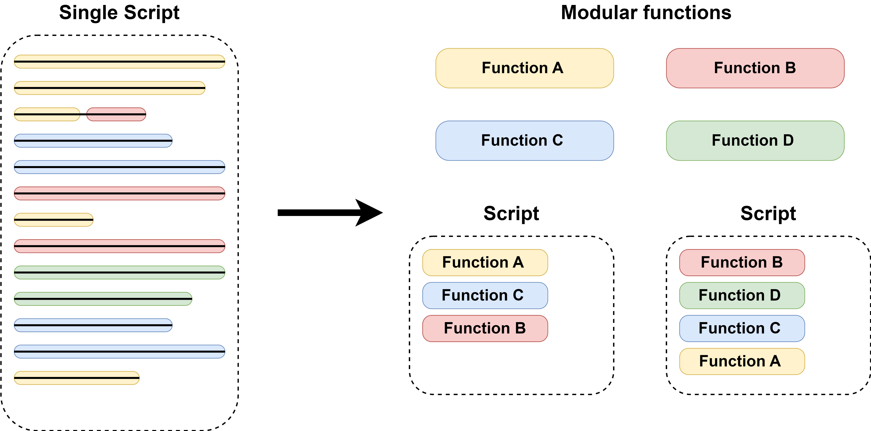
Tidying up / Modular Code

Slide 6
Tidying up / Modular Code
Modular coding is a software design technique that involves breaking code down into smaller, reusable units called modules or functions.
Advantages
Your code is easier to read, debug, and maintain.
Improve reusability of your code for yourself and others.
Use functions to break down complex tasks into simpler steps.

Slide 7
Defensive Programming
Program defensively, i.e., assume that errors are going to arise, and write code to detect them when they do.
Put assertions in programs to check their state as they run, and to help readers understand how those programs are supposed to work.
Failed assertions will generate a `AssertionError`
Use pre-conditions to check that the inputs to a function are safe to use.
Use post-conditions to check that the output from a function is safe to use.

Slide 8
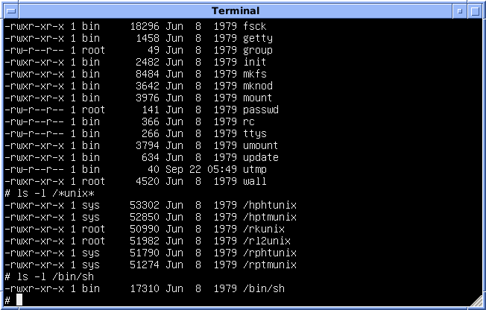
Command-line programs: Running python scripts in the terminal
when to use the terminal:
Automation
Working on remote servers , like an HPC/cloud platforms
Command line arguments : Building command-line tools or utilities that accept arguments from the user.
This Photo by Unknown Author is licensed under CC BY-SA

