Slide 1
Gas Exchange Surfaces
Organisms that have evolved adaptations for gas exchange must have specialized tissues designed for the molecular exchanges.
The specialized tissues are found in the skin of some small organisms, gills of many aquatic organisms, & the lungs of some larger terrestrial organisms.
The exchange of gases sometimes occurs between the air & living tissue (lungs) or between water & the living tissue (gills).
In many organisms the gases are immediately exchanged to blood vessels to be circulated to body tissues.

Slide 2
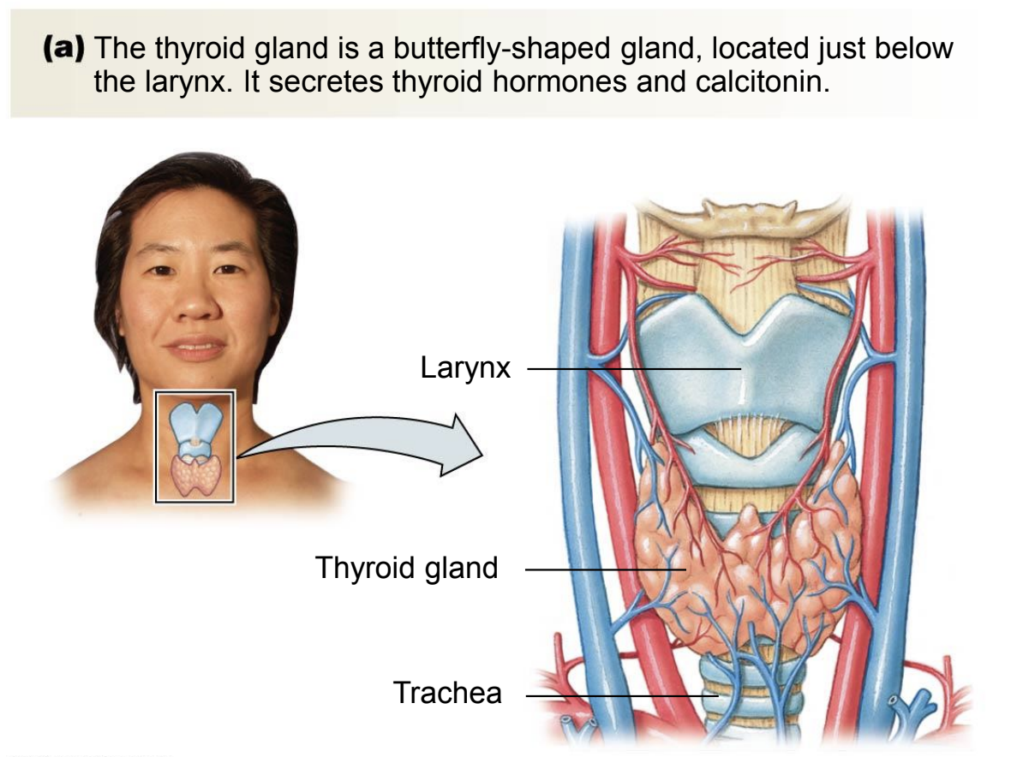
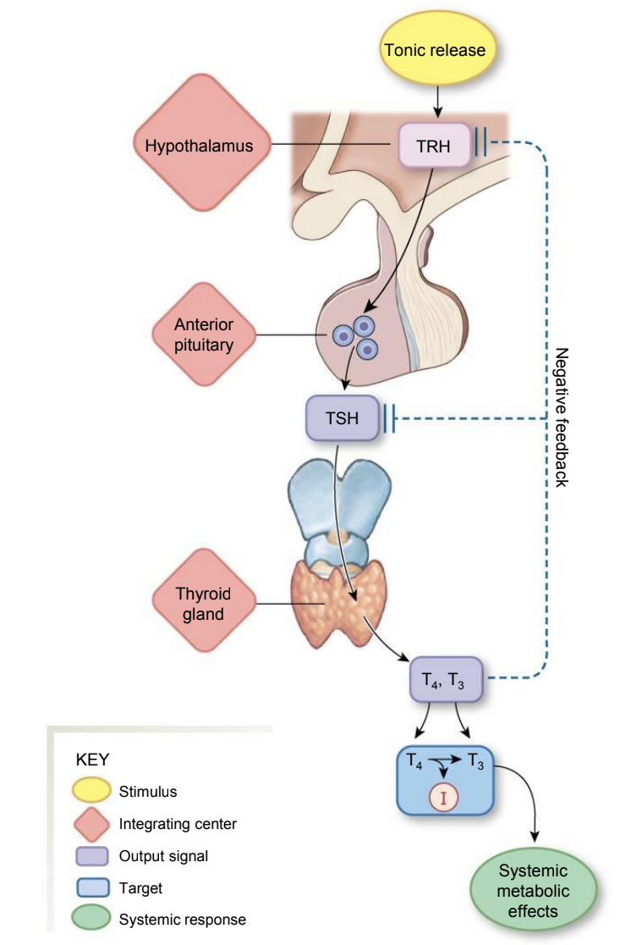
The Hypothalamus, Pituitary Gland & Endocrine System cont.
The thyroid gland consists of two lobes on the ventral surface of the trachea & produces two iodine-containing hormones: triiodothyronine (T₃) & thyroxine (T₄).
This is stimulated by the production of TSH from the anterior pituitary.
It can also produce the hormone calcitonin.
Thyroid hormones stimulate metabolism while influencing development & maturation.
Proper thyroid function requires dietary iodine for hormone production.
Hyperthyroidism - excessive secretion of thyroid hormones, causes high body temperature, weight loss, irritability & high blood pressure.
Graves’ disease - a form of hyperthyroidism in humans.
Hypothyroidism - a low secretion of thyroid hormones, causes weight gain, lethargy & intolerance to cold.

