Slide 1
Data Sources
Cloud
Fog
Mist
Virtualization
AI - Analytics
Data Science Studio
Model Management
Feature Engineering
Multi Cloud Data Platform
Model as a Service
Visualization
Analysis
Model Learning / Evaluation
Collect
Transform
Store
Model Monitoring
Big Data / ML Cluster
APIs
APIs
Notes:
Data sources: DB + Event Backbone

Slide 2
Data Sources
Cloud
Fog
Mist
Virtualization
Apps
Cloud
Fog
Mist
AI - Analytics
Data Science Studio
Model Management
Feature Engineering
Model as a Service
Multi Cloud Data Platform
Visualization
Analysis
Model Learning / Evaluation
Collect
Transform
Store
Model Monitoring
APIs
Big Data / ML Cluster
APIs
Data Flow
Cognitive Prebuilt Models
Speech To Text – Text To Speech
Image Recognition
Tone Analyzer
NLU
Model Flow
Chatbot
Notes:
Data sources: DB + Event Backbone

Slide 3





Intelligent Application
END
USER
BFF - Orchestration
MICROSERVICE
DATA
MICROSERVICE
DATA
DECISION
SERVICE
Analytic Scoring
VISUAL
SERVICES
SPEECH
SERVICES
NATURAL
LANGUAGE
SERVICES
DATA
TRANSFORMATION
DATA STORE
EVENT
SORUCES
EDGE DATA
TRANSFORMATION
DATA
TRANSFORMATION
Event Backbone
EXTERNAL
DATA
SERVICES
Real time data injection
DATA STORE
STREAMING
ANALYTICS
AI
MODEL MONITORING
EVENT
SORUCES
Real Time AI & Analytics

Slide 4


Data Injection
DATA
TRANSFORMATION
PUBLIC DATA
SOURCES
DATA
TRANSFORMATION
DATA
REPOSITORIES
AI & Analytics
ENTERPRISE
DATA
Workflow
DATA
TRANSFORMATION
Event Backbone
AI MODEL
BUILDER
ML CLUSTER

Slide 5
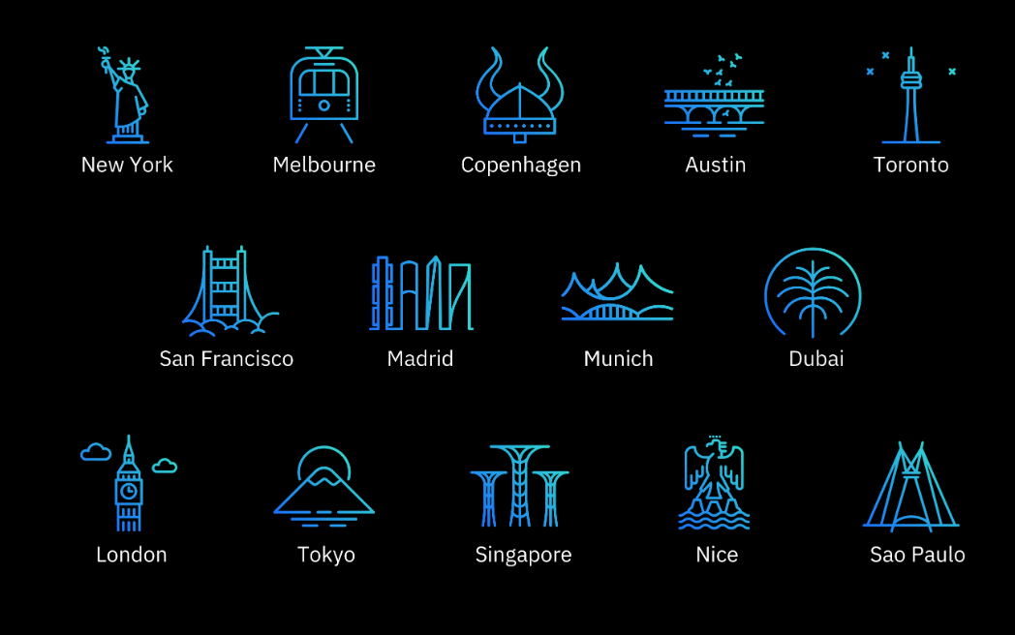
IBM Garage Locations

