Slide 1

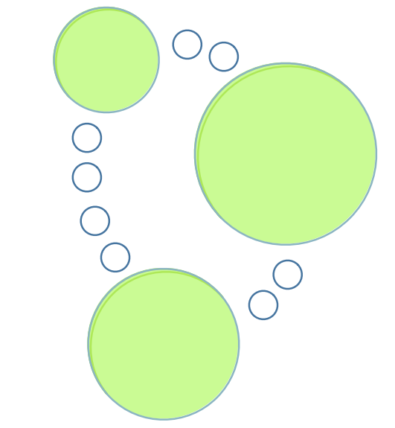
Neo4j Session

Slide 2
What is Neo4j ?
Neo4j is an "embedded, disk-based, fully transactional Java persistence engine that stores data structured in graphs rather than in tables".

Slide 3
Myths about Neo4j
Neo4j is big database
Neo4j is a framework
Neo4j fits only with network based applications
Neo4j is in memory DB and fits for small applications

Slide 4
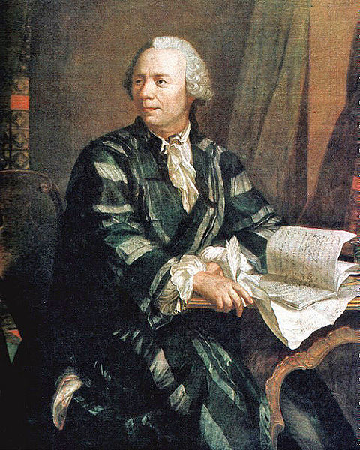
Leonhard Euler 1707-1783

Slide 5
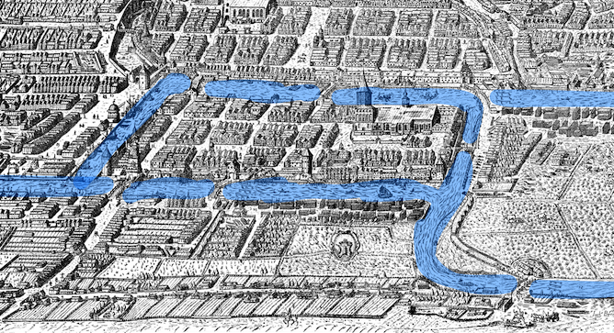
Königsberg (Prussia) - 1736
In 1736, the mathematician Leonhard Euler used the arrangement of the city's bridges and islands as the basis for the Seven Bridges of Königsberg Problem, which led to the mathematical branches of topology and graph theory. In the 19th century Königsberg was the birthplace of the influential mathematician David Hilbert.
Seven Bridges of Königsberg Problem
The problem was to find a walk through the city that would cross each bridge once and only once.

Slide 6
Why Neo4j ?
true ACID transactions
high availability
scales to billions of nodes and relationships
high speed querying through traversals
Pure graph

Slide 7
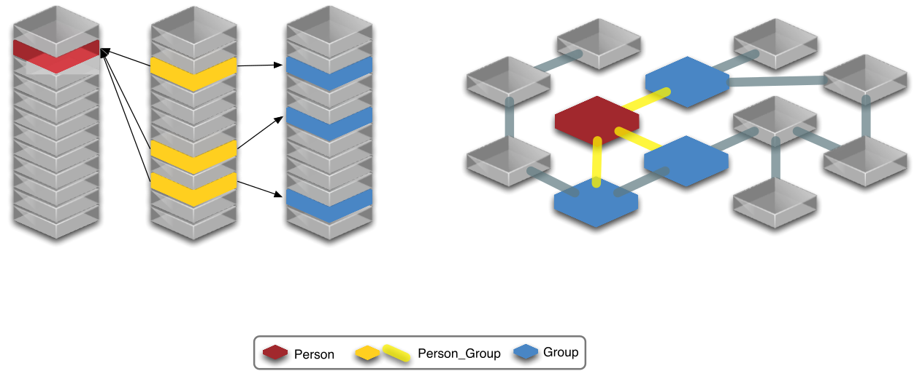
RDBMS vs Graph DB

Slide 8
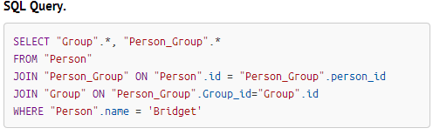
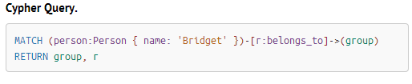
SQL vs Cypher

Slide 9
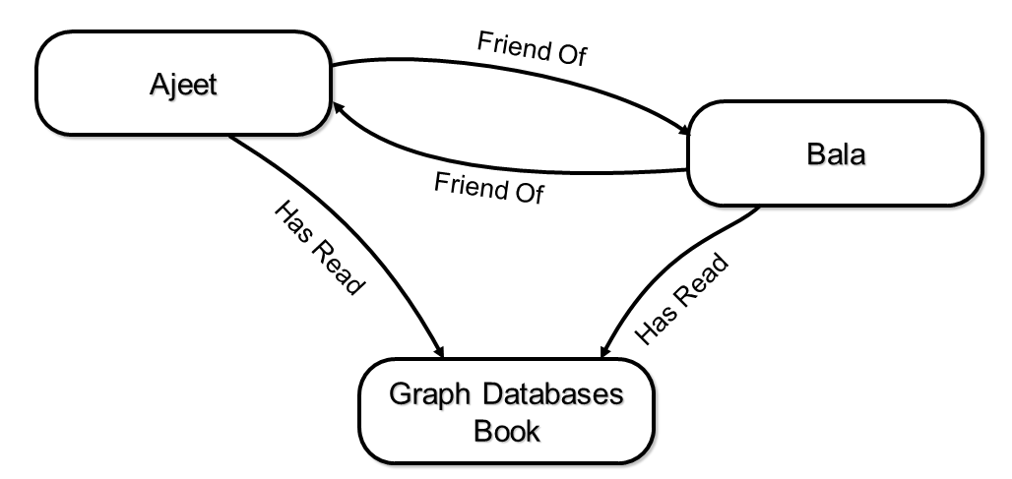
Data in Neo4j\Graph

Slide 10
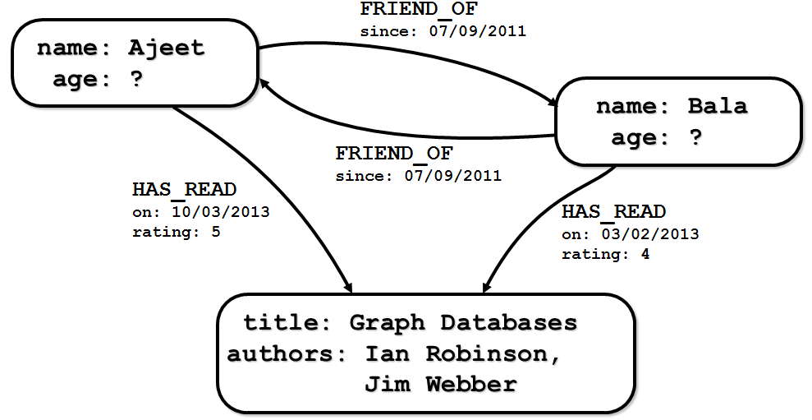
More data…

Slide 11
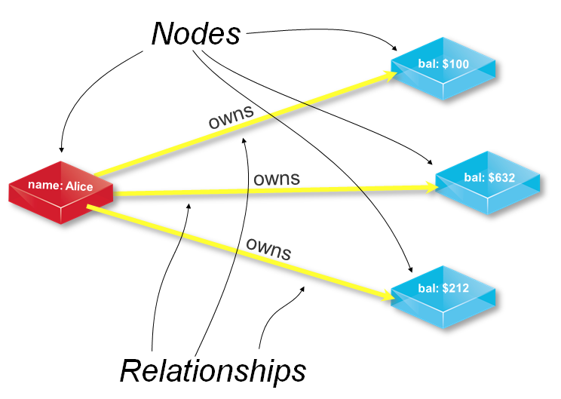

Slide 12
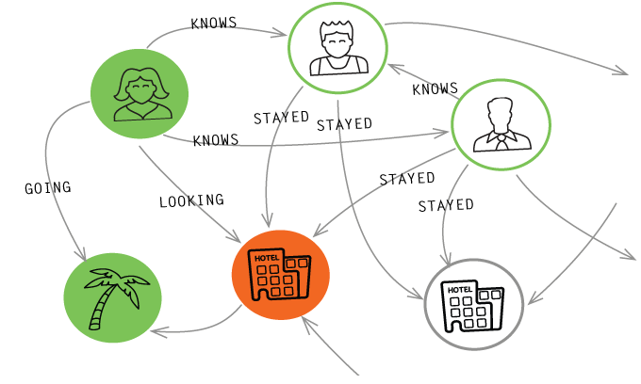
Modeling with Graphs

Slide 13
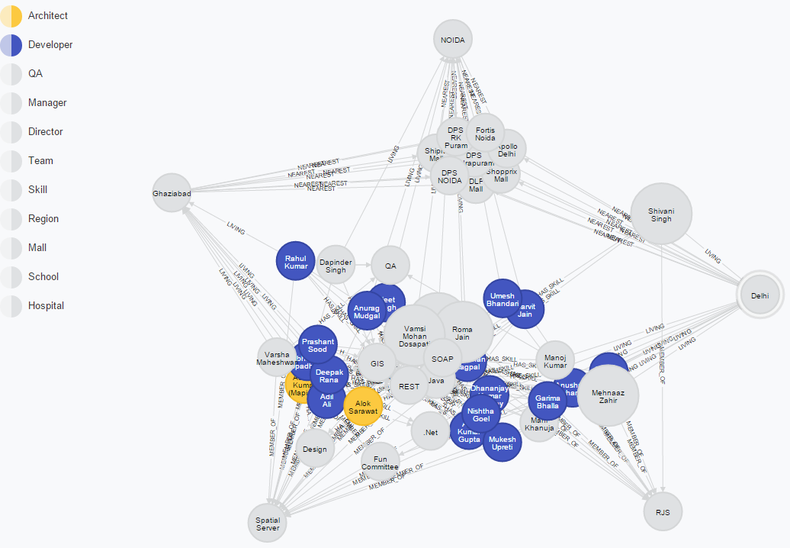
Neo4j: Sample App

Slide 14
Neo4j: Server Configuration
conf/neo4j-server.properties
org.neo4j.server.database.location=data/graph.db
org.neo4j.server.webserver.port=7474
#allow any client to connect
org.neo4j.server.webserver.address=0.0.0.0
org.neo4j.server.webserver.maxthreads=200
org.neo4j.server.db.tuning.properties=neo4j.properties
org.neo4j.server.transaction.timeout=60

Slide 15
Neo4j Performance Configuration
neo4j.properties
use_memory_mapped_buffers=true
neostore.nodestore.db.mapped_memory=50M
neostore.relationshipstore.db.mapped_memory=500M
neostore.propertystore.db.mapped_memory=300M
neostore.propertystore.db.strings.mapped_memory=300M
neostore.propertystore.db.arrays.mapped_memory=0M

Slide 16
Neo4j Installation
bin/neo4j | neo4j itself
bin/neo4j-shell | a command-line shell
conf/ | configuration files
data/ | graph data, logs

Slide 17

Neo4j: Java API
Lets start

Slide 18
API: Embedded database
GraphDatabaseService graphDb = new GraphDatabaseFactory().
newEmbeddedDatabaseBuilder( "target/database/location" ).
loadPropertiesFromFile( pathToConfig + "neo4j.properties" ).
newGraphDatabase();

Slide 19
API: Neo4j Server
Neo4jConnection connect=null;
connect = new Driver(). connect(DB_URL, new Properties());
ResultSet resultSet=connect.createStatement().executeQuery("YOUR QUERY")

Slide 20
API: REST API
POST http://localhost:7474/db/data/cypher
Accept: application/json; charset=UTF-8
Content-Type: application/json
{ "query" : "CREATE (n:Person { name : {name} }) RETURN n", "params" : { "name" : "Andres" }
}

Slide 21
API: Wrap operations in a transaction
Transaction tx = graphDb.beginTx();
try {
// Database operations go here
tx.success();
}catch(Exception ex){
tx.failure();
}finally{
tx.close();
}

Slide 22
API: Create index
Transaction tx = graphDb.beginTx();
Index<Node> nodeIndex = null;
try {
nodeIndex = graphDb .index().forNodes(“NODE_INDEX”.getValue());
tx.success();
}catch(Exception ex){
tx.failure();
}finally{
tx.close();
}

Slide 23
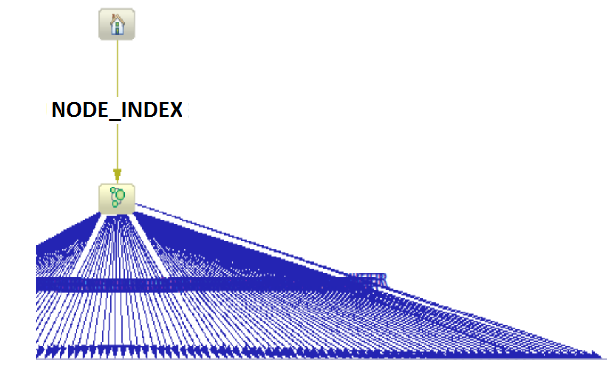

Slide 24
API: Create a small graph
Node mukesh = graphDb.createNode();
mukesh.setProperty( "Name", "Mukesh" );
mukesh.setProperty( "Designation", "Advisory Software Engineer" );
nodeIndex.add(mukesh , "Name", "Mukesh" );
Node midev = graphDb.createNode();
midev.setProperty( "Name", "Spatial Server" );
midev.setProperty( "ProductOwner", "Mike Buck" );
nodeIndex.add(midev , "Name", " Spatial Server " );
Relationship relationship = mukesh.createRelationshipTo( midev, RelTypes.BelongsTo );
relationship.setProperty( "Years", 0.0 );

Slide 25
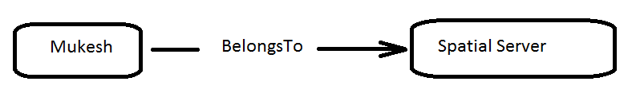

Slide 26
API: Relationships
import org.neo4j.graphdb.RelationshipType;
private static enum RelTypes implements RelationshipType {
BelongsTo
}

Slide 27
API: Add More data
Node noida= graphDb.createNode();
noida.setProperty( "Name", “NOIDA" );
nodeIndex.add(node, “foo”, “value”);
Relationship relationship2 = mukesh.createRelationshipTo( midev, RelTypes.LivingIn );
relationship2.setProperty( "Years", 5.0 );
arcIndex.add(relationship2, “foo”, “value”);

Slide 28
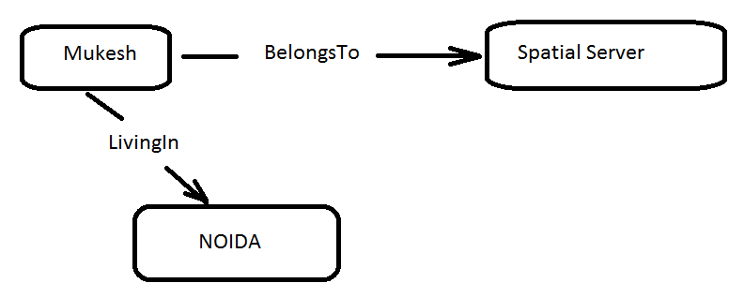

Slide 29
API: Read data
GraphDatabaseService graphDb = dbWrapper.getGraphDb();
Index<Node> nodeIndex = dbWrapper.getNodeIndex();
Transaction tx = graphDb.beginTx();
Node source = nodeIndex.get(“NODE_ID”.getValue(), sourceNodeId).getSingle();

Slide 30
API: Delete data
firstNode.getSingleRelationship( RelTypes.KNOWS, Direction.OUTGOING ).delete();
firstNode.delete();
secondNode.delete();

Slide 31
API: Execute query
//import org.neo4j.cypher.javacompat.ExecutionEngine;
//import org.neo4j.cypher.javacompat.ExecutionResult;
ExecutionEngine engine = new ExecutionEngine(graphDb, StringLogger.SYSTEM);
String query = “START r=relationship(*) where r.NightSpeed >= 119 return r”;
ExecutionResult result;
Transaction tx = graphDb.beginTx();
try{
result = engine.execute(query );
Iterator<Node> itr = result.columnAs("n");
//Process itr
tx.success();
}finally{
tx.close();
}

Slide 32
API: Traversing
private static List<Node> getFriends(final Node person ) {
TraversalDescription td = Traversal.description()
.breadthFirst()
.relationships( RelTypes.KNOWS, Direction.OUTGOING )
.evaluator( Evaluators.excludeStartPosition() );
Traverser friendsTraverser = td.traverse( person );
List<Node> friends = new ArrayList<Node>();
for ( Path friendPath : friendsTraverser ){
Node friend = friendPath.endNode()
friends.add(friend);
}
return friends;
}

Slide 33
API: Traversing continues …
PathFinder<WeightedPath> pathFinder = GraphAlgoFactory.dijkstra(PathExpanders.forTypesAndDirections(
LinkType.ONE_WAY_OUT_STREET, Direction.OUTGOING,
LinkType.ONE_WAY_IN_STREET, Direction.INCOMING,
LinkType.BIDIRECTIONAL_STREET, Direction.BOTH),
EntityAttributeKey.DISTANCE.getValue() );
WeightedPath shortestPath = pathFinder.findSinglePath( source, destination );

Slide 34
Introduction to Cypher
Declarative Pattern-Matching language
SQL-like syntax
Designed for graphs

Slide 35
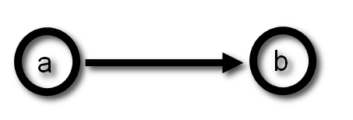
Two nodes, one relationship
START a=node(*)
MATCH (a)-->(b)
RETURN a, b;

Slide 36
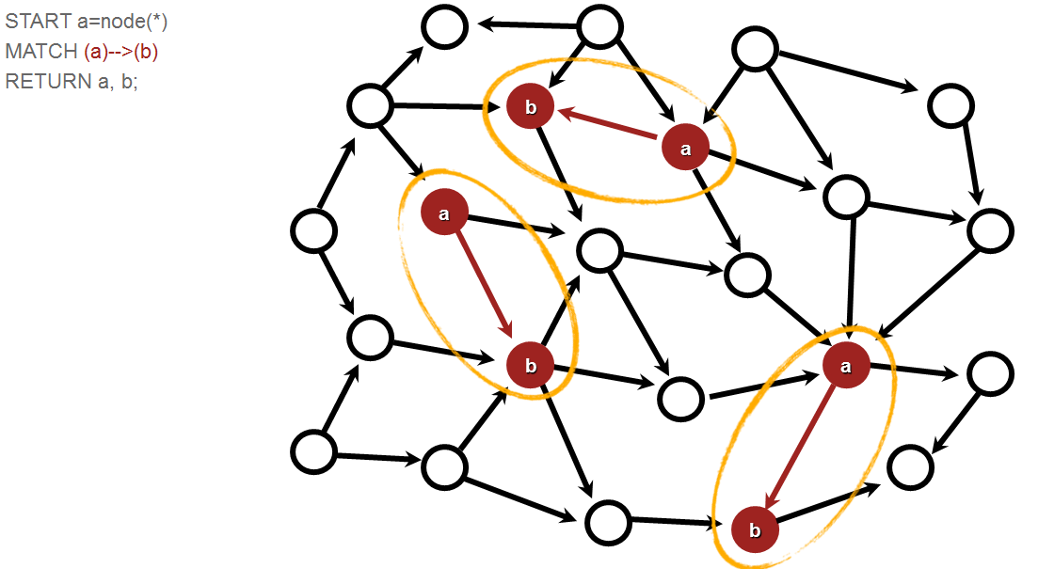

Slide 37
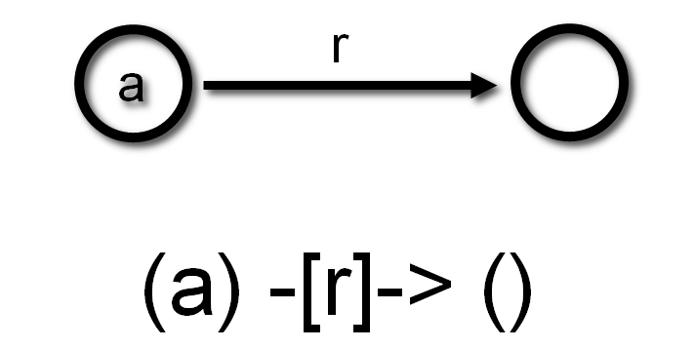
START a=node(*)
MATCH (a)-[r]->()
RETURN a.name, type(r);

Slide 38
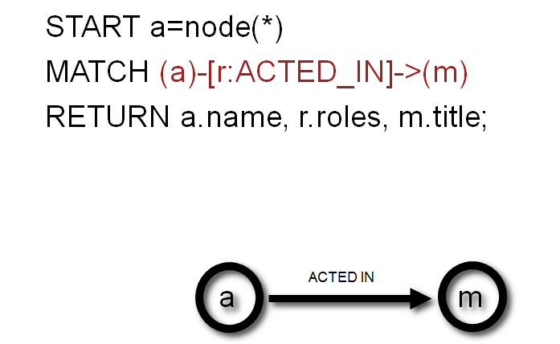

Slide 39
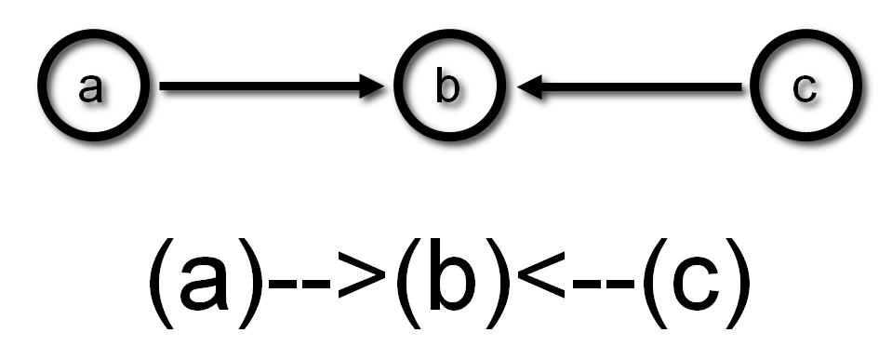
Paths

Slide 40
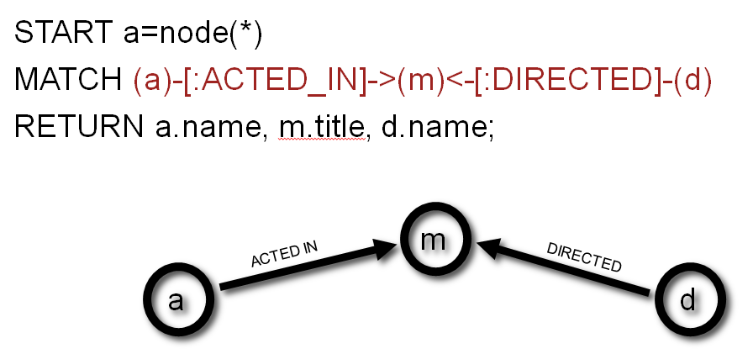
Paths

Slide 41
START a=node(*)
MATCH (a)-[:ACTED_IN]->(m)<-[:DIRECTED]-(d)
RETURN a.name AS actor, m.title AS movie, d.name AS director;
actor | movie | director
“Keanu Reeves” | “The Matrix” | “Andy Wachowski”
“Keanu Reeves” | “The Matrix Reloaded” | “Andy Wachowski”
“Noah Wyle” | “A Few Good Men” | “Rob Reiner”
“Tom Hanks” | “Cloud Atlas” | “Andy Wachowski”
... | ... | ...

Slide 42
Aggregation
count(x) | - add up the number of occurrences
min(x) | - get the lowest value
max(x) | - get the highest value
avg(x) | - get the average of a numeric value
collect(x) | - collected all the occurrences into an array

Slide 43
Constraints on properties
START actor=node:node_auto_index(name="Keanu Reeves")
MATCH (actor)-[r:ACTED_IN]->(movie)
WHERE "Neo" IN r.roles
RETURN DISTINCT movie.title;

Slide 44
Deleting nodes
START emial=node:SpatialServerEmployeeIndex(name="Bharat")
DELETE emial;

Slide 45
Deleting relationships
START email=node:SpatialServerEmployeeIndex(name="Bharat")
MATCH (email)-[r:MEMBER_OF]->(:SpatialServer)
DELETE r;

Slide 46
Updating Graphs with Cypher
Creating nodes
CREATE ({title:"Mystic River", released:1993});
Adding properties
START movie=node:node_auto_index(title="Mystic River")
SET movie.tagline = "We bury our sins here, Dave. We wash them clean."
RETURN movie;
Creating Relationships
START movie=node:node_auto_index(title="Mystic River"),
kevin=node:node_auto_index(name="Kevin Bacon")
CREATE UNIQUE (kevin)-[:ACTED_IN {roles:["Sean"]}]->(movie);

Slide 47
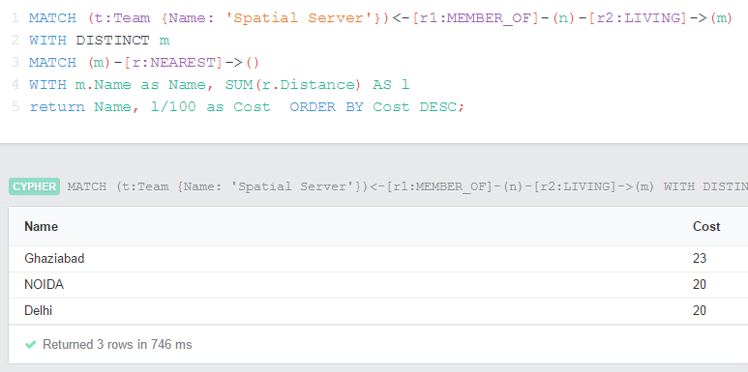
Neo4j: Recommendations engine
References:
Amazon: http://www.cs.umd.edu/~samir/498/Amazon-Recommendations.pdf
Item-Based Collaborative Filtering: http://files.grouplens.org/papers/www10_sarwar.pdf

Slide 48
References: Readings
http://neo4j.com/
https://structr.org/
http://docs.spring.io/spring-data/neo4j/docs/current/reference/html/
http://files.grouplens.org/papers/www10_sarwar.pdf
http://www.cs.umd.edu/~samir/498/Amazon-Recommendations.pdf
NeoSampleApp source:
https://github.com/4ajeet/neo-sample

Slide 49


