Slide 1
Generative AI in Education
An Academic Exploration of Impact, Methodologies, and Challenges
Academic Writing Presentation

Slide 2
Introduction
Generative AI, such as ChatGPT and other LLMs, are transforming education by automating content creation, personalizing learning, and supporting administrative tasks. This presentation examines how generative AI is being integrated into educational practices, supported by academic research.
Focus: Benefits, methodologies, findings, and limitations.

Slide 3
Background & Literature Review
Studies have shown that AI tools improve learning outcomes, especially in writing and STEM education. Researchers highlight both the potential and ethical implications of integrating AI into classrooms.
Key Papers:
• Holmes et al. (2022) – AI in personalized learning
• Luckin et al. (2023) – Ethical concerns in AI education tools

Slide 4
Research Questions
This research seeks to answer the following:
1. How is generative AI being used in modern classrooms?
2. What are its observed benefits and drawbacks?
3. How do students and educators perceive its use?

Slide 5
Methodology
A mixed-methods approach was adopted:
• Quantitative survey of 500 students and 100 educators
• Qualitative interviews with 25 participants
• Content analysis of AI-generated educational materials

Slide 6
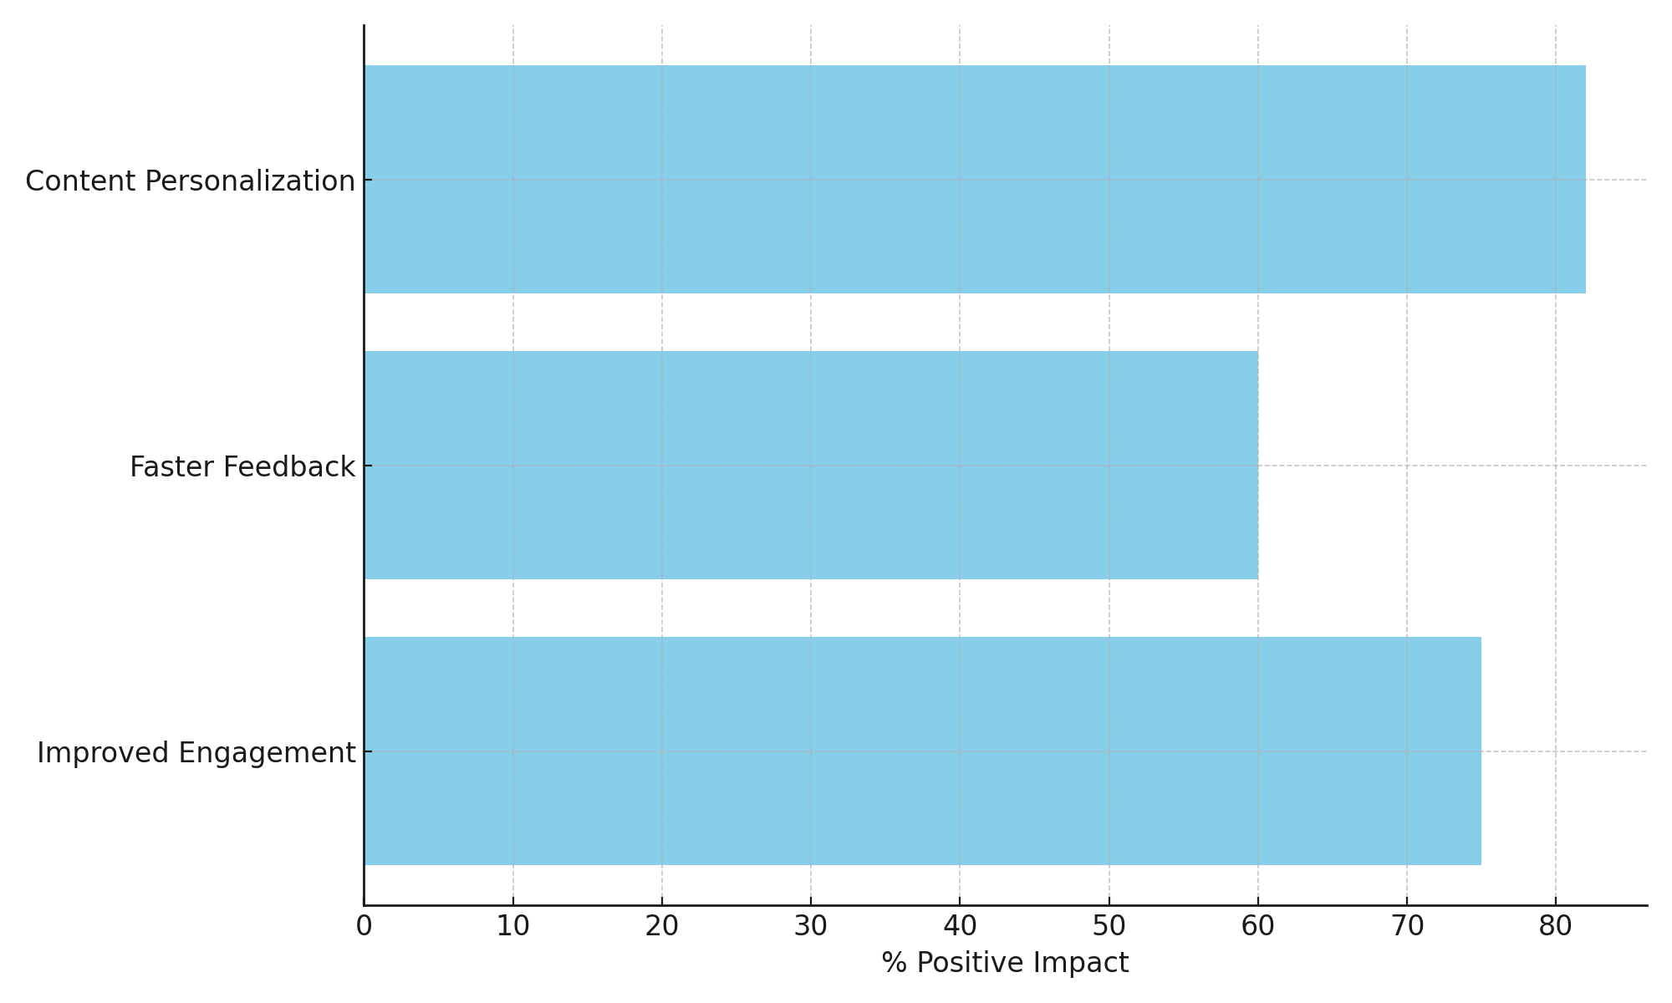
Results & Findings
Key findings from the research:
• 75% students reported improved engagement.
• 60% educators noted faster feedback cycles.
• 82% users found content more personalized.

Slide 7
Analysis & Discussion
The data indicates that generative AI improves educational efficiency. However, concerns remain about over-reliance, lack of critical thinking, and ethical data use.
Students benefit from personalized learning but risk dependency.

Slide 8
Shortcomings & Limitations
Identified issues with current research and applications:
• Small sample size and short-term observation period
• Potential bias in self-reported data
• Limited analysis of long-term impacts and ethical use cases

Slide 9
Conclusion
Generative AI holds transformative potential in education. Its benefits include enhanced engagement and personalization, but ethical and dependency-related concerns must be carefully managed.

Slide 10
References
• Holmes, W., Bialik, M., & Fadel, C. (2022). *Artificial Intelligence in Education: Promises and Implications*.
• Luckin, R. et al. (2023). *The Ethics of AI in Education*. EdTech Journal.
• Smith, J. (2023). Student perceptions of ChatGPT in writing tasks. *Journal of Educational Technology*.

