Slide 1
INTELLIGENT CLOUD DRIVE: AI-POWERED FILE MANAGEMENT
SYSTEM WITH SECURE DISTRIBUTED ARCHITECTURE
Project Work Review-3
Presented by
Harsh Pratap Singh [25MCA1027]
Under the Guidance of
Dr. Saranya G
Assistant professor-Senior Grade
School of Computer Science and Engineering
Vellore Institute of Technology, Chennai.

Slide 2
Table of Contents
1. Literature Review
2.Problem Statement & Objectives
3. System Architecture
4. Technology Stack
5. Module Descriptions with Algorithms
6. Dataset Description
7. AI Model — Empirical Evaluation Results
8. Per-Category Performance Analysis
9. Cross-Validation Stability
10. Security Implementation (JWT + BCrypt)
11. Key Code Highlights
12. Challenges & Solutions
13. Work Remaining
14. References

Slide 3
LITERATURE REVIEW SUMMARY
S. No | Paper Title | Authors & Year | Objectives | Methodology | Algorithms Used | Features | Merits | Limitations
1 | Text Categorization with Support Vector Machines | Joachims, T. (1998) | Compare SVM against NB, KNN, Decision Trees for text categorization. | Empirical evaluation on Reuters-21578 and Ohsumed benchmarks. | SVM, Naive Bayes, KNN, Decision Trees | High-dimensional sparse text vectors, precision/recall | SVMs consistently outperform NB in high-dimensional text. | Focused on long documents; does not evaluate short-text (filename) classification.
2 | Fileprints: Identifying File Types by N-Gram Analysis | Li, W. J. et al. (2005) | Classify file types using byte-level n-gram frequency distributions. | Statistical centroid models; classification via Mahalanobis distance. | Centroid-based classifier, Statistical distance | Byte-level n-grams, file fingerprints | High accuracy without headers or extensions. | Operates at byte level, not filename text; computationally expensive.
3 | Text Classification Algorithms: A Survey | Kowsari, K. et al. (2019) | Comprehensive survey of text classification pipeline. | Structured survey of BoW, TF-IDF, Word2Vec, GloVe, BERT. | NB, SVM, RF, CNN, RNN, BERT | TF-IDF, word embeddings, deep learning features | Covers entire pipeline; open-access and highly cited. | Survey paper — no novel algorithm; no filename-specific evaluation.
4 | TF-IDF Feature Weighting Comparative Study | Das, M. et al. (2023) | Compare TF-IDF vs N-Gram across multiple ML classifiers. | Empirical analysis on unstructured text datasets. | SVM, Random Forest, Logistic Regression | TF-IDF weighting, N-gram features, accuracy | Validates TF-IDF effectiveness across classifiers. | Limited to English; no character-level n-gram evaluation.
5 | The Google File System | Ghemawat, S. et al. (2003) | Design a scalable distributed file system for data-intensive apps. | System design: decoupled control/data planes. | N/A (System Architecture) | Metadata separation, fault tolerance, append writes | Foundational paradigm for cloud storage. | Designed for Google-scale; not for single-node desktop.

Slide 4
LITERATURE REVIEW SUMMARY (CONTINUED)
S. No | Paper Title | Authors & Year | Objectives | Methodology | Algorithms Used | Features | Merits | Limitations
6 | Challenges of Microservice Architectures: A SLR | Söylemez, M. et al. (2022) | Synthesize benefits and challenges of microservices from 85 studies. | Systematic Literature Review (SLR). | N/A (Architectural patterns) | Scalability, fault isolation, technology diversity | Comprehensive SLR; identifies design patterns. | Enterprise-scale focus; no small-scale evaluation.
7 | Performance Analysis of Spring Boot Microservices | Kusiak, T. & Powroźnik, P. (2021) | Benchmark Spring Boot vs .NET under concurrent loads. | Apache JMeter stress testing on Azure. | N/A (Performance benchmarking) | HTTP throughput, latency, memory, CPU | Validates Spring Boot for concurrent REST APIs. | Cloud-hosted only; no local deployment evaluation.
8 | JWT and HMAC SHA-256 for Web Application Security | Prasad, S. & Sharma, V. (2023) | Analyze JWT security vulnerabilities and best practices. | Security analysis of JWT vulnerability vectors. | HMAC SHA-256, RSA | Token replay, algorithm confusion, brute-force | Comprehensive security analysis with defenses. | Web APIs only; no desktop-to-server auth evaluation.
9 | Argon2: Memory-Hard Password Hashing | Biryukov, A. et al. (2016) | Introduce Argon2 and compare against BCrypt, PBKDF2, scrypt. | Cryptographic analysis of memory-hardness. | Argon2, BCrypt, PBKDF2, scrypt | Time-cost, memory-cost, parallelism parameters | PHC winner; proves BCrypt GPU vulnerability. | Argon2 has lower Java/Spring library maturity.
10 | Container Orchestration Frameworks Comparison | Strauss, T. et al. (2019) | Compare Docker Swarm, Kubernetes, Apache Mesos. | Quantitative/qualitative benchmarking. | N/A (Infrastructure benchmarking) | Service discovery, load balancing, auto-scaling | Validates Docker Compose for small deployments. | Production clusters focus; no academic project eval.

Slide 5
PROBLEM STATEMENT & OBJECTIVES
The Problem:
• Data Explosion: Global data creation expected to reach 181 ZB by 2025 (IDC). Manual file organization is unsustainable.
• Security Gaps: Traditional cloud systems use plain-text passwords, session cookies, and lack per-user file isolation.
• No Intelligence: Existing lightweight cloud drives do not auto-categorize files, forcing users into manual folder creation.
Our Objectives:
1. Design a multi-tier cloud file storage system with a secure REST API
2. Implement JWT-based stateless authentication with BCrypt password hashing
3. Build an AI microservice that classifies files into 6 categories using NLP
4. Empirically compare Multinomial Naive Bayes vs Linear SVM on ultra-short text
5. Develop a JavaFX desktop client with distributed deployment support

Slide 6
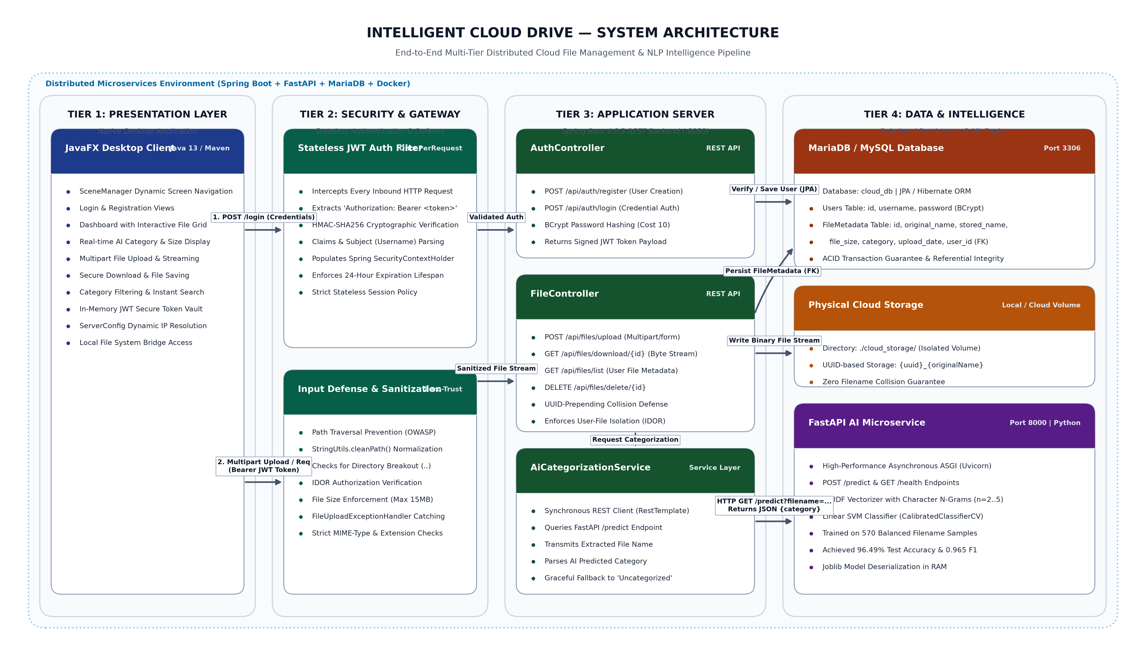
SYSTEM ARCHITECTURE

Slide 7
TECHNOLOGY STACK
Layer | Technology | Version | Purpose
Frontend | JavaFX | 13 | Desktop GUI — Login, Register, Dashboard screens
Frontend Build | Maven + javafx-maven-plugin | 0.0.4 | Compile & launch JavaFX modules
Backend | Spring Boot | 4.0.3 | REST API server, dependency injection
ORM | Hibernate JPA | 6.x | Object-Relational Mapping for entities
Database | MariaDB / MySQL | 10.6+ | User accounts, file metadata storage
Security | Spring Security + JJWT | 6.x / 0.12.6 | JWT auth, BCrypt password hashing
AI / ML | Scikit-Learn | latest | TF-IDF, Naive Bayes, Linear SVM
AI API | FastAPI + Uvicorn | latest | Python REST API serving ML predictions
Serialization | Joblib | latest | Trained model persistence to disk
Build Tool | Maven Wrapper (mvnw) | 3.3.4 | Zero-install reproducible builds

Slide 8
MODULE DESCRIPTIONS & ALGORITHMS
Module 1: User Authentication
• Algorithm: BCrypt (Blowfish, cost factor 10) + JWT (HMAC-SHA256, 24hr expiry)
• Flow: Register → BCrypt hash → DB | Login → BCrypt verify → JWT issued → Bearer header on all requests
Module 2: File Management
• Upload: Multipart → path traversal sanitization → disk write → DB persist + AI categorization
• Download/Delete: IDOR prevention — JWT username vs uploadedBy field ownership check
Module 3: AI File Categorization
• Algorithm: TF-IDF Character N-grams (n=2..5) + Linear SVM (CalibratedClassifierCV)
• 6 Categories: Archives, Code, Documents, Executables, Media, System & Logs
• Graceful fallback: if AI offline → file marked 'Uncategorized'
Module 4: JavaFX Desktop Client
• SceneManager pattern, dynamic ServerConfig.java for distributed deployment
• Screens: LoginScreen, RegisterScreen, DashboardScreen (file grid + AI category)

Slide 9
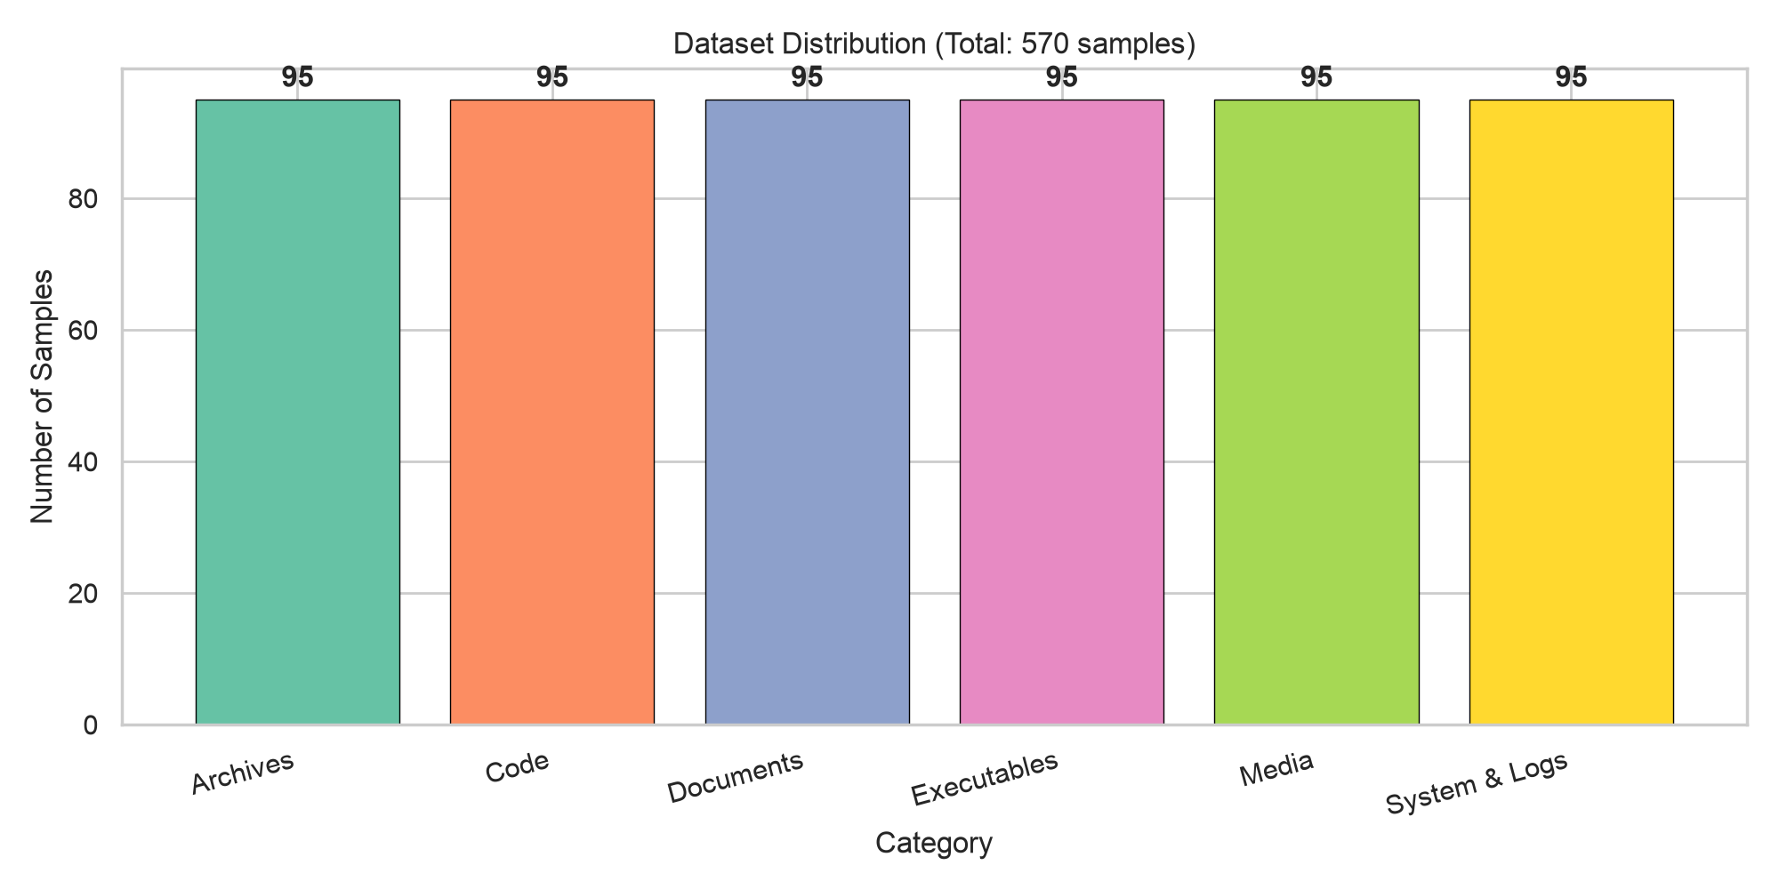
DATASET DESCRIPTION
Property | Value
Total Samples | 570
Train / Test Split | 456 (80%) / 114 (20%)
Categories | 6 (balanced — 95 samples each)
Feature Type | Filenames (ultra-short text, 5–30 characters)
Feature Extraction | TF-IDF with character n-grams (n = 2 to 5)

Slide 10
AI MODEL — EMPIRICAL EVALUATION RESULTS
Metric | Multinomial Naive Bayes | Linear SVM (LinearSVC) | Winner
Test Accuracy | 94.74% | 96.49% | SVM (+1.75%)
Precision (Macro) | 94.85% | 96.75% | SVM (+1.90%)
Recall (Macro) | 94.74% | 96.49% | SVM (+1.75%)
F1-Score (Macro) | 94.71% | 96.48% | SVM (+1.77%)
5-Fold CV F1 (Mean±SD) | 92.40% (±0.018) | 96.47% (±0.011) | SVM (+4.07%)
Key Finding: Linear SVM consistently outperforms Naive Bayes across all metrics with lower variance in cross-validation (±0.011 vs ±0.018), indicating superior generalization stability.

Slide 11
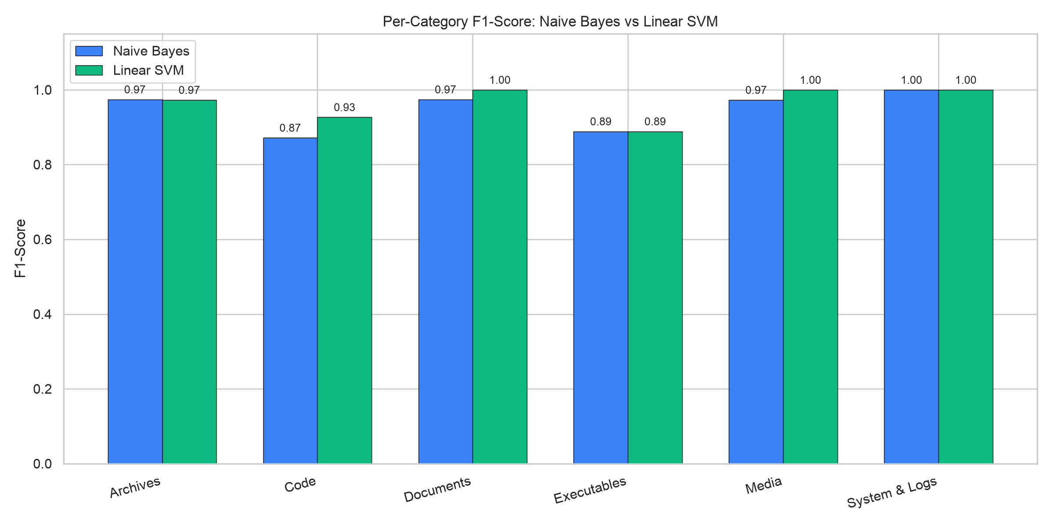
PER-CATEGORY F1 SCORE ANALYSIS
Category | Support | NB F1 | SVM F1 | Δ
Archives | 19 | 0.97 | 0.97 | —
Code | 19 | 0.87 | 0.93 | +6%
Documents | 19 | 0.97 | 1.00 | +3%
Executables | 19 | 0.89 | 0.89 | —
Media | 19 | 0.97 | 1.00 | +3%
System & Logs | 19 | 1.00 | 1.00 | —

Slide 12
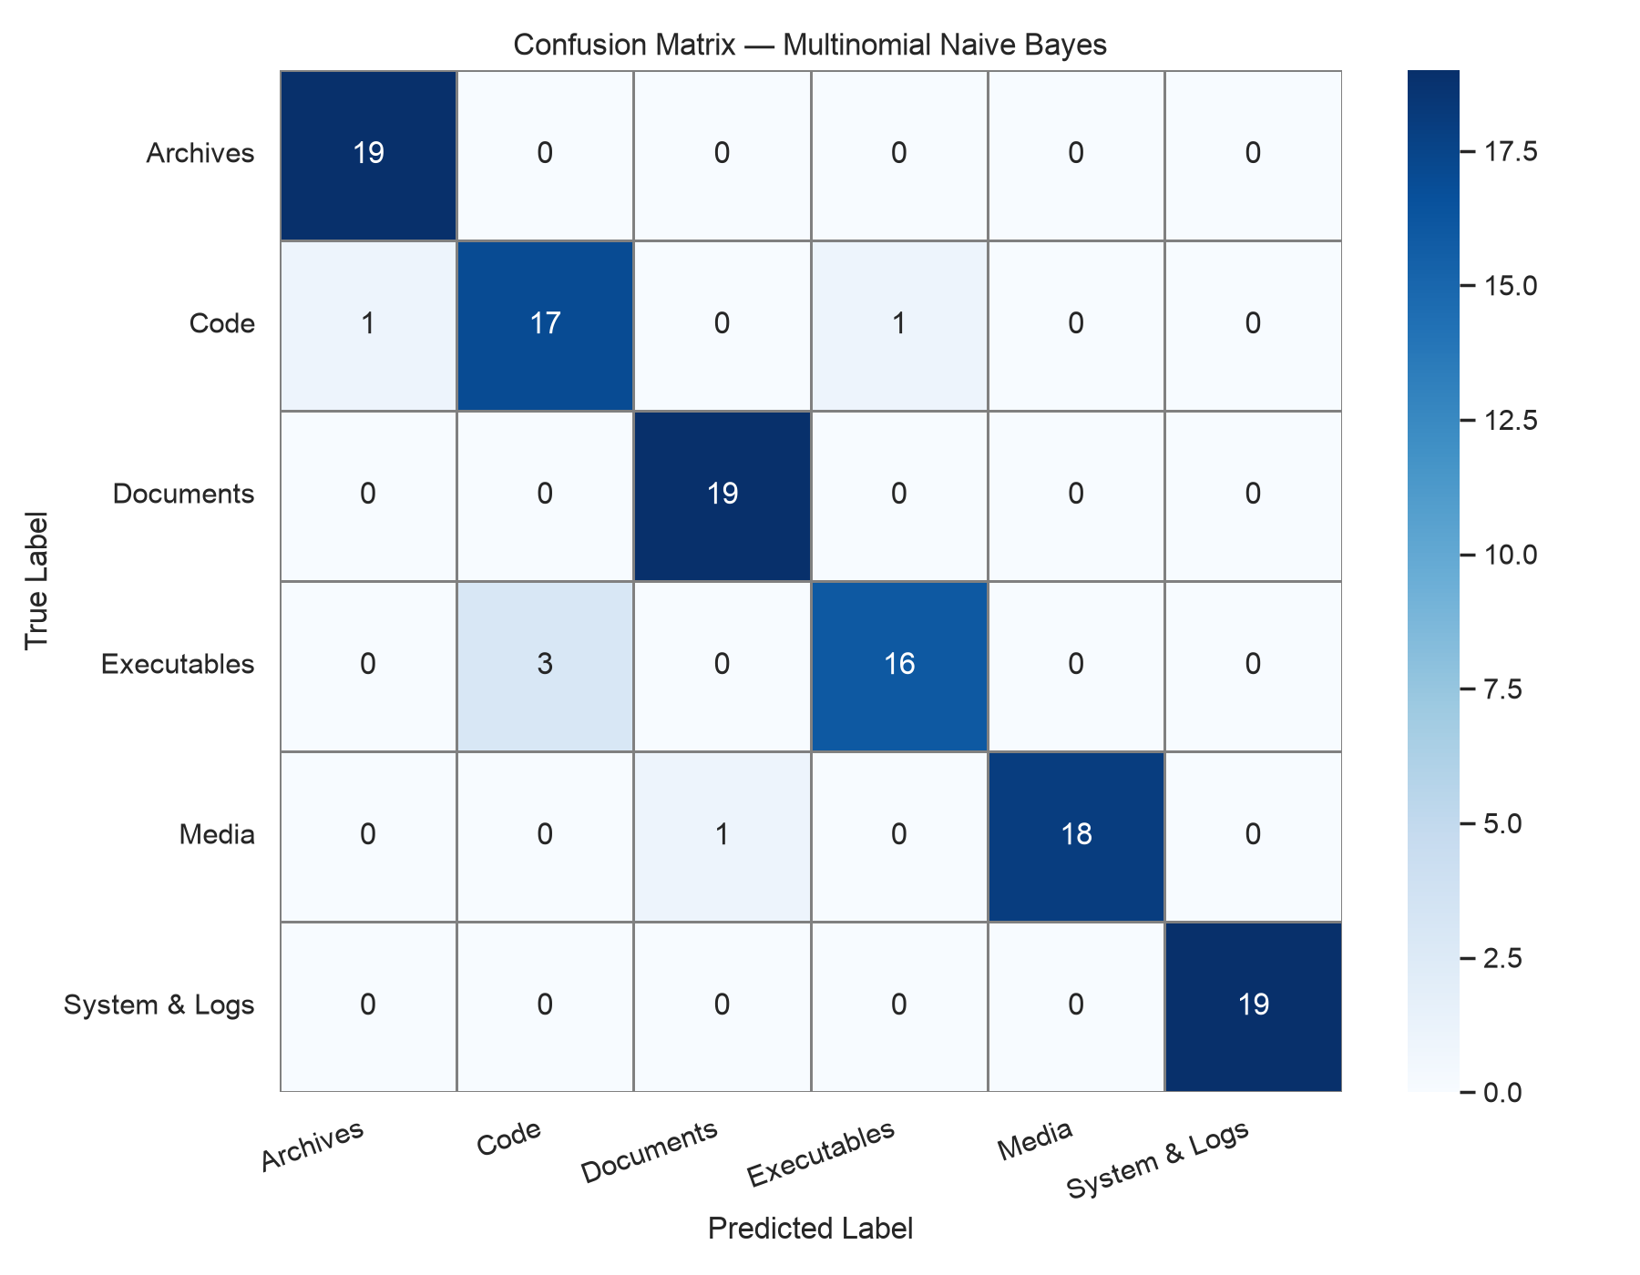
CONFUSION MATRIX — NAIVE BAYES

Slide 13
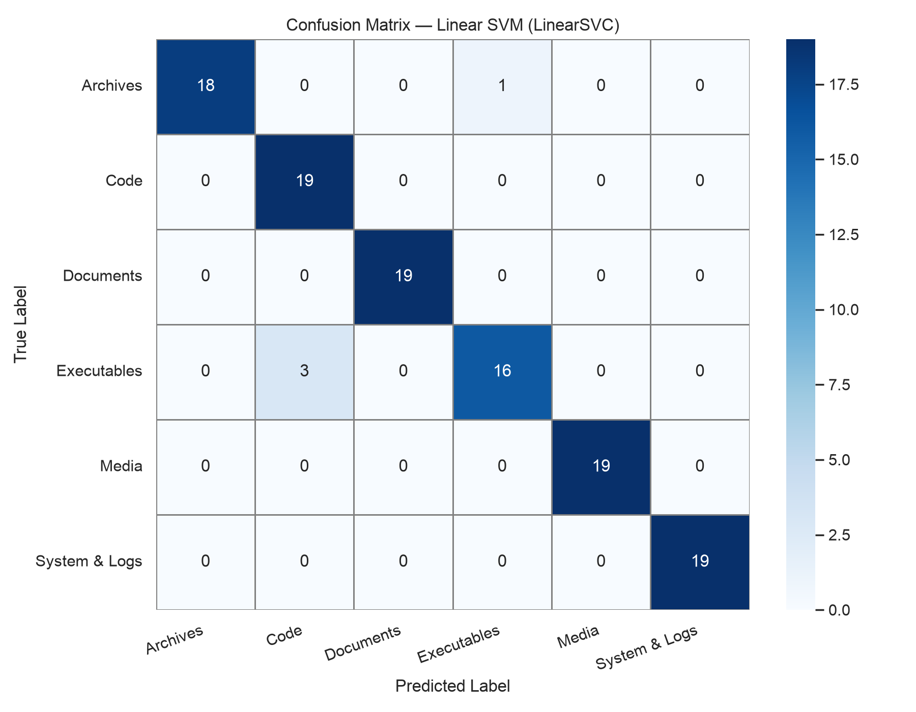
CONFUSION MATRIX — LINEAR SVM

Slide 14
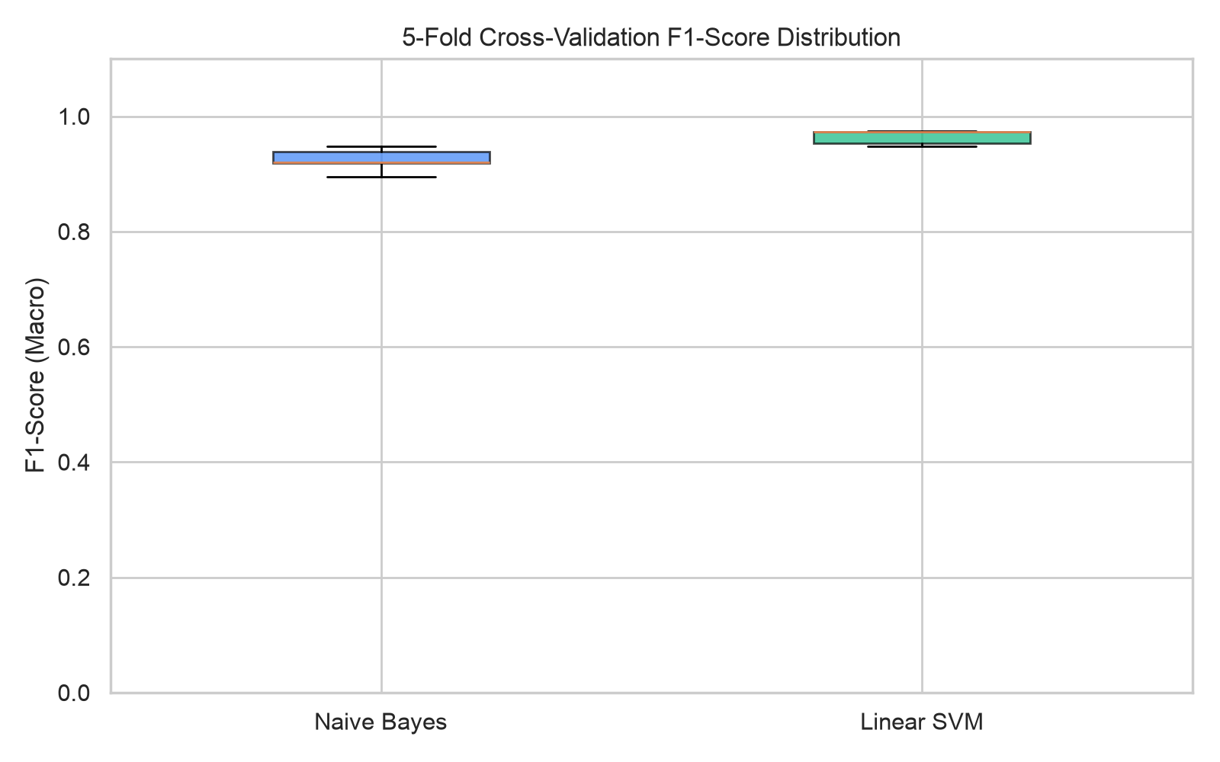
CROSS-VALIDATION STABILITY (5-FOLD)
Fold | Naive Bayes F1 | Linear SVM F1
1 | 0.948 | 0.974
2 | 0.938 | 0.948
3 | 0.894 | 0.954
4 | 0.919 | 0.974
5 | 0.921 | 0.974
Mean ± SD | 0.924 ± 0.018 | 0.965 ± 0.011

Slide 15
SECURITY IMPLEMENTATION
Feature | Implementation | Purpose
Password Storage | BCrypt (Blowfish, cost 10) | Adaptive hash — expensive for brute-force
Token Auth | JWT HMAC-SHA256, 24hr expiry | Stateless — no server sessions or cookies
Session Strategy | STATELESS (Spring Security) | Immune to CSRF attacks
Path Traversal | cleanPath() + normalize() + prefix check | Blocks ../../etc/passwd attacks
IDOR Prevention | JWT username vs uploadedBy check | Users can only access own files
File Size Limit | 15 MB max (configurable) | Prevents DoS via oversized uploads

Slide 16
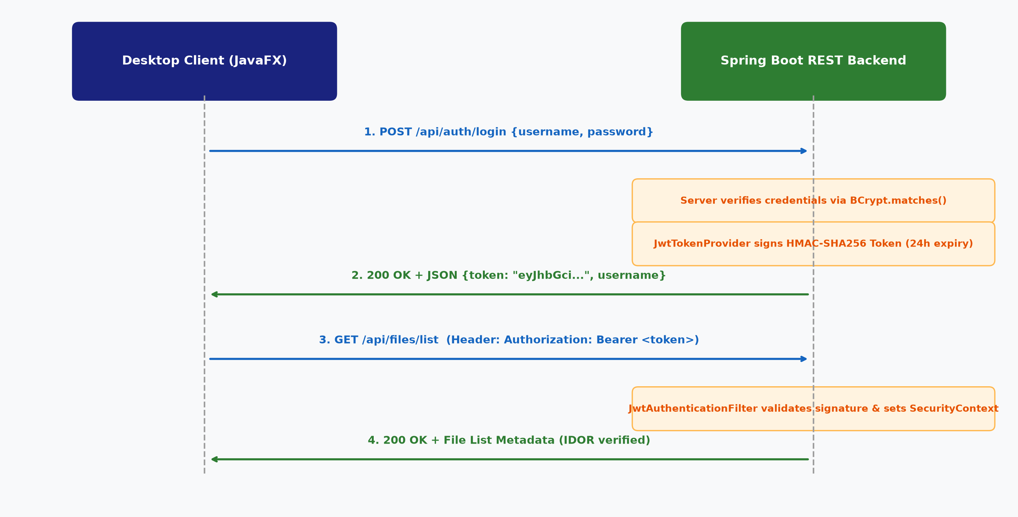
JWT AUTHENTICATION FLOW

Slide 17
IMPLEMENTATION PROGRESS (60%+)
Module | Status | Key Deliverables
Repository Cleanup | Done | Removed artifacts, updated .gitignore
AI Model Pipeline | Done | Dataset, training, evaluation, 7 charts, serialized models
FastAPI AI Service | Done | /predict, /health, /evaluate, /predict/detailed endpoints
Backend Security | Done | BCrypt + JWT + path traversal + IDOR prevention
REST API | Done | Register, Login, Upload, List, Download, Delete
Frontend Network | Done | JWT token storage, Bearer headers, ServerConfig.java
Admin Panel | Done | Legacy servlet-based user management at /admin
Run Scripts | Done | Fish, Bash, Windows .bat launch scripts
Documentation | Done | 7 detailed setup & deployment guides
Distributed Deploy | Done | Windows backend + Linux frontend support

Slide 18
KEY CODE HIGHLIGHTS
1. AI Prediction Endpoint (FastAPI — Python):
@app.post("/predict")
def predict_category(data: FileData):
prediction = active_model.predict([data.filename])[0]
return {"category": prediction}
2. JWT Token Generation (Java — Spring Boot):
return Jwts.builder()
.subject(username).issuedAt(now)
.expiration(new Date(now + 86400000)) // 24 hours
.signWith(secretKey) // HMAC-SHA256
.compact();
3. AI-Powered Upload with Path Traversal Prevention:
String clean = StringUtils.cleanPath(file.getOriginalFilename());
Path target = Paths.get(UPLOAD_DIR).resolve(clean).normalize();
String category = aiService.analyzeAndCategorize(clean);
metadata.setCategory(category); fileRepository.save(metadata);

Slide 19
CHALLENGES & SOLUTIONS
Challenge | Solution
Ultra-short text (5-30 chars) | Character n-grams (n=2..5) instead of word tokenization
Frontend-backend protocol mismatch | Updated to return JSON with JWT; frontend parses & stores token
Path traversal vulnerability | Triple-layer: cleanPath → normalize → startsWith prefix check
IDOR on file download/delete | Ownership check: JWT username vs uploadedBy field
Cross-machine deployment | ServerConfig.java reads host from system props / env vars
AI service offline during upload | Graceful fallback: categorize as 'Uncategorized' on timeout
Run scripts broken via symlinks | Used realpath(status -f) to resolve canonical path

Slide 20
WORK REMAINING (PHASE 4 — OCTOBER)
Task | Priority | Estimated Effort
UI Polish — Dashboard styling, file icons per category | Medium | 2–3 days
Add file search/filter by category | Medium | 1–2 days
Write 60–70 page final project report | High | 5–7 days
Prepare final demo with live deployment | High | 1 day
Optional: Containerize with Docker | Low | 1 day
Optional: Add file preview (images, PDFs) | Low | 2 days

Slide 21
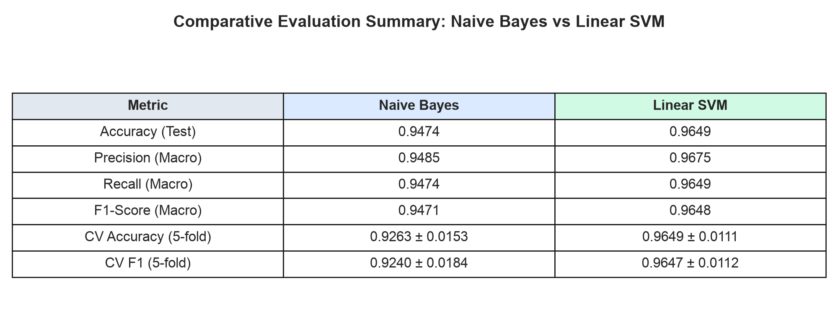
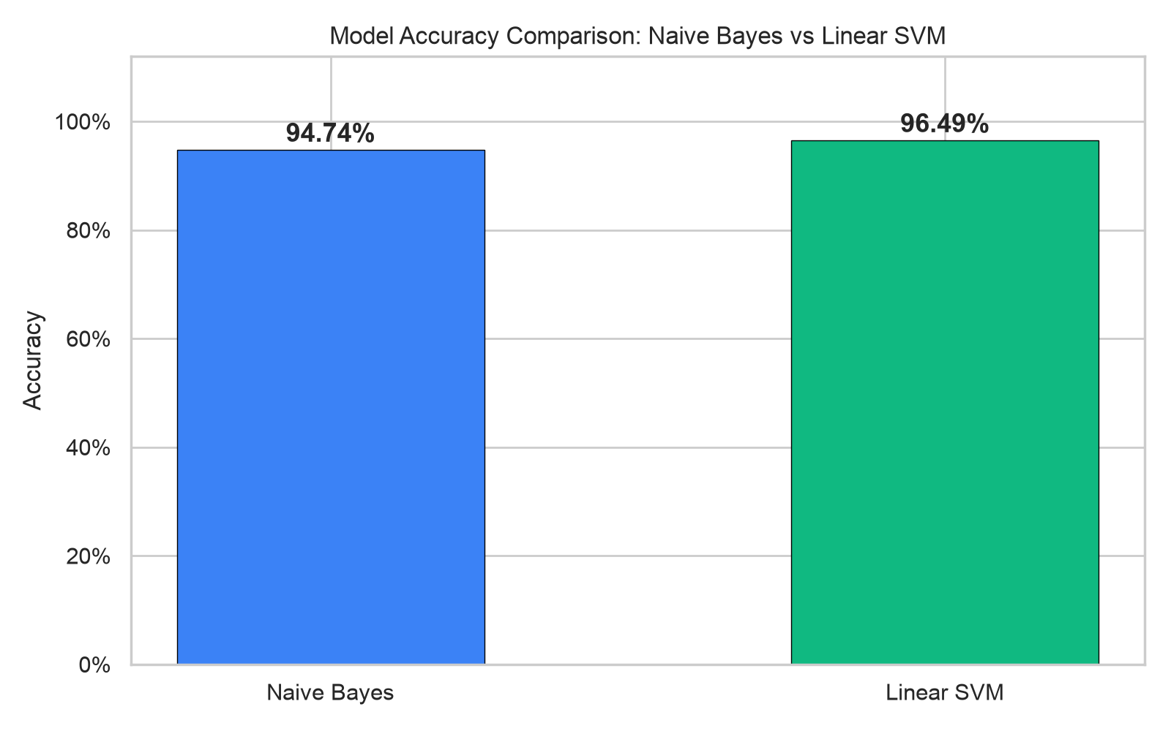
METRICS SUMMARY — VISUAL COMPARISON

Slide 22
REFERENCES
1. Joachims, T. (1998). "Text categorization with Support Vector Machines." Proc. 10th European Conference on Machine Learning.
2. Kowsari, K. et al. (2019). "Text Classification Algorithms: A Survey." Information, 10(4), 150.
3. Jones, M. et al. (2015). "JSON Web Token (JWT)." RFC 7519, IETF.
4. Provos, N. & Mazières, D. (1999). "A Future-Adaptable Password Scheme." USENIX Annual Technical Conference.
5. Pedregosa, F. et al. (2011). "Scikit-learn: Machine Learning in Python." JMLR, 12, 2825–2830.
6. Das, M. et al. (2023). "A comparative study on TF-IDF feature weighting method." Int. J. Advanced Research in CS.
7. Prasad, S. R. S. S. S. & Sharma, V. K. (2023). "Enhancing data security: JWT and HMAC integration." IJCAIT.
8. Biryukov, A. et al. (2016). "Argon2: New generation of memory-hard functions." IEEE Euro S&P.
9. Ghemawat, S. et al. (2003). "The Google File System." Proc. 19th ACM SOSP.
10. FastAPI Documentation. Ramírez, S. (2024). https://fastapi.tiangolo.com.

Slide 23
THANK YOU

