Slide 1
INTELLIGENT CLOUD DRIVE: AI-POWERED FILE MANAGEMENT
SYSTEM WITH SECURE DISTRIBUTED ARCHITECTURE
Project Work Review-2
Presented by
Allen [Your Roll No]
Under the Guidance of
[Guide Name]
[Designation]
School of Computer Science and Engineering
Vellore Institute of Technology, Chennai.

Slide 2
DOMAIN: DISTRIBUTED SYSTEMS & APPLIED MACHINE LEARNING
Industry Relevance: The explosive growth of digital data across personal and enterprise environments demands intelligent, automated file management solutions. IDC estimates that global data creation will reach 181 zettabytes by 2025, making manual file organization unsustainable.
Technological Convergence:
• ML Maturity: Advances in Natural Language Processing (NLP) and supervised classification now allow systems to categorize unstructured data (like filenames) with high accuracy using lightweight models.
• Microservices & Containerization: Modern software engineering favors distributed, independently deployable services orchestrated via Docker, enabling scalable and maintainable architectures.
The Opportunity: This project sits at the intersection of Applied ML and Secure Distributed Systems — building a privacy-preserving, AI-powered cloud drive that runs entirely locally without exposing user data to third-party services.

Slide 3
THE PROBLEM: MANUAL FILE MANAGEMENT & SECURITY GAPS
Currently, cloud storage systems have critical shortcomings:
• No Intelligence: Users must manually organize files into folders. There is no automatic categorization based on file content or context.
• Privacy Concerns: Cloud-based AI services (e.g., Google Drive's Smart Features) require uploading data to external servers, creating data privacy risks for sensitive files.
• Weak Security in DIY Solutions: Existing open-source file management prototypes often store passwords in plain text, lack proper authentication tokens, and are vulnerable to path traversal attacks.
The Gap: There is no lightweight, locally-hosted system that combines AI-powered file classification with enterprise-grade security (JWT + BCrypt) in a desktop application that keeps all data on-premise.

Slide 4
LITERATURE REVIEW SUMMARY
S. No | Paper Title | Authors & Year | Objectives | Methodology | Algorithms Used | Features | Merits | Limitations
1 | Text Categorization with Support Vector Machines | Joachims, T. (1998) | Compare SVM against NB, KNN, Decision Trees for text categorization. | Empirical evaluation on Reuters-21578 and Ohsumed benchmarks. | SVM, Naive Bayes, KNN, Decision Trees | High-dimensional sparse text vectors, precision/recall | SVMs consistently outperform NB in high-dimensional text. | Focused on long documents; does not evaluate short-text (filename) classification.
2 | Fileprints: Identifying File Types by N-Gram Analysis | Li, W. J. et al. (2005) | Classify file types using byte-level n-gram frequency distributions. | Statistical centroid models; classification via Mahalanobis distance. | Centroid-based classifier, Statistical distance | Byte-level n-grams, file fingerprints | High accuracy without headers or extensions. | Operates at byte level, not filename text; computationally expensive.
3 | Text Classification Algorithms: A Survey | Kowsari, K. et al. (2019) | Comprehensive survey of text classification pipeline. | Structured survey of BoW, TF-IDF, Word2Vec, GloVe, BERT. | NB, SVM, RF, CNN, RNN, BERT | TF-IDF, word embeddings, deep learning features | Covers entire pipeline; open-access and highly cited. | Survey paper — no novel algorithm; no filename-specific evaluation.
4 | TF-IDF Feature Weighting Comparative Study | Das, M. et al. (2023) | Compare TF-IDF vs N-Gram across multiple ML classifiers. | Empirical analysis on unstructured text datasets. | SVM, Random Forest, Logistic Regression | TF-IDF weighting, N-gram features, accuracy | Validates TF-IDF effectiveness across classifiers. | Limited to English; no character-level n-gram evaluation.
5 | The Google File System | Ghemawat, S. et al. (2003) | Design a scalable distributed file system for data-intensive apps. | System design: decoupled control/data planes. | N/A (System Architecture) | Metadata separation, fault tolerance, append writes | Foundational paradigm for cloud storage. | Designed for Google-scale; not for single-node desktop.

Slide 5
LITERATURE REVIEW SUMMARY (CONTINUED)
S. No | Paper Title | Authors & Year | Objectives | Methodology | Algorithms Used | Features | Merits | Limitations
6 | Challenges of Microservice Architectures: A SLR | Söylemez, M. et al. (2022) | Synthesize benefits and challenges of microservices from 85 studies. | Systematic Literature Review (SLR). | N/A (Architectural patterns) | Scalability, fault isolation, technology diversity | Comprehensive SLR; identifies design patterns. | Enterprise-scale focus; no small-scale evaluation.
7 | Performance Analysis of Spring Boot Microservices | Kusiak, T. & Powroźnik, P. (2021) | Benchmark Spring Boot vs .NET under concurrent loads. | Apache JMeter stress testing on Azure. | N/A (Performance benchmarking) | HTTP throughput, latency, memory, CPU | Validates Spring Boot for concurrent REST APIs. | Cloud-hosted only; no local deployment evaluation.
8 | JWT and HMAC SHA-256 for Web Application Security | Prasad, S. & Sharma, V. (2023) | Analyze JWT security vulnerabilities and best practices. | Security analysis of JWT vulnerability vectors. | HMAC SHA-256, RSA | Token replay, algorithm confusion, brute-force | Comprehensive security analysis with defenses. | Web APIs only; no desktop-to-server auth evaluation.
9 | Argon2: Memory-Hard Password Hashing | Biryukov, A. et al. (2016) | Introduce Argon2 and compare against BCrypt, PBKDF2, scrypt. | Cryptographic analysis of memory-hardness. | Argon2, BCrypt, PBKDF2, scrypt | Time-cost, memory-cost, parallelism parameters | PHC winner; proves BCrypt GPU vulnerability. | Argon2 has lower Java/Spring library maturity.
10 | Container Orchestration Frameworks Comparison | Strauss, T. et al. (2019) | Compare Docker Swarm, Kubernetes, Apache Mesos. | Quantitative/qualitative benchmarking. | N/A (Infrastructure benchmarking) | Service discovery, load balancing, auto-scaling | Validates Docker Compose for small deployments. | Production clusters focus; no academic project eval.

Slide 6
RESEARCH GAPS
The Intelligence Gap (No AI in File Management):
• Most personal cloud storage solutions (Google Drive, Dropbox) rely on manual folder organization.
• Gap: There is no lightweight, locally-hosted AI system that autonomously classifies files using NLP without sending data to external servers.
The Security Gap (Weak Prototype Security):
• Existing open-source file management prototypes store passwords in plain text, lack JWT tokens, and are vulnerable to IDOR attacks.
• Gap: Academic prototypes rarely implement production-grade security (BCrypt + JWT + path traversal prevention) in a cohesive system.
The Comparative Study Gap (NB vs SVM for Short Text):
• Existing NB vs SVM comparisons (Joachims, 1998) focus on long documents (news articles, research papers).
• Gap: There is no empirical study comparing Naive Bayes and SVM specifically for ultra-short text classification (filenames of 5–30 characters).

Slide 7
RESEARCH OBJECTIVES
• To design and implement a multi-component distributed file management system comprising a JavaFX desktop client, Spring Boot REST API server, and FastAPI AI microservice.
• To implement and validate an NLP-based file classification pipeline using TF-IDF character n-gram feature extraction with supervised ML classifiers (Multinomial Naive Bayes and SVM).
• To conduct a comparative analysis of Naive Bayes vs. SVM for short-text (filename) classification, evaluating accuracy, precision, recall, and F1-score across six predefined categories.
• To demonstrate secure software engineering practices including BCrypt password hashing, JWT-based stateless authentication, input sanitization, and per-user file authorization.
• To containerize all system components using Docker Compose, showcasing modern DevOps deployment principles.

Slide 8
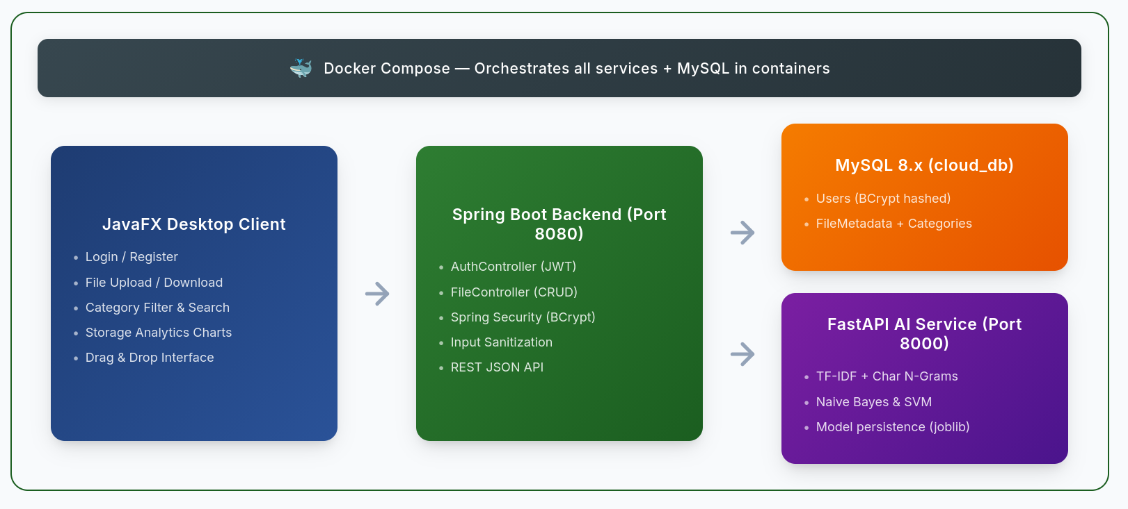
PROPOSED APPROACH & SYSTEM ARCHITECTURE

Slide 9
SIGNIFICANCE OF THE SOLUTION
• Privacy-Preserving AI: All ML inference runs locally — no file data leaves the user's machine, unlike cloud-based solutions (Google Drive, OneDrive Smart Features).
• Comparative ML Study: Provides empirical evidence on Naive Bayes vs. SVM performance for an under-studied classification task (ultra-short filename text), contributing to the NLP research body.
• Production-Grade Security in an Academic Context: Demonstrates JWT + BCrypt + input sanitization in a cohesive system, bridging the gap between academic prototypes and industry standards.
• Reproducible Deployment: Docker Compose enables one-command deployment of the entire 3-service stack, ensuring reproducibility for evaluation and future research.

Slide 10
PROJECT PLAN & TIMELINE
Phase | Task | Month 1 | Month 2 | Month 3 | Month 4 | Month 5 | Month 6 | Month 7 | Month 8
P1 | Lit. Review & Synopsis | ████ | ████
P2 | Java FX (UI & API) |  | ████ | ████ | ████
P3 | AI Model Dev (Offline) |  |  | ████ | ████ | ████
P4 | Backend & Integration |  |  |  |  | ████ | ████
P5 | Testing & Data Collection |  |  |  |  |  | ████ | ████
P6 | Final Report & Paper |  |  |  |  |  |  | ████ | ████
Milestones |  | Synopsis | App UI | AI Model v1 |  | Beta App |  | Final Paper | Final Viva

Slide 11
REFERENCES
1. Joachims, T. (1998). "Text categorization with Support Vector Machines: Learning with many relevant features." Proceedings of ECML '98, pp. 137–142. Springer. https://doi.org/10.1007/BFb0026683
2. Li, W. J., Wang, K., Stolfo, S. J., & Herzog, B. (2005). "Fileprints: Identifying file types by n-gram analysis." Proceedings of the 2005 IEEE Workshop on Information Assurance, pp. 64–71. IEEE. https://doi.org/10.1109/IAW.2005.1495935
3. Kowsari, K., Meimandi, K. J., Heidarysafa, M., Mendu, S., Barnes, L., & Brown, D. (2019). "Text classification algorithms: A survey." Information (MDPI), 10(4), 150. https://doi.org/10.3390/info10040150
4. Das, M., Selvakumar, K., & Alphonse, P. J. A. (2023). "A comparative study on TF-IDF feature weighting method and its analysis using unstructured dataset." arXiv preprint. https://doi.org/10.48550/arXiv.2308.04037
5. Ghemawat, S., Gobioff, H., & Leung, S. T. (2003). "The Google File System." Proceedings of SOSP '03, pp. 29–43. ACM. https://doi.org/10.1145/945445.945450

Slide 12
REFERENCES (CONTINUED)
6. Söylemez, M., Tekinerdogan, B., & Tarhan, A. K. (2022). "Challenges and solution directions of microservice architectures: A systematic literature review." Applied Sciences, 12(11), 5507. https://doi.org/10.3390/app12115507
7. Kusiak, T., & Powroźnik, P. (2021). "Performance analysis of .NET and Spring Boot microservices on Microsoft Azure." Journal of Computer Sciences Institute, 21, 414–419. https://doi.org/10.35784/jcsi.6268
8. Prasad, S. R. S. S. S., & Sharma, V. K. (2023). "Enhancing data security: JWT and HMAC SHA-256 for web application security." IJRITCC, 11(9), 993–998. https://doi.org/10.17762/ijritcc.v11i9.9930
9. Biryukov, A., Dinu, D., & Khovratovich, D. (2016). "Argon2: New generation of memory-hard functions for password hashing." 2016 IEEE EuroS&P, pp. 292–302. https://doi.org/10.1109/EuroSP.2016.31
10. Strauss, T., Beyschlag, J., & Kesselheim, S. (2019). "A comprehensive feature comparison study of open-source container orchestration frameworks." Applied Sciences, 9(5), 931. https://doi.org/10.3390/app9050931

Slide 13
THANK YOU

