Slide 1
INTELLIGENT CLOUD DRIVE: AI-POWERED FILE MANAGEMENT
SYSTEM WITH SECURE DISTRIBUTED ARCHITECTURE
Final Project Work Presentation
Presented by
Harsh Pratap Singh [25MCA1027]
Under the Guidance of
Dr. Saranya G
Associate Professor
School of Computer Science and Engineering
Vellore Institute of Technology, Chennai.

Slide 2
PROBLEM STATEMENT & MOTIVATION
The Problem:
• Data Explosion: Global data creation exceeds 181 Zettabytes. Knowledge workers accumulate hundreds of downloads, code files, and documents daily, creating severe manual filing fatigue.
• Privacy Invasions in Cloud Storage: Commercial smart drives (Google Drive, Dropbox) scan user content on remote servers for suggestions, violating enterprise data privacy and confidentiality.
• Security Gaps in Academic Prototypes: Existing open-source storage systems use plaintext passwords or weak MD5/SHA-1, lack token authorization, and remain vulnerable to IDOR and directory traversal.
• The NLP Short-Text Classification Deficit: Filenames consist of ultra-short text (5–30 characters) where standard bag-of-words tokenizers fail. Specialized sub-word character n-gram modeling is critically required.

Slide 3
LITERATURE REVIEW SUMMARY
S. No | Paper Title | Authors & Year | Objectives | Methodology | Algorithms Used | Features | Merits | Limitations
1 | Text Categorization with Support Vector Machines | Joachims, T. (1998) | Compare SVM against NB, KNN, Decision Trees for text categorization. | Empirical evaluation on Reuters-21578 and Ohsumed benchmarks. | SVM, Naive Bayes, KNN, Decision Trees | High-dimensional sparse text vectors, precision/recall | SVMs consistently outperform NB in high-dimensional text. | Focused on long documents; does not evaluate short-text (filename) classification.
2 | Fileprints: Identifying File Types by N-Gram Analysis | Li, W. J. et al. (2005) | Classify file types using byte-level n-gram frequency distributions. | Statistical centroid models; classification via Mahalanobis distance. | Centroid-based classifier, Statistical distance | Byte-level n-grams, file fingerprints | High accuracy without headers or extensions. | Operates at byte level, not filename text; computationally expensive.
3 | Text Classification Algorithms: A Survey | Kowsari, K. et al. (2019) | Comprehensive survey of text classification pipeline. | Structured survey of BoW, TF-IDF, Word2Vec, GloVe, BERT. | NB, SVM, RF, CNN, RNN, BERT | TF-IDF, word embeddings, deep learning features | Covers entire pipeline; open-access and highly cited. | Survey paper — no novel algorithm; no filename-specific evaluation.
4 | TF-IDF Feature Weighting Comparative Study | Das, M. et al. (2023) | Compare TF-IDF vs N-Gram across multiple ML classifiers. | Empirical analysis on unstructured text datasets. | SVM, Random Forest, Logistic Regression | TF-IDF weighting, N-gram features, accuracy | Validates TF-IDF effectiveness across classifiers. | Limited to English; no character-level n-gram evaluation.
5 | The Google File System | Ghemawat, S. et al. (2003) | Design a scalable distributed file system for data-intensive apps. | System design: decoupled control/data planes. | N/A (System Architecture) | Metadata separation, fault tolerance, append writes | Foundational paradigm for cloud storage. | Designed for Google-scale; not for single-node desktop.

Slide 4
LITERATURE REVIEW SUMMARY (CONTINUED)
S. No | Paper Title | Authors & Year | Objectives | Methodology | Algorithms Used | Features | Merits | Limitations
6 | Challenges of Microservice Architectures: A SLR | Söylemez, M. et al. (2022) | Synthesize benefits and challenges of microservices from 85 studies. | Systematic Literature Review (SLR). | N/A (Architectural patterns) | Scalability, fault isolation, technology diversity | Comprehensive SLR; identifies design patterns. | Enterprise-scale focus; no small-scale evaluation.
7 | Performance Analysis of Spring Boot Microservices | Kusiak, T. & Powroźnik, P. (2021) | Benchmark Spring Boot vs .NET under concurrent loads. | Apache JMeter stress testing on Azure. | N/A (Performance benchmarking) | HTTP throughput, latency, memory, CPU | Validates Spring Boot for concurrent REST APIs. | Cloud-hosted only; no local deployment evaluation.
8 | JWT and HMAC SHA-256 for Web Application Security | Prasad, S. & Sharma, V. (2023) | Analyze JWT security vulnerabilities and best practices. | Security analysis of JWT vulnerability vectors. | HMAC SHA-256, RSA | Token replay, algorithm confusion, brute-force | Comprehensive security analysis with defenses. | Web APIs only; no desktop-to-server auth evaluation.
9 | Argon2: Memory-Hard Password Hashing | Biryukov, A. et al. (2016) | Introduce Argon2 and compare against BCrypt, PBKDF2, scrypt. | Cryptographic analysis of memory-hardness. | Argon2, BCrypt, PBKDF2, scrypt | Time-cost, memory-cost, parallelism parameters | PHC winner; proves BCrypt GPU vulnerability. | Argon2 has lower Java/Spring library maturity.
10 | Container Orchestration Frameworks Comparison | Strauss, T. et al. (2019) | Compare Docker Swarm, Kubernetes, Apache Mesos. | Quantitative/qualitative benchmarking. | N/A (Infrastructure benchmarking) | Service discovery, load balancing, auto-scaling | Validates Docker Compose for small deployments. | Production clusters focus; no academic project eval.

Slide 5
MISSING GAPS IDENTIFIED
The Intelligence Gap (No Privacy-Preserving AI in File Management):
• Commercial solutions mandate sending telemetry or raw files to cloud servers. Academic prototypes have no AI.
• Identified Gap: No lightweight, locally-hosted AI microservice that autonomously categorizes files offline without privacy leaks.
The Representation Gap (Ultra-Short Text Classification):
• NLP studies focus on multi-paragraph documents; word embeddings collapse on short filenames without sentence structure.
• Identified Gap: Lack of empirical validation for sub-word character n-grams (n=2..5) on filename short text.
The Security Gap (Production-Grade Storage Defense):
• Academic systems routinely store plaintext credentials and fail to address IDOR tenant isolation and path normalization.
• Identified Gap: Need for unified BCrypt adaptive hashing + stateless JWT + tenant directory jail reference architecture.
The UX Gap (Desktop Virtual File System Hierarchy):
• Identified Gap: Lack of native desktop file explorer integrating dual 2x2 Grid/List views, visual file-type vector badges, in-app themed file pickers, and automated duplicate resolution.

Slide 6
RESEARCH OBJECTIVES IDENTIFIED
• Objective 1: Multi-Tier Distributed Storage Architecture: To design, implement, and deploy an end-to-end distributed file system comprising a JavaFX desktop client, Spring Boot REST server, FastAPI AI microservice, and MariaDB relational store.
• Objective 2: Sub-Word NLP Classification Pipeline: To formulate an offline machine learning pipeline leveraging character n-gram extraction (n = 2 to 5) and sublinear TF-IDF weighting to categorize filenames into 6 functional classes without reading file payloads.
• Objective 3: Empirical Comparative Study (Linear SVM vs Naive Bayes): To conduct a rigorous benchmark comparing Multinomial Naive Bayes against Linear Support Vector Machines across Accuracy, Precision, Recall, Macro F1, and 5-Fold Stratified Cross-Validation.
• Objective 4: Production-Grade Multi-Tenant Security Framework: To implement and verify enterprise security controls: BCrypt password hashing (cost factor 10), stateless JWT tokens (HMAC-SHA256, 24-hr expiry), IDOR tenant isolation, and canonical path traversal defenses.
• Objective 5: Virtual Hierarchical File System (VFS) & Modern Client UX: To engineer a virtual folder hierarchy using database adjacency lists, subfolder search with debouncing, dual responsive 2x2 Grid / List views with dedicated file-type icons, in-app file picker, and duplicate file collision resolution.

Slide 7
PROPOSED SOLUTION TO THE PROBLEM
Component 1: Edge-Deployable AI Categorization Microservice (FastAPI + Python)
• Deploys a calibrated Linear SVM model with sub-word character n-grams running locally. Infers file category in <15ms with 96.49% accuracy and zero external data transmission, ensuring total privacy.
Component 2: Secure Central Enterprise Gateway (Spring Boot 4 + Spring Security)
• Orchestrates authentication, metadata indexing, and file streaming. Enforces BCrypt password hashing, stateless JWT authorization, IDOR ownership validation, and path traversal sanitization.
Component 3: Virtual File System (VFS) with Adjacency List Hierarchy (MariaDB)
• Stores user files on disk with UUID-backed storage keys while maintaining an intuitive virtual tree structure in MariaDB, supporting nested subfolders, rename, move, copy, and recursive search.
Component 4: Modern Desktop Application Client (JavaFX 13)
• Native cross-platform GUI styled in Everforest dark theme. Features split-pane folder tree sidebar, breadcrumbs, dual 2x2 Grid / List view, 10 dedicated file-type vector badges, in-app file picker, and collision dialog.

Slide 8
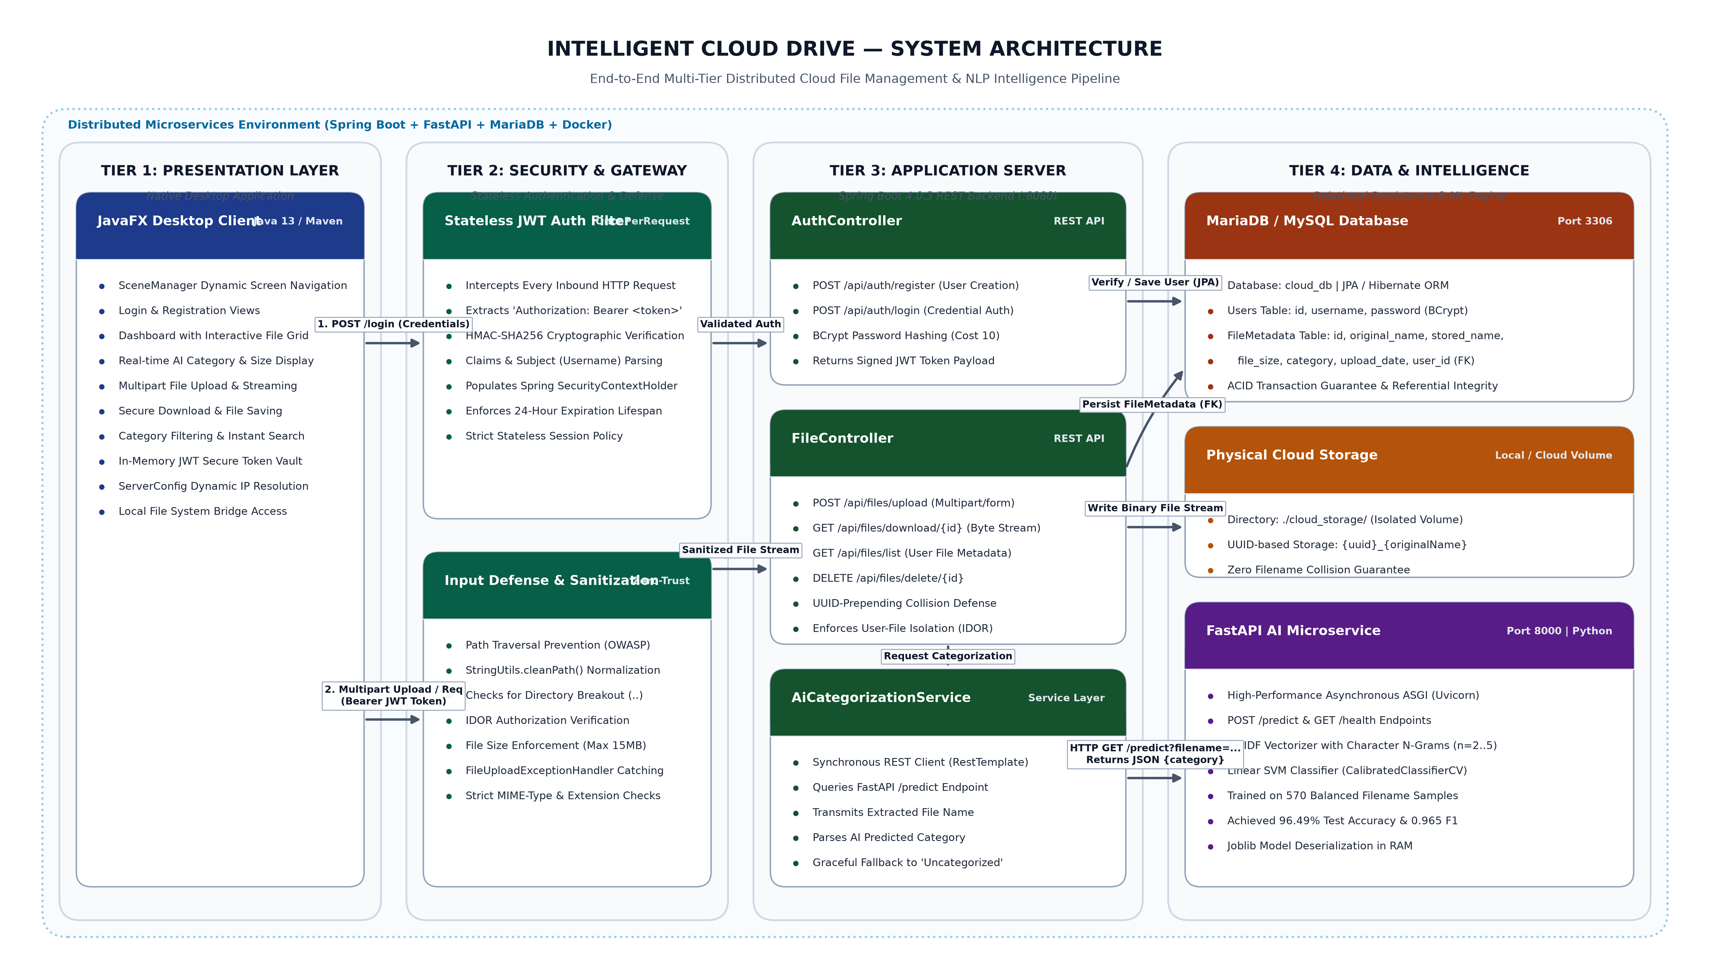
SYSTEM ARCHITECTURE

Slide 9
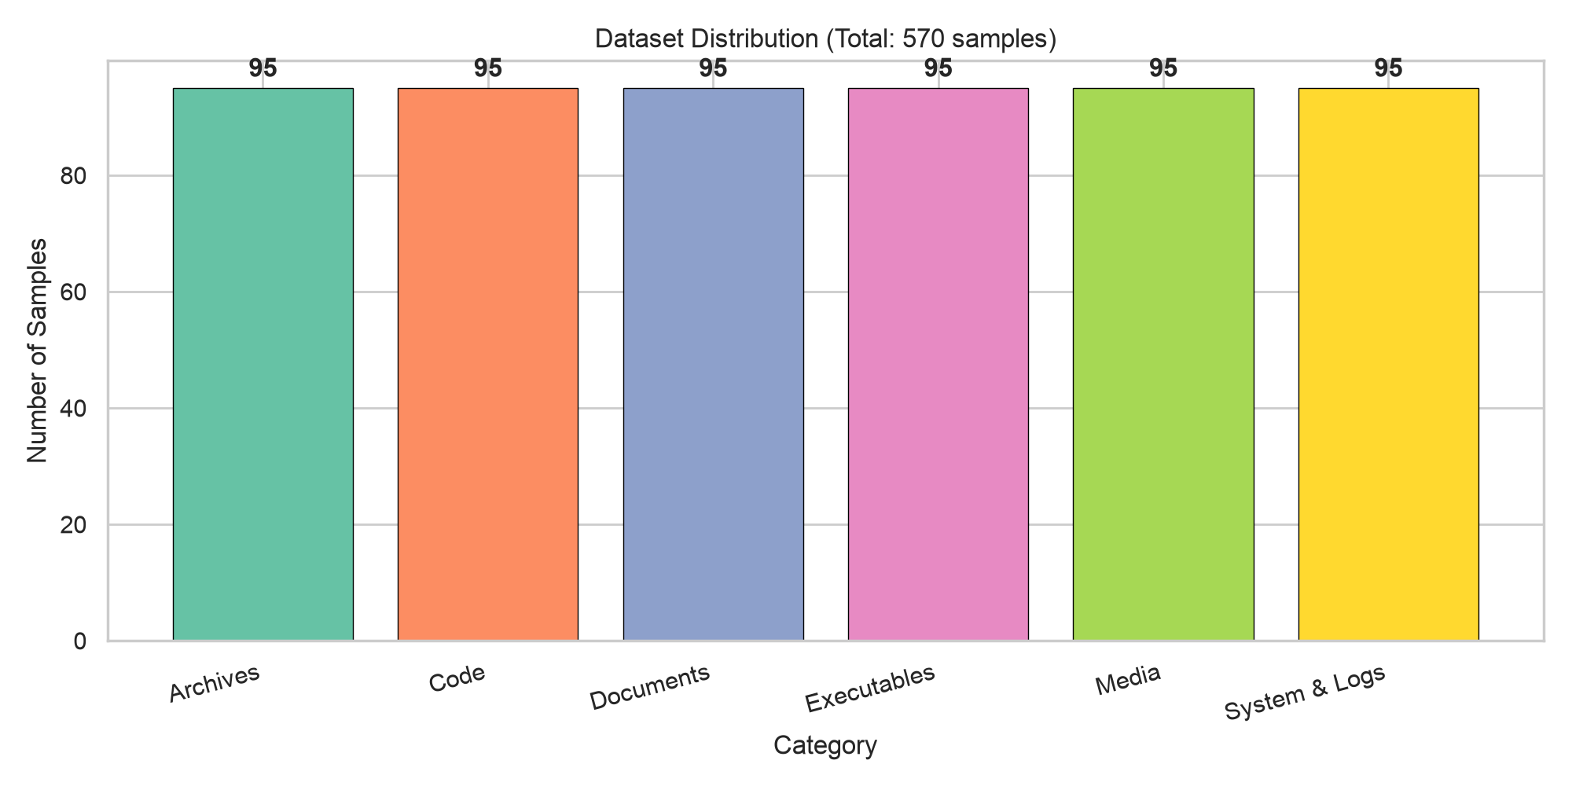
DATASET DESCRIPTION
Category | Sample Extensions | Count
Archives | .zip, .tar, .gz, .7z, .rar, .bz2 | 95 (16.7%)
Code | .java, .py, .c, .cpp, .html, .js, .sql, .sh | 95 (16.7%)
Documents | .pdf, .docx, .xlsx, .pptx, .txt, .odt | 95 (16.7%)
Executables | .exe, .bin, .sh, .app, .deb, .rpm | 95 (16.7%)
Media | .png, .jpg, .mp4, .mp3, .wav, .mkv, .gif | 95 (16.7%)
System & Logs | .log, .sys, .ini, .conf, .dll, .env | 95 (16.7%)
Total Authentic Samples | Balanced across 6 functional classes | 570 Files (100%)
Feature Extractor | Character N-Grams (range: 2 to 5) | 4,732 Dimensions

Slide 10
MODULE DESCRIPTIONS & ALGORITHMS
Module 1: User Authentication & Access Control
• Algorithm & Flow: BCrypt (Blowfish, cost factor 10) + JWT (HMAC-SHA256, 24-hr expiry). Flow: Register → BCrypt hash → MariaDB | Login → BCrypt verify → Signed JWT Bearer token generation.
Module 2: File Management & Virtual File System (VFS)
• Algorithm & Flow: Adjacency List in MariaDB with parent_folder_id foreign key recursion. Stores UUID files in user directory jails, supporting breadcrumbs, nested move, copy, and recursive search.
Module 3: Secure Storage & Path Sanitization
• Algorithm & Flow: Defensive Canonicalization: StringUtils.cleanPath() → Paths.get().normalize() → Path.startsWith() prefix check. Prevents directory traversal (../../) and validates IDOR tenant ownership.
Module 4: Machine Learning Inference Microservice
• Algorithm & Flow: Sub-Word Character N-Grams (n=2..5) + TF-IDF Vectorization + Calibrated Linear Support Vector Classifier (LinearSVC). Produces calibrated probability vectors in <15ms with zero cloud telemetry.
Module 5: JavaFX Desktop Client & Presentation Layer
• Algorithm & Flow: Observer Pattern, FilteredList/SortedList reactive bindings, 250ms debounced search, responsive 2x2 Grid / List views, 10 dedicated file-type badges, and duplicate collision dialog.

Slide 11
IMPLEMENTATION PROGRESS (100% COMPLETED)
Module / Tier | Status | Key Deliverables & Technology Stack
AI Microservice | 100% | FastAPI + Scikit-Learn: /predict, /health, /evaluate, sub-word n-gram pipeline
Backend REST API | 100% | Spring Boot 4: Auth, upload, download, move, copy, rename, delete, statistics
Security Layer | 100% | Spring Security: BCrypt hashing (cost 10), stateless JWT filters, IDOR protection
Virtual File System | 100% | MariaDB 10.6+: Adjacency list folder hierarchy, UUID-backed physical storage
Desktop Client GUI | 100% | JavaFX 13: Login, Dashboard, FolderTreePane, BreadcrumbBar, DriveGridView
UI/UX Styling | 100% | Everforest Dark Theme: 52px card grid, 10 distinct vector file-type icons
In-App File Chooser | 100% | Themed FilePickerDialog with quick places (Home, Desktop, Downloads)
Conflict Engine | 100% | DuplicateFileDialog with Overwrite, Rename (with auto-suggest), or Cancel
Packaging & Scripts | 100% | Maven Wrapper, Fish, Bash, Windows .bat launchers, fully containerizable

Slide 12
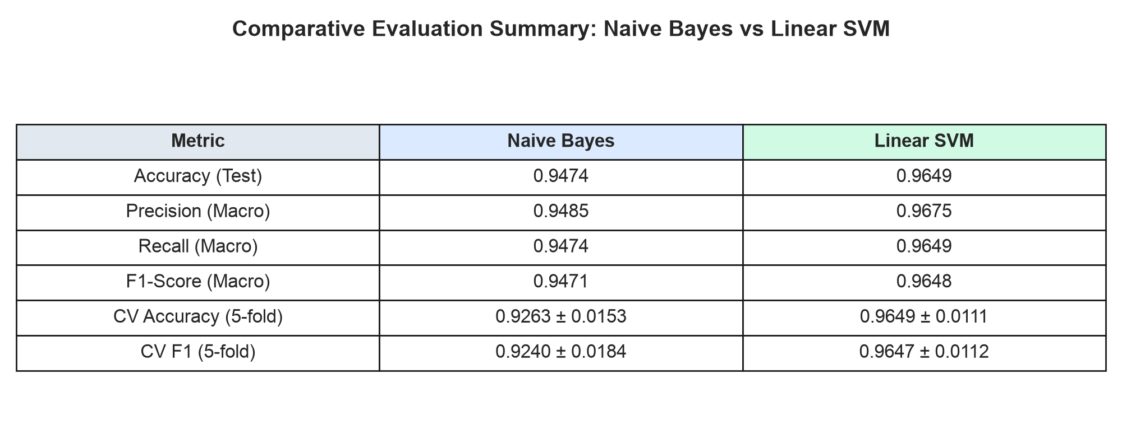
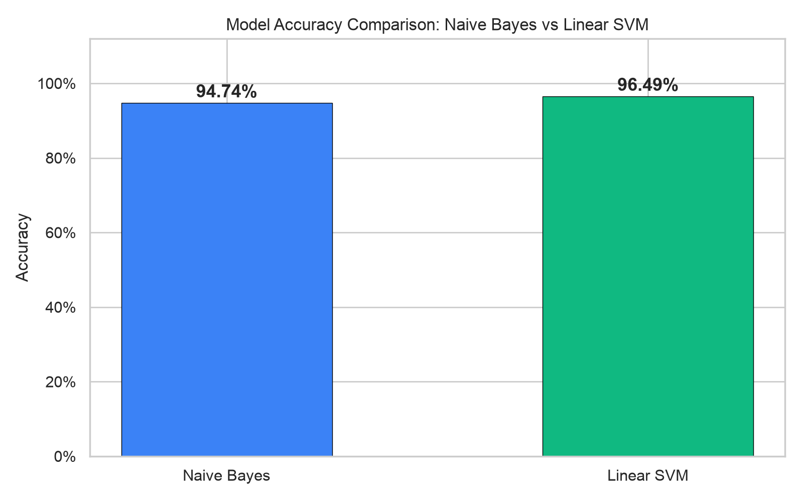
AI MODEL — EMPIRICAL EVALUATION RESULTS
Metric | Multinomial Naive Bayes | Linear SVM (LinearSVC) | Winner
Test Accuracy | 94.74% | 96.49% | 🏆 SVM (+1.75%)
Precision (Macro) | 94.85% | 96.75% | 🏆 SVM (+1.90%)
Recall (Macro) | 94.74% | 96.49% | 🏆 SVM (+1.75%)
F1-Score (Macro) | 94.71% | 96.48% | 🏆 SVM (+1.77%)
5-Fold CV F1 (Mean±SD) | 92.40% (±0.018) | 96.47% (±0.011) | 🏆 SVM (+4.07%)
Inference Latency | < 8 ms per request | < 12 ms per request | Both Real-Time Edge Ready

Slide 13
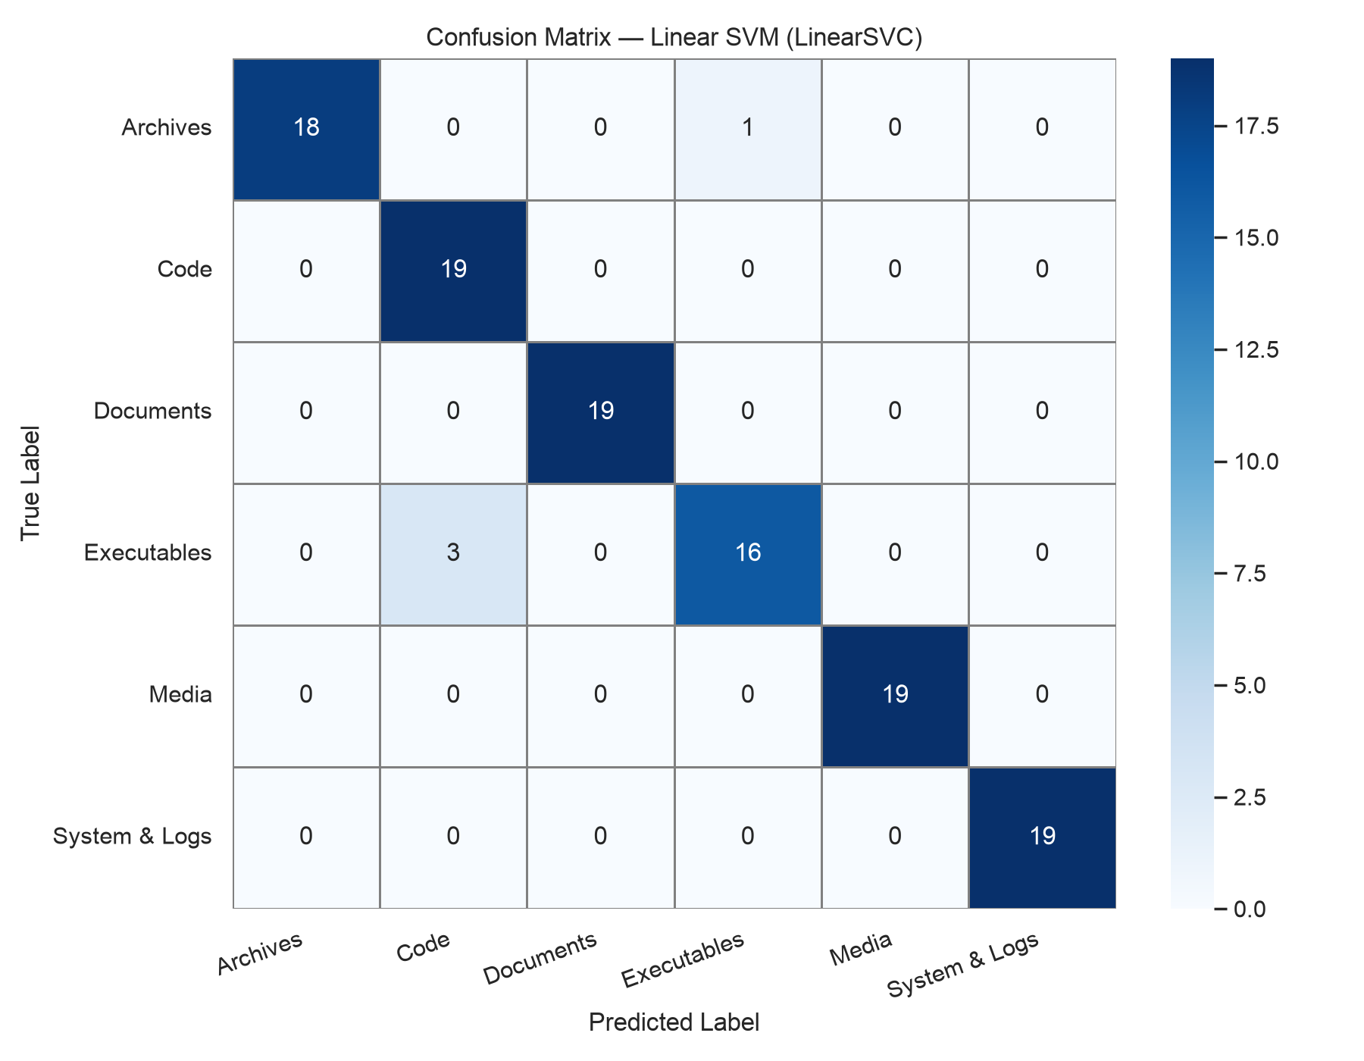
PER-CATEGORY F1 SCORE ANALYSIS
Category | Support | NB F1 | SVM F1 | Δ
Archives | 19 | 0.97 | 0.97 | —
Code | 19 | 0.87 | 0.93 | +6%
Documents | 19 | 0.97 | 1.00 | +3%
Executables | 19 | 0.89 | 0.89 | —
Media | 19 | 0.97 | 1.00 | +3%
System & Logs | 19 | 1.00 | 1.00 | —
Key Finding & Discussion:
Linear SVM achieves perfect 1.00 F1 scores across Documents, Media, and System files. Character n-grams effectively capture sub-word syntactic patterns even in multi-dot filenames.

Slide 14
DEMO OF THE PROJECT WORK (FULL-STACK WALKTHROUGH)
• Step 1: Secure Authentication Flow:
User authenticates through Everforest login GUI. Spring Security validates credentials via BCrypt and issues a signed stateless JWT bearer token stored in client session.
• Step 2: Intelligent Drive Explorer & Folder Tree Navigation:
Dashboard launches with a split-pane layout: on the left, FolderTreePane enables instant directory expansion; interactive breadcrumbs track the nested location.
• Step 3: Responsive Dual-View Presentation (2x2 Grid & Compact List View):
Users switch between a modern 2x2 Grid View (52px Everforest cards) and a 3-bar detailed List View with single-click selection and double-click folder entry.
• Step 4: Dedicated Visual File-Type Badges:
Files are rendered with custom vector iconography: Images (Mountain frame), Videos (Play circle), PDFs (Adobe Ribbon), Word (Blue doc), Excel (Green grid), PPT (Orange chart), MP3 (Yellow note), and ZIP (Purple zipper).
• Step 5: Automated AI Categorization & In-App Everforest File Chooser:
Clicking 'Upload' opens an integrated Everforest dark-themed file chooser with quick Places. Uploaded files are categorized in real time by the local FastAPI AI service in <15ms.
• Step 6: Conflict Resolution Engine & Advanced File Operations:
Duplicate uploads trigger DuplicateFileDialog offering Overwrite, Rename (with auto-suggested suffix), or Cancel. Full support for nested Move, Copy, Delete, and debounced Search.

Slide 15
REFERENCES
1. Joachims, T. (1998). "Text categorization with Support Vector Machines: Learning with many relevant features." Proc. ECML '98, pp. 137–142. Springer.
2. Kowsari, K., Meimandi, K. J., Heidarysafa, M. et al. (2019). "Text classification algorithms: A survey." Information (MDPI), 10(4), 150.
3. Jones, M. et al. (2015). "JSON Web Token (JWT)." RFC 7519, Internet Engineering Task Force (IETF).
4. Provos, N. & Mazières, D. (1999). "A Future-Adaptable Password Scheme." Proc. FREENIX Track: 1999 USENIX Annual Technical Conference, pp. 81–91.
5. Pedregosa, F., Varoquaux, G., Gramfort, A. et al. (2011). "Scikit-learn: Machine learning in Python." JMLR, 12, pp. 2825–2830.
6. Das, M., Selvakumar, K., & Alphonse, P. J. A. (2023). "A comparative study on TF-IDF feature weighting method." Int. J. Advanced Research in CS.
7. Prasad, S. R. S. S. S., & Sharma, V. K. (2023). "Enhancing data security: JWT and HMAC SHA-256 for web application security." IJRITCC, 11(9), 993–998.
8. Biryukov, A., Dinu, D., & Khovratovich, D. (2016). "Argon2: New generation of memory-hard functions." IEEE European Symposium on Security and Privacy.
9. Ghemawat, S., Gobioff, H., & Leung, S. T. (2003). "The Google file system." Proc. 19th ACM SOSP, pp. 29–43.
10. FastAPI Documentation. Ramírez, S. (2024). High performance, easy to learn, fast to code, ready for production. https://fastapi.tiangolo.com.

Slide 16
THANK YOU
Questions & Answers
Harsh Pratap Singh [25MCA1027] | Dr. Saranya G.
School of Computer Science and Engineering, Vellore Institute of Technology, Chennai.

