Slide 1
Cats and Dogs Breed Classifier
Prepared by: Andrey Balykin, Sophia Tretiakova, Daria Sheblanova

Slide 2
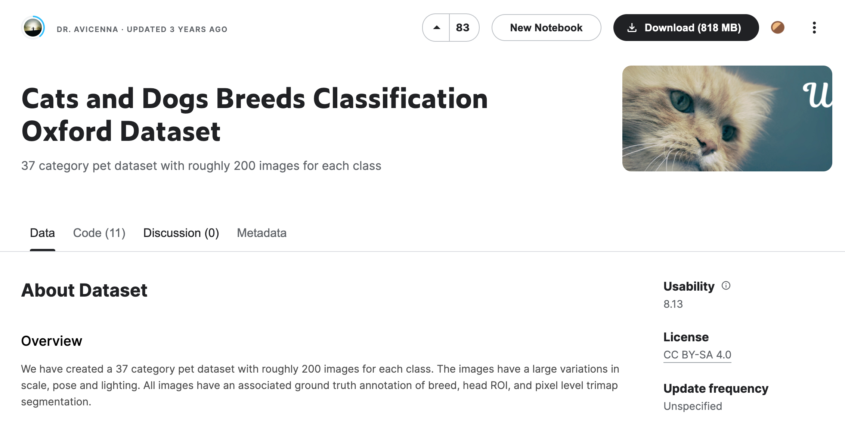
Dataset

Slide 3
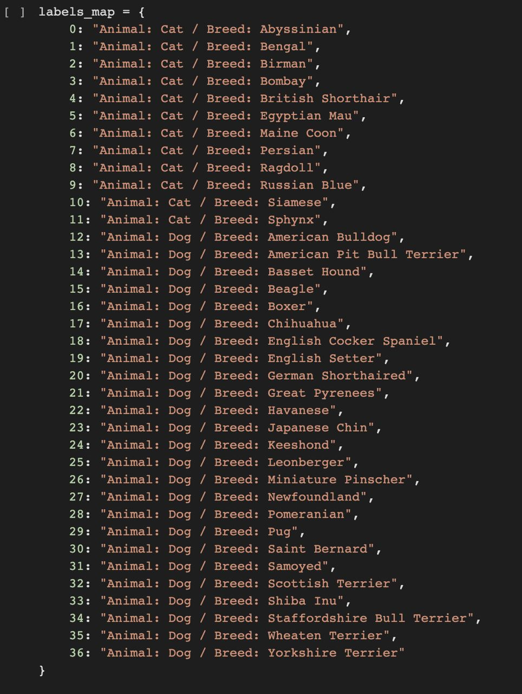
Breeds

Slide 4
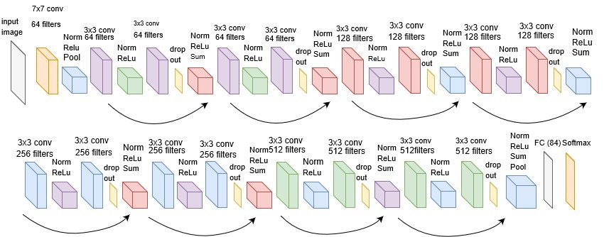
Architecture (ResNet 18)

Slide 5
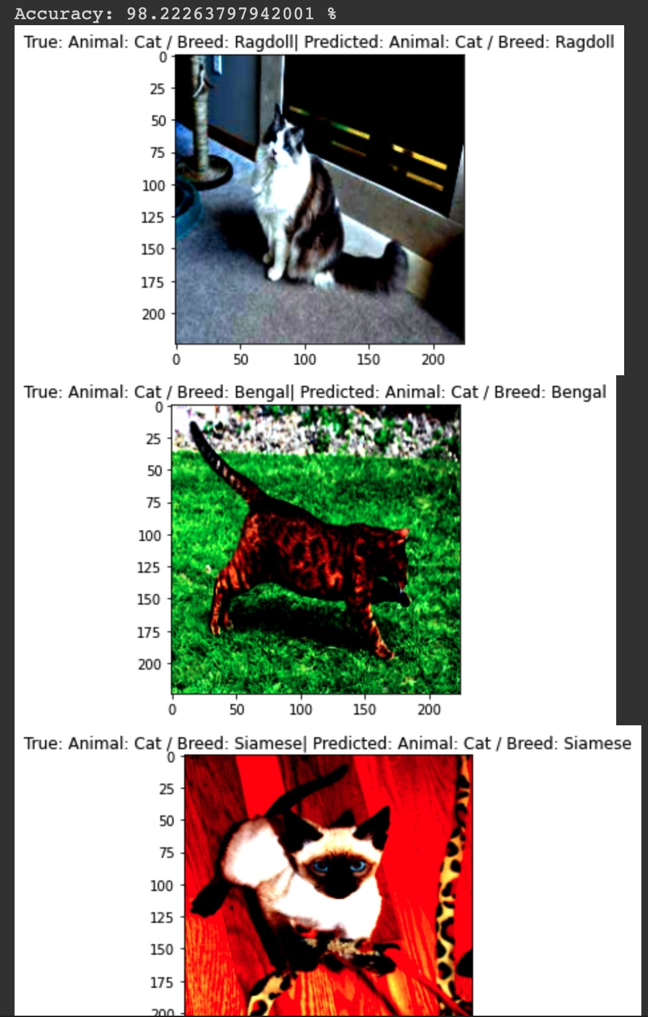
Results

Slide 6
Bot
@breed_classifier_bot
https://t.me/breed_classifier_bot

