Slide 1

CAB MANAGEMENT SYSTEM

Slide 2
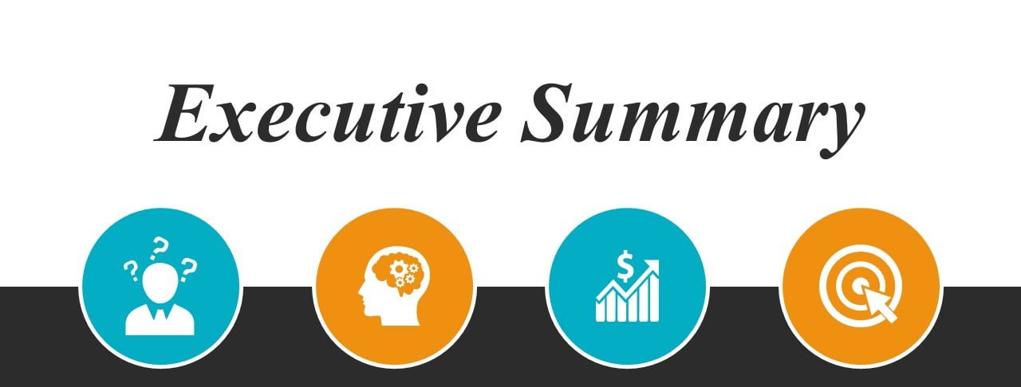
Problem
Solution
Scope
Objectives
Lots of paperwork
Tedious database management
Lack of security for records
Performance
Efficiency
Reduces workload
Control & Security
Higher visibility
Boosts profit
Minimizes cost
Provide safe cab services
Easy access to cab hiring
Quick payment options
Customer satisfaction

Slide 3
Introduction
Online service which will automate the process of booking a cab.
Aims at offering the best of cab services to clients in need.
Created to provide an excellent customer experience and streamline all cab-related operations.

Slide 4
Scope
The scope of a cab management system will depend on the specific needs and requirements of the business.
Some systems may focus solely on booking and dispatch.
While our cab management system provide a more comprehensive range of features.

Slide 5
Scope of cab management system for drivers
They can wait at a convenient place and look for bookings , so there is no need of waste fuel.
No need to carry changes with them.
They have the authority to provide each passenger ratings and feedback.

Slide 6
Scope of cab management for passengers
Booking a ride from anywhere is possible. Hence, making it very convenient for users.
The payment mechanism is very convenient for the travelers, since they do not have to carry cash around with them.
With the use of the app, there is more transparency because passengers can evaluate and rate cab drivers.
They don't have to stand on the side of the road, waiting for a cab. This saves them a significant amount of time and effort.

Slide 7
Overall scope of cab management system
Taxi booking apps have seen a great growth in recent years, and this trend is expected to continue in the future. It's a business that will never die because it benefits passengers and app users in so many ways.
The taxi market expected CAGR 9.22% in 2019-2024. The market value will be US$216,810m in 2020 and US$318,765m in 2023.

Slide 8

Background
Why are we doing this project ?

Slide 9
2) Cab allocation during peak hours:- The website's poor performance.
solution:- Use better technology, a good algorithm, cleaner code will always outperform.
3 ) Providing a safe and secure service:- Give a safe and secure service.
1) Having good drivers:- There have been numerous cases where a lack of experience and professional behavior resulted in customers reporting the drivers as having had a hazardous driving experience.
solution:- Hire trained drivers. Establish better feedback and driver tracking system to assess your driver's performance.
Solution:- Doing the background check and profiling your drivers before hiring them as your employee would be an efficient way to build that trust and become a successful on-demand cab booking system.
Solutions

Slide 10
Extra Features that can be added
Cab booking using voice facility :- Here the user can book a cab using their voice. This feature is also helpful for blind people.
Cab type preference :- System can offer preferences for selecting different types of cabs like Economy (Shared ride, lowest cost), Premium (Spacious, affordable sedans), More (Compact rental, Local city travel).
Booking Flexibility :- User can book for a ride right at that moment or later at a desired time.
In-app messenger : - Through this platform user and driver can communicate within the application.

Slide 11

COSTING

Slide 12
Costing
Complexity
When deciding on a budget, the first item to consider is the app's complexity.

Slide 13
API :
Or application programming interface, is a set of rules and protocols that allows different software systems to communicate with each other.
Here are some examples of APIs that might be used in a cab management system, along with some possible costs:

Slide 14

Payment API
Maps API
An API that provides access to mapping data and functionality, such as routing and real-time traffic information. Prices for maps APIs can vary, but typically start at around $0.50 per 1,000 map loads.
An API that allows the cab management system to accept and process payments from customers. Prices for payment APIs can vary, but typically start at around 2.9% + $0.30 per transaction.

Slide 15
Total Hours of Development
Development Phase | Hours required
UX UI design | 1– 2 weeks
Front end development | 3-4 weeks
Back-end development | 3-5 weeks
Testing and QA | 1-2 weeks
Total Duration = 8-13 weeks

Slide 16
Conclusion
Cab service management system is a very effective, efficient, reliable and economic web application from all aspects.
It fulfills all the current needs of a client when it comes to cab services.
Provides Higher Visibility
Helps to boost profit
Minimize Cost

