Slide 1

Fibonacci Search
Abbas Bayramlı

Slide 2


As the name suggests, the Fibonacci Search Algorithm uses Fibonacci numbers to search for an element in a sorted input array.
But first, let us revise our knowledge on Fibonacci numbers.
Fibonacci Series is a series of numbers that have two primitive numbers 0 and 1. The successive numbers are the sum of preceding two numbers in the series. This is an infinite constant series, therefore, the numbers in it are fixed. The first few numbers in this Fibonacci series include −
0, 1, 1, 2, 3, 5, 8, 13, 21, 34, 55, 89…
The main idea behind the Fibonacci series is also to eliminate the least possible places where the element could be found. In a way, it acts like a divide & conquer algorithm (logic being the closest to binary search algorithm). This algorithm, like jump search and exponential search, also skips through the indices of the input array in order to perform searching.
This Photo by Unknown author is licensed under CC BY-SA.

Slide 3
Fibonacci Search Algorithm
Fibonacci Search is a comparison-based technique that uses Fibonacci numbers to search an element in a sorted array.
Algorithm takes logarithmic time complexity to search for an element. Since it is based on a divide on a conquer approach and is similar to idea of binary search, the time taken by this algorithm to be executed under the worst case consequences is O(log n).
Similarities with Binary Search:
Works for sorted arrays
A Divide and Conquer Algorithm.
Has Log n time complexity.
Differences with Binary Search:
Fibonacci Search divides given array into unequal parts
Binary Search uses a division operator to divide range. Fibonacci Search doesn’t use /, but uses + and -. The division operator may be costly on some CPUs.
Fibonacci Search examines relatively closer elements in subsequent steps. So when the input array is big that cannot fit in CPU cache or even in RAM, Fibonacci Search can be useful.

Slide 4
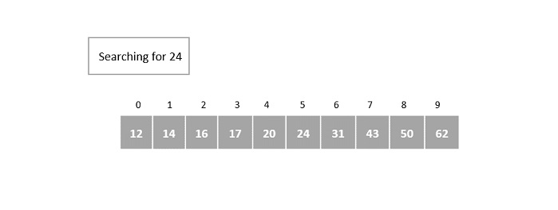
Example
Suppose we have a sorted array of elements {12, 14, 16, 17, 20, 24, 31, 43, 50, 62} and need to identify the location of element 24 in it using Fibonacci Search.

Slide 5
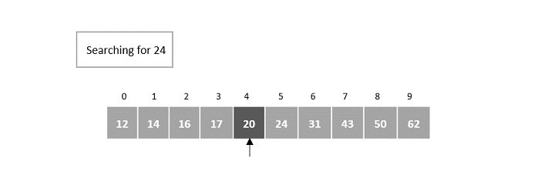

Step 1
The size of the input array is 10. The smallest Fibonacci number greater than 10 is 13.
Therefore, F_{m} = 13, F_{m-1} = 8, F_{m-2} = 5.
We initialize offset = -1
Step 2
In the first iteration, compare it with the element at index = minimum (offset + F_{m-2}, n – 1) = minimum (-1 + 5, 9) = minimum (4, 9) = 4.
The fourth element in the array is 20, which is not a match and is less than the key element.

Slide 6
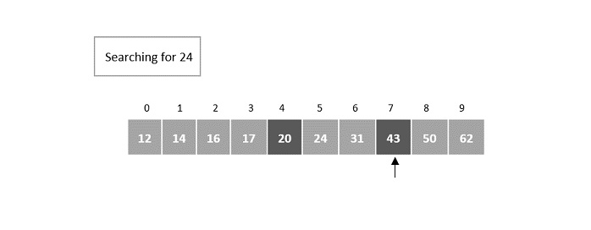
In the second iteration, update the offset value and the Fibonacci numbers.
Since the key is greater, the offset value will become the index of the element, i.e. 4. Fibonacci numbers are updated as F_{m} = F_{m-1} = 8.
Fm-1 = 5, Fm-2 = 3.
Now, compare it with the element at index = minimum (offset + F_{m-2}, n – 1) = minimum (4 + 3, 9) = minimum (7, 9) = 7.
Element at the 7th index of the array is 43, which is not a match and is also lesser than the key.
Step 3

Slide 7
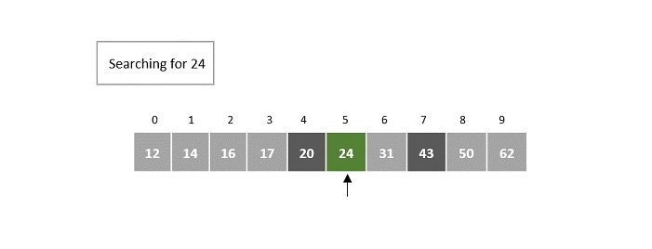
^{Step 4}
We discard the elements after the 7th index, so n = 7 and offset value remains 4.
Fibonacci numbers are pushed two steps backward, i.e. F_{m} = F_{m-2} = 3.
F_{m-1} = 2, F_{m-2} = 1.
Now, compare it with the element at index = minimum (offset + Fm-2, n – 1) = minimum (4 + 1, 6) = minimum (5, 7) = 5.
The element at index 5 in the array is 24, which is our key element. 5th index is returned as the output for this example array.

