Slide 1
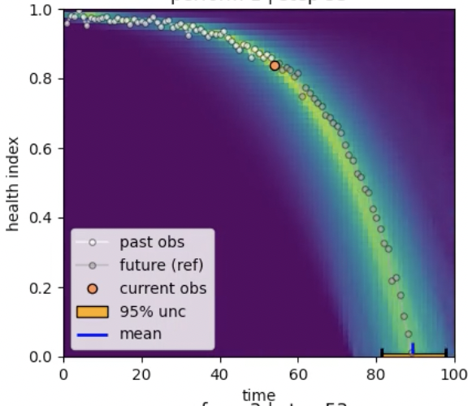
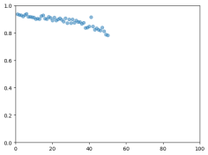
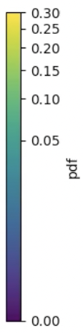


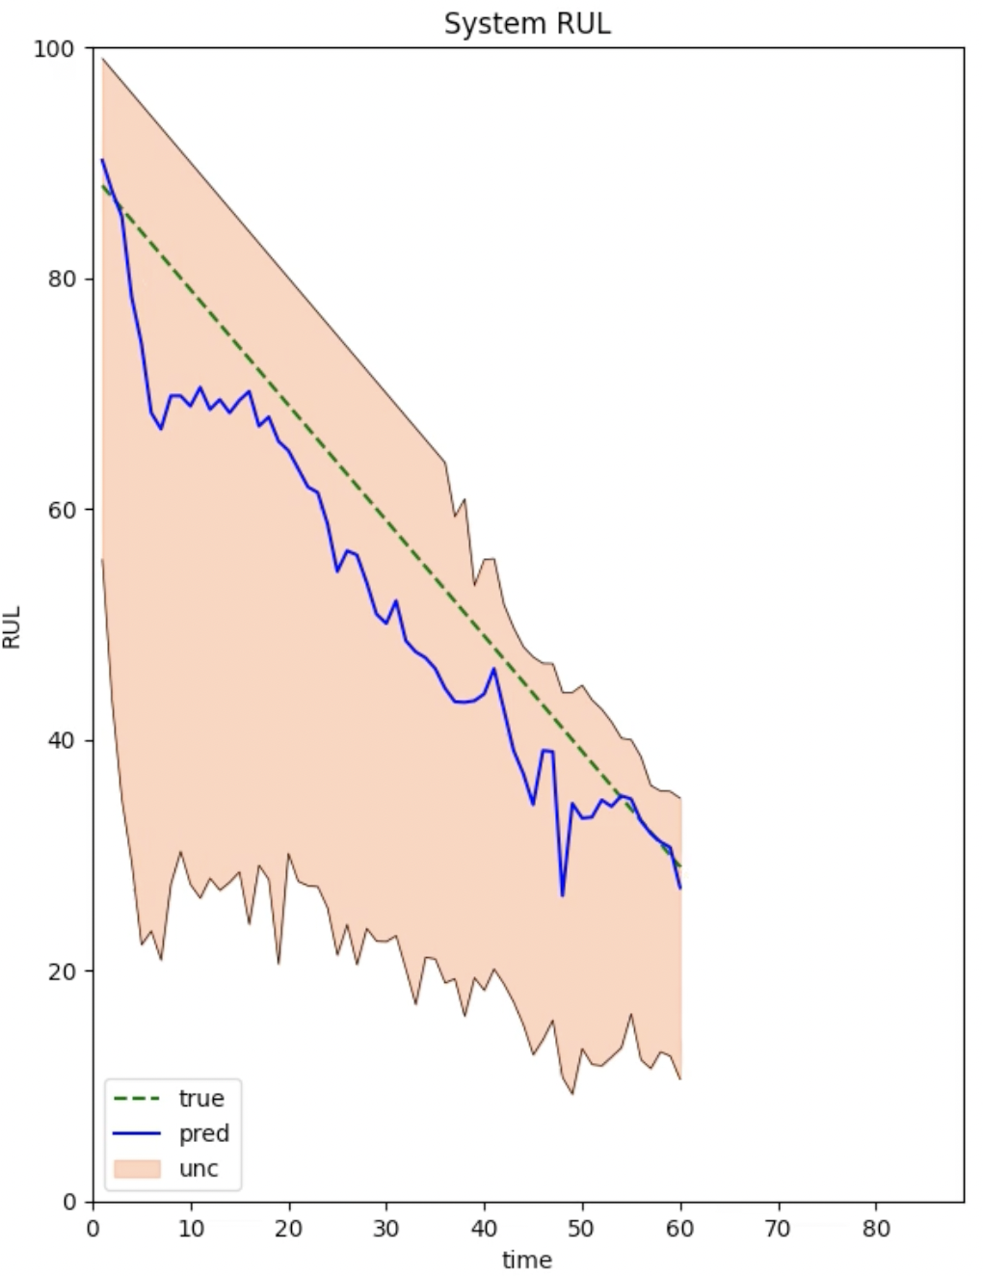

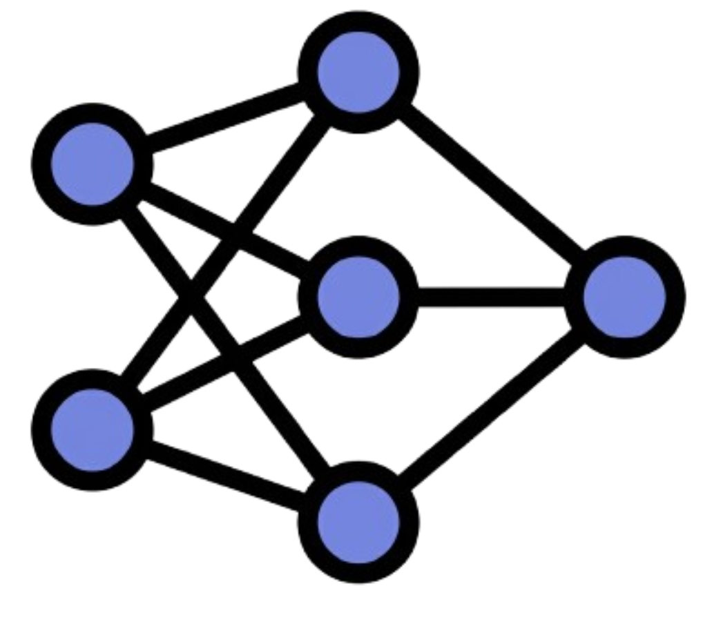

Performance-Based Probabilistic RUL Prediction via Particle Filtering
with Neural-Guided Inference.
Estimate System Health
Predict Degradation
Infer RUL Distribution
Conventional Data-Driven Approaches:
Direct RUL regression
No explicit degradation modeling
Limited uncertainty quantification
Estimation
Prediction
Sensor
measurements
Performance Metric Estimation
Stochastic Degradation Model
Sensor
Measurements
Black-box
Network
Point RUL
Estimate
Posterior Distribution
of Degradation Parameters
RUL Prediction with Uncertainty
Validated Using Multiple N-CMAPSS Benchmark Datasets
Competitive Accuracy
Interpretable Predictions
Calibrated Uncertainty
Separating Estimation and Prediction Improves Interpretable and Uncertainty-Aware RUL Prognostics

